Slide 1
Radiation
In astronomy, the main source of information about celestial bodies and other objects is the visible light or more generally electromagnetic radiation.
From Wikipedia.
It also is important for the atmosphere of Earth, so you’ll meet it if you are going into Earth atmosphere science…

Slide 2
Radiation
One of the most complicated topics in astrophysics
“We choose … to do the other things not because they are easy, but because they are hard” (J.F. Kennedy)

Slide 3
Radiative transport
In the radiative zone of the solar interior, the energy is transported by radiation: mean free path of photons is small (~2 cm).
The radiative energy exchange in the photosphere defines its temperature structure and is responsible for convective instability.
In the photosphere photons escape: mean free path becomes infinite. This is wavelength-dependent.
Radiation passes through the solar atmosphere, collects the information about it and reaches our telescopes.

Slide 4
Radiation + MHD
We already have system of equations which describes solar plasma dynamics: MHD
Provides us with temperature, pressure, density, magnetic field
We should include radiative source term to take into account radiative energy exchange
Then our Sun will be complete (and visible!)

Slide 5
Radiative source term
Radiation intensity
Radiative flux
Frequency-integrated radiative heating rate
The latter quantity can be directly included into the MHD energy equation as the source term in the right-hand side.
The big question is to find I_{ν} …

Slide 6
Radiative transport equation 1
I_{ν}+dI_{ν}
θ
We describe a change in intensity for photons travelling a distance ds though plasma in a specific direction at a given position.
x
ds
κ(ν) - absorption coefficient (how much is absorbed from I coming into; units 1/cm)
j(ν,θ) - emission coefficient (how much is emitted; units erg/s/cm^3/Hz/ster)
κ(ν)
J(ν,θ)
I_{ν}(x,θ)
Came out
Came in
Absorbed
Emitted

Slide 7
Radiative transport equation 2
Rewrite, in direction θ:
Define:
Radiative transport equation
“optical depth”
Source function
Recall x is downwards.

Slide 8
Radiative transport equation 3
Formal solution:
Still looks quite simple: sum of the intensity which escaped absorption and the emitted intensity. If S is known, easy to integrate.
Note: if source function depends on intensity – integral equation, much more difficult, since can depend on wavelength.

Slide 9
Optically thin / optically thick
x, τ
Plane-parallel, homogeneous plasma.
I₀ intensity comes from the left.
No scattering.
S₀ , κ₀
I
I₀
Solution of RTE:
Optically thick:
Optically thin:
Information on incident radiation I₀ is totally lost! We see only the source S₀.
See the photons generated by S₀ and all but small part τ₀ of incident radiation.

Slide 10
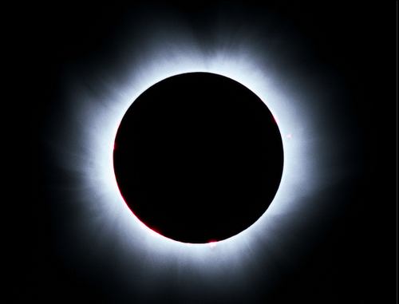
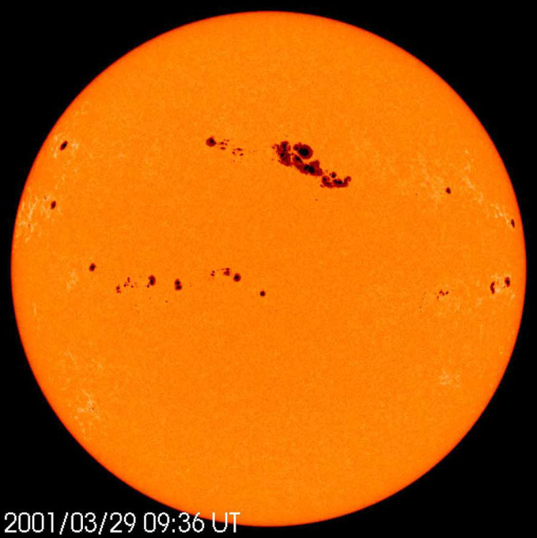
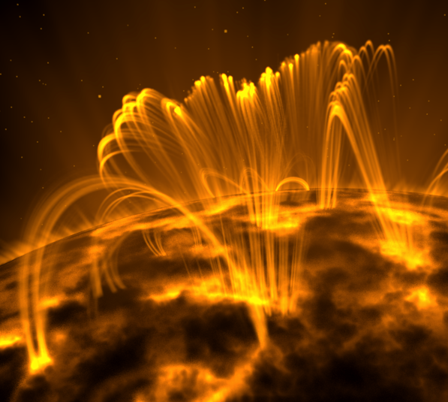
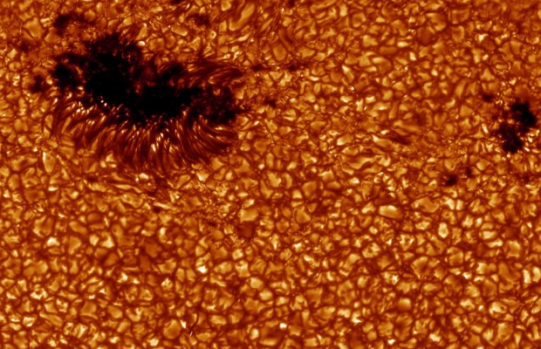
Thin/thick examples:
Thin: solar corona, coronal emission lines.
Thick: solar photosphere, continuum
What happens in between is more complex…

Slide 11
Local thermodynamic equilibrium
Strict thermodynamic equilibrium = black body at temperature T
Planck function:
“Local” thermodynamic equilibrium:
occurs when local thermal collisions determine the atom states (collisional excitation). Radiation in this case is weakly coupled to the matter.
This is VERY useful simplification, works for dense astrophysical sources of radiation, such as solar photosphere.
Otherwise non-LTE: nightmare, since atomic states depend on the radiation field.

Slide 12
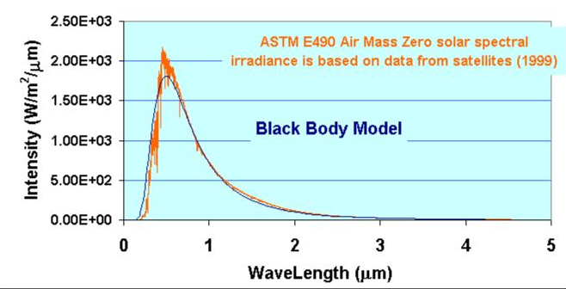
LTE: works well for the Sun

Slide 13
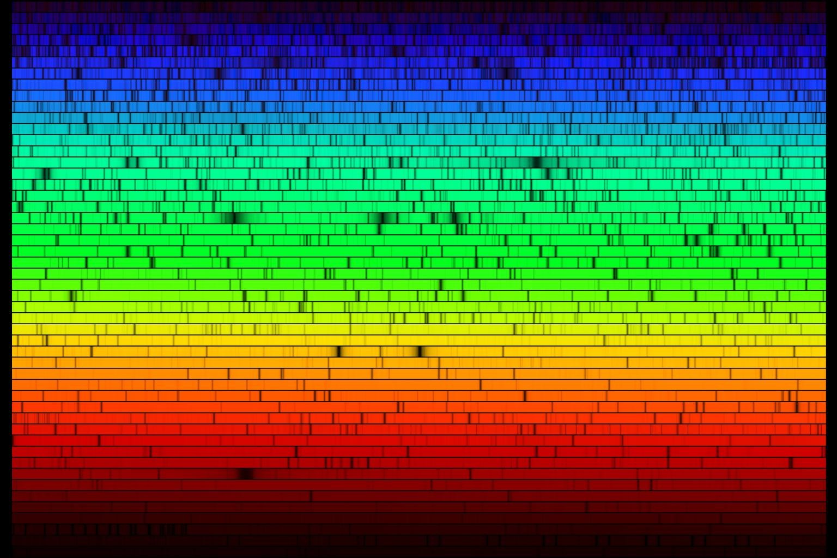
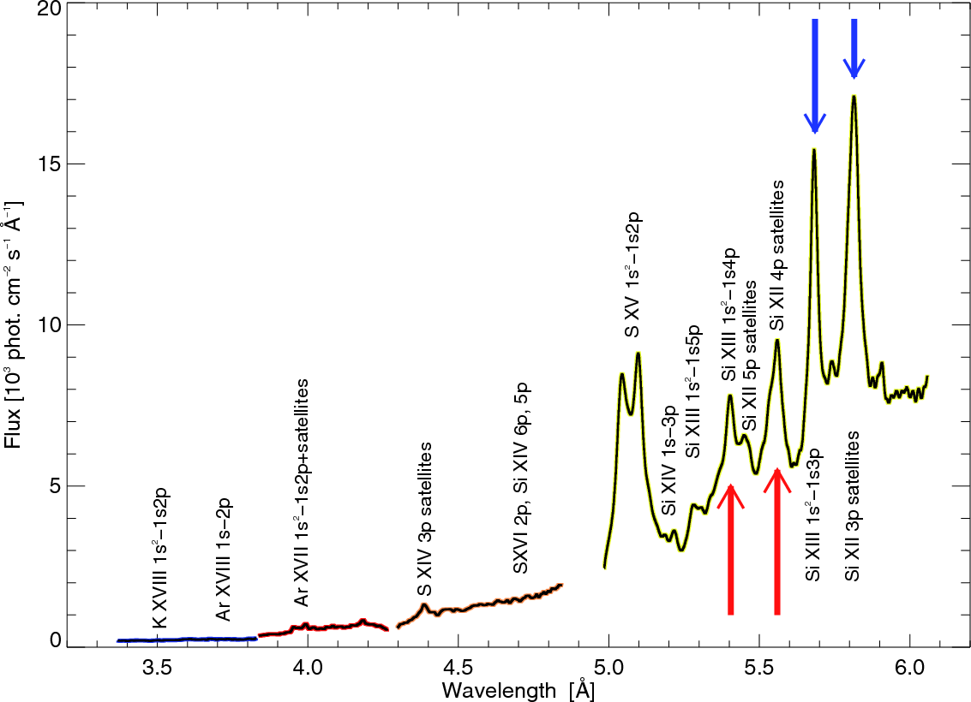
Optical depth and absorption coefficient: the devil is in the detail
We assume local thermodynamic equilibrium, so the problem with the source function is sorted. There is one more parameter in the radiative transport equation:
κ – absorption coefficient. Here bigger problems come. It depends on the wavelength, temperature, pressure, density, magnetic field, chemistry, atomic physics, quantum mechanics.
Spectrum of the Sun. Absorption lines (optically thick).
X-ray spectrum of the solar corona. Emission lines (optically thin).

Slide 14
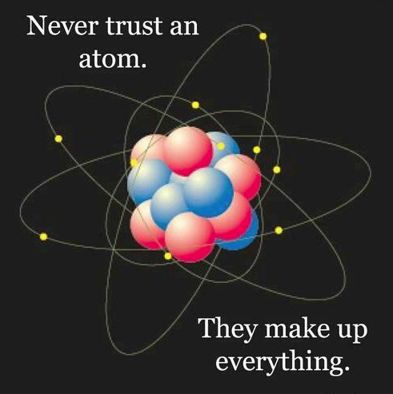
Atomic levels
Electrons in atoms can take only discrete energy levels. These energy levels are described by their corresponding quantum numbers.
6
E₆
5
E₅
4
E₄
Energy
3
E₃
2
E₂
1
E₁=0

Slide 15
Atomic levels
If more than one quantum state corresponds to an energy level, this energy level is called degenerate.
6
g₆=2
5
g₅=1
4
g₄=1
Energy
3
g₃=3
2
g₂=1
1
g₁=4
Degeneracy can be removed. For example, in magnetic field: Zeeman effect.

Slide 16
Level transitions: spontaneous emission
If there is a free place on a lower energy level, an electron can jump down from a higher energy level: this is called spontaneous emission.
6
E₆
5
E₅
4
E₄
γ
Energy
Einstein coefficients: they describe the probability of an electron to jump between the levels.
3
E₃
2
E₂
1
E₁=0
Einstein A-coefficient describes a probability of spontaneous emission:

Slide 17
Level transitions: absorption
If there is a free place on the energy level above, the electron can absorb photon, and jump a level up. This is what causes absorption lines in the solar atmosphere.
6
E₆
5
E₅
4
E₄
γ
Energy
3
E₃
2
E₂
1
E₁=0
Einstein B-coefficient describes a probability of absorption (radiative absorption coefficient):

Slide 18
Level transitions: stimulated emission
Interaction of electron at higher energy state with incident photon of a certain energy can result in the electron dropping to a lower energy level and radiating a photon with the same energy as the incident one: stimulated emission. Used in lasers (natural or human-made).
6
E₆
5
E₅
4
E₄
γ
Energy
γ
3
E₃
2
E₂
1
E₁=0
Einstein B-coefficient describes also a probability of stimulated emission:

Slide 19
Level transitions
Level transitions (absorption/emission) can be from any pair of the energy levels, if the transition obeys selection rules.
6
E₆
5
E₅
4
E₄
γ
Energy
γ
3
E₃
2
E₂
1
E₁=0

Slide 20
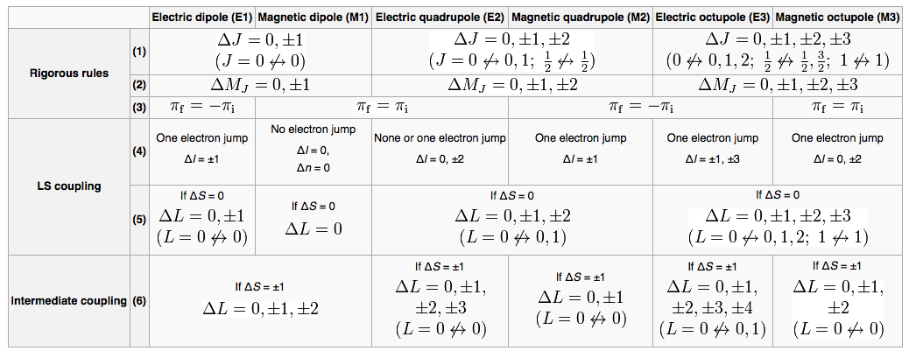
Selection rules
From Wikipedia…
J=L+S – total angular momentum; L – azimuthal angular momentum, S – spin angular momentum, M_{J} – secondary total angular momentum. Those are related to n, l, m_{l}, m_{s} – principal, azimuthal, magnetic, spin quantum numbers. Very laborous…

Slide 21
Anyway: absorption coefficient
The absorption coefficient is related to Einstein’s coefficients:
Here, n_{k} and n_{i} are populations for levels k and i.
To find populations (in LTE) use Maxwell-Boltzmann distribution:
Z is partition function, temperature dependent (available in tables online…):
g_{i} – degeneracy of level i
Note, works only in LTE. In non-LTE populations depend on the radiation field…

Slide 22
Einstein coefficients again
Einstein coefficients can be related to a single parameter for electron transition:
f₁₂ is called “oscillator strength”, given by expression from quantum mechanics:
R is operator sum of electron coordinates, m – quantum states.
Well, given in tables sometimes, or calculated explicitly for simple atoms…

Slide 23
Thermal line broadening
We know (in principle) how to calculate n and B. There is one more thing: ϕ_{ik}
If there was nothing in the world but quantum mechanics, the atom would absorb exactly at its frequency. But the atoms move (thermal motion).
Motion of atom which radiates results in Doppler frequency shift (Doppler effect):
Atoms move randomly according to Maxwell distribution, which, if substituted into the frequency shift, will result in Gaussian thermal broadening of dependence of absorption coefficient on frequency.
ρκ_{ν}
σ
ν₀
ν

Slide 24
Natural line broadening
Spontaneous excitation/deexcitation leads to a limited lifetime of an electron in excited state.
If we have limited lifetime Δt, we have also Heisenberg uncertainty principle:
From it we can derive:
It can be shown that the line profile shape becomes to be of the form:
which is Lorentz profile, where
Nice manifestation of quantum mechanics. There is also collisional broadening (similar).

Slide 25
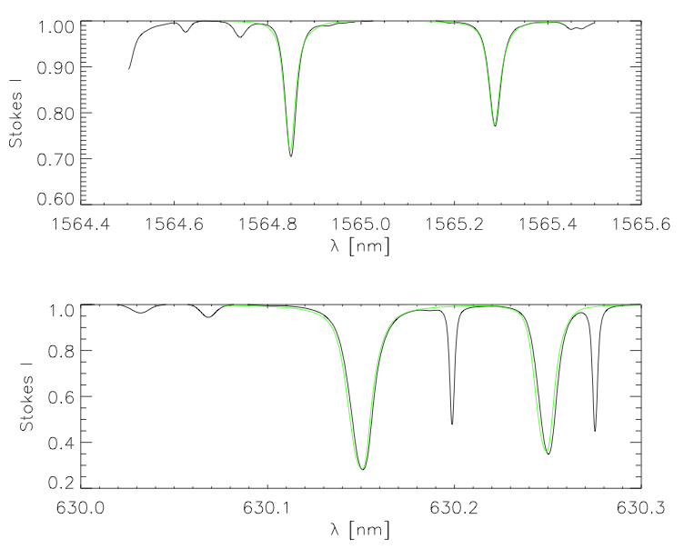
Line profile
After we substitute everything into radiative transport equation, we get an (absorption or emission) line profile:
ρκ_{ν}
σ
ν₀
ν
Absorption line profiles calculated for a line of neutral iron in the solar photosphere.

Slide 26
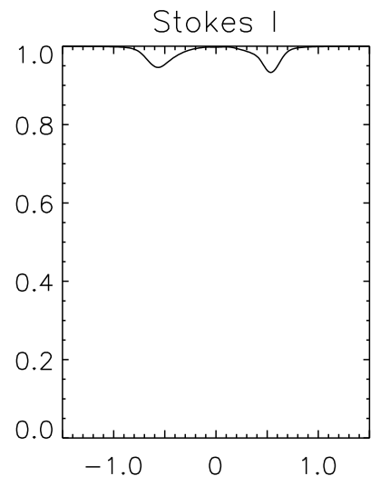
Zeeman effect
If level degeneracy is removed, a level splits into a number of levels. Degeneracy can be removed by magnetic (Zeeman effect) or electric (Stark effect) fields.
6
g₆=2
5
g₅=1
4
g₄=1
Energy
3
g₃=3
2
g₂=1
1
g₁=4
Distinct pattern of Zeeman-split absorption line profile

Slide 27
Bulk plasma motions, Doppler effect
Line profile without bulk Doppler shift
Line profile with Doppler shift:
u•l – projection of velocity vector onto line of sight
Results in a shift of whole line profile, not broadening.

Slide 28
What can we get from line profiles?
1: Presence of a line profile from a particular atom – chemistry, abundance of elements.
2: Transition, line width – temperature in the region of line formation
3: Central line wavelength – plasma velocity in the region of line formation
4: Zeeman splitting – wavelength distance between Zeeman components is a direct measure of magnetic field strength.
Note: those profiles are calculated from MHD box you have. They agree well with the observations (black line).

Slide 29
Bound-free and free-free transitions
We covered here bound-bound transitions – when an electron jumps between the energy levels.
There is a possibility for electron to absorb a light and be ripped off an atom (ionization – recombination process). This is called bound-free transition.
Bound-free transitions do not have exact wavelength: they contribute to continuum radiation, or everything except absorption lines.
There are also free-free transitions: absorbing/emitting of photon by a free electron, also continuum.

Slide 30
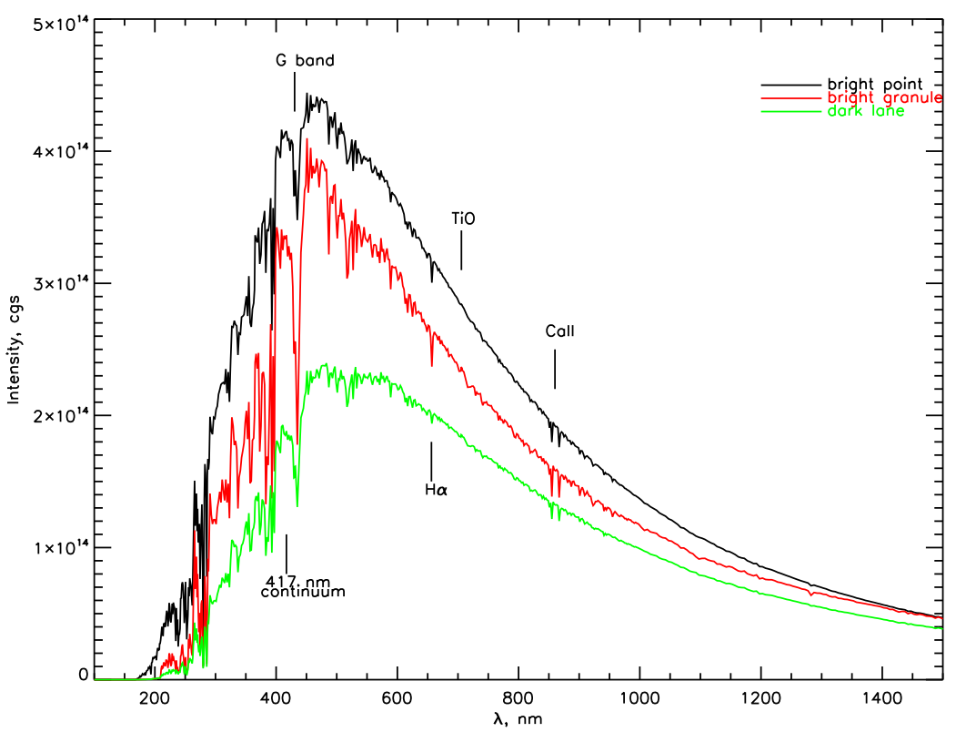
All this leads us to:
Solar spectrum!

Slide 31
Solar polarimetry
Light gets polarized when it passes through magnetic field. The stronger magnetic field – the stronger polarization.
This process is direction-dependent: magnetic field is vector, electro-magnetic field is vector too.
Measuring polarization of radiation coming from the Sun can provide an information not only on magnetic field strength, but also on magnetic field direction.
Stokes parameters: I, V, Q, U. I is for usual intensity, V (circularly polarized) is for line-of-sight magnetic field, Q and U are linear polarizations and for magnetic fields perpendicular to the line of sight.

Slide 32
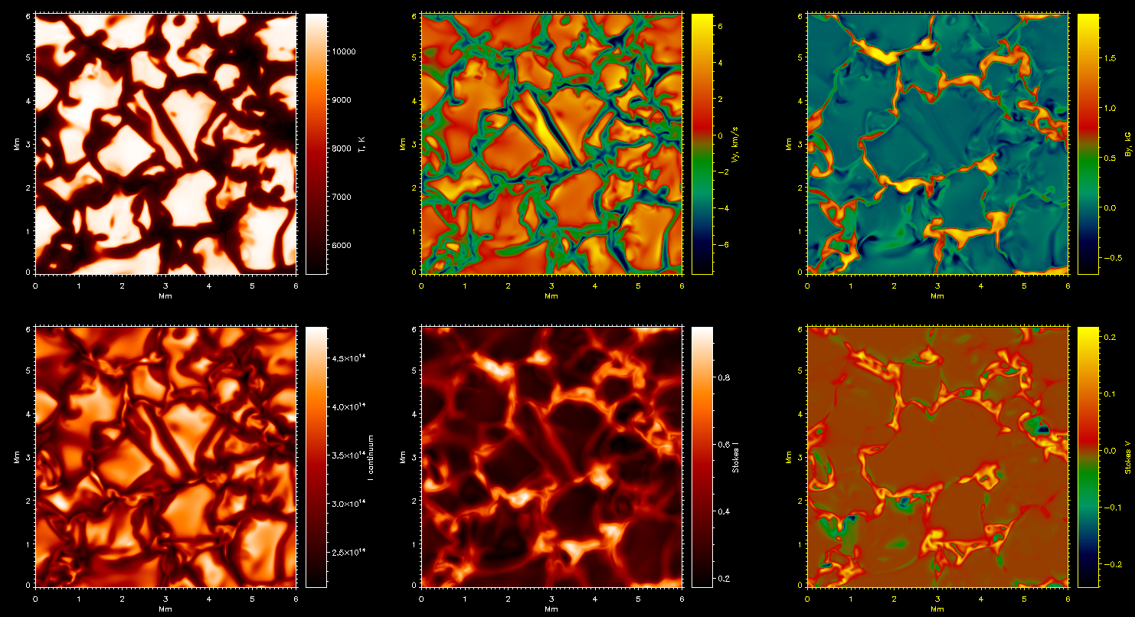
Solar spectropolarimetry

Slide 33
That’s it. Few notes:
There are more mechanisms for line broadening: in computation Voigt profiles are used instead of Gaussians/Lorentzians.
Molecules radiate/absorb too. They are more complicated than atoms: more degrees of freedom (rotational, vibrational states) . Leads to absorption line bands observed at the Sun.
We did not cover emission lines. They are slightly simpler. Used for temperature diagnostics in corona.
Actually, we did not cover so many things…

