Slide 1
Waves
Disturbances which travel through space and matter
Carry energy and information
Sometimes need medium to propagate in (mechanical waves, sound), sometimes don’t (EM waves)

Slide 2
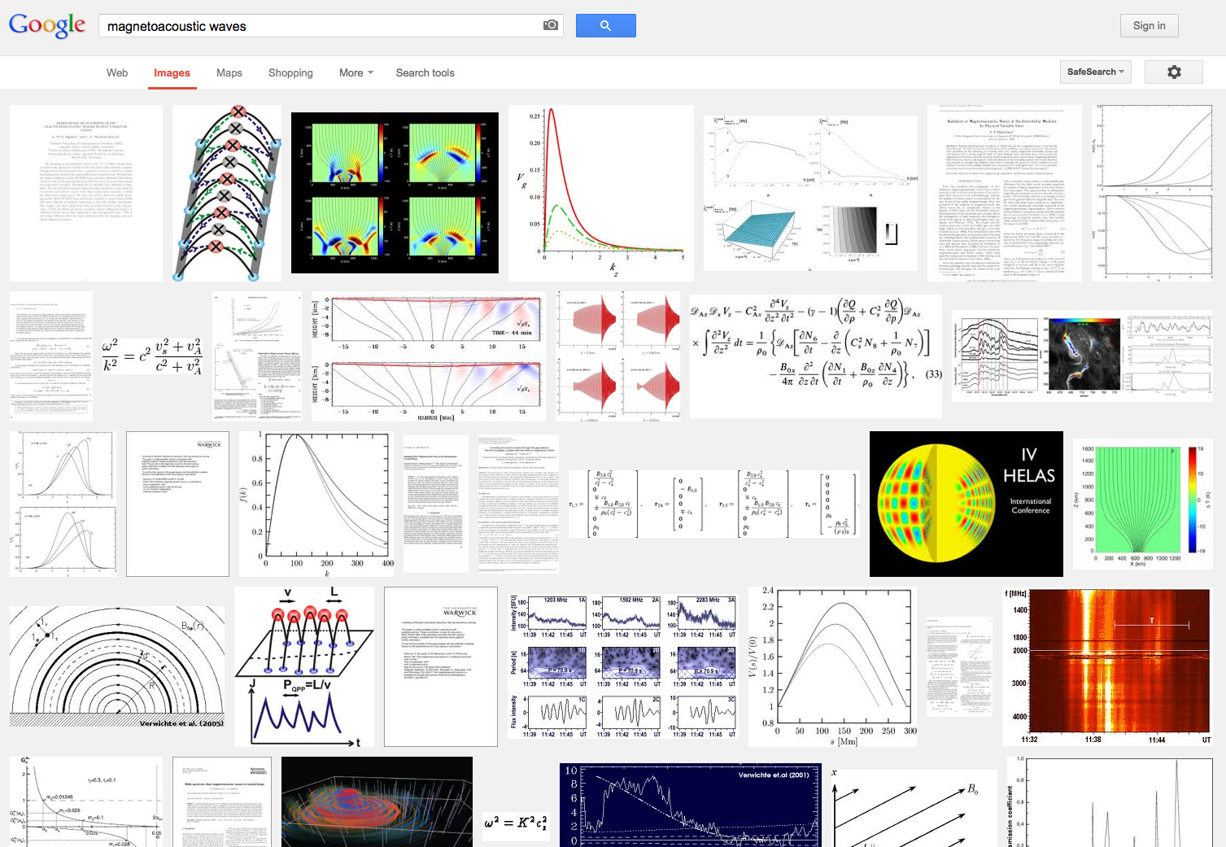
MHD waves

Slide 3
Adiabatic MHD

Slide 4
Linearized MHD
Assume equilibrium and small deviations from it:
Then:

Slide 5
Linearized MHD
Take time derivative of the momentum equation and substitute all other equations into it.
1 equation, 1 unknown!
Linearized equation of motion. All studies of MHD waves and instabilities start from this equation.

