Slide 1
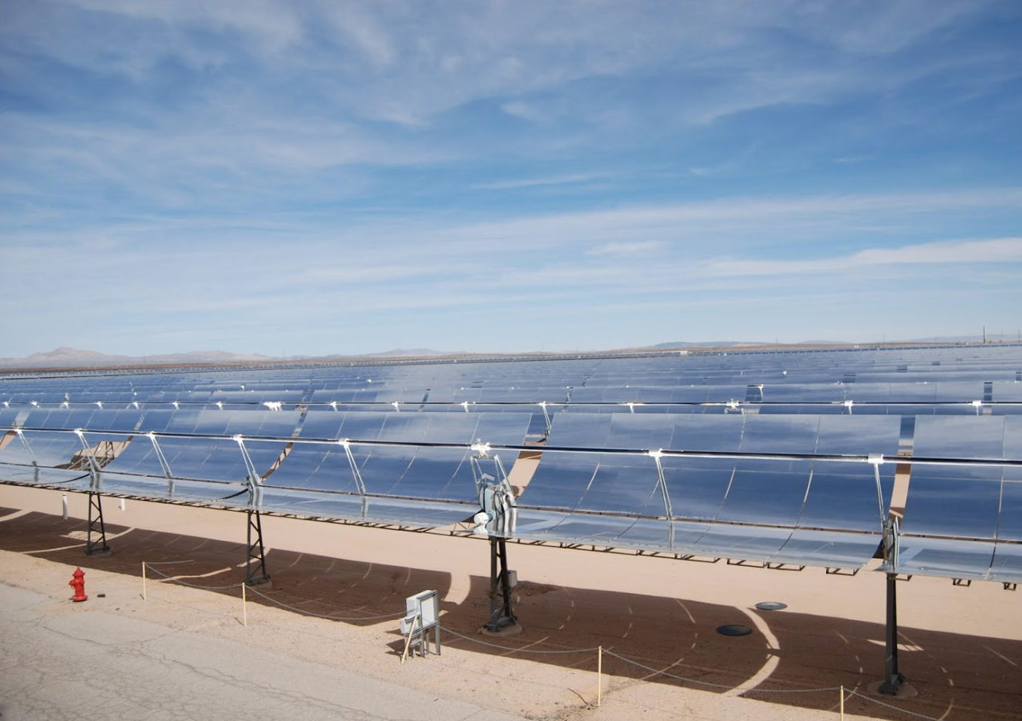
Meanwhile, somewhere in California

Slide 2
Solar plasma
Convection is complicated
Temperature is very high
Completely or partially ionized gas ->
Charges (protons and electrons) are present
+ Magnetic field is somehow generated and observed
Quite dense
-> Need a good description of ionized fluid (plasma), since solving ~10³⁰ equations of motion for each charged particle is not realistic…

Slide 3
MHD
Start with basic principles: 6D volume in phase space, distribution function
Derive general transport equation
Calculate 0,1,2-momenta for velocity
Average over different particle types
Add induction equation for magnetic field
Simplify

Slide 4
Some kinetics
- Distribution function for particles f(r_{i},p_{i},t) in 6-dimensional space of coordinates and momenta. We can write a “conservation” equation for it.
Liouville equation
Collisions change the “conservation”:
Boltzmann equation (BE)
BE in vector form

Slide 5
Simplifying kinetics
- We want to get rid of velocity part of space. To do it we integrate BE for particle type a over an arbitrary volume in v-space d³V. We also multiply BE by a function of v, Χ(v).
Where the averages <> are
Generalized transport equation for Χ.

