Slide 1
Solar interior
Solar interior
Standard solar model
Solar evolution, past, present and future

Slide 2
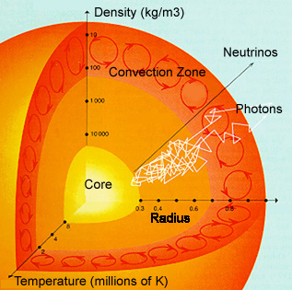
The solar interior
Solar interior cannot be directly observed, information is from:
Theoretical models
Helioseismology
Solar neutrinos
Consists of the core, radiative zone, convection zone. The core produces energy, which is then transported radially outwards through the radiative zone (by radiation) and then through the convection zone (by convection).

Slide 3
Solar chemical composition
Element | Abundance | Mass fraction
H | 0.934042096 | 0.76914905
He | 0.064619943 | 0.21284852
O | 0.000759218 | 0.00489926
C | 0.000371849 | 0.00090196
N | 0.000091278 | 0.00875263
Fe | 0.000039844 | 0.00046787
Mg | 0.000035511 | 0.00003996
Si | 0.000033141 | 0.00004053
Al | 0.000002757 | 0.00131240
Ca | 0.000002140 | 0.00152403
Na | 0.000001997 | 0.00006377
These are photospheric abundances. The photosphere is mostly composed of hydrogen (93.4% of atoms). Some helium (6.5%). Everything else is <0.1%.
But this “everything else” is important:
where do those elements come from?
also, they are widely used in solar spectropolarimetry
Interestingly, the core has more helium than hydrogen. Since the energy is transported radiatively (not convectively) there, there is no mixing, so no core helium appears at the surface.

Slide 4

The core
Mass is turned into energy
Burn rate: 7•10¹¹ kg/s (Apollo mission Saturn V first stage engine F-1 burned 2500 kg/s of kerosene+oxygen)
Temperature (particle velocity) and density (distance between particles) are high enough for protons (hydrogen ions) to overcome Coloumb barrier and ram into each other.
Most of the solar energy (99%) is coming from proton-proton chain (p-p chain)
1% is from CNO cycle for present-day Sun (in hotter stars can be dominant source)

Slide 5
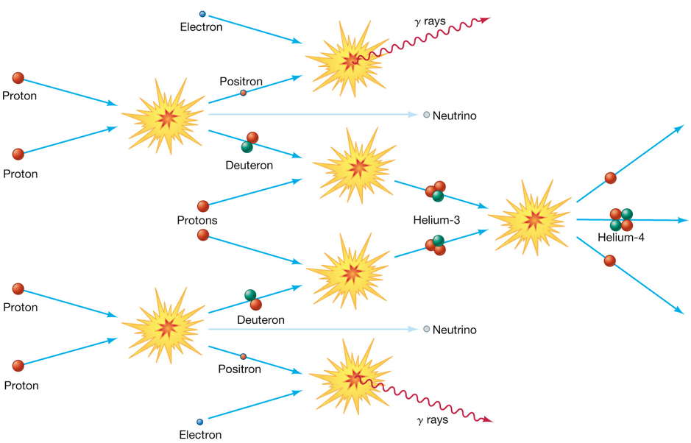
p-p chain

Slide 6
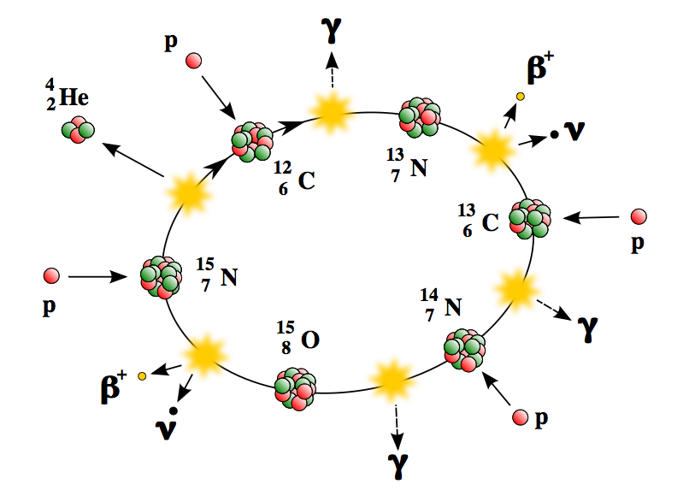
CNO cycle

Slide 7
Energy output
Both p-p and CNO chains are closed loops.
Both p-p and CNO chains produce Helium (α-particle), neutrinos, and γ-radiation.
Both p-p and CNO chains produce 26 MeV per Helium nucleus in form of photons and neutrinos.
Photons are reabsorbed by gas, gas is heated.
Neutrinos escape.

Slide 8
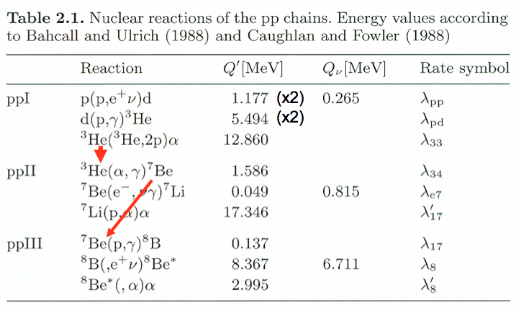
p-p branches and energies
Branching ratios: 1 vs 2 - 87/13, 2 vs 3 – 13/0.015

Slide 9
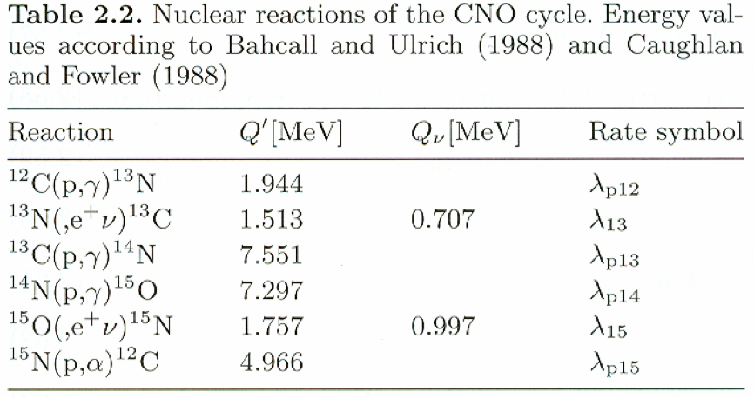
CNO cycle energies
Note: C, N and O act only as catalysts. Basically, the same thing happens here as in p-p chain!

Slide 10
Some stellar physics to remind
We know: M, L, R.
We also know that the Sun is in (more or less) equilibrium.
We have gas pressure, radiative pressure and gravity. We also have an energy source – the core.
We assume the Sun is non-rotating and spherically symmetric.

Slide 11
Equations of stellar (gas ball) structure
Mass:
(1) and (2) can be grouped into Lane-Emden equation:
(1) Mass continuity:
Equation of state:
(2) Hydrostatic equilibrium:
Connects pressure, density, temperature, energy generation rate, chemical composition, opacity etc. Cannot be expressed as a single/simple equation. Simple approximations available:
Polytrope, polytropic index n=1/(γ-1); analytical solutions exist for n=0,1,5 for Lane-Emden eqn.
Total pressure, e.g.:
Luminosity equation:
Ideal gas equation of state
Include radiative pressure? (find if and where it is important for the Sun! What about other stars?)
Energy transport – next page.
Although they give an idea of how a star behaves, they are crude approximations. Reality is much more complex! Normally, tabular equations of state for numerical integration etc.

Slide 12
Equations of stellar structure II
Energy transport in radiative zone
Photon mean free path:
where σ_{T} is Thompson scattering constant, <N_{e}> is electron number density.
The Sun is neutral, so <N_{e}> = <N_{P}> - mean proton number density, which is equal
Then, λ=0.018 m. Time for a photon to travel this distance is λ/c=6•10⁻¹¹ s.
Random walk: total number of walks for a photon to travel from the core to the surface is (R_{Sun}/λ)² =
1.5•10²¹. The time for a photon to travel from the core to the surface is then 9•10¹⁰ s = 3000 years.
Thermal equilibrium -> Planck function for intensity.
Not going into details for a while (we could have some time later): we substitute Planck function into radiative transport equation, integrate it over angle and frequency, calculate opacities and introduce Rosseland opacity, after some tweaking to get the temperature gradient if the energy is transported by radiative diffusion:

Slide 13
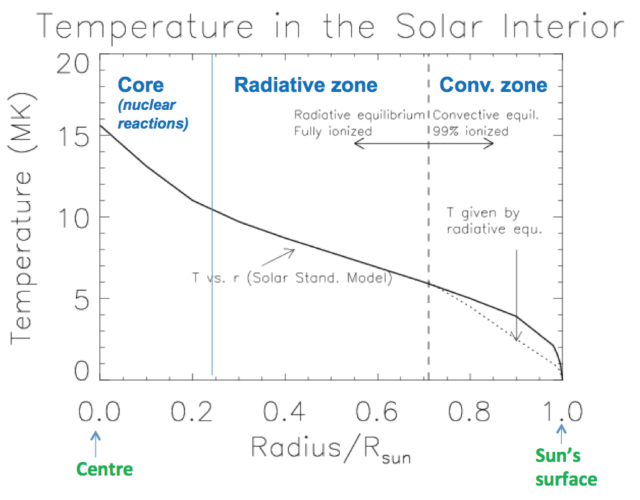
Radiative zone and convective zone
As the temperature decreases towards the solar surface, fully ionized gas begins to recombine: opacity κ increases, and plasma becomes less transparent. Thus
gives stronger temperature gradient. Radiative transport becomes inefficient, convective transport gets into play.

Slide 14
Adiabatic convection
Gas
To understand what is convection, we follow a gas element which rises adiabatically (does not exchange heat with surrounding gas).
Now, if ρ₂’<ρ₂ (density within gas element is smaller than outside density), the gas element will keep rising. At the top, the gas element radiates/looses heat, cools and falls down.
This is the convective cycle.
Evidence of convection: dynamic granulation at the solar surface.
Gas element
Gas outside
ρ₂’, p₂’, T₂’
ρ₂, p_{2,} T₂
ρ₁’, p₁’, T₁’
ρ₁, p_{1,} T₁

Slide 15
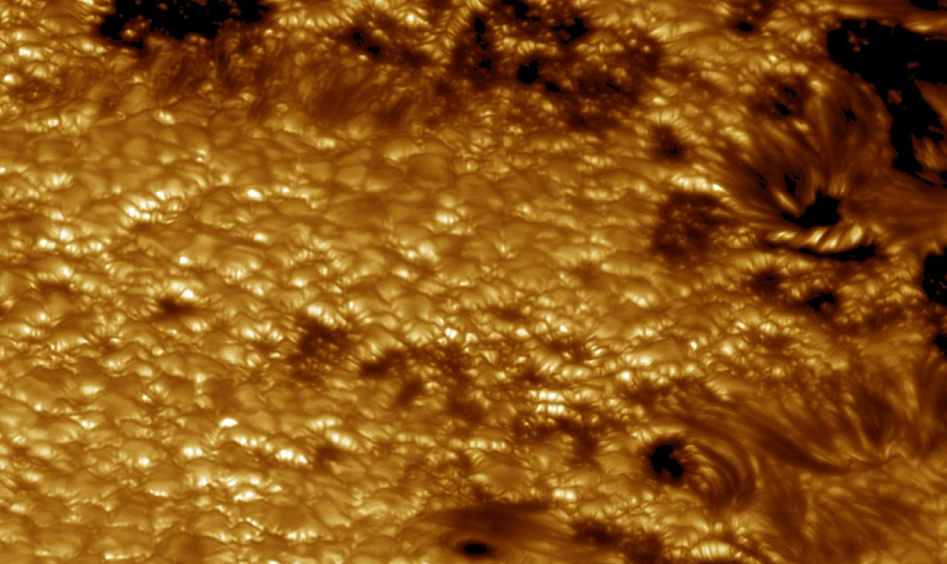
Solar surface granulation

Slide 16
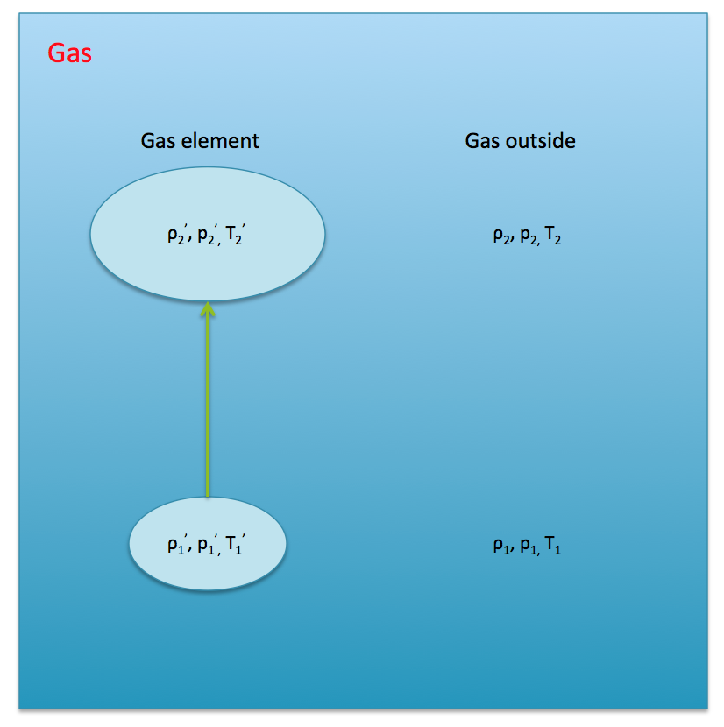
Convection
If a gas element rises quickly compared to the time to absorb or emit radiation, it can be considered as adiabatic process, for which
Here - ratio of specific heat capacities at constant pressure and volume. It is 5/3 for a fully ionized hydrogen.
Same gas element:
Bottom:
Pressures equal at the top:
Density at the top:
Using and , and assuming P=P(r), T=T(r), ρ=ρ(r), we derive:
Schwarzschild instability criterion
Adiabatic temperature gradient
Convection occurs when the actual temperature gradient is greater than adiabatic temperature gradient.

Slide 17
Brunt-Väisälä frequency
Imagine a parcel of gas with density ρ₁ in vertically stratified (arbitrary, non-adiabatic) gas background with ρ(r), P(r), T(r), and ρ₂<ρ₁. A small adiabatic displacement r of the parcel upwards will lead to an extra gravitational force directed downwards and acting on the parcel:
ρ₂’, P₂, T₂’
ρ₂, P₂, T₂
g
r
ρ(r)
ρ₁, P_{1,} T₁
ρ₁, P_{1,} T₁
- Harmonic oscillator equation
Straightforward solution:
oscillatory
Where - Brunt-Väisälä frequency.
unstable (exp growth)
Show that N²<0 is equivalent to Schwarzschild instability criterion!
By the way, we’ve just discovered solar internal g-modes. Currently not observed, since hidden below convective zone and evanescent. Expected ~<1mm/s solar surface velocity, very low frequency: one of the unsolved problems in solar physics…

Slide 18
But
Convection is complicated: complex interaction of non-linear flows, turbulence, which do not (currently?) allow analytical solutions. Some clues are from mixing length theory, want better description…

Slide 19
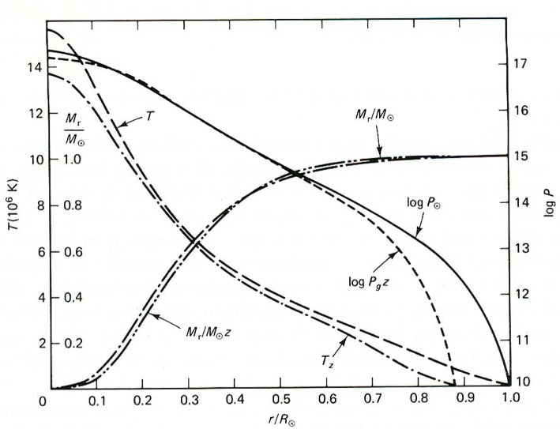
Internal structure of the Sun
Internal structures are shown for ZAMS (zero-age-main-sequence, young, subscript z) and present-day (subscript , reaching 1 solar radius) Sun.

Slide 20
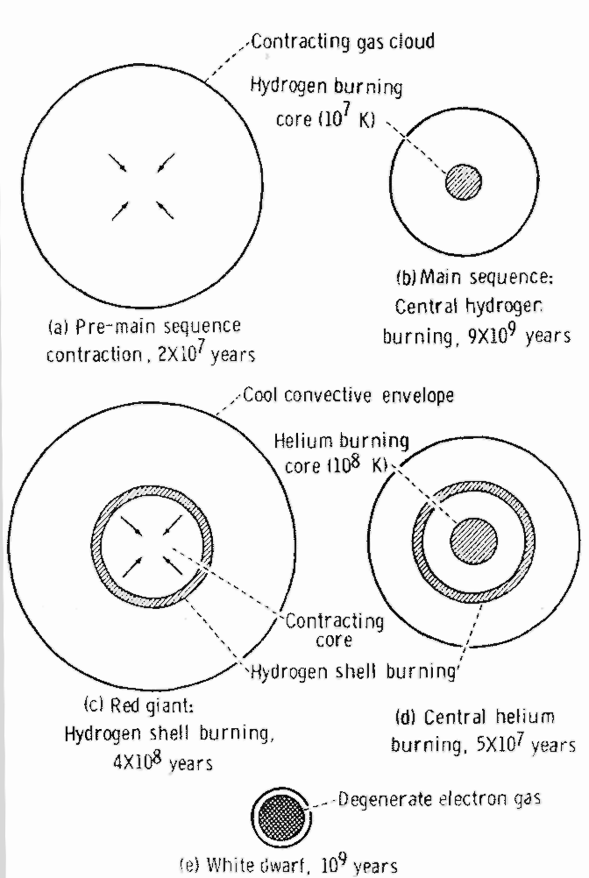
Solar evolution (sad but true…)
Evolution of the Sun:
Gravitational Contraction
Main Sequence
Red giant
He-burning stage
White dwarf

Slide 21
Solar plasma
Convection is complicated
Temperature is very high
Completely or partially ionized gas ->
Charges (protons and electrons) are present
+ Magnetic field is somehow generated and observed
Quite dense
-> Need a good description of ionized fluid (plasma), since solving ~10³⁰ equations of motion for each charged particle is not realistic…

