Slide 1
M4111 The Sun and stars
Solar Physics

Slide 2
Course structure
My part - 12 lectures: week 1 – week 6
6 assignments:
5 (each week) to do at home (5% of final mark)
1 assignment – computational work (10%) ?
Exam: 70% two parts
Question time.

Slide 3
What we will do
The Sun: general overview
Structure of the Sun, solar plasma
MHD approximation, MHD system derivation
MHD waves in the solar atmosphere
Wavelength-dependent radiative transport in the solar atmosphere
Solar photospheric observations and spectro-polarimetry

Slide 4
What I will try to do:
Show you why solar physics is important
Give you a more or less complete picture of the solar structure
Introduce (radiative) magneto-hydrodynamics as a good theory describing many parts of the Sun
Show what is going on in the Sun

Slide 5
Overview
Brief overview of the Sun
Solar physics in relation to other branches of physics
Impact of the Sun on Earth

Slide 6
Many stellar physicists think stars are simple.
They will be simple too if observed from 100 parsecs!

Slide 7
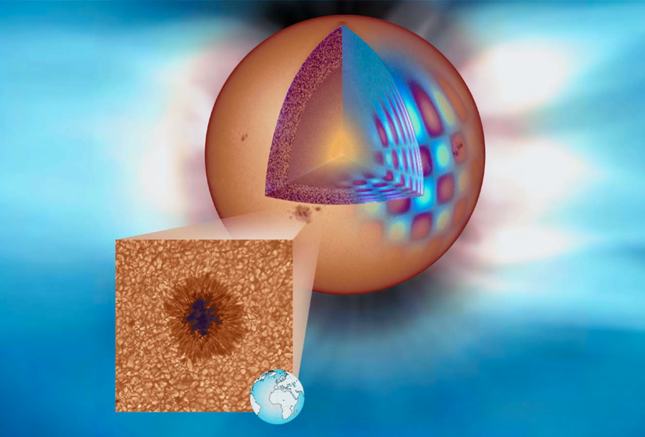
Brief overview of the Sun

Slide 8
Our star
The Sun is a usual, normal star: G2 spectral class of main sequence, middle aged (4 Gyr)
The Sun is a special star for us, the only star which:
  Supplies us with the energy
  Is close enough to us to resolve the scales on which fundamental physical processes take place
  Is a natural physical lab where we can learn about various branches of physics

Slide 9
Numbers about the Sun
Mass: 2•10³⁰ kg = 1M
Radius: 6.96•10⁵ km = 1R
Age: 4.55•10⁹ years (from meteorite isotopes)
Distance from Earth: 1AU=1.496(±0.025)•10⁸ km=8 light minutes
Luminosity: 3.84•10²⁶ W = 1L
Effective temperature: T_{eff}=5777K
Core temperature: T=15•10⁶K
Average density: 1.4 g/cm³
Core density: 150 g/cm³
Surface gravity acceleration: 244 m/s²
Rotation period: 27 days at equator (synodic, Carrington rotation, as seen from Earth)
1 arc second ≈ 700 km at the solar surface

Slide 10
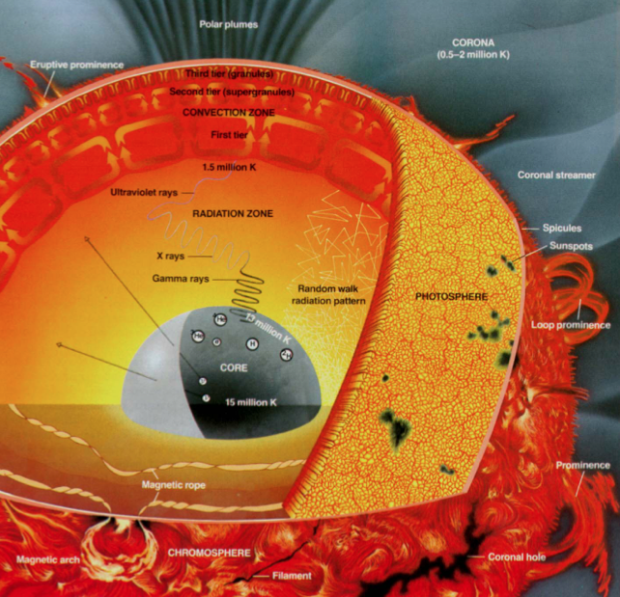
The Sun’s structure
Solar interior: everything we don’t see, below the solar (optical) surface. Divided into the core (where hydrogen burns), radiative zone and convection zone.
Solar atmosphere: everything we see, directly observable part of the Sun. Divided into photosphere, chromosphere, corona, heliosphere.

Slide 11
The solar surface
The material the Sun is made of shows no phase transition (e.g. from solid to liquid or gas, as on Earth). Define solar surface through its radiation.
The photons in the solar interior make a random walk, continuously re-emitted and re-absorbed. Mean free path increases rapidly with the distance from the solar core (density decrease).
At the solar surface, the mean free path is large enough for the photons to escape from the Sun. This height depends on the radiation wavelength.
Surface corresponds to the optical depth τ=1. τ=1 at λ=500 nm is usually a standard for solar surface.

Slide 12
Wide range of parameters
Between the core and corona:
Gas density changes by 30 orders of magnitude
Temperature changes by 4 orders of magnitude
Time scales change from 10⁻¹⁰ s to billions of years.
Different theoretical and observational techniques have to be used to study different parts of the Sun: e.g. helioseismology, nuclear physics for the solar interior, magneto-hydrodynamics for convection zone and atmosphere, spectropolarimetry for measuring magnetic fields etc.

Slide 13

Connection to other physics branches
Plasma physics/turbulence
Stellar physics/activity/evolution
Interstellar medium
Solar and exo-planets
Solar physics
Atomic/molecular/nuclear physics
Solar-terrestrial relations, Earth climate
Fundamental physics/gravitation/neutrinos

Slide 14
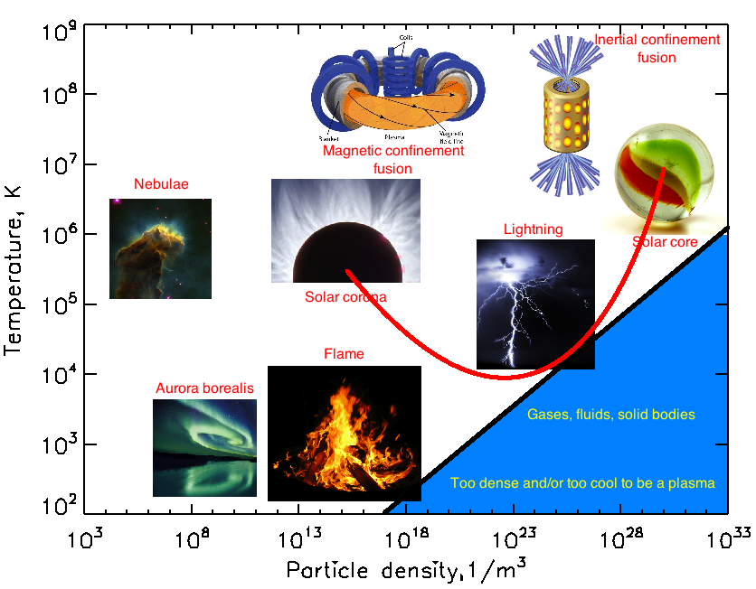
Plasma physics lab

Slide 15
Gravitation/Relativity & the Sun
Curved light path / Mercury orbit precession: tests of General Relativity
Red shift of spectral lines: test of Einstein’s Equivalence Principle
Shape of the Sun: quadruple moment of solar gravitational field, tests for alternative relativity theories (e.g. Brans-Dicke theory)
Solar evolution models/comparison to observations: tests for limits on evolution of fundamental constants
Polarization of spectral lines: tests of Equivalence Principle and alternative theories

Slide 16
Solar neutrino problem
Neutrinos are particles very weakly interacting with matter
The Sun radiates neutrinos from proton-proton chain reaction (¹₁H+¹₁H -> ²₂He -> ²₁D+e⁺+ν_{e})
Measurements of neutrino flux went into discrepancy between the standard model of the solar interior and standard model of particle physics.
This discrepancy lead to a discovery of neutrino mass -> neutrinos can change their types and be unnoticed by neutrino detectors.
Surprisingly, the standard solar model was correct, particle physics was wrong!

Slide 17
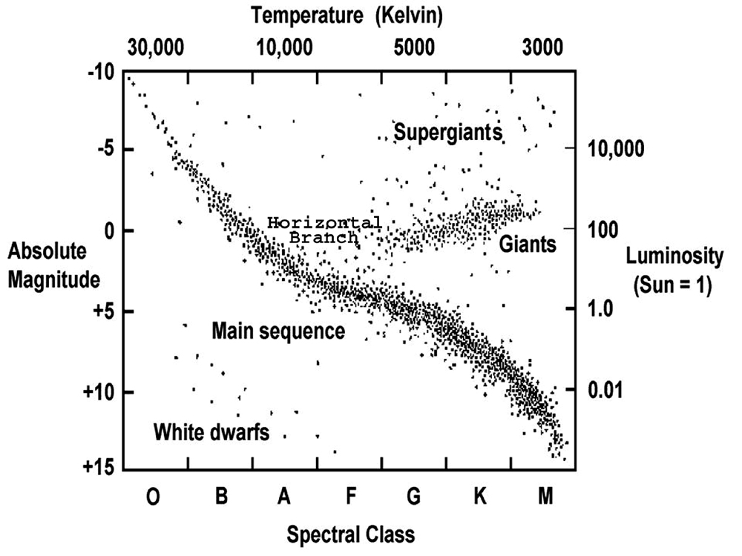
Other stars have magnetic activity too!
The Sun is best studied!
F, G, K, M stars (with outer convective envelopes) show magnetic activity and have B of G-kG.
Early-type starts Ap, Bp (kG-100kG), Be (100G)
White dwarfs (kG-10⁹G), no activity
Pulsars/black holes (not on H-R diagram)

Slide 18
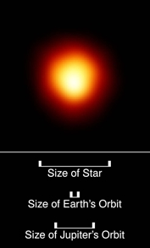
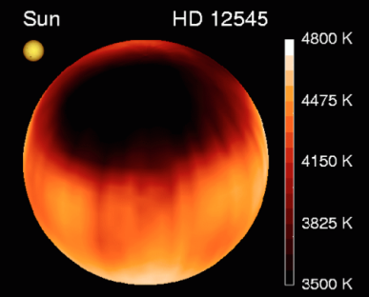
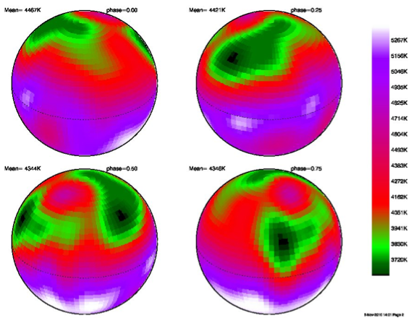
Other stars
HD12545: a big starspot was detected using Doppler imaging on this giant star.
II Pegasi: flares observed 10⁸ times more energetic than the solar ones.
Betelgeuse: models and recent spectropolarimetric measurements show B=1G, produced by local dynamo in upper layers of convection zone.

Slide 19
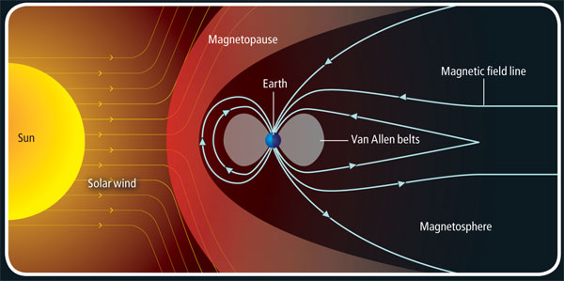
The Sun and Earth
Solar output affects the magnetosphere and atmosphere of Earth (and other planets)
Habitable environment on Earth exists due to solar energy
Questions about evolution of other planets in Solar System: water on Mars? future of Venus?

Slide 20
Solar wind story
In 1859, Richard Carrington and Richard Hodgson independently made the first observation of what would later be called a solar flare. This is a sudden outburst of energy from the Sun's atmosphere. On the following day, a geomagnetic storm was observed, and Carrington suspected that there might be a connection.
Eugene Parker showed that even though the Sun's corona is strongly attracted by solar gravity, it is such a good conductor of heat that it is still very hot at large distances. Since gravity weakens as distance from the Sun increases, the outer coronal atmosphere escapes supersonically into interstellar space.
Opposition to Parker's hypothesis on the solar wind was strong. The paper he submitted to the Astrophysical Journal in 1958 was rejected by two reviewers. It was saved by the editor Subrahmanyan Chandrasekhar.
In January 1959, the Soviet satellite Luna 1 first directly observed the solar wind and measured its strength.

Slide 21
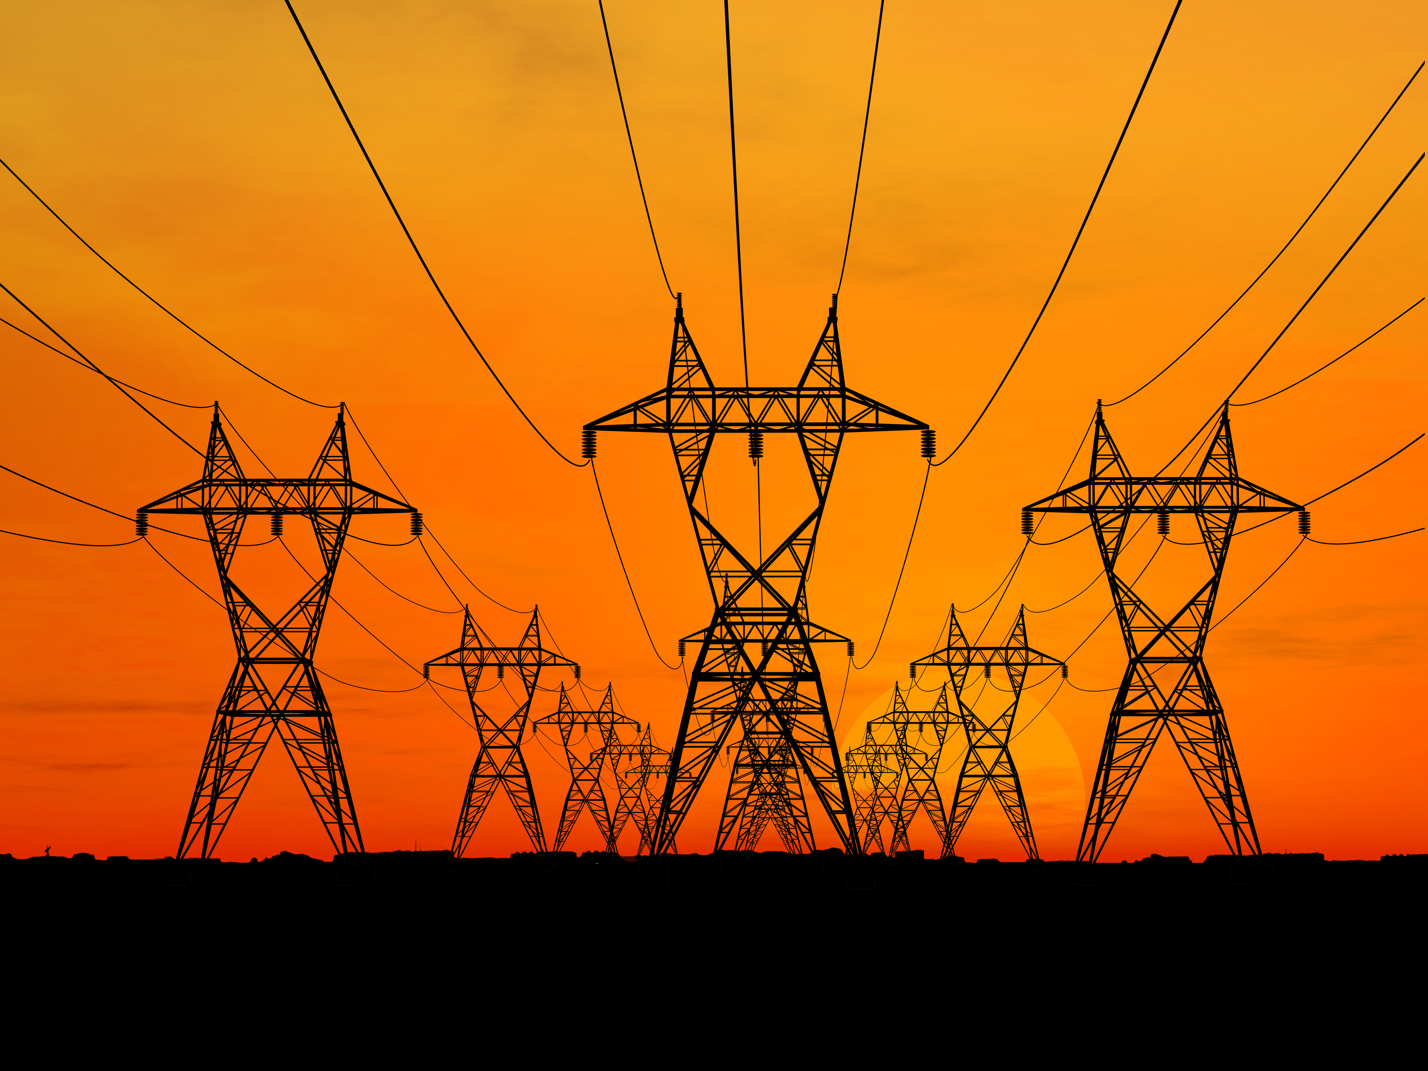
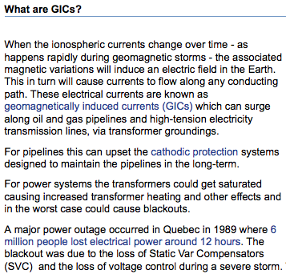

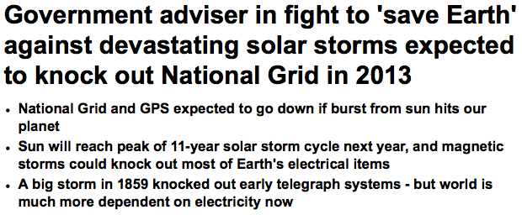
Back to Earth: solar influence
Solar flares and geomagnetic storms are large-scale events affecting human life on Earth globally.

Slide 22
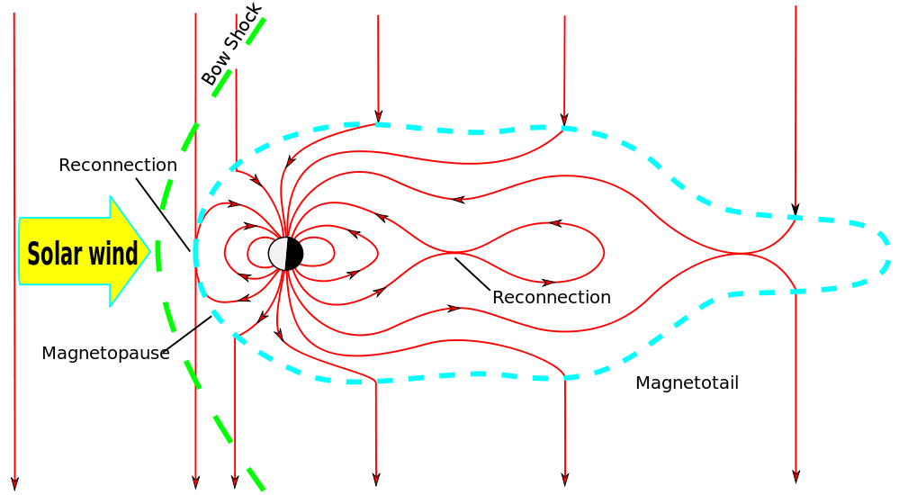
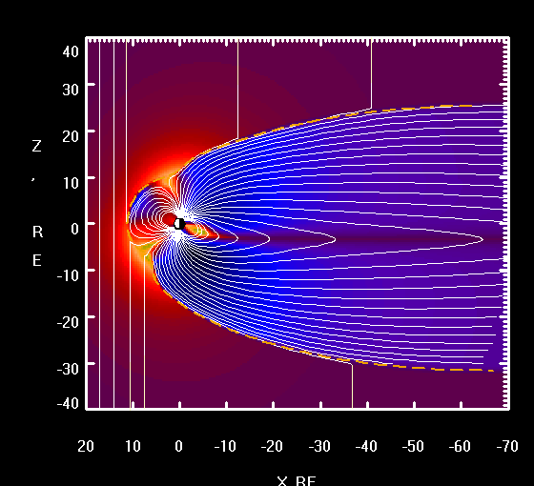
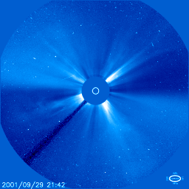
Geomagnetic storms
Power disruptions
Coronal mass ejection (CME)
Damage to pipelines
Geomagnetically induced currents
Radiation hazard
Charged particles leak through magnetosphere
Auroras
Particles and magnetic field
Communication disruptions
Ionospheric disturbances
Pigeons lose their minds

Slide 23
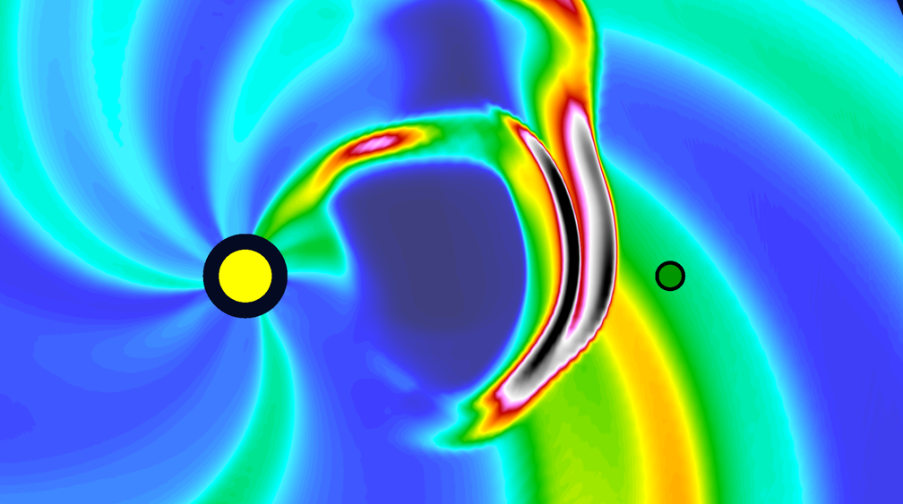
Space weather
Need for ability to predict
Current solar observational data
Space weather forecast
fast computer
Detailed physical laws

Slide 24
Enough for today

