Slide 1








ALR^{n}: Accelerated Higher-Order Logistic Regression
Nayyar A. Zaidi, Geoffrey I. Webb, Mark J. Carman, Francois Petitjean, Jesus Cerquides

Slide 2
Outline of the Talk
Motivation (2 mins)
Proposed Approach (5 mins)
Experimental Section (5 mins)
Conclusion and Future Works (3 mins)
Questions (5 mins)

Slide 3

Motivation
Machine learning is confronted with ever growing data quantity
Arrival of Big Data
Many state-of-the-art learning algorithms were developed in the context of relatively small datasets
Large training sets often support the creation of very detailed models that can encode complex high-order multi-variate distributions
Such models would over-fit small training datasets and should be avoided

Slide 4

Motivation
Machine learning is confronted with ever growing data quantity
Arrival of Big Data
Many state-of-the-art learning algorithms were developed in the context of relatively small datasets
Large training sets often support the creation of very detailed models that can encode complex high-order multi-variate distributions
Such models would over-fit small training datasets and should be avoided

Slide 5
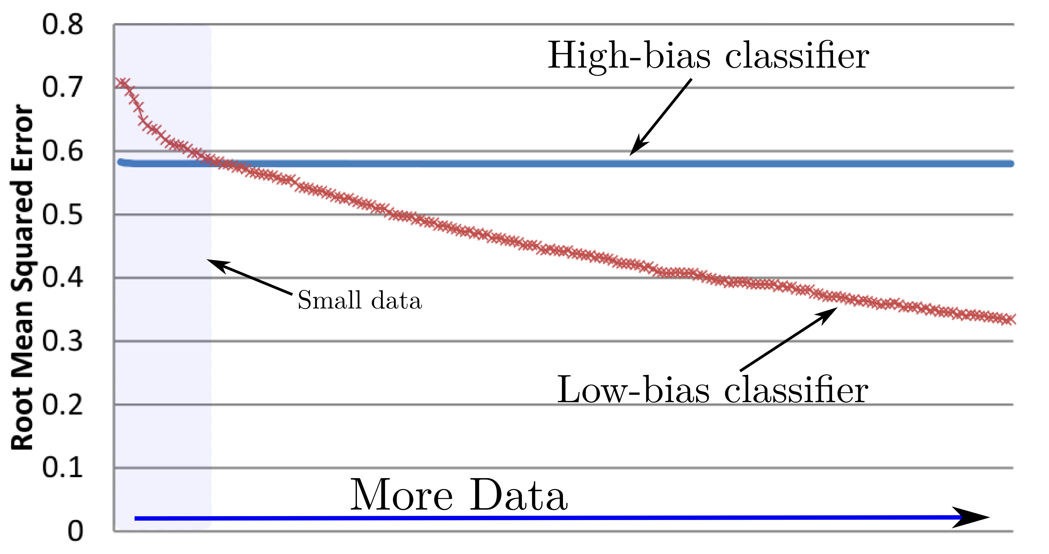
Low-bias vs. High-bias Classifiers
For small quantities of data, the low-variance learner achieves the lowest error.
However, as the data quantity increases, the low-bias learner comes to achieve the lower error as it can better model higher-order distributions from which the data might be sampled
Example of low-variance learner: naïve Bayes/Logistic Regression
Example of low-bias learner: Bayesian Networks

Slide 6
Low-bias vs. High-bias Classifiers (Contd)
Y
Y
Y
X₁
X₂
X₃
X₄
X₁ X₂
X₁ X₃
X₁ X₄
X₂X₃
X₂X₄
X₁X₄
X₁ X₂ X₃
X₁ X₂ X₄
X₁ X₃ X₄
X₂ X₃ X₄
High Bias
Low Bias
Y: Class variable
X₁, X_{2,} X_{3,} X_{4:} Variable

Slide 7
Higher-Order LR (LR^{n})
Bias (representation bias) is the biggest contributor to 0-1 Loss for big problem
As variance component of error approaches to zero when data set size increases
Bias originates from inability of the model to capture higher-order interactions that exists in the data
How about reducing the bias of LR by taking into account higher-order interactions?
We call such model: LR^{n}

Slide 8
Higher-Order LR (LR^{n})
Bias (representation bias) is the biggest contributor to 0-1 Loss for big problem
As variance component of error approaches to zero when data set size increases
Bias originates from inability of the model to capture higher-order interactions that exists in the data
How about reducing the bias of LR by taking into account higher-order interactions?
We call such model: LR^{n}

Slide 9
Higher-Order LR (LR^{n})
Bias (representation bias) is the biggest contributor to 0-1 Loss for big problem
As variance component of error approaches to zero when data set size increases
Bias originates from inability of the model to capture higher-order interactions that exists in the data
How about reducing the bias of LR by taking into account higher-order interactions?
We call such model: LR^{n}

Slide 10
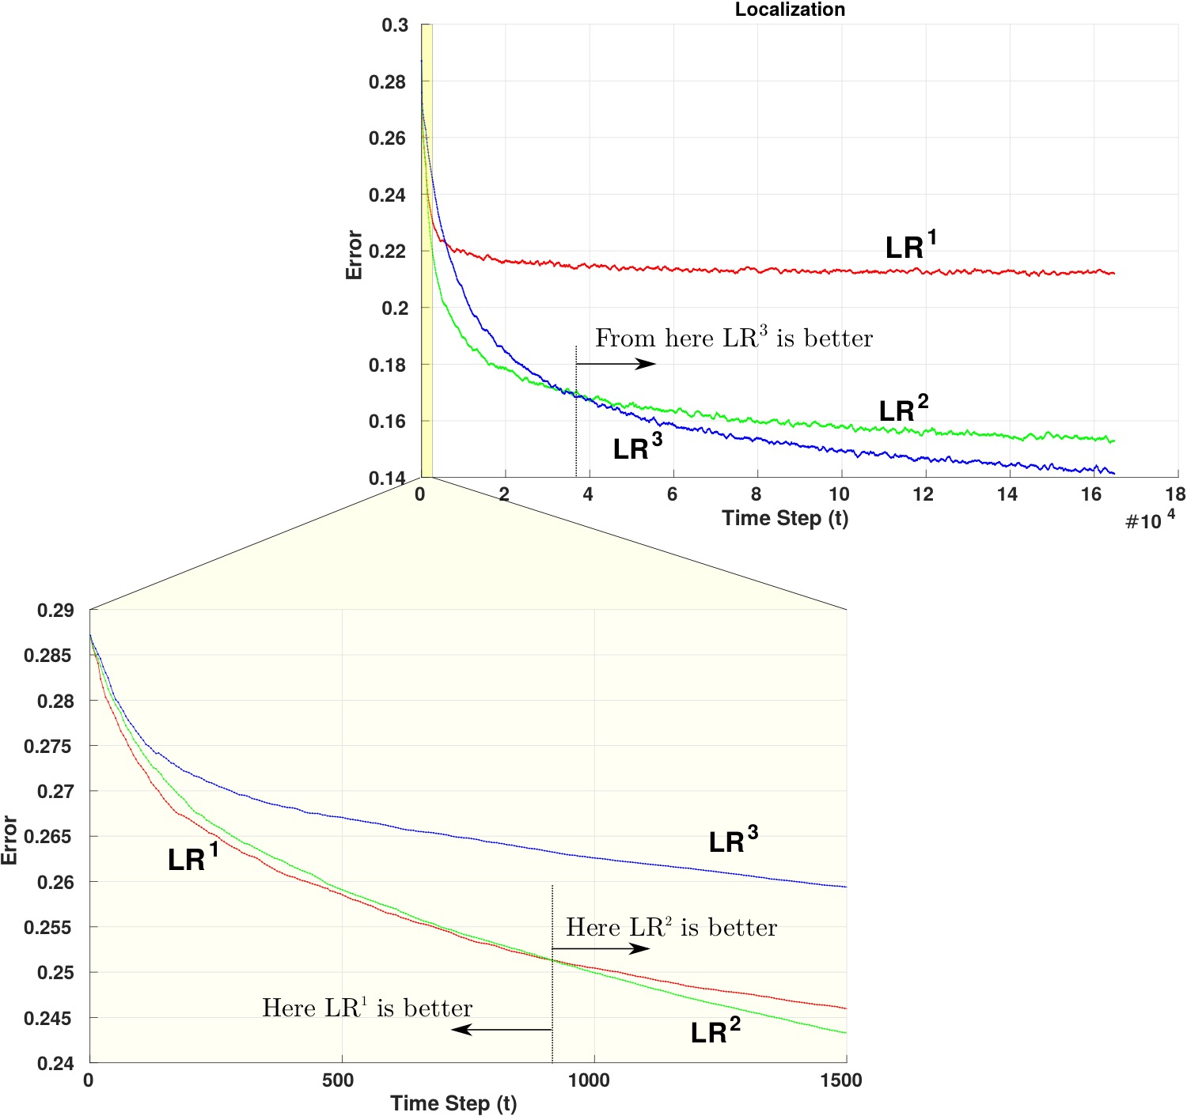
Higher-Order LR (LR^{n})
Comparative analysis of LR, LR² and LR³ with varying quantities of data
LR^{n} trained with SGD

Slide 11
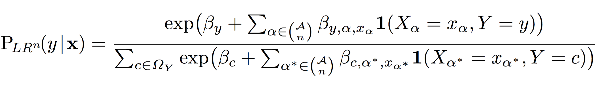
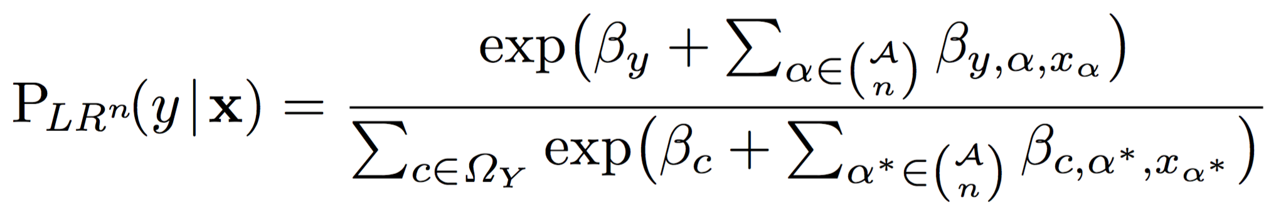
Higher-Order LR (LR^{n})
We define LR^{n} as:
And Simplify this to:

Slide 12
Higher-Order LR (LR^{n})
We define LR^{n} as:
And Simplify this to:
Too Slow

Slide 13
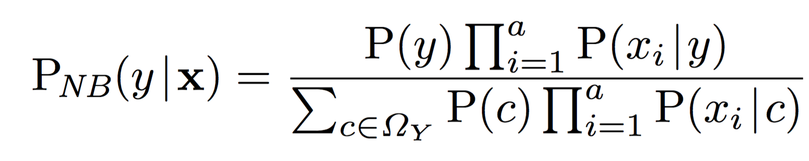
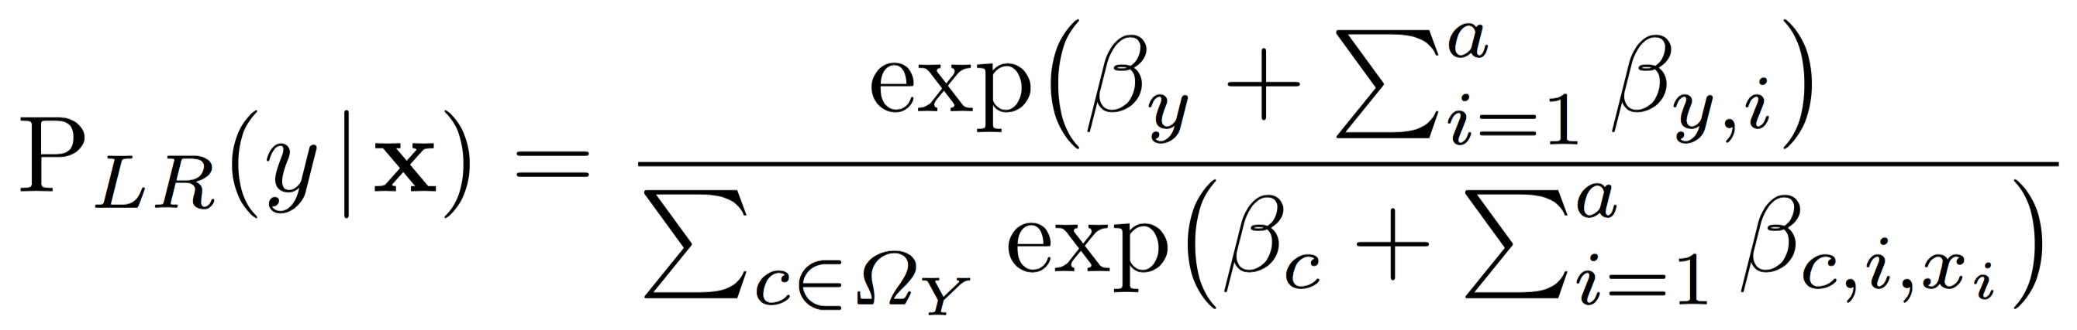
Equivalence between NB and LR
Let us look at Naïve Bayes, Logistic Regression

Slide 14
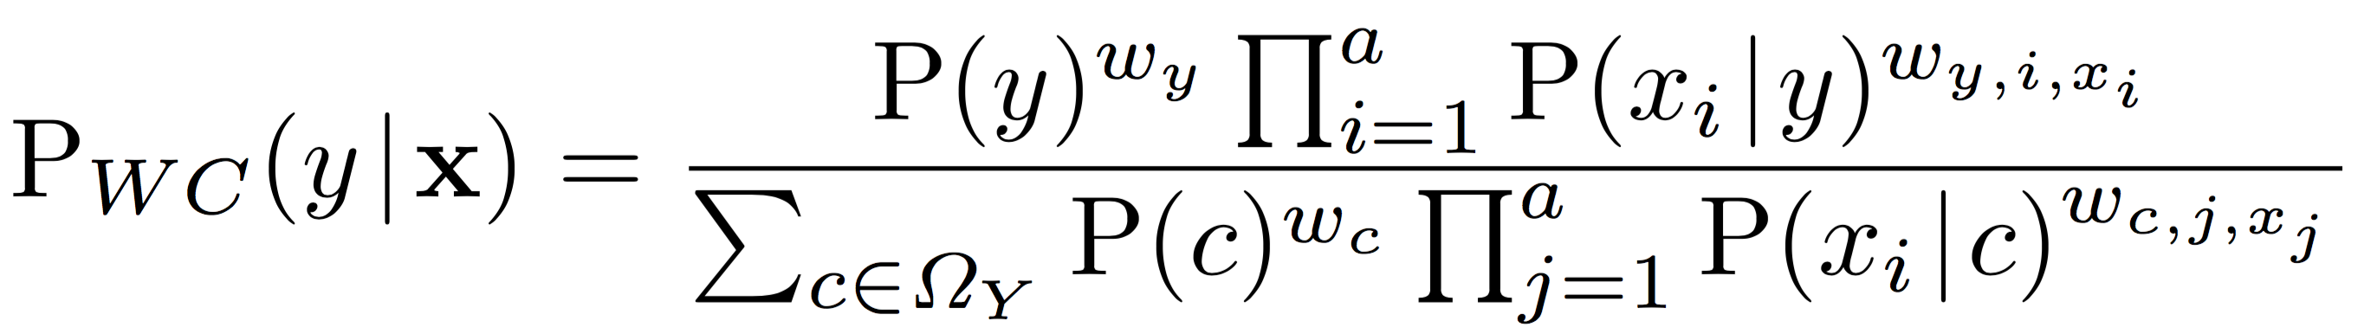
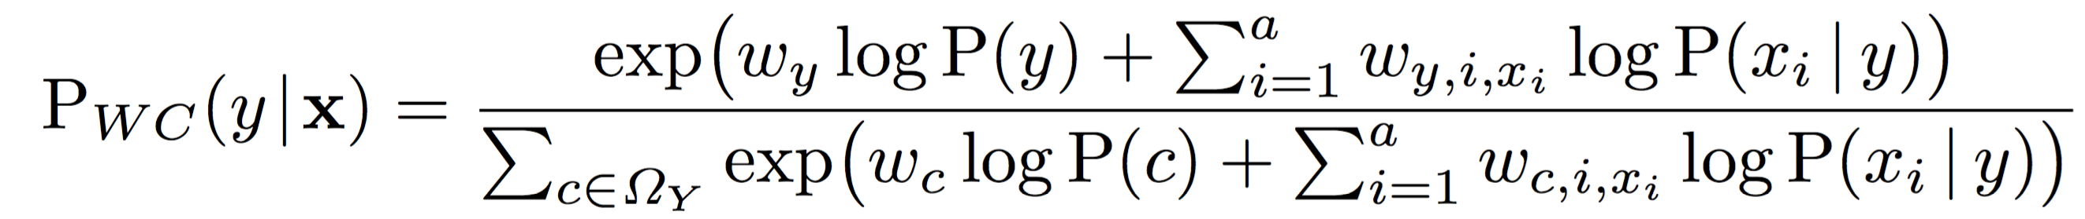
Equivalence between NB and LR
Let us look at Naïve Bayes, Logistic Regression

Slide 15
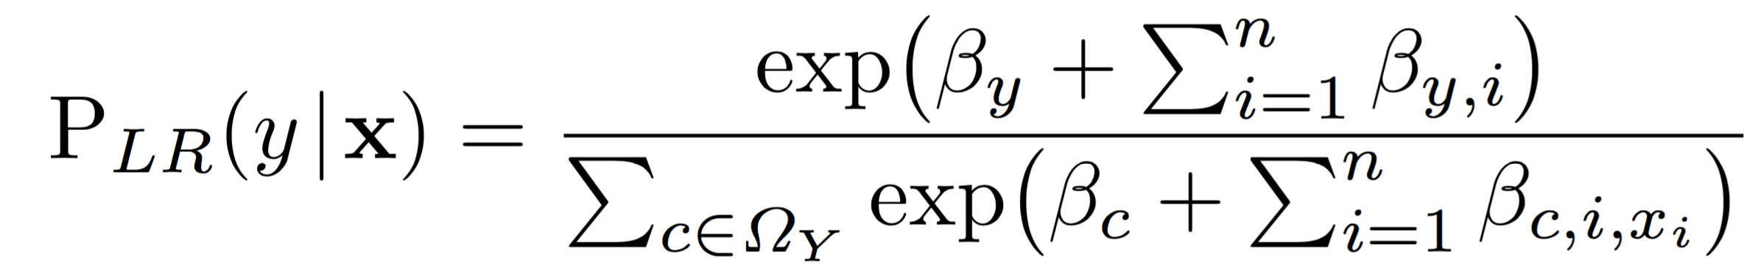
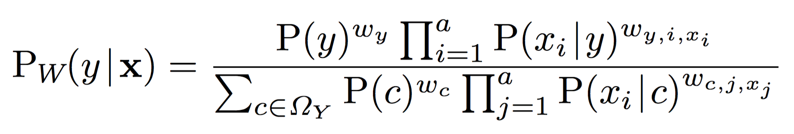
Equivalence between NB and LR
Let us look at Naïve Bayes, Logistic Regression

Slide 16

Pre-conditioning for LR^{n}
Like NB is a generative equivalent of LR, we need a generative equivalent for LR^{n}
We can not create a Bayesian Network of this form

Slide 17
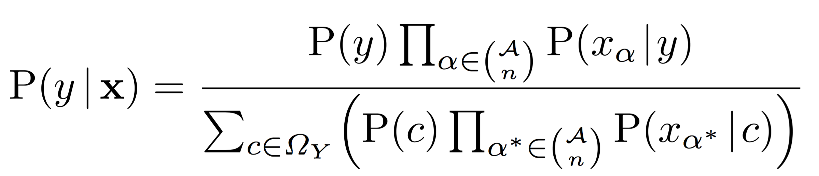
Pre-conditioning for LR^{n}
Like NB is a generative equivalent of LR, we need a generative equivalent for LR^{n}
We can not create a Bayesian Network of this form

Slide 18
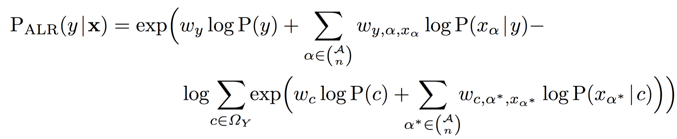
ALR^{n}

Slide 19
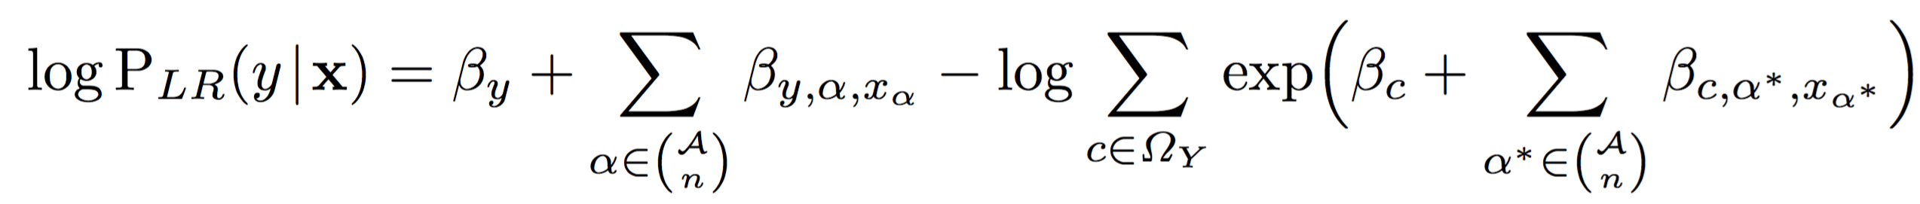
Comparison: ALR^{n} vs. LR
Let us compare the formulation of Accelerated Logistic Regression vs. Logistic Regression
Direct equivalence holds between the two parameterization

Slide 20
Comparison: ALR^{n} vs. LR
Let us compare the formulation of Accelerated Logistic Regression vs. Logistic Regression
Direct equivalence holds between the two parameterization

Slide 21
Experimental Setup
Standard UCI Datasets
Numeric attributes discretized using MDL
Optimization algorithms tested: L-BFGS, Conjugate Gradient, Gradient Descent, SGD
Only L-BFGS and Conjugate Gradient results are reported

Slide 22
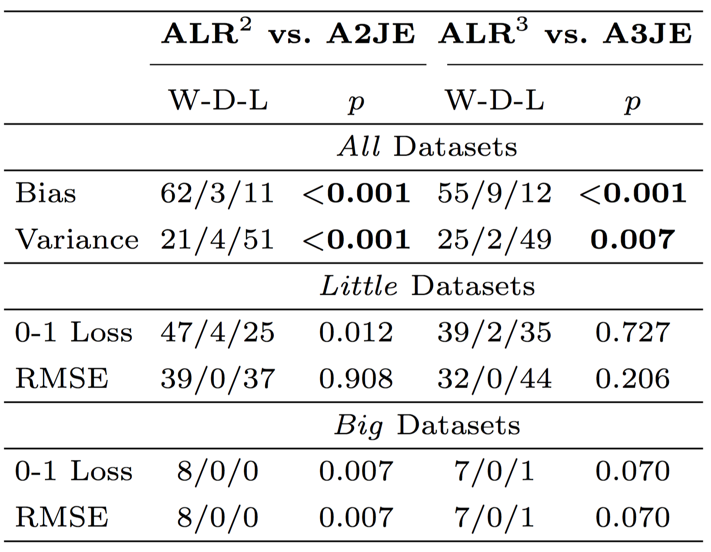
ALR^{n} vs AnJE
Win Draw Loss Comparison

Slide 23
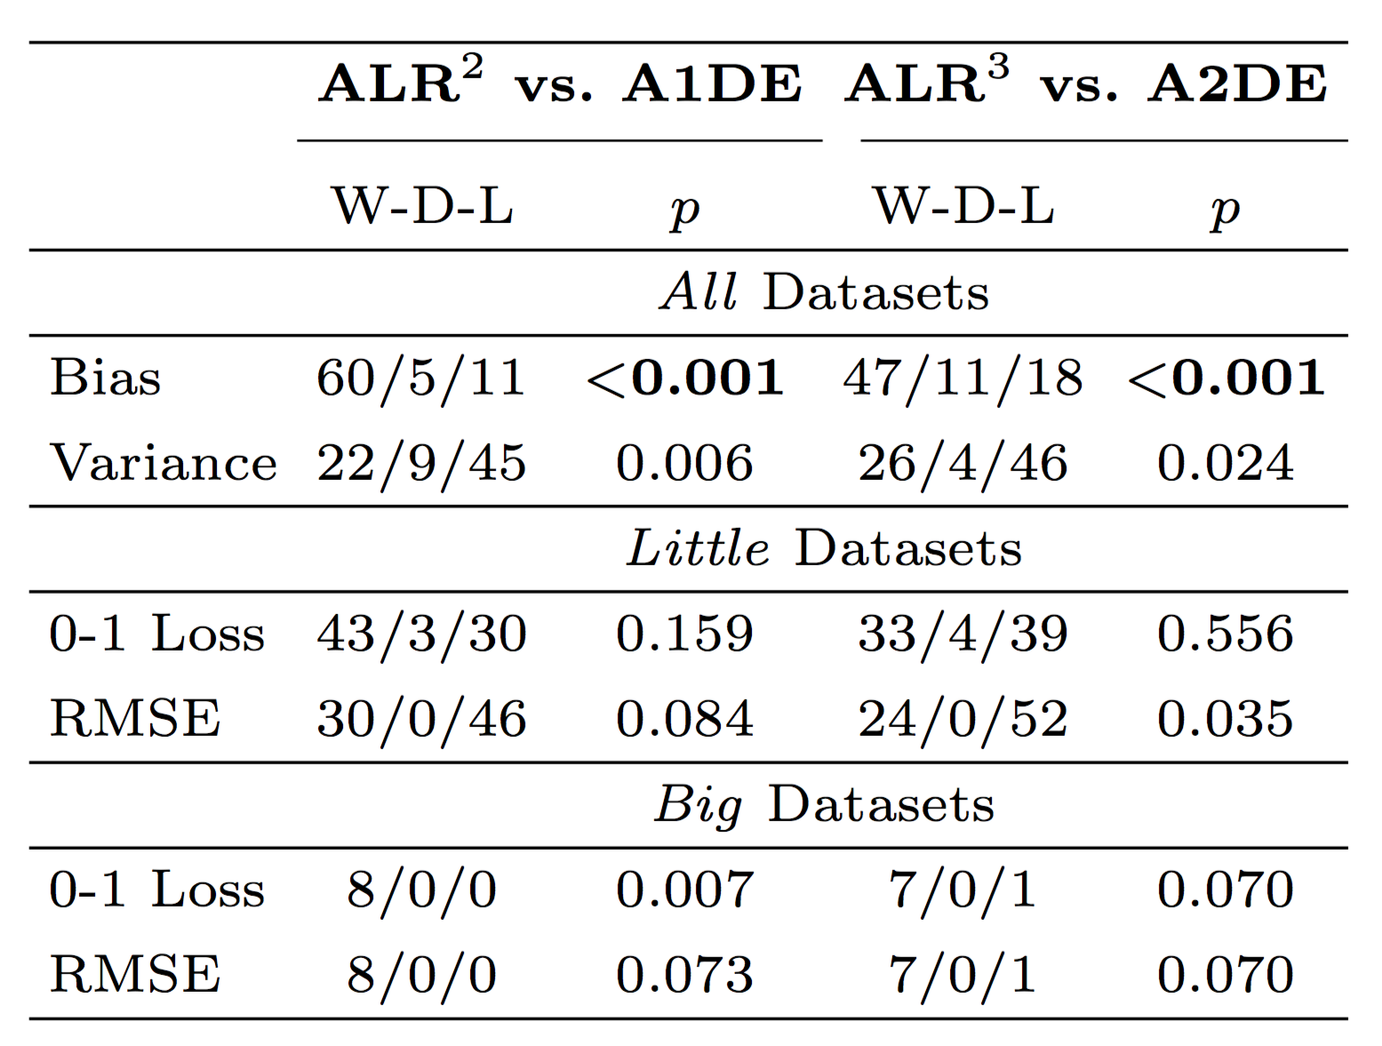
ALR^{n} vs AnDE
Win Draw Loss Comparison

Slide 24
ALR² vs. LR²

Slide 25
ALR³ vs. LR³

Slide 26
ALR² vs. LR²

Slide 27
ALR³ vs. LR³

Slide 28
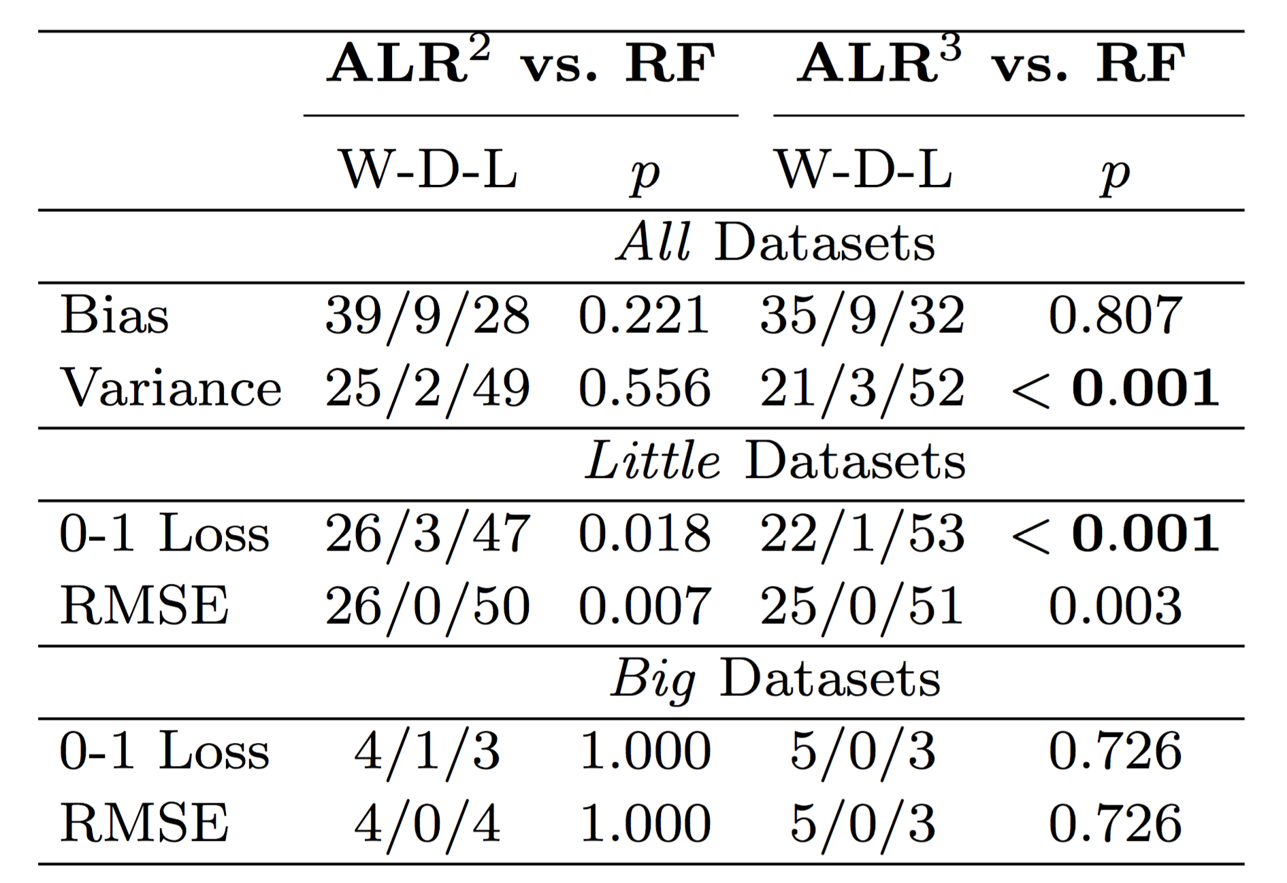
ALR^{n} vs RF100
Win Draw Loss Comparison

Slide 29
Conclusion
For big datasets, we need low-bias classifiers
We can reduce the bias of LR significantly by incorporating higher-order interactions in the model
This translates to much better accuracy for big datasets
Similar to LR, one can speed-up LR^{n} by pre-conditioning with the generative estimates
This leads to faster training time and desirable convergence profile
Many directions for future research:
  Scaling to higher n
  Hierarchical ALR^{n} that incorporates lower-level parameters, this is desirable in cases when certain interactions only appear at the testing time

