Slide 1


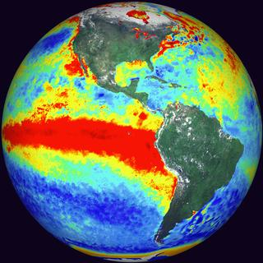
To infinity
and
Beyond
El Niño
Dietmar Dommenget

Slide 2
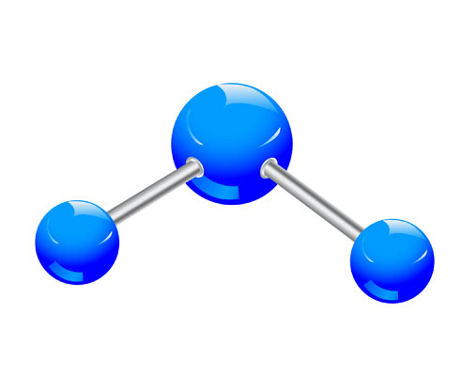
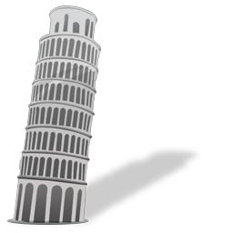
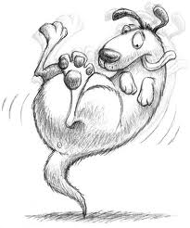
overview
introduction
Connections
Skewness
Slab El Nino

Slide 3
overview
introduction
Connections
Skewness
Slab El Nino

Slide 4
The Team
Tobias Bayr
Claudia Frauen
Sabine Haase
Malte Jansen
Noel Keenlyside
Mojib Latif
Vladimir Semenov

Slide 5
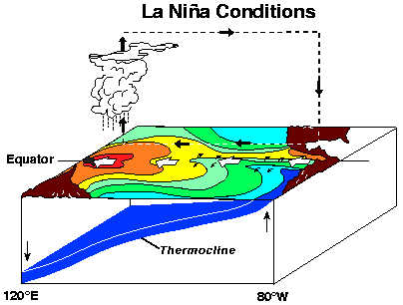
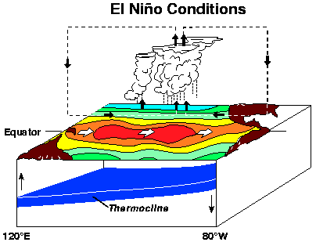
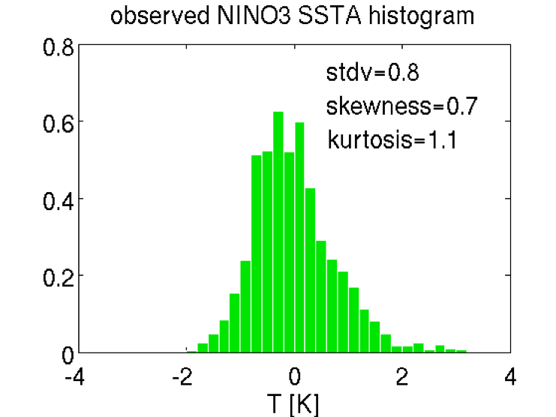
The ‘classical’ El Niño

Slide 6
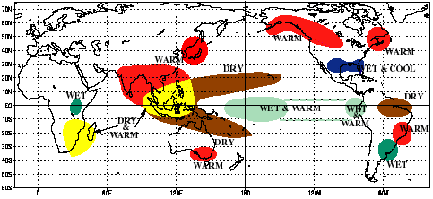
The ‘classical’ El Niño
Teleconnections

Slide 7
ENSO model hierarchy
Coupled GCMs
Atmos. complexity
Cane & Zebiak [1987]
Statistical atmosphere
T
Barnett et al. [1993]
h
Jin [1997]
Ocean complexity

Slide 8
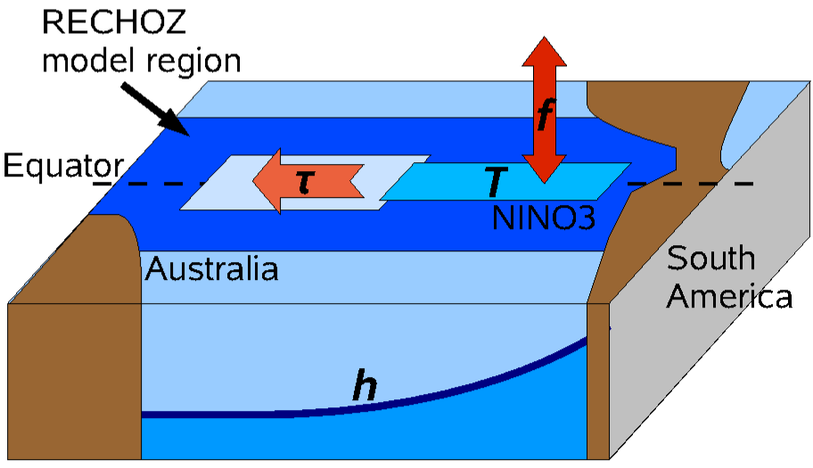
ENSO Recharge Oscillator
[Jin 1997]

Slide 9
ENSO model hierarchy
Coupled GCMs
Atmos. complexity
Cane & Zebiak [1987]
Statistical atmosphere
T
Barnett et al. [1993]
h
Jin [1997]
Ocean complexity

Slide 10
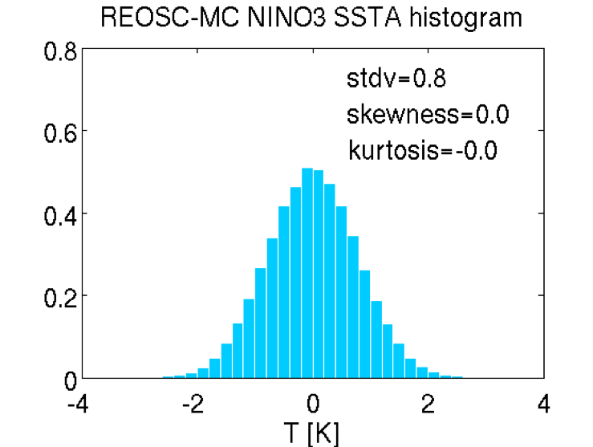
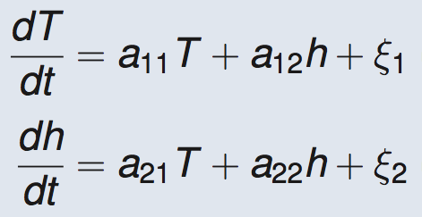
ENSO linear Recharge Oscillator
[Jin 1997]

Slide 11
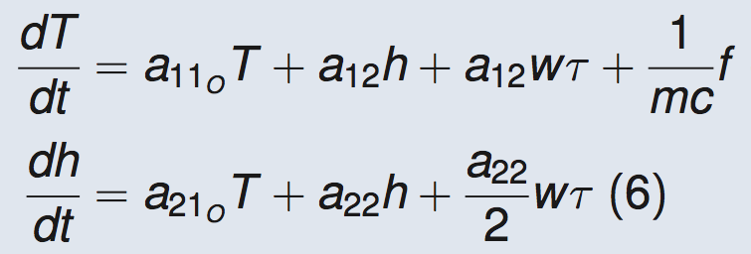
ECHAM5 - Recharge Oscillator
Low-resolution (T31)
Fixed pattern
Mixed layer model outside tropical Pacific

Slide 12
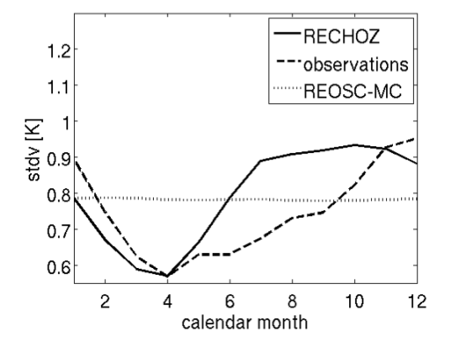
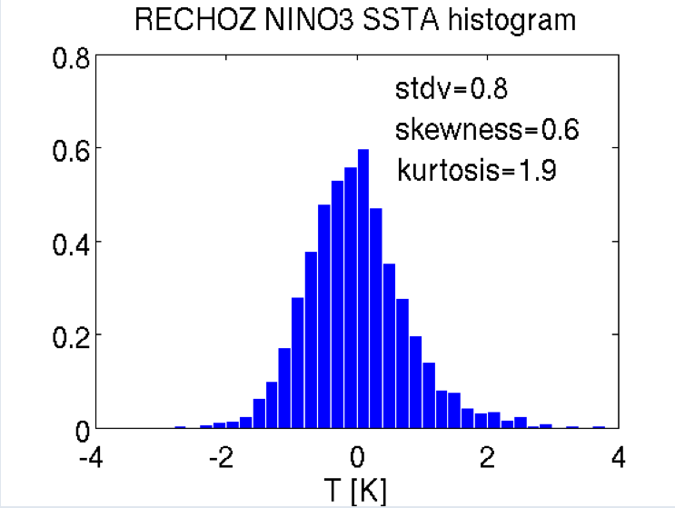
ECHAM5 - Recharge Oscillator
Seasonal cycle of STDV
PDF of NINO3 SST

Slide 13
ENSO model hierarchy
Coupled GCMs
Frauen & Dommenget
[2010]
Atmos. complexity
Cane & Zebiak [1987]
Statistical atmosphere
T
Barnett et al. [1993]
h
Jin [1997]
Ocean complexity

Slide 14
overview
introduction
Connections
Skewness
Slab El Nino

Slide 15
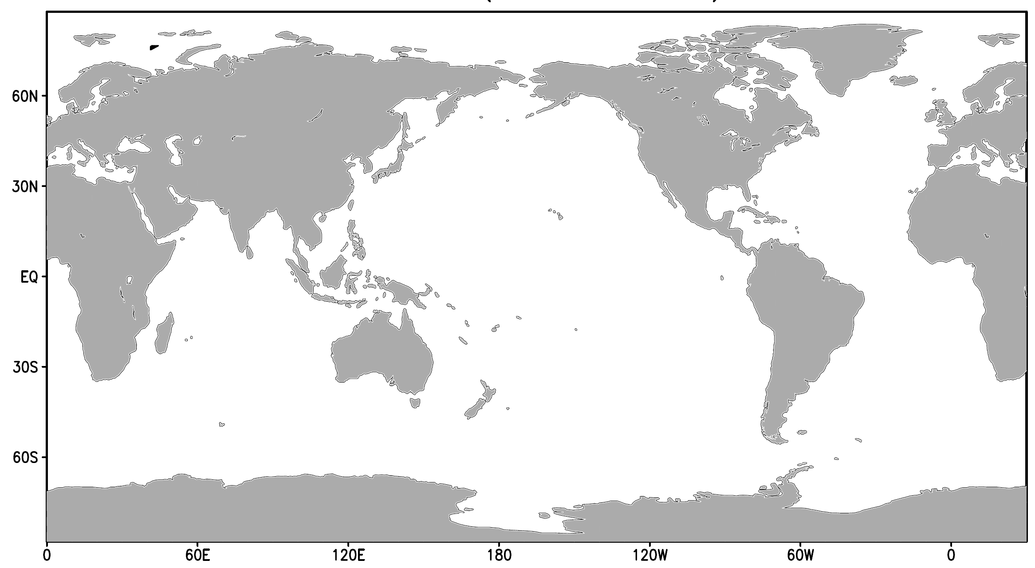
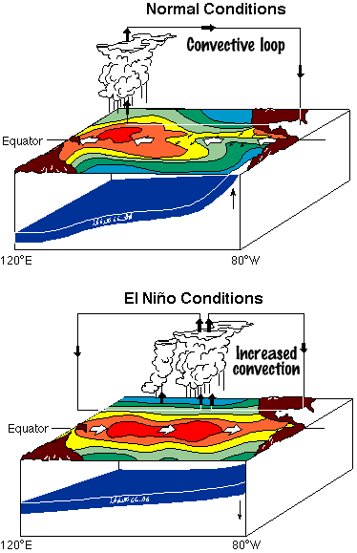
Tropical Ocean Interactions
Does the Atlantic and Indian Ocean feedback onto ENSO?
?
?

Slide 16
Observed Tropical Ocean Interactions
T
h

Slide 17





T
Observed Tropical Ocean Interactions
h
-
-
+
+

Slide 18
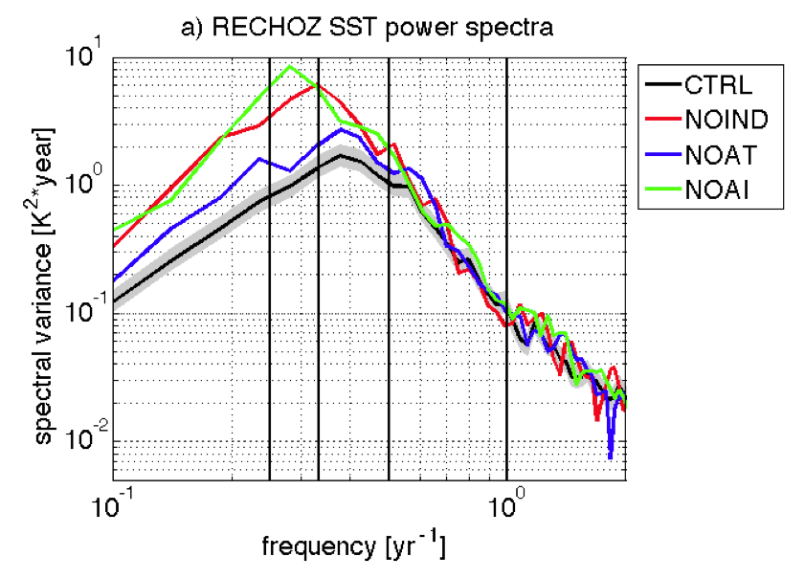
ECHAM5 Tropical Ocean Interactions
500yrs long model simulations

Slide 19
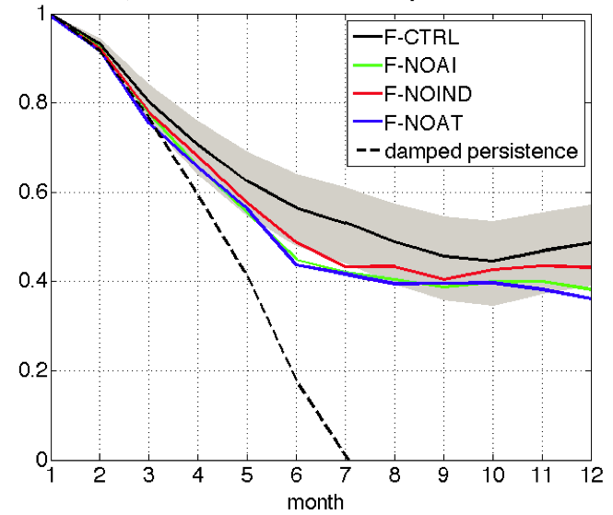
ECHAM5 Tropical Ocean Interactions
200 perfect model forecast ensembles
NINO3 SST anomaly correlation skill

Slide 20
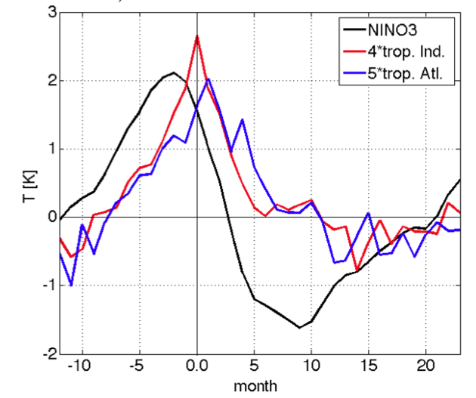
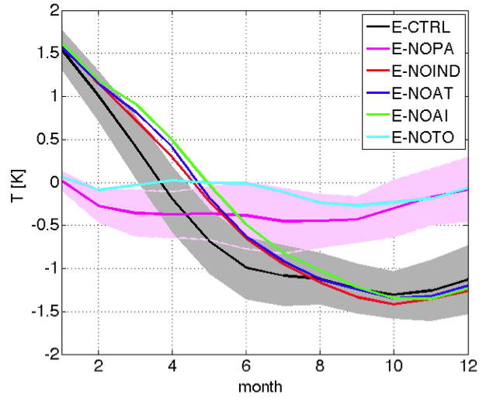
ECHAM5 Tropical Ocean Interactions
8 selected events model forecast ensembles
Control mean SST evolution
Forecast ensemble mean SST

Slide 21
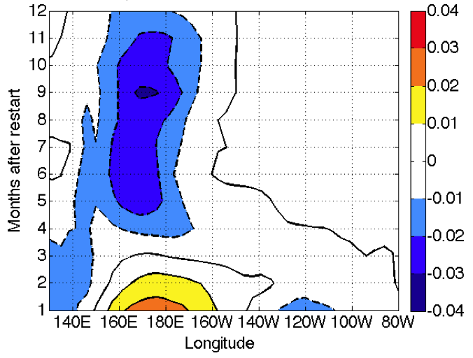
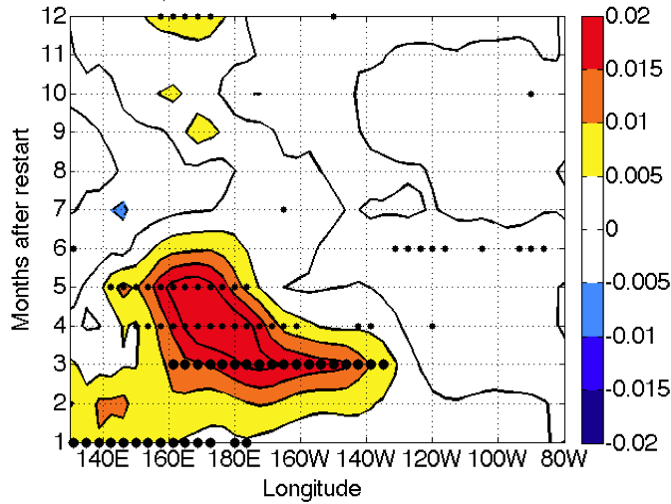
ECHAM5 Tropical Ocean Interactions
8 selected events model forecast ensembles
Control mean zonal wind evolution
Difference: NOAI - control

Slide 22
overview
introduction
Connections
Skewness
Slab El Nino

Slide 23
El Niño Skewness

Slide 24
ECHAM5 -recharge oscillator

Slide 25
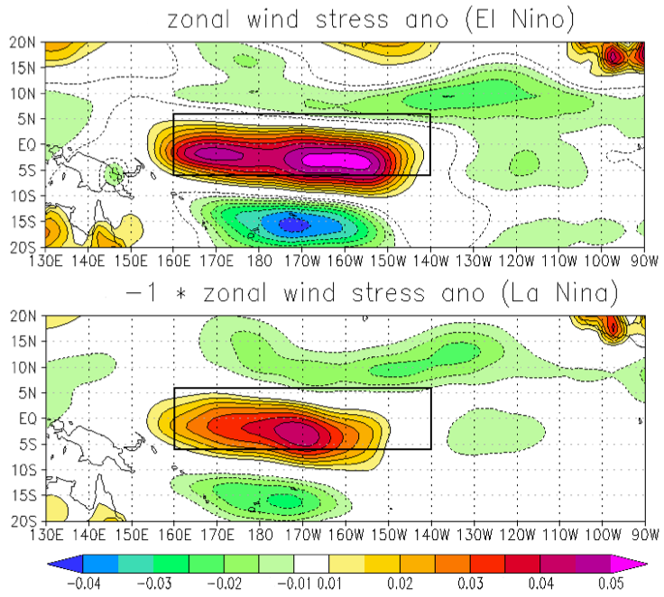
Non-linear zonal wind response

Slide 26
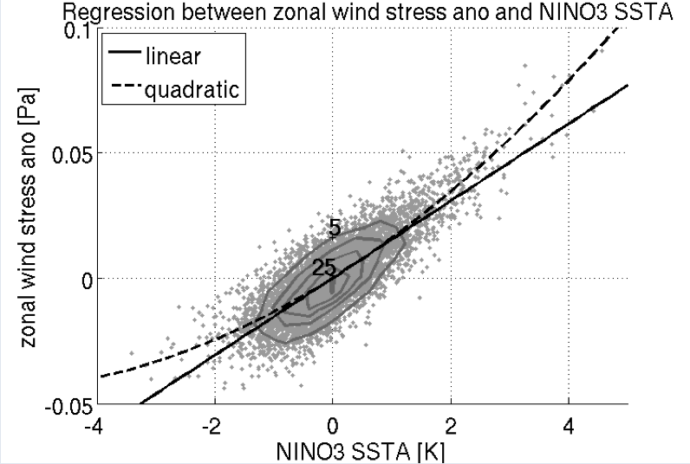
Non-linear SST-zonal wind stress coupling

Slide 27
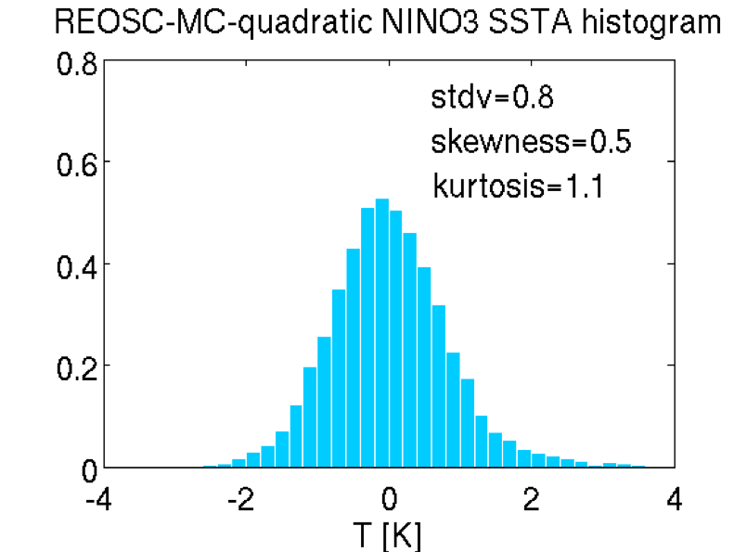
Non-linear recharge-oscillator model
T
h

Slide 28
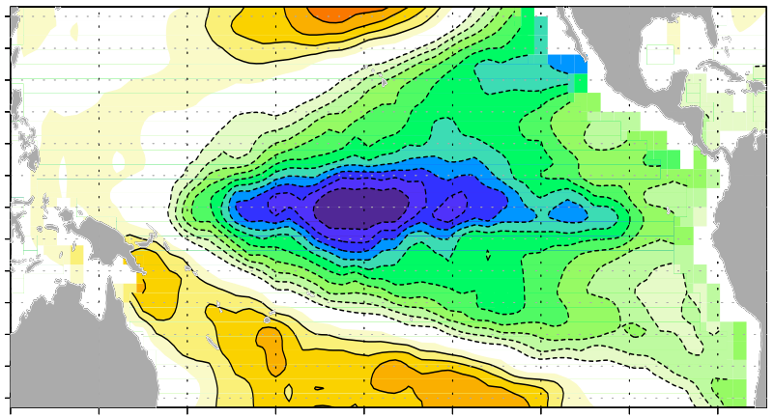
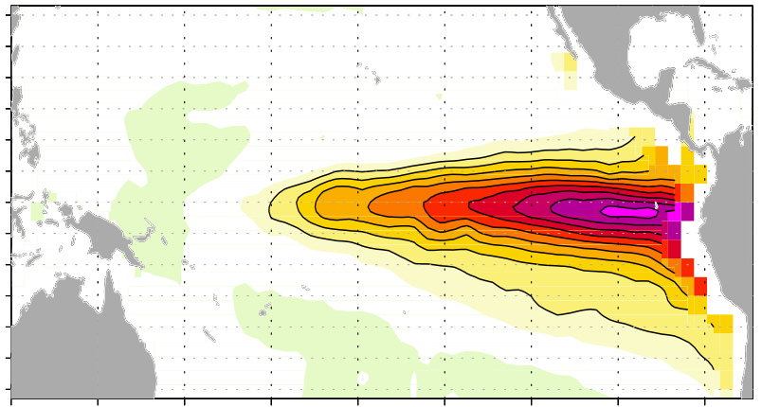
Non-linear Pattern and Time Evolution
La Niña
El Niño

Slide 29
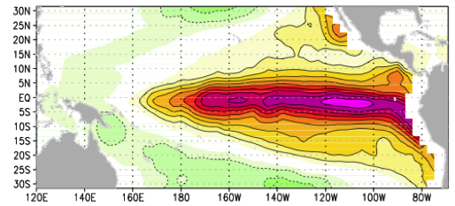
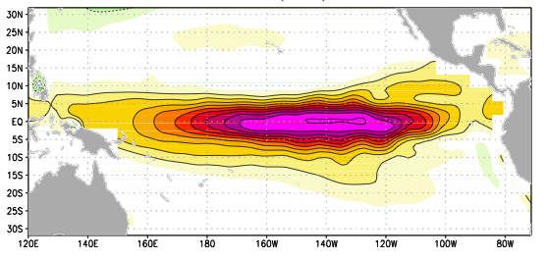
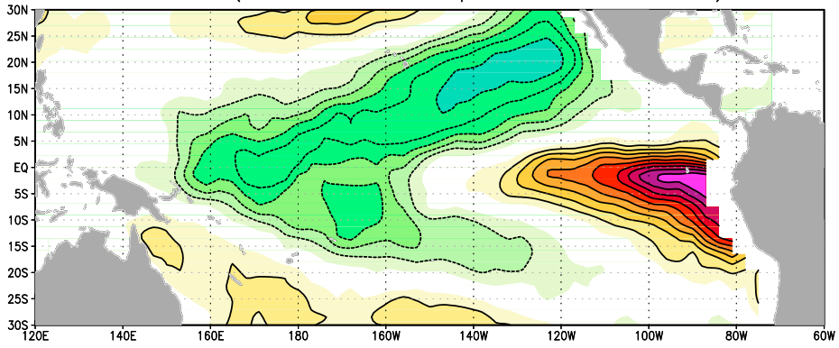
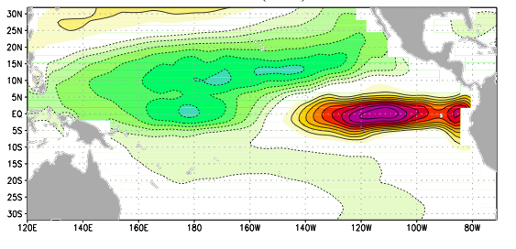
Motivation
El Nino Modoki
Slab Ocean Model
EOF-1 (44%)
EOF-1 (36%)
EOF-2 (10%)
EOF-2 (14%)
[Ashok et al. 2007]
“As the variances explained by the first two EOF patterns are well separated … , it is reasonable to expect that these two patterns represent different modes of climate variability.”
What is the meaning of EOF-2?

Slide 30
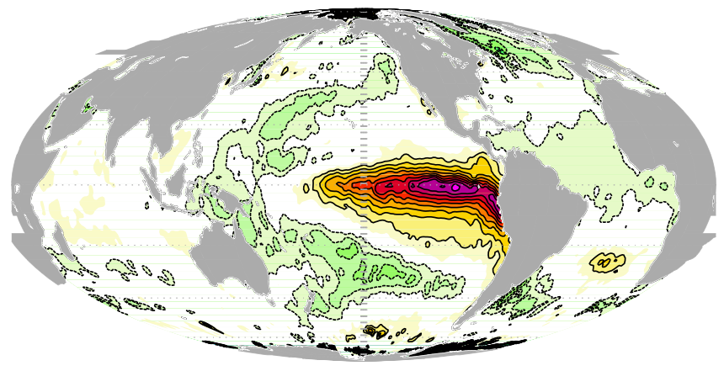
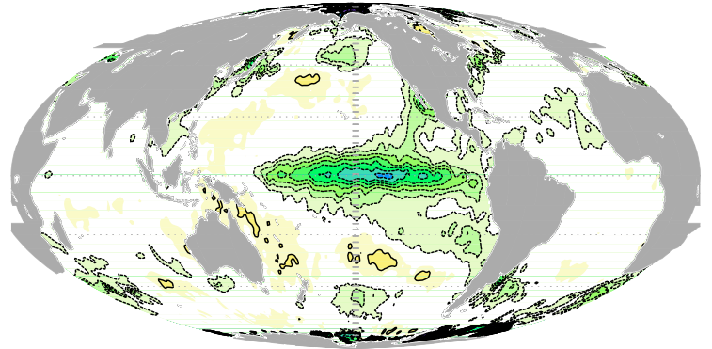
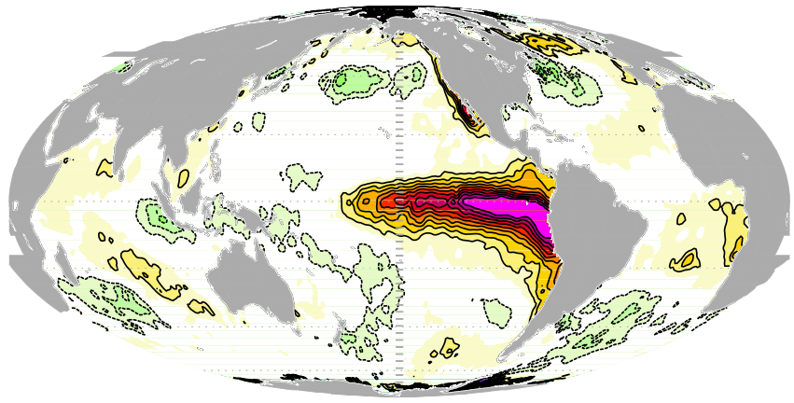
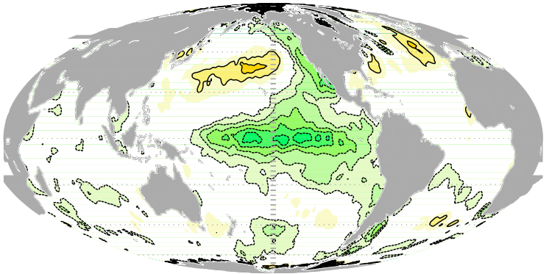
Motivation
ENSO pattern non-linearity
El Ninos
La Ninas

Slide 31
Motivation
Non-linear wind response
El Nino Modoki
Pattern
non-linearity

Slide 32
Non-linear Pattern and Time Evolution
Observed Pattern Non-Linearity

Slide 33
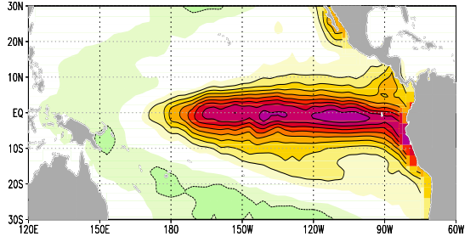
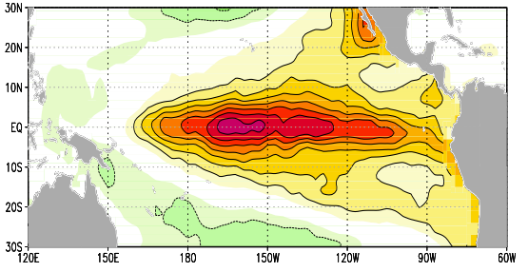
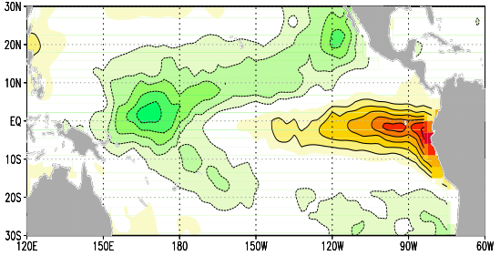
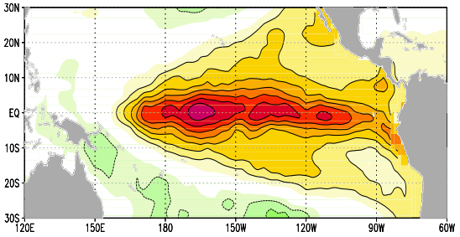
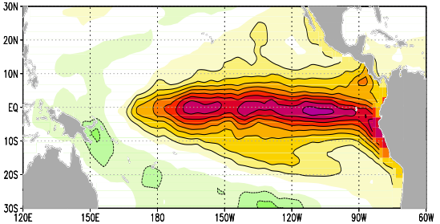
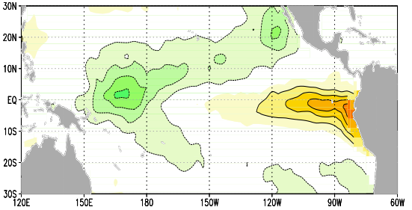
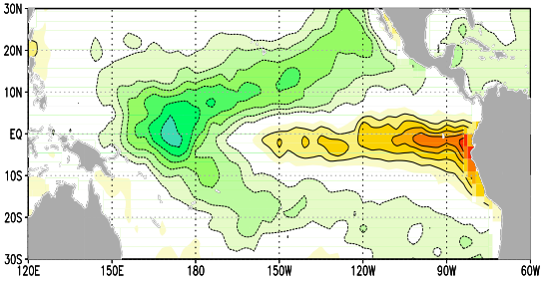
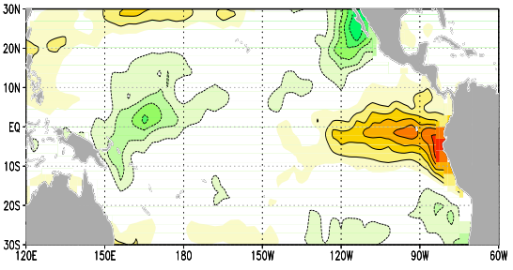
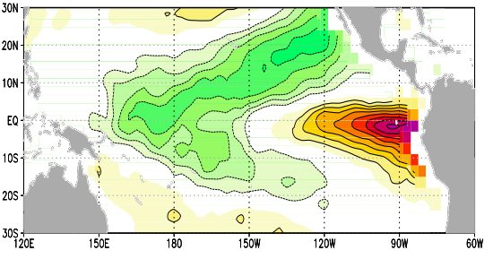
Observed Non-Linearity in the Pattern
Strong El Niño
Strong La Niña
Diff. Strong
Weak El Niño
Weak La Niña
Diff. Weak
[K/K]
Diff. El Niño
Diff. La Niña
EOF-2
Composites are normalized by the mean NINO3.4 SST

Slide 34
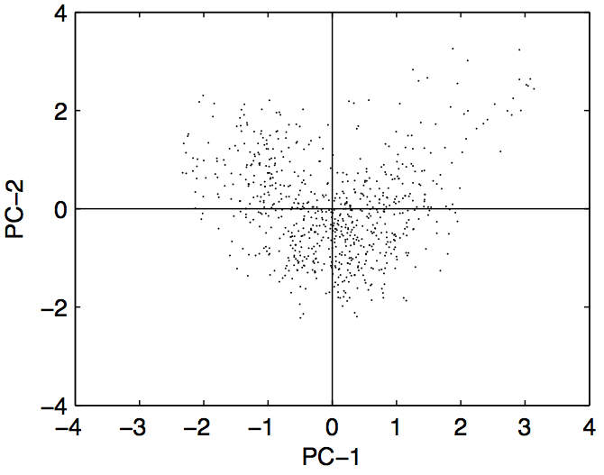
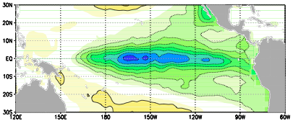
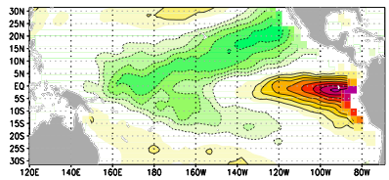
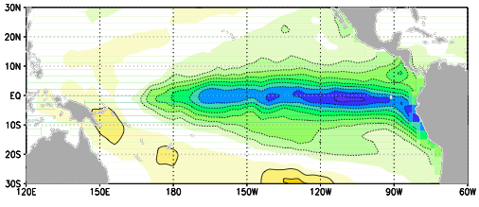
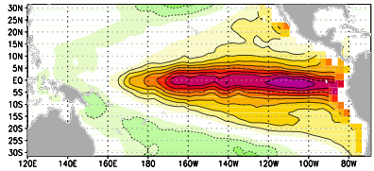
Observed Non-Linearity in EOFs
Strong La Niña
Strong El Niño
PC-2
Weak La Niña
Weak El Niño

Slide 35
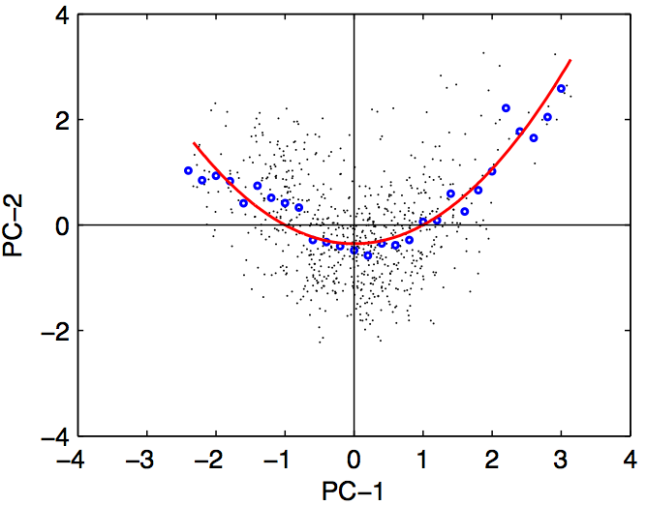

Observed Non-Linearity in EOFs
Strong La Niña
Strong El Niño
PC-2
Weak La Niña
Weak El Niño

Slide 36

Observed Non-Linearity in EOFs
PC-2

Slide 37
Observed Non-Linearity in EOFs

Slide 38




Observed Non-Linearity in EOFs
El Niño
Skewness = 1.3
Kurtosis = 2.7
(-) La Niña
Skewness = -0.6
Kurtosis = -0.2

Slide 39
Non-linear Pattern and Time Evolution
Observed Non-Linearity in
Bjerknes feedbacks & time evolution

Slide 40


Observed Non-Linearity in the time evolution
Strong El Niño
Strong La Niña
difference
[K/K]
Composites are normalized by the mean NINO3.4 SST at lag 0

Slide 41




Observed Bjerknes feedbacks
Strong El Niño
Strong La Niña
difference
Zonal wind vs. SST
Thermocline depth vs. zonal wind

Slide 42
CMIP3 models (CGCMs)
Coupled GCMs

Slide 43

Selecting ‘good’ CGCMs
difference
difference

Slide 44








CGCMs Non-Linearity in the Pattern
Strong El Niño
Strong La Niña
Diff. Strong
Weak El Niño
Weak La Niña
Diff. Weak
Diff. El Niño
Diff. La Niña
EOF-2
Composites are normalized by the mean NINO3.4 SST

Slide 45






CGCMs Non-Linearity in EOFs
El Niño
(-) La Niña

Slide 46


CGCMs Non-Linearity in the time evolution
Strong El Niño
Strong La Niña
difference

Slide 47




CGCMs Bjerknes feedbacks
Strong El Niño
Strong La Niña
difference
Zonal wind vs. SST
Thermocline depth vs. zonal wind

Slide 48
Hybrid coupled model (RECHOZ)
Frauen & Dommenget [2010]
Linear low-order ocean
Fix SST pattern
Non-linear complex atmosphere
Zonal wind causes non-linearity

Slide 49



RECHOZ Bjerknes feedbacks
Strong El Niño
Strong La Niña
difference
Zonal wind vs. SST
Thermocline depth vs. zonal wind

Slide 50



Recharge Oscillator
T
h
Wind response
Thermocline depth evolution
dashed: linear
solid: non-linear

Slide 51

RECHOZ model forecasts
100 perfect model forecast
Anomaly correlation skill
Jan.
Dec.

Slide 52
overview
introduction
Connections
Skewness
Slab El Nino

Slide 53
The Slab Ocean El Niño
Can El Niño exist without ocean dynamics?
The tail wags the dog

Slide 54
Slab Ocean Dynamics
Atmosphere GCM
Slab ocean
Complete Slab ocean model
Ocean points do not interact
No thermocline dynamics
All spatial coherence comes from the atmosphere

Slide 55
ENSO model hierarchy
Coupled GCMs
Dommenget [2011]
Frauen & Dommenget
[2010]
Atmos. complexity
Cane & Zebiak [1987]
Statistical atmosphere
T
Barnett et al. [1993]
h
Jin [1997]
Ocean complexity

Slide 56

The Slab Ocean El Niño

Slide 57

The Slab Ocean El Niño
SST standard deviation
20 slab ocean models
4 slab ocean models

Slide 58

The Slab Ocean El Niño

Slide 59
The Slab Ocean El Niño
Evolution of the Slab El Nino event
It looks like the SST-mode forced by the atmosphere [e.g. Neelin et al. 1998]

Slide 60

The Slab Ocean El Niño
Cross-correlation
SST
dSST/dt
Net heat
LW
latent
SW
sensible
lead / lag time

Slide 61
The Slab Ocean El Niño Dynamics
Decay phase
Mature phase
Neutral mean state
Initial phase

Slide 62


SST mean state dependence
Mean SST climate
4 slab ocean models
20 slab ocean models

Slide 63
The Slab Ocean El Niño Inertia
NINO3 SST Spectra

Slide 64


Coupled GCM models
Have the Slab El Nino dynamics any relevance for coupled GCMs?
Observed (NCEP)
Slab ocean
SST
dSST/dt
Net heat
SW
sensible
CMIP3 CNRM-CM3
lead / lag time

Slide 65


Cloud feedbacks
Have the Slab El Nino dynamics any relevance for coupled GCMs?

Slide 66
Conclusions

Slide 67
Conlusions: Interactions
The tropical Atlantic and Indian Ocean feedback onto ENSO
The tropical Atlantic impacts the ENSO predictions
-
-

Slide 68


Conclusions: El Niño Skewness
El Niño skewness is caused by a non-linear wind response to SST
This does not exclude a possible contribution of ocean processes
There is some El Niño vs. La Niña pattern non-linearity

Slide 69
Conclusions: Slab Ocean El Niño
El Niño can exist without ocean dynamics in a CGCM
It is NOT a ECHAM model artifact. It exist in many GCMs
It looks like the SST-mode [ e.g. Neelin et al. 1998]
It indicates important positive atmospheric feedbacks
4 slab ocean models

Slide 70
Thank you!
Dietmar Dommenget

