Slide 1
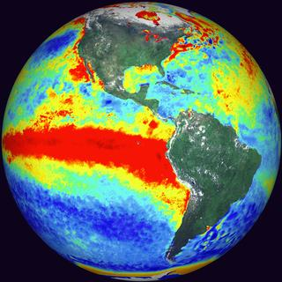
To infinity
and
Beyond
El Niño
Dietmar Dommenget

Slide 2
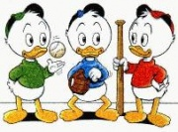
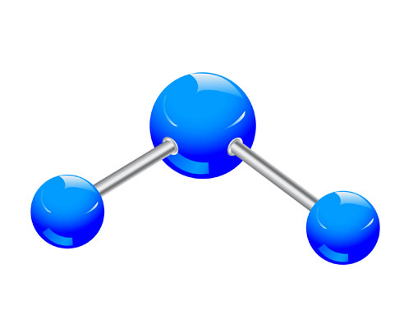
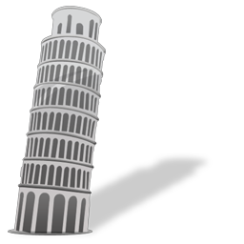
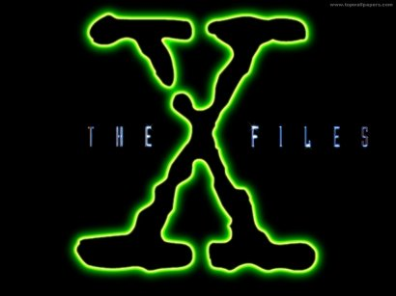
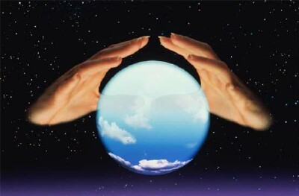
overview
introduction
Triplets
Connections
Skewness
X-files
Future

Slide 3
overview
introduction
Triplets
Connections
Skewness
X-files
Future

Slide 4
The Team
Tobias Bayr
Claudia Frauen
Malte Jansen
Noel Keenlyside
Mojib Latif
Vladimir Semenov

Slide 5
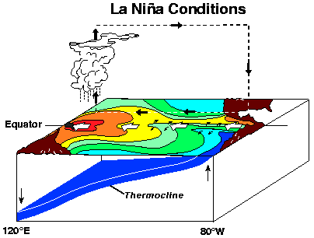
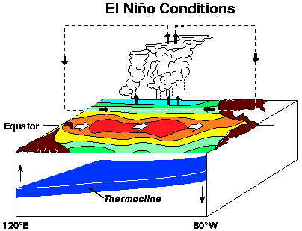
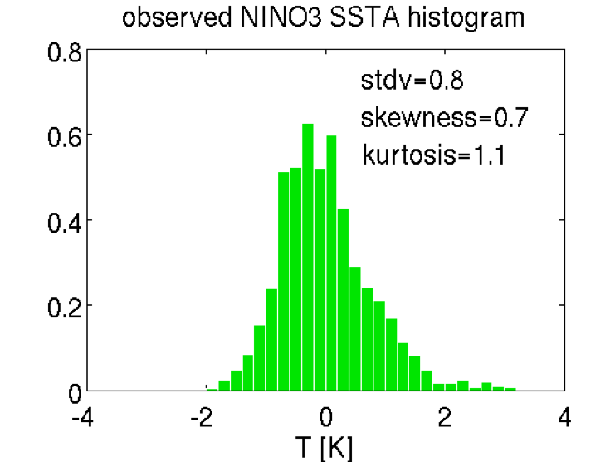
The Classical El Niño

Slide 6
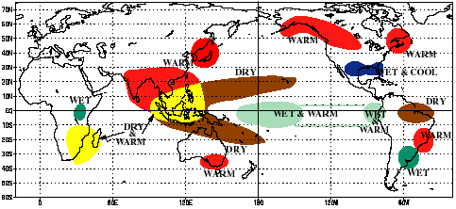
The Classical El Niño
Teleconnections

Slide 7
overview
introduction
Triplets
Connections
Skewness
X-files
Future

Slide 8
Triplets
Does a recharge oscillator exist in
the Atlantic and Indian Ocean as well?
?
?

Slide 9
Triplets
Does Dewey has two twin brothers?
Huey
Dewey
Louie

Slide 10
Background
Mean SST
[ºC]

Slide 11
Background
Stdv SST
[ºC]

Slide 12
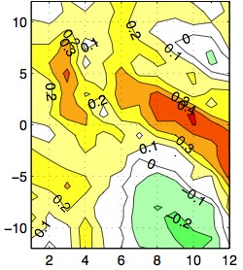
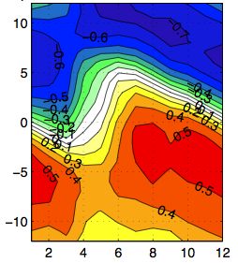
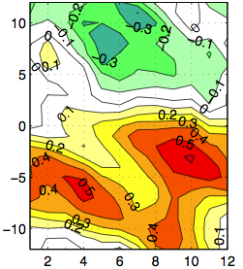
Background
Heat content vs. SST
Cross Correlation
Lead time SST [mon]
Calendar month

Slide 13
Recharge oscillator eigenvalues
Imaginary part
(eigenfrequency)
Real part
(grows rate)

Slide 14
Recharge oscillator eigenvalues
damped
amplified

Slide 15
overview
introduction
Triplets
Connections
Skewness
X-files
Future

Slide 16
Tropical Ocean Interactions
Does the Atlantic and Indian Ocean feedback onto ENSO?
?
?

Slide 17
Tropical Ocean Interactions

Slide 18
Tropical Ocean Interactions
-
-
+
Cross correlation
+
NINO3 SST lead month
NINO3 SST lead month
NINO3 SST lead month

Slide 19
overview
introduction
Triplets
Connections
Skewness
X-files
Future

Slide 20
El Niño Skewness

Slide 21
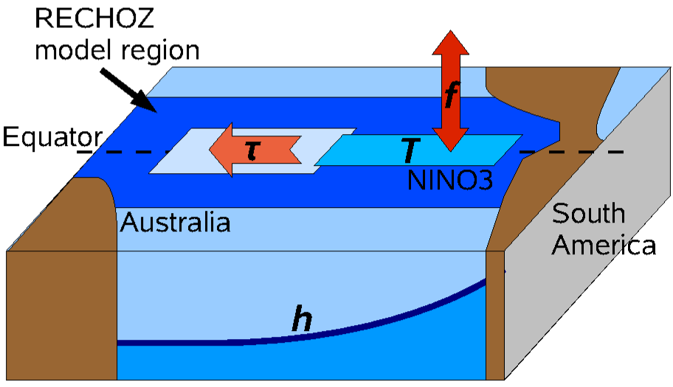
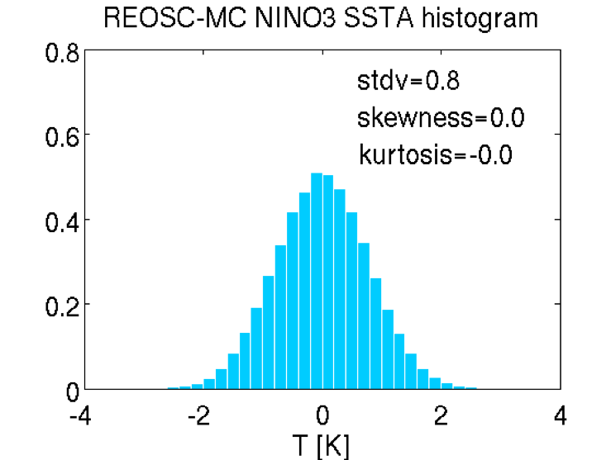
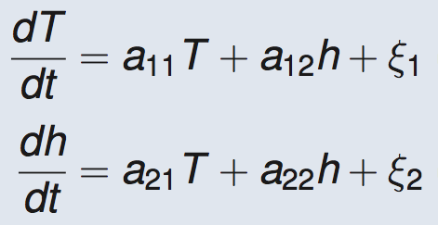
ENSO linear recharge oscillator
[Jin 1997]

Slide 22
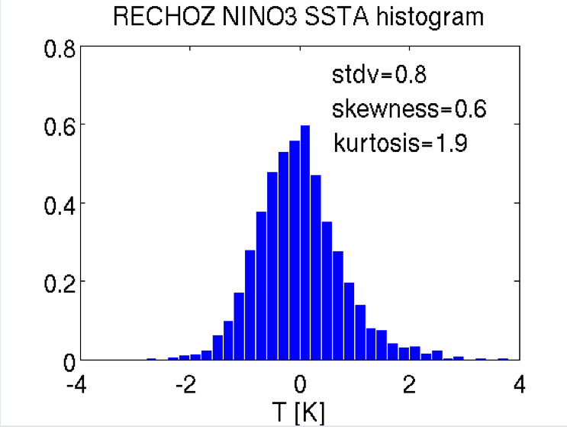
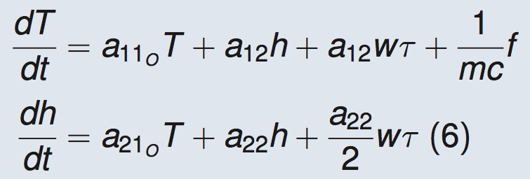
ECHAM5 -recharge oscillator

Slide 23
ECHAM5 -recharge oscillator

Slide 24
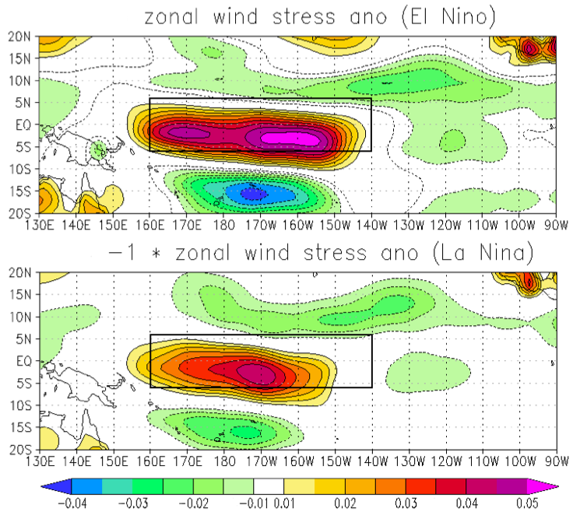
Non-linear zonal wind response

Slide 25
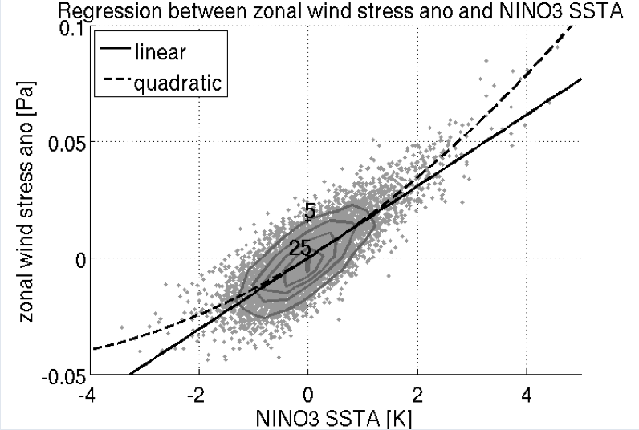
Non-linear SST-zonal wind stress coupling

Slide 26
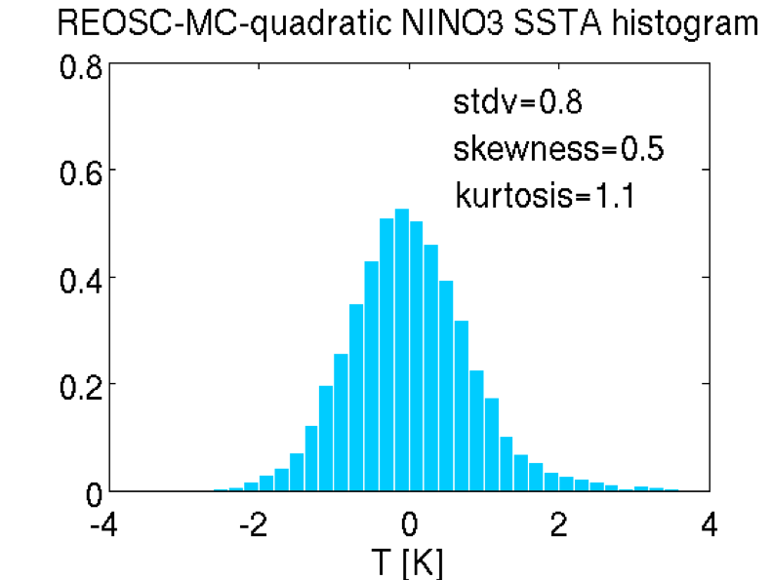
Non-linear recharge-oscillator model

Slide 27
overview
introduction
Triplets
Connections
Skewness
X-files
Future

Slide 28
The Slab Ocean El Niño

Slide 29
The Slab Ocean El Niño
SST standard deviation
20 slab ocean models
4 slab ocean models

Slide 30
The Slab Ocean El Niño

Slide 31
The Slab Ocean El Niño

Slide 32
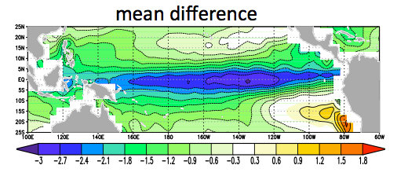
SST mean state dependence
Mean SST climate
4 slab ocean models
20 slab ocean models

Slide 33
overview
introduction
Triplets
Connections
Skewness
X-files
Future

Slide 34
El Niño under climate change
EL Niño is getting stronger?
EL Niño is becoming more frequent?
The mean SST is changing into a permanent EL Niño?
EL Niño is changing its pattern?

Slide 35
El Niño is getting stronger?
SST standard deviation IPCC CMIP3 database
20th century
21th century

Slide 36
El Niño is getting stronger?
20th century
21th century
Ratio: 21th /20th

Slide 37
El Niño is getting stronger?
GFDL
MIROC
Ratio: 21th /20th

Slide 38
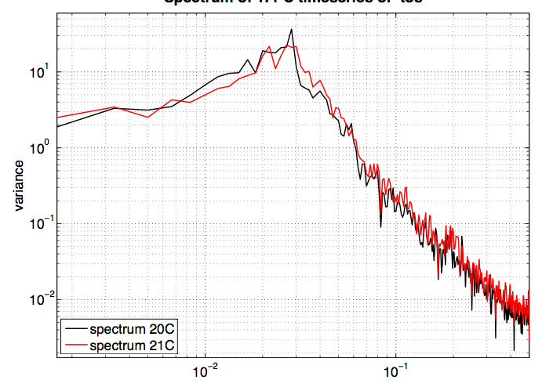
El Niño is becoming more frequent?
Spectra SST PC-1
Frequency [1/mon]

Slide 39
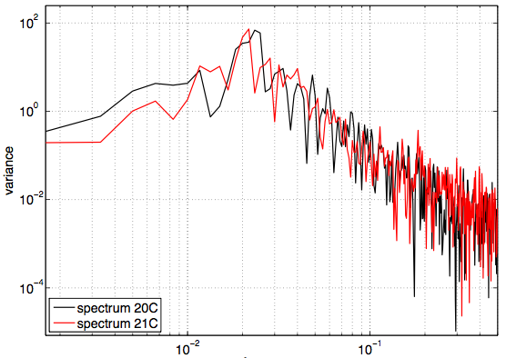
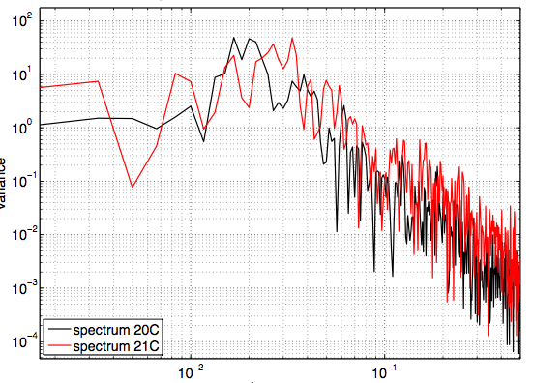
El Niño is becoming more frequent?
MPI
GFDL
Frequency [1/mon]
Frequency [1/mon]

Slide 40
Change into a permanent El Niño?
SST mean IPCC CMIP3 database
20th century
21th century

Slide 41
Change into a permanent El Niño?
Mean difference
GFDL
Hadcm3

Slide 42
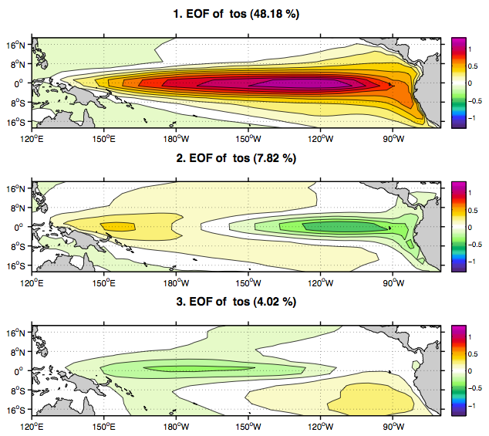
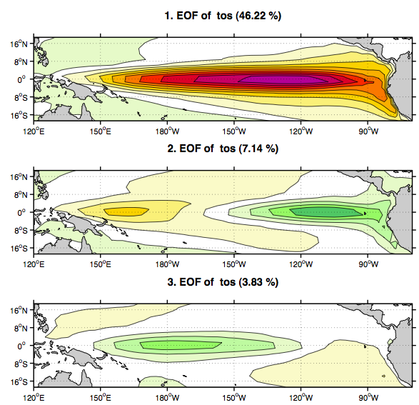
El Niño is changing its pattern?
20th century
21th century
EOF-1 (48%)
EOF-1 (46%)
EOF-2 (7.8%)
EOF-2 (7.1%)
EOF-3 (4.0%)
EOF-3 (3.8%)

Slide 43
Conclusions

Slide 44
Conclusions: Triplets
Does Dewey has two twin brothers?
Huey
Big Dewey
Little Louie
No Huey
Dewey
Louie

Slide 45
Conlusions: Interactions
The tropical Atlantic and Indian Ocean feedback onto ENSO
-
-

Slide 46
Conclusions: El Niño Skewness
El Niño skewness is caused by a non-linear atmospheric response to SST
This does not exclude a possible contribution of ocean processes

Slide 47
Conclusions: Slab Ocean El Niño
El Niño can exist without ocean dynamics
This could be a ECHAM model artifact (clouds, convection)
It could be Madden-Julian oscillation kind of dynamics
4 slab ocean models

Slide 48
Conclusions: El Niño changing?
Changes are weak and uncertain
Models largely disagree on how El Niño changes
Strongest changes does not project on El Niño
Mean difference

Slide 49
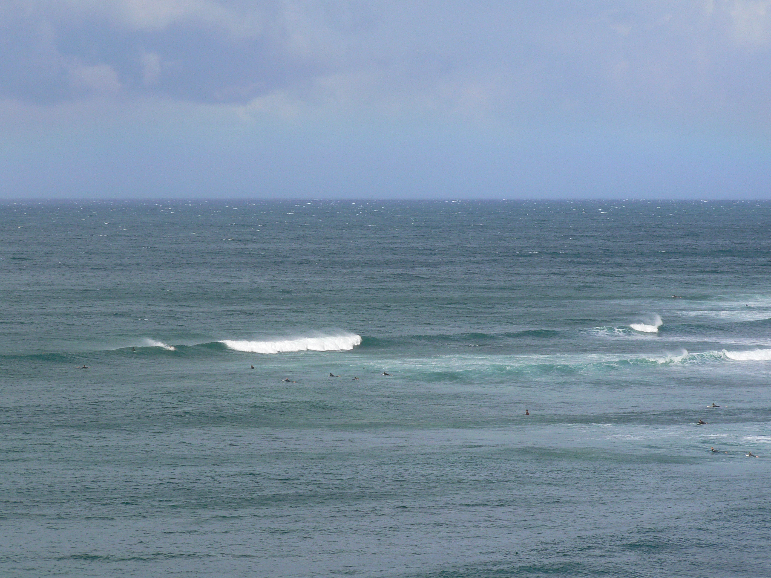
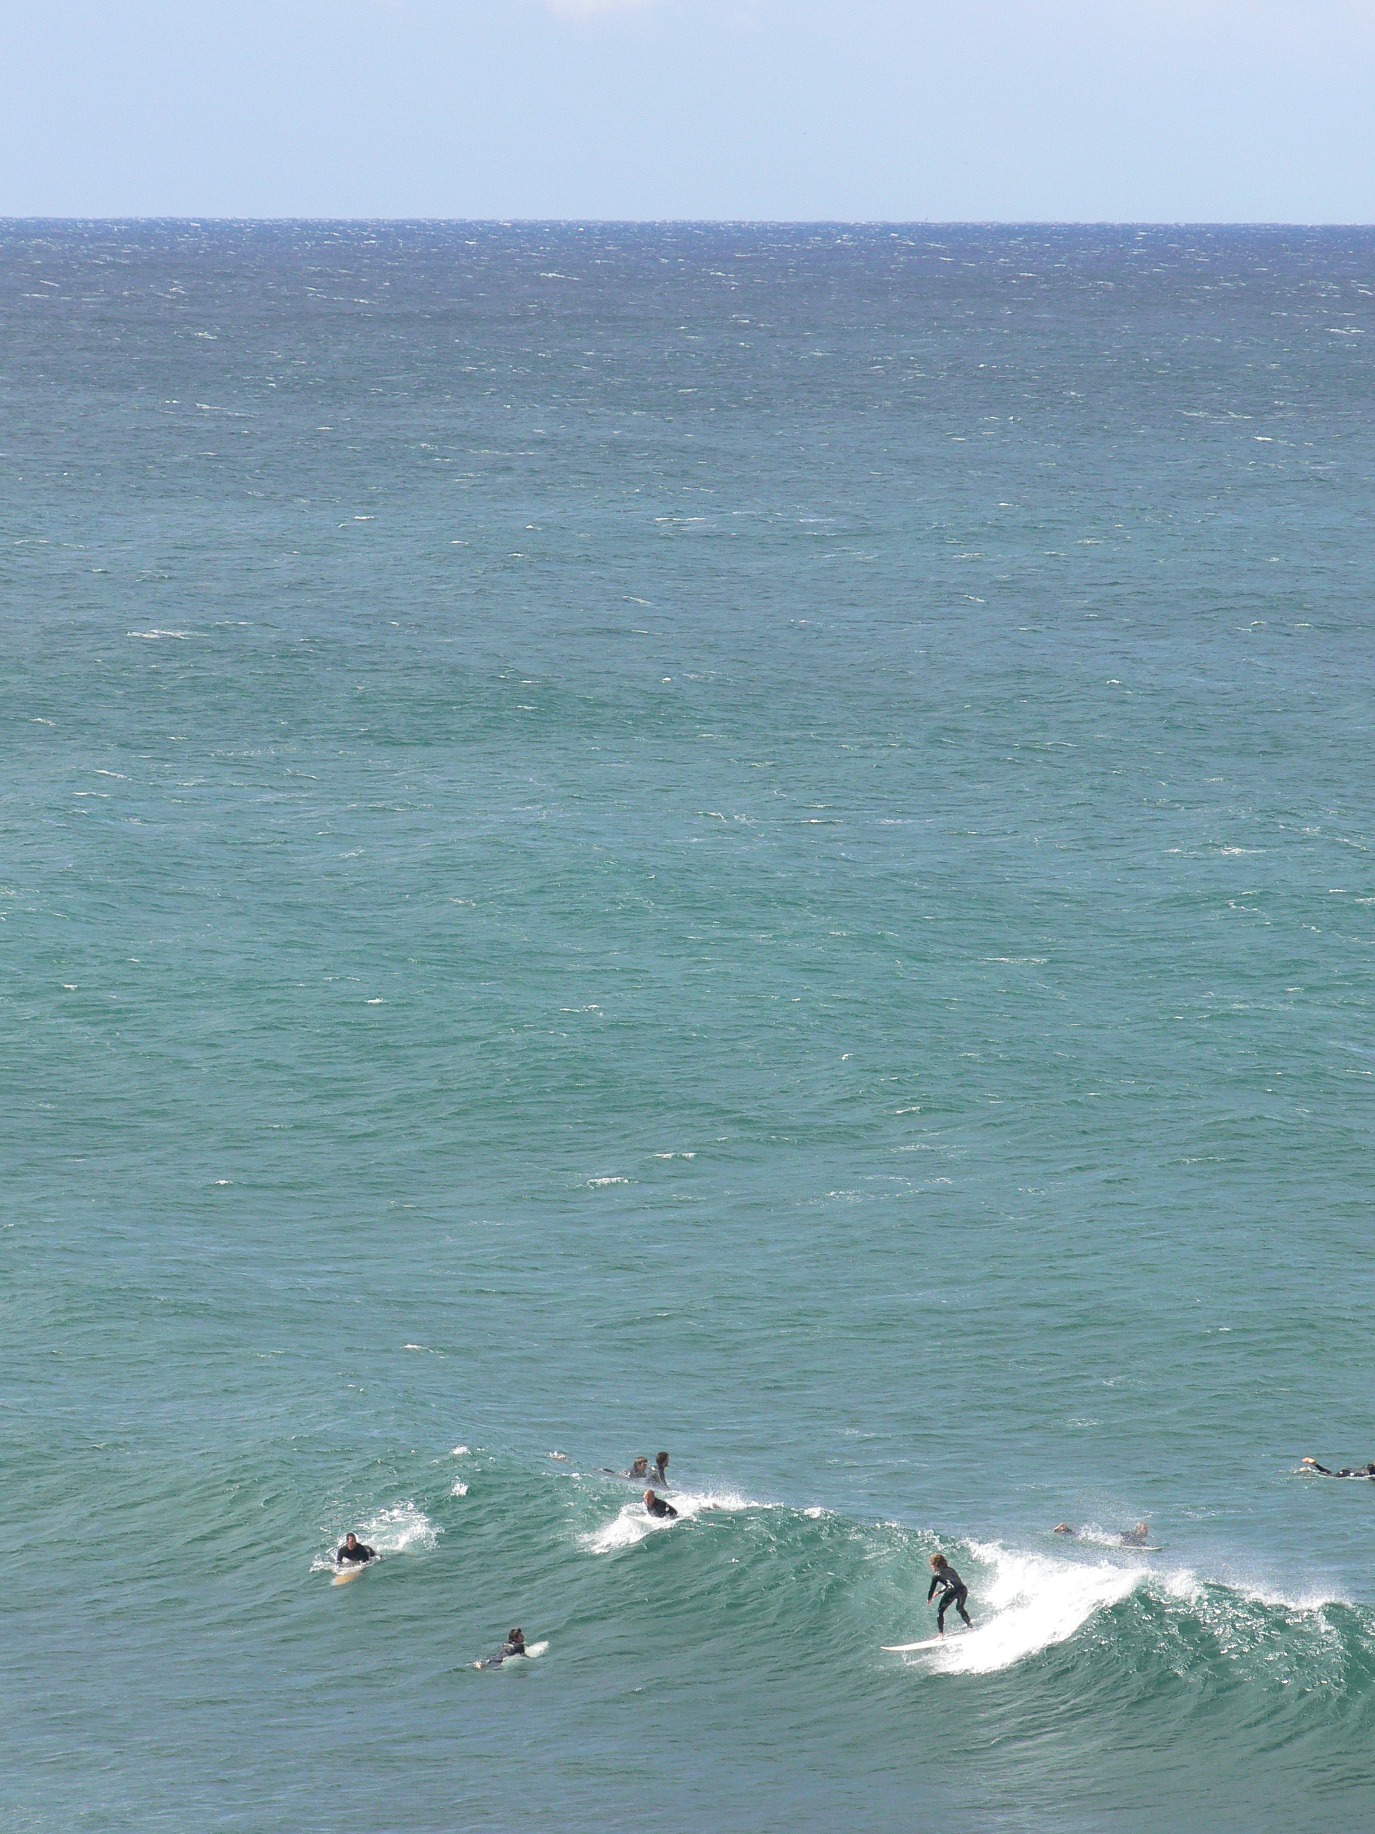
Thank you
Dietmar Dommenget

