Slide 1
Boundary Layer Clouds & Sea Spray
Steve Siems, Yi (Vivian) Huang, Luke Hande, Mike Manton & Thom Chubb

Slide 2
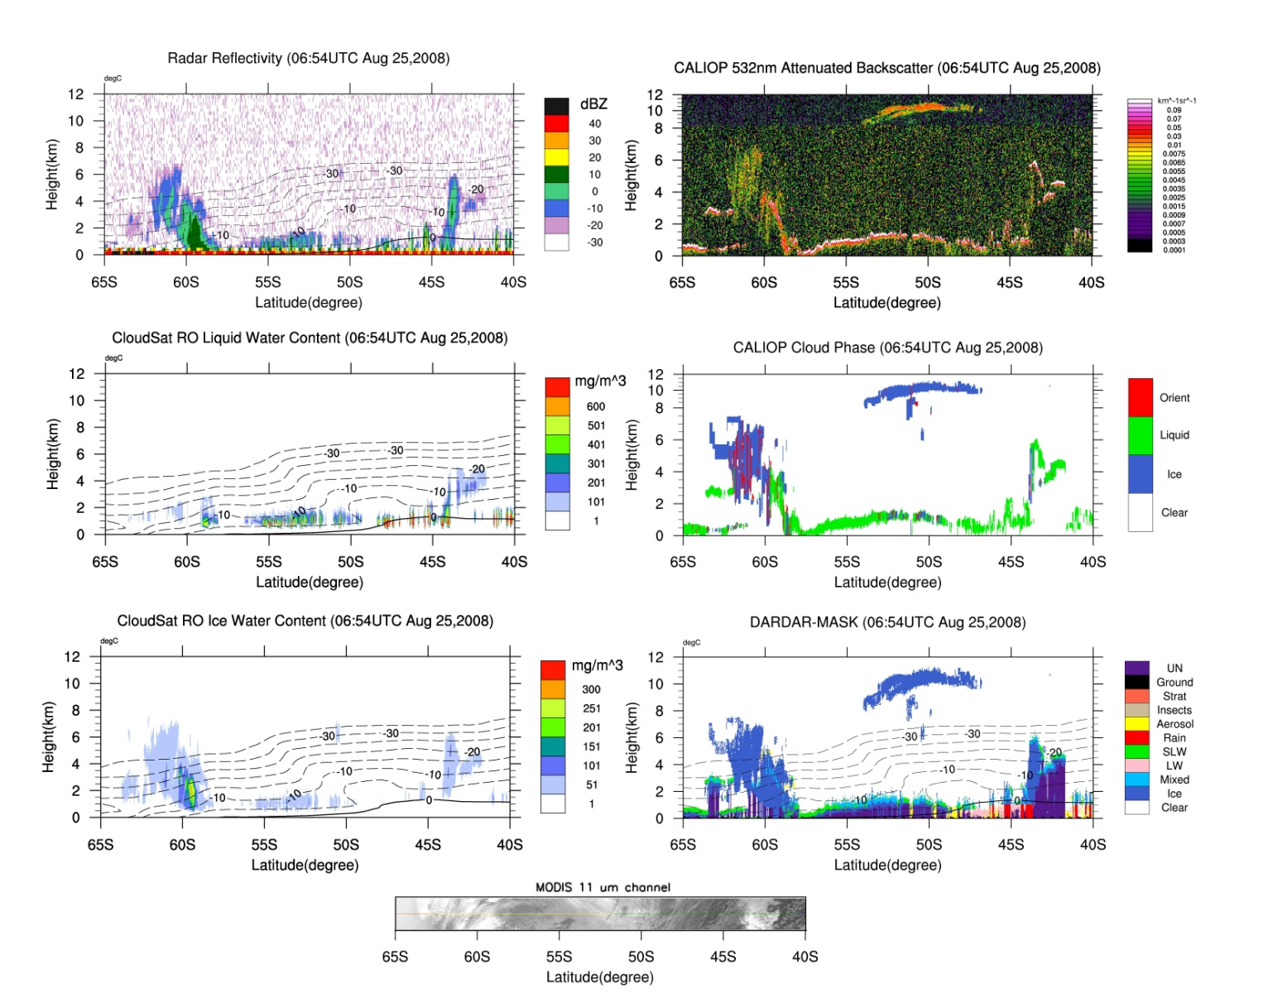

Slide 3
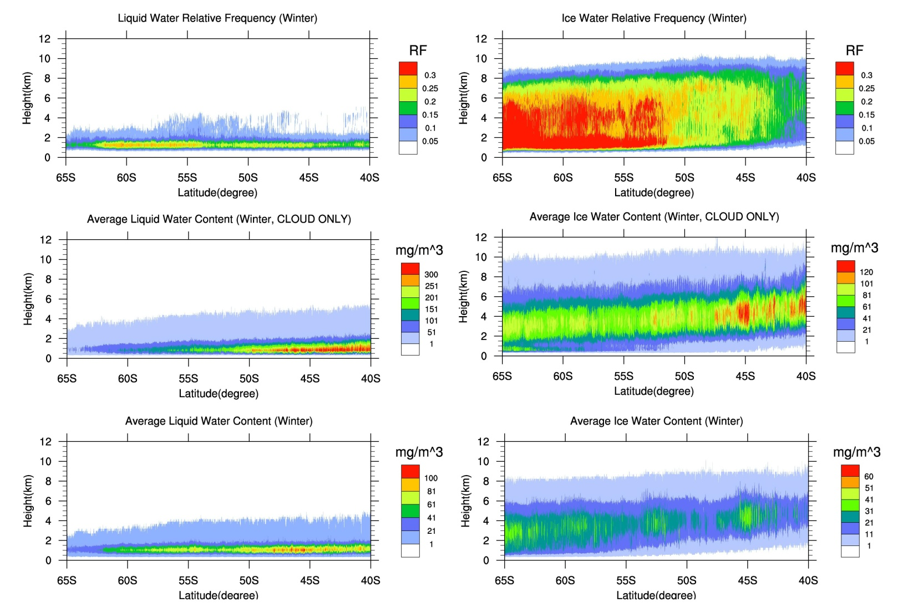
CloudSat climatology (2006-2009) of cloud liquid water and cloud ice. (Huang et al. 2012 J. Climate.)
Winter
(Huang et al. 2012)

Slide 4
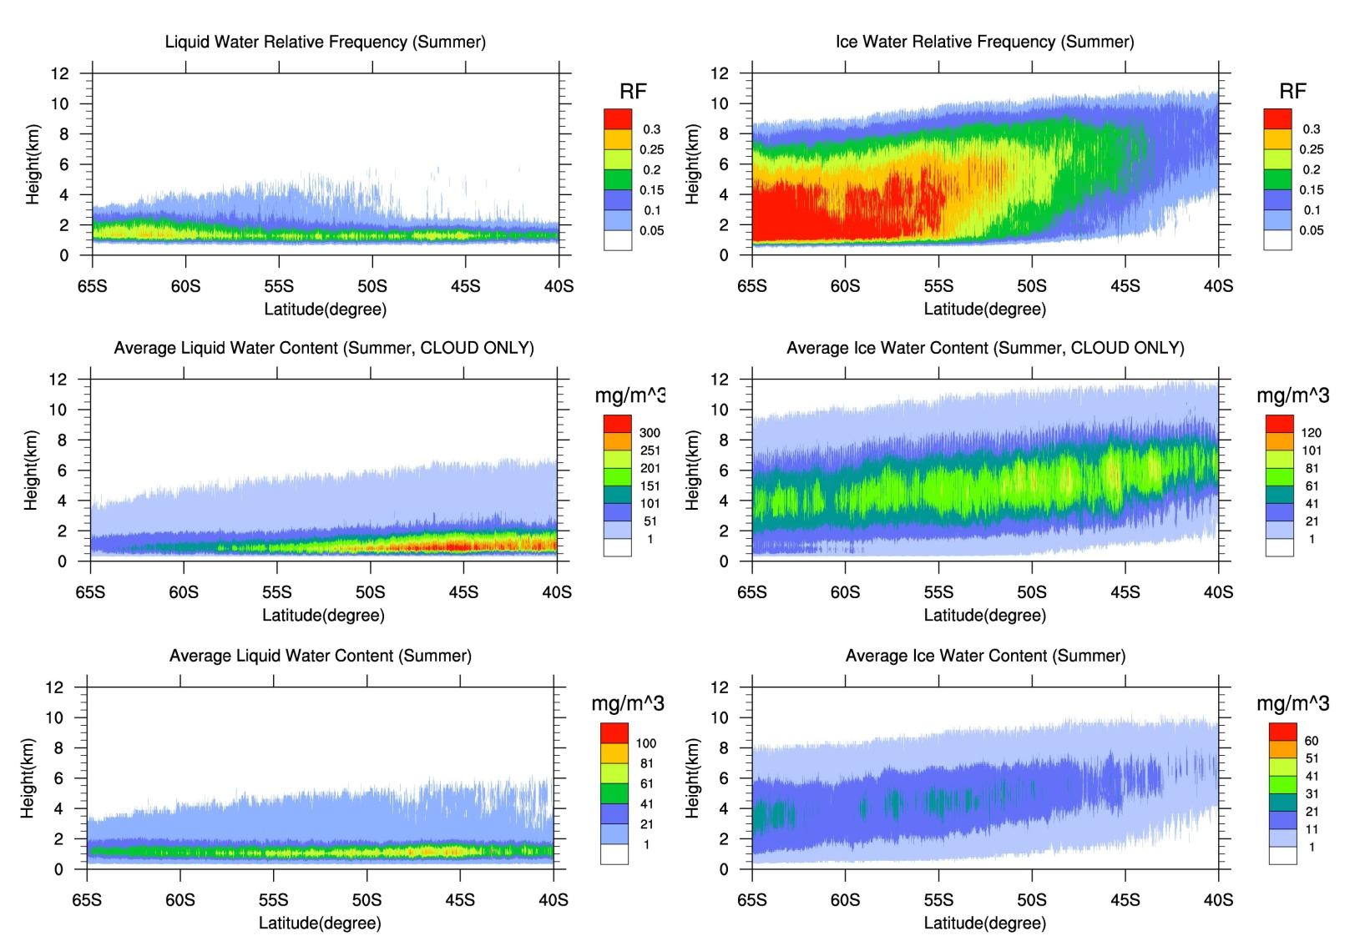
Summer
(Huang et al. 2012)

Slide 5
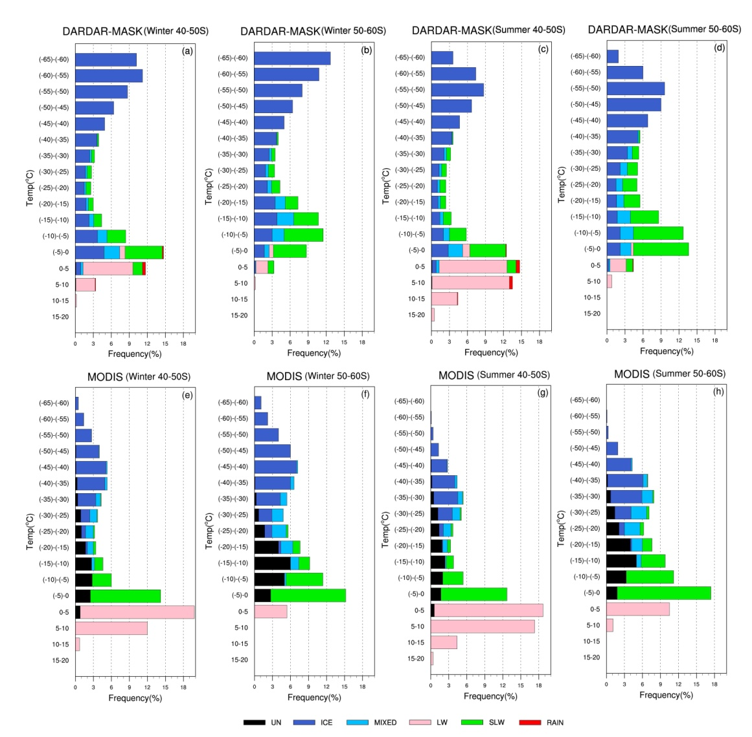
DARDAR-MASK
MODIS

Slide 6
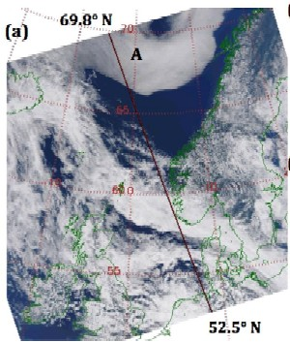
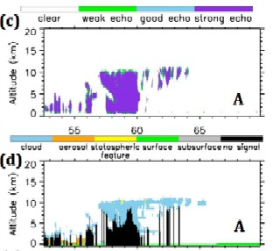
Chan and Comiso (GRL, 2011) noted that certain types of geometrically thin, low-level clouds that are apparent in the MODIS image could not be detected by CloudSat and CALIOP, due to the coarse vertical resolution and the low-level ground clutter contamination for the CPR, and the limited sensitivity of CALIOP to the clouds’ geometrically thin nature and surface proximity.

Slide 7
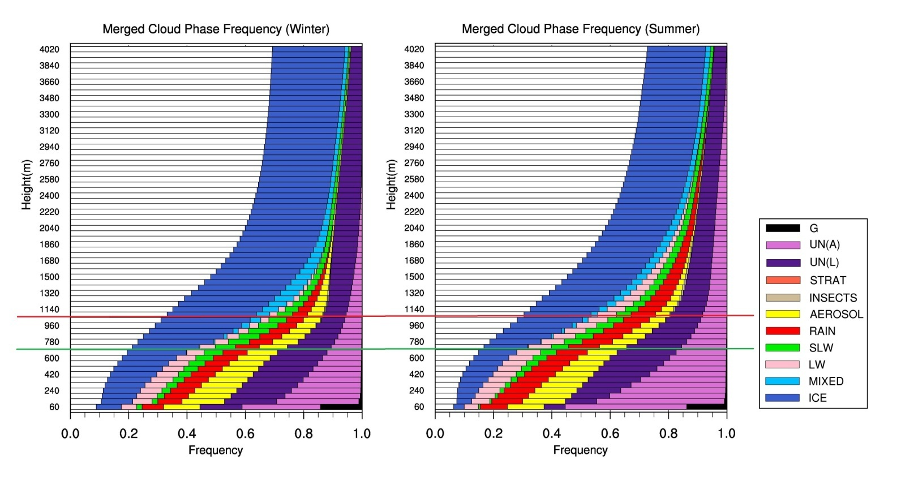
Absolute frequency of cloud phase (horizontally integrated) as seen by the DARDAR-MASK.
Note that this is ALL cloud, not just cloud-top.
Submitted to JGR

Slide 8
Conclusion reached from climatology study of the low-altitude clouds over the SO using DARDAR-MASK:
(1) The bulk of the cloud mass over the SO may be at heights less than 1 km, which is problematic for the observations due to the physical limitation of the CPR and the common extinction of CALIOP.
(2) While all the products have shown ample evidences of the extensive existence of SLW over the SO for the low-altitude clouds, the DARDAR-MASK finds more ICE and MIXED PHASE at cloud-top than either CALIPSO or MODIS. This is likely to be a consequence of various assumptions made when the temperature is between freezing and -20° C.
(3) Challenges remain when considering the geometrically thin clouds near the surface that are apparent to MODIS but could possibly be missed by both the CPR and CALIOP.
(4) The non-negligible observation of aerosol over the SO recorded by DARDAR-MASK is likely to be sea spray. What is the boundary between sea spray and clouds?

Slide 9
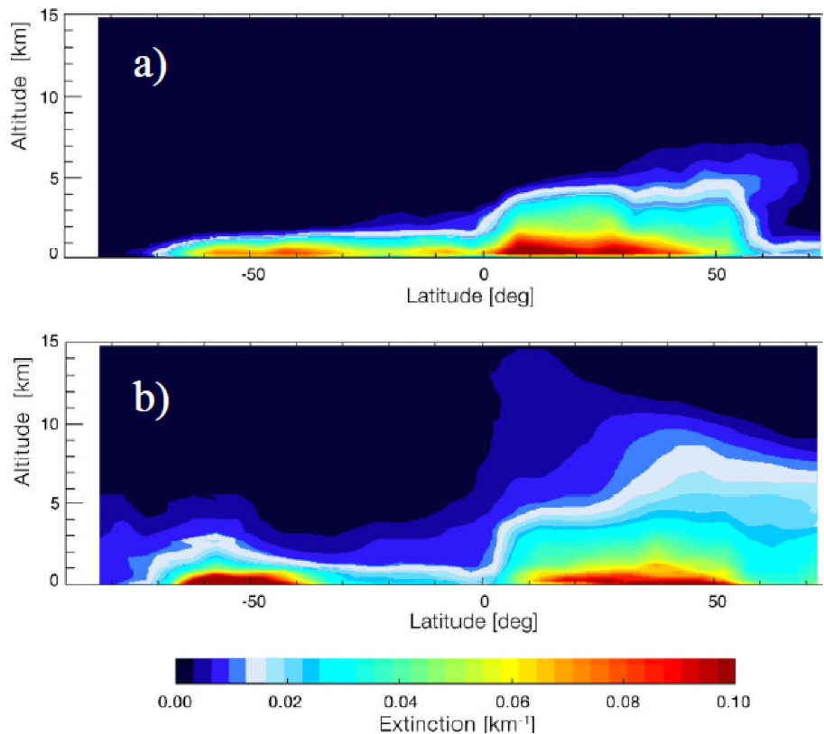
Figure 1. From Yongxiang Hu’s seminar on CALIPSO observations at the Bureau of Meteorology in 2011. The slide was labeled ‘vertical distribution of aerosol optical depth.’ This is for April 2008 only. The top panel is CALIPSO observations, the bottom is from a GEOS-5/GOCART simulation.

Slide 10
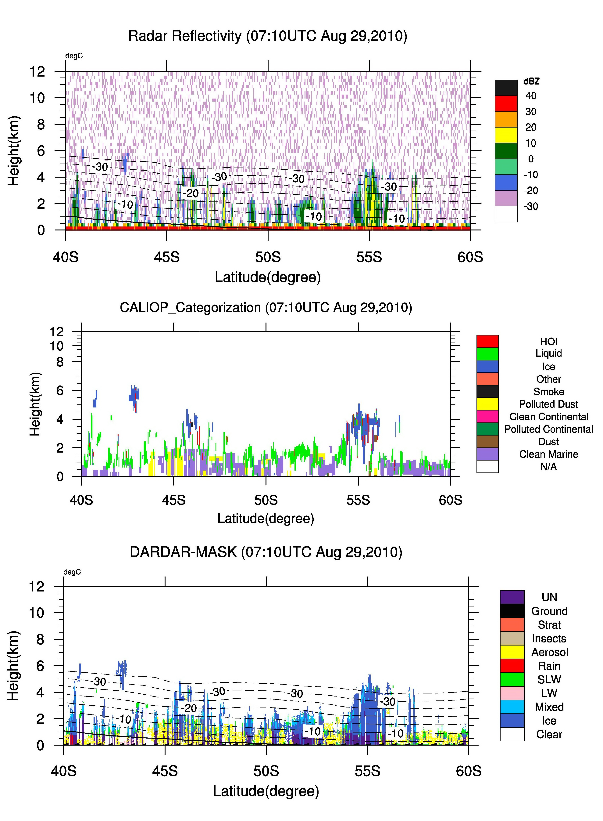
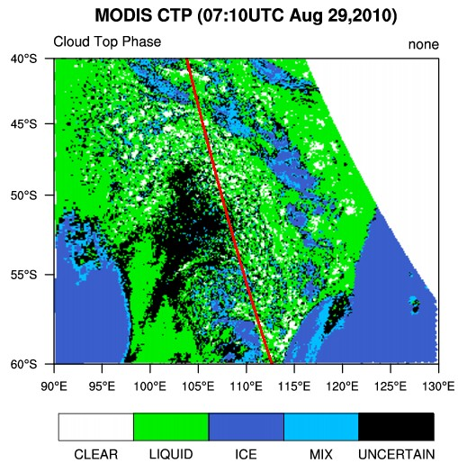
CASE C

Slide 11
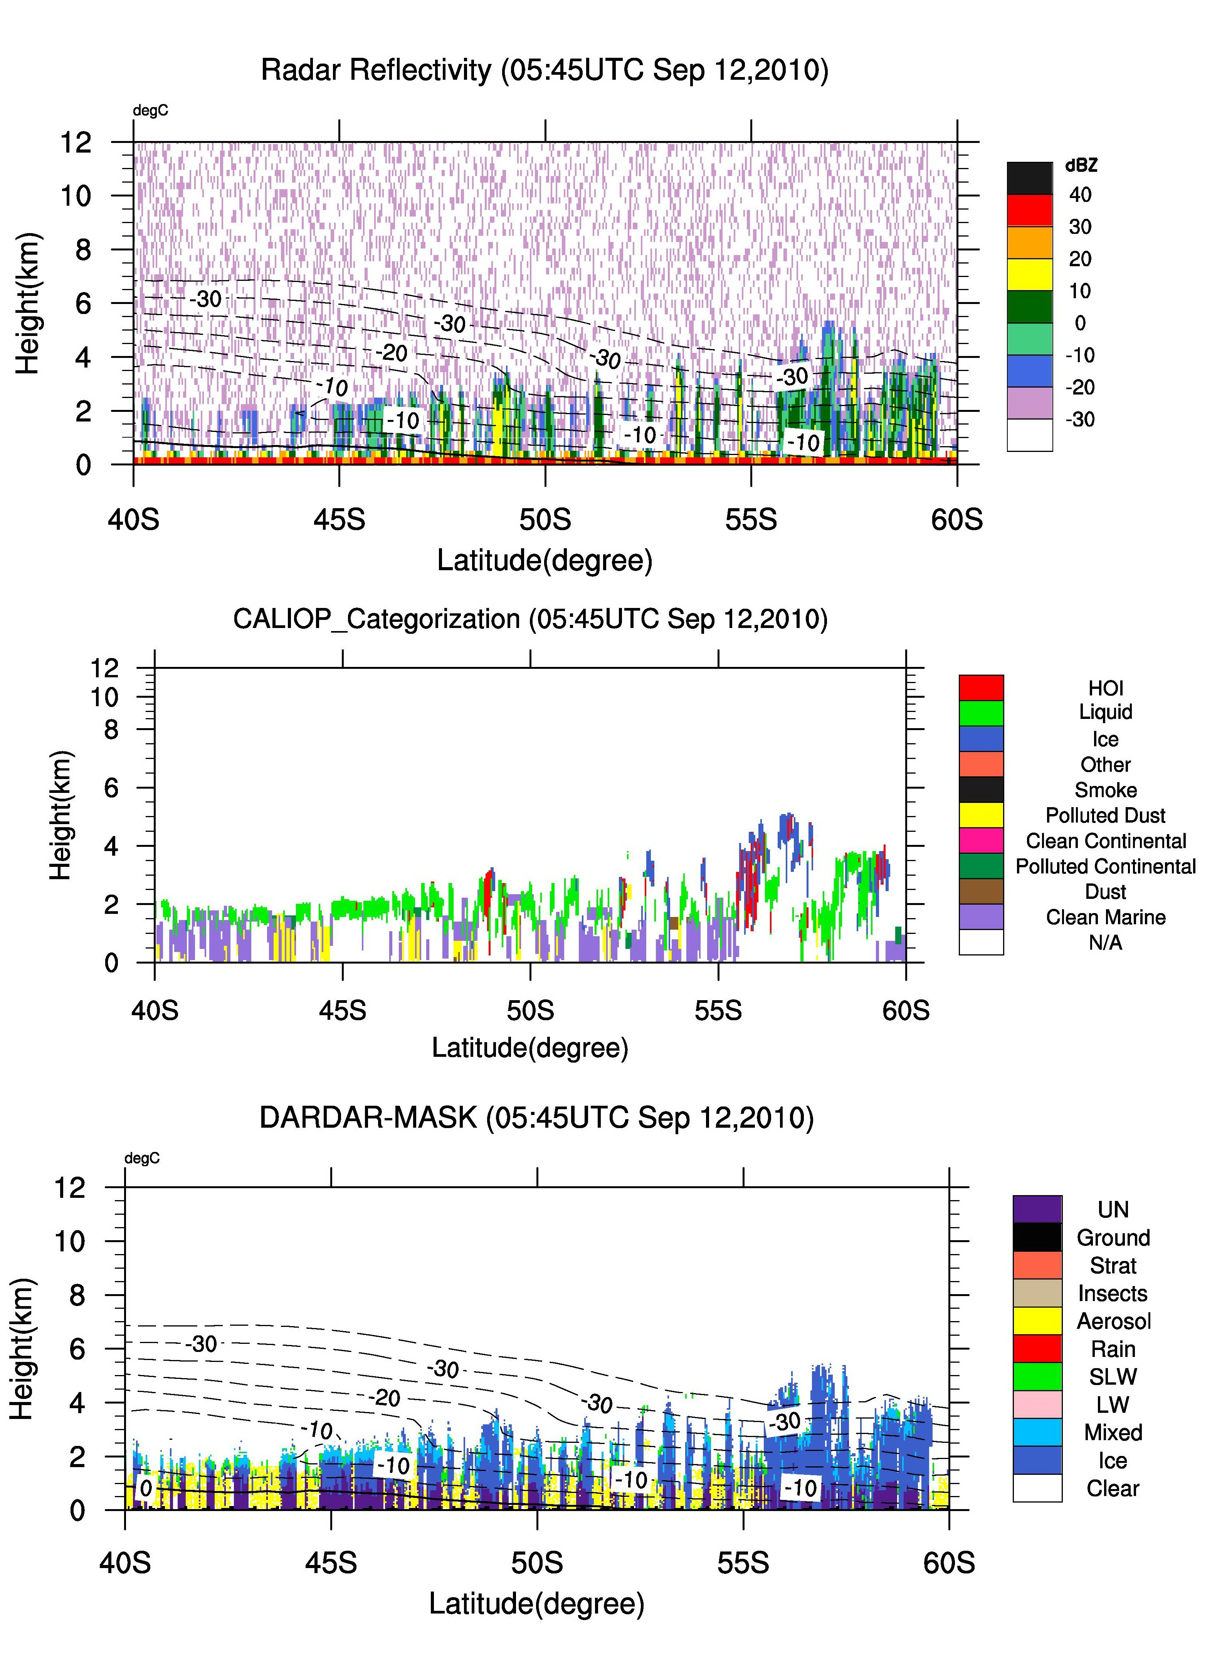
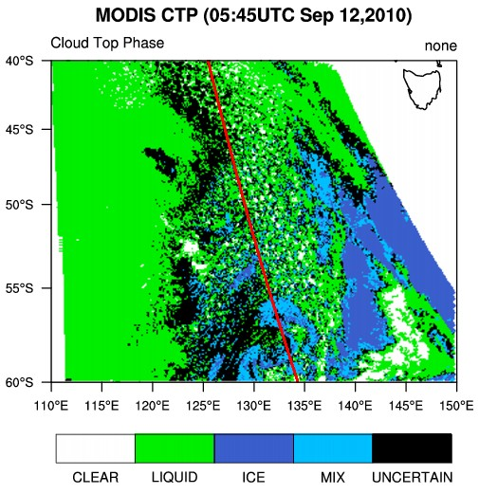
CASE D

Slide 12
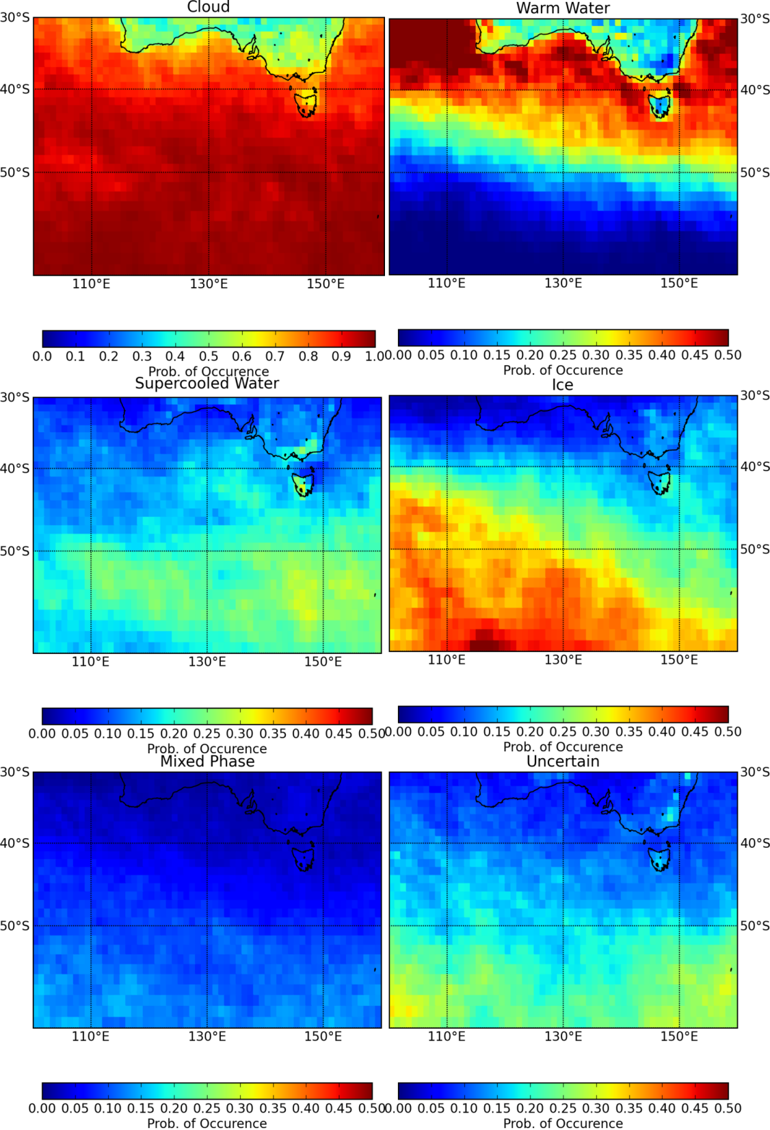
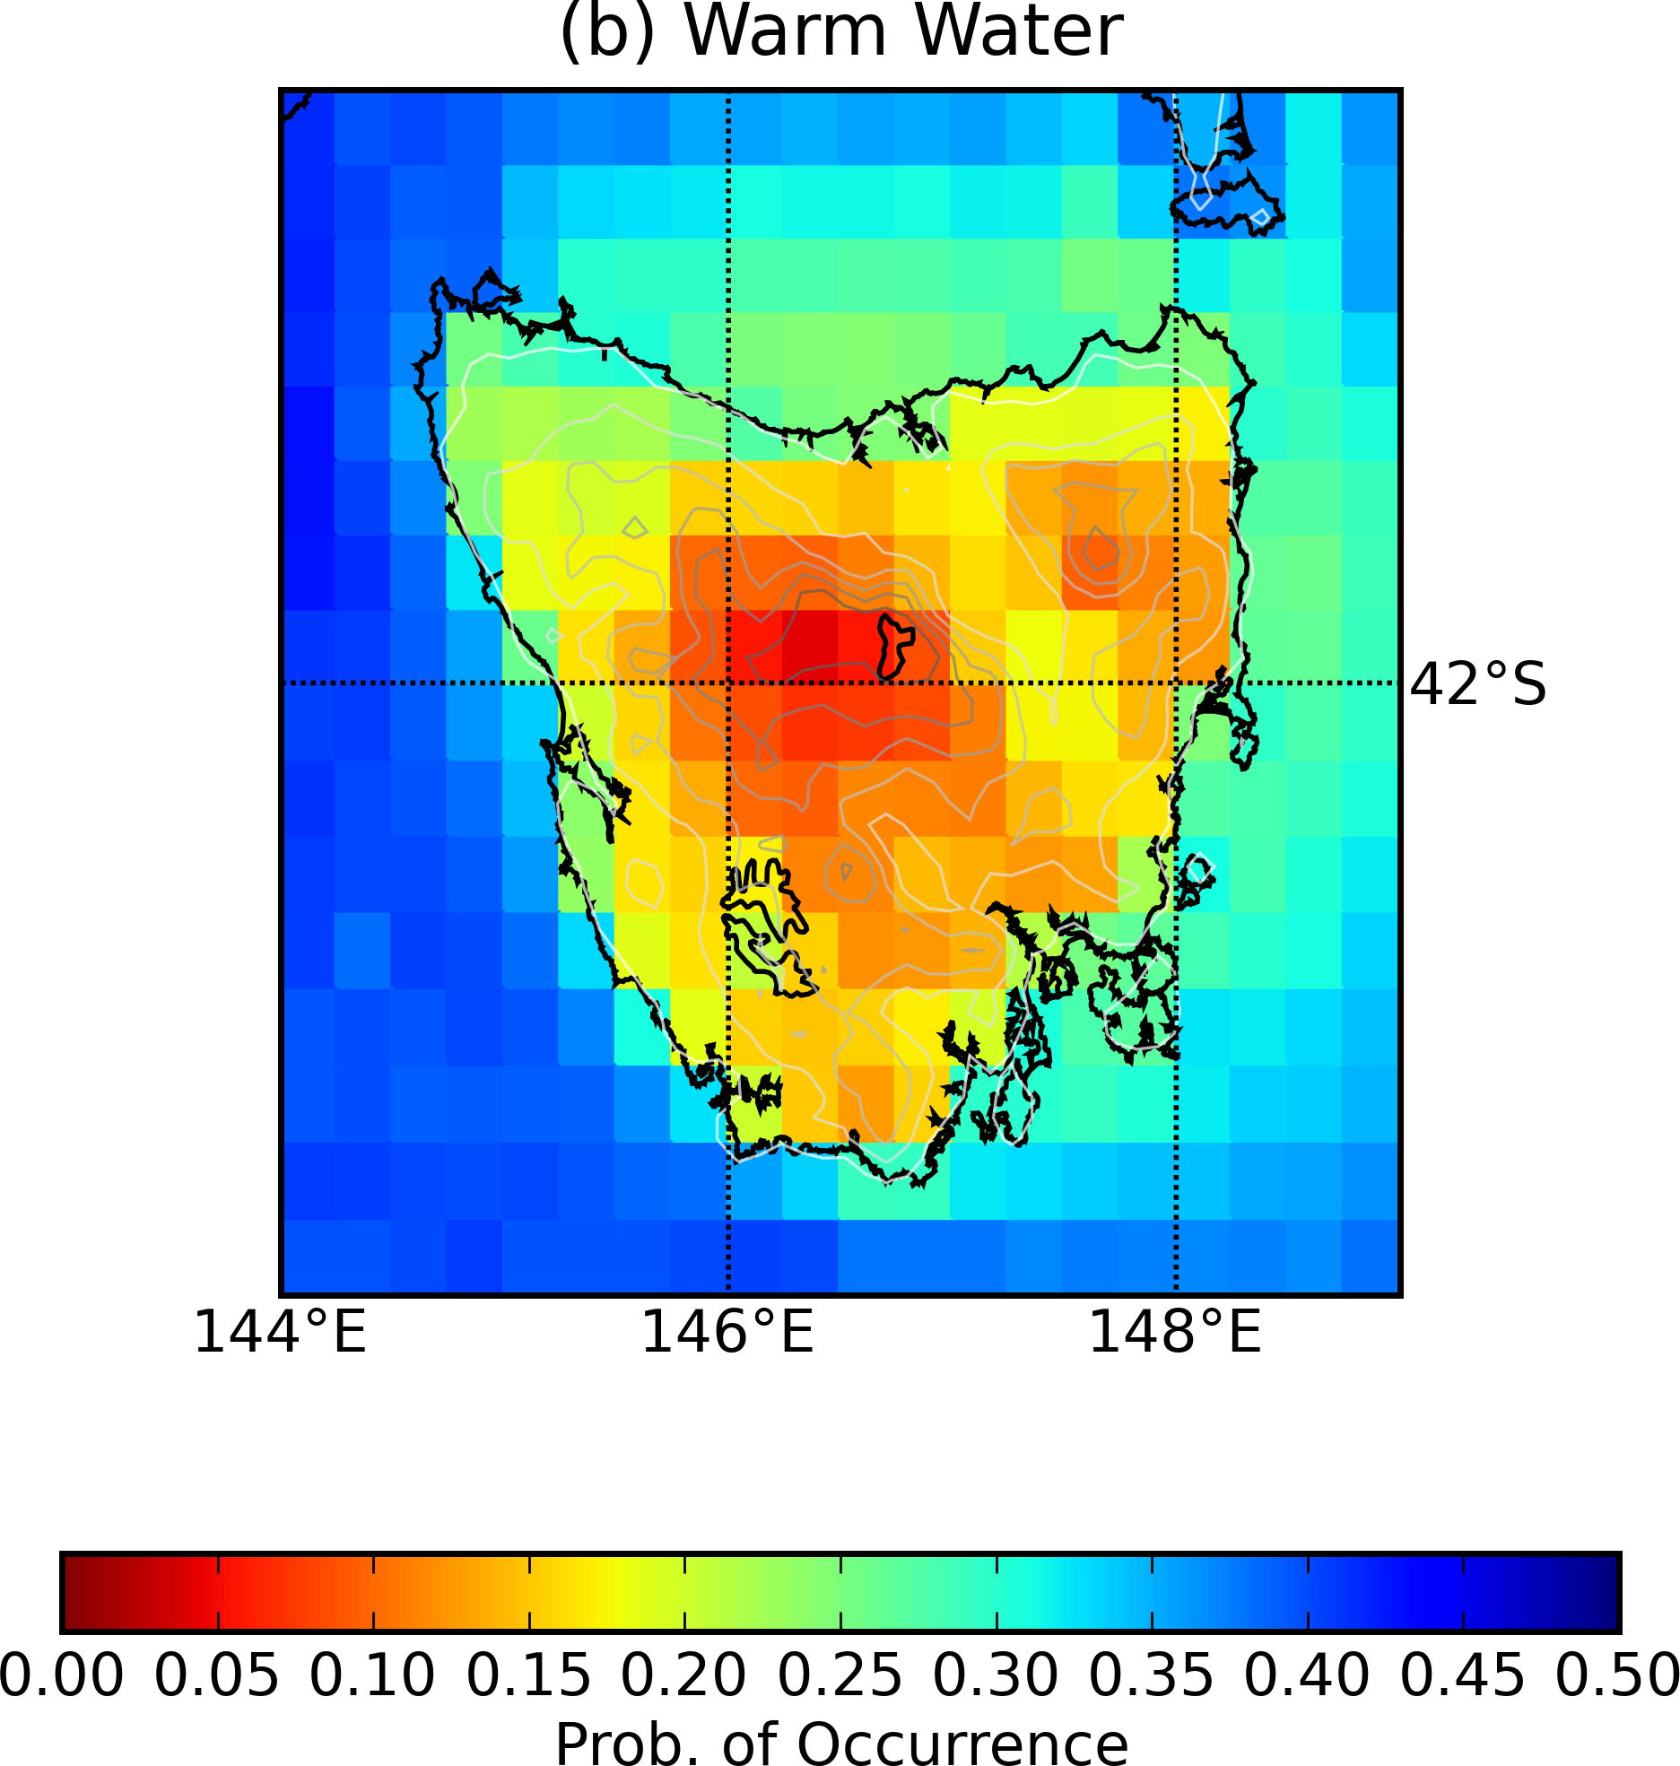
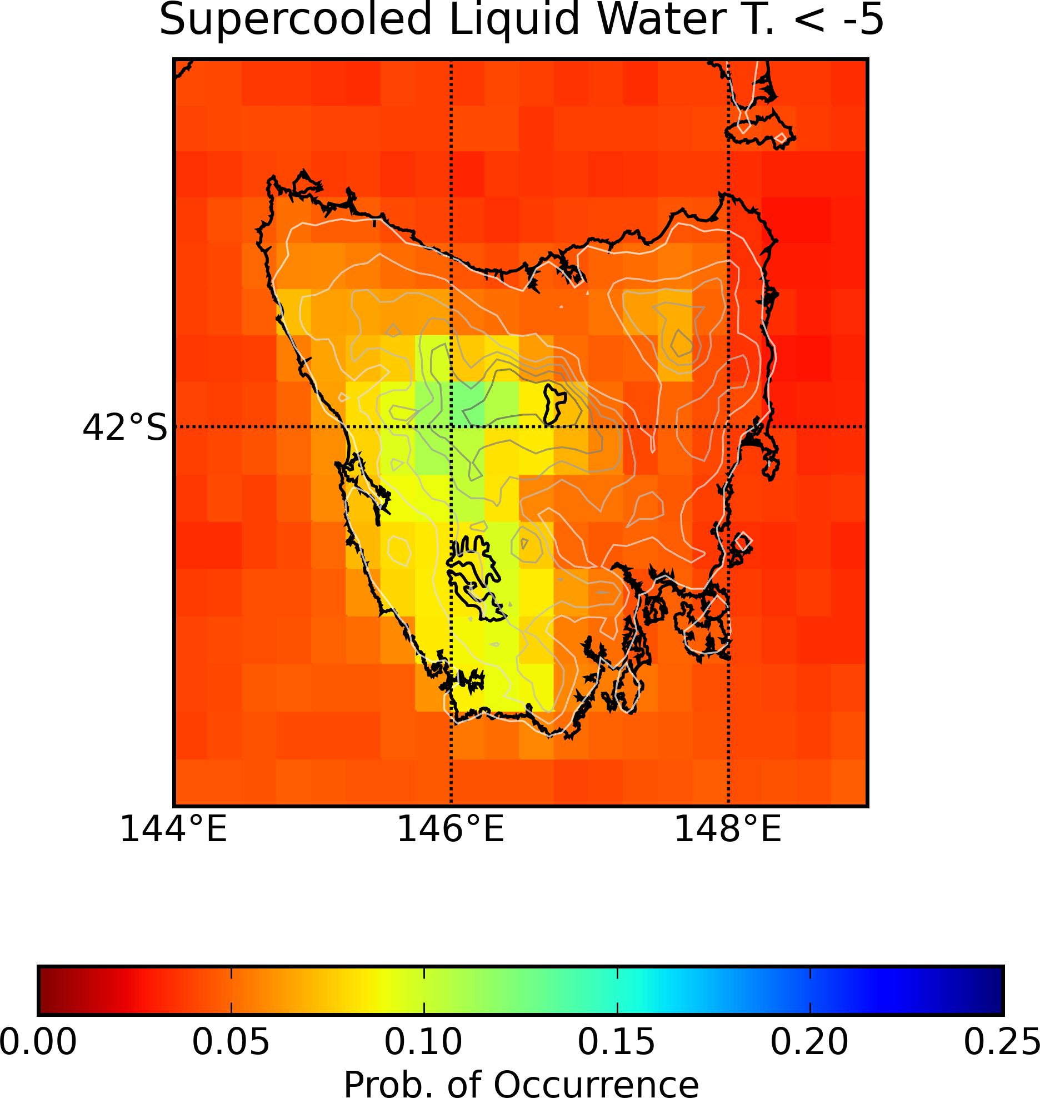
WINTER

Slide 13
Influence of sea-salt on aerosol radiative properties in the Southern Ocean marine boundary layer D. M. Murphy et al. Science 1998
There has been considerable debate about the relative importance of sea-salt and sulphate from non-sea-salt sources in determining aerosol radiative effects in the marine boundary layer. In the marine boundary layer, the most numerous aerosols are volatile sulphate particles smaller than about 0.08 mm and most of the aerosol mass is in a few sea-salt particles larger than 1 mm. Yet intermediate-size aerosols between about 0.08 and 1 mm diameter are the most relevant to the radiative forcing of climate because they efficiently scatter solar radiation and also serve as cloud nuclei. Indeed, Charlson et al. hypothesized that oceanic production of sulphate aerosols from the oxidation of dimethyl sulphide could be a powerful feedback in the climate system. It is generally assumed that marine aerosols smaller than about 1mm are non-sea-salt sulphate, but a recent review cites indirect evidence that many aerosols in the sub-micrometre range contain at least some sea-salt4,5. Here we present direct observational evidence from a remote Southern Ocean region that almost all aerosols larger than 0.13mm in the marine boundary layer contained sea-salt. These sea-salt aerosols had important radiative effects: they were responsible for the majority of aerosol-scattered light, and comprised a significant fraction of the inferred cloud nuclei.

Slide 14
Can we distinguish between sea spray and boundary layer clouds?
Is there a direct correlation between winds/waves/sea spray and boundary layer clouds?
Is what are the physical processes in moving from sea spray and clouds (or vice versa)? Is it different for warm air advection than cold air advection?

