Slide 1
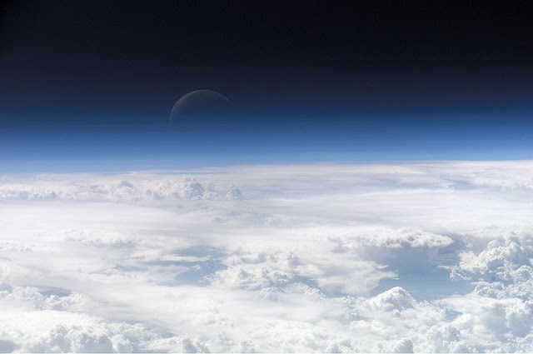
A Study on the Cloud Thermodynamic phase over the Southern Ocean using A-Train Observations and WRF Simulations
Yi Huang Steve Siems Michael Manton
This research has benefited from the discussions with Alain Protat,
Julien Delanoë, Charmaine Franklin and Gregory Thompson.

Slide 2
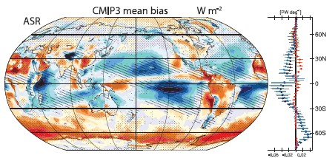
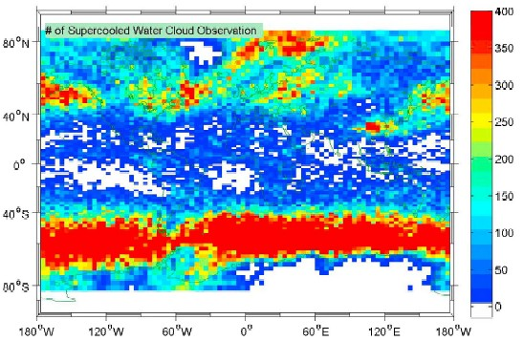
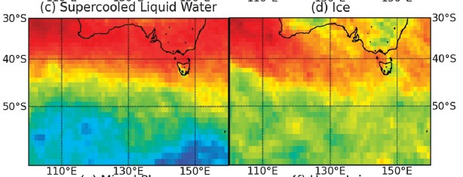
Research Background
Cloud thermodynamic phase has a vital impact on cloud lifetime and precipitation efficiency (Han et al. 1998; Storelvmo et al. 2010; Choi et al. 2010). The transmissions of solar and terrestrial radiations are also highly dependent on the phase of clouds (Curry and Ebert 1992; Shupe and Intrieri 2004; Sedlar et al. 2011)
Trenberth and Fasullo (2010)
(Hu et al. 2010)
(Morrison et al. 2011)

Slide 3
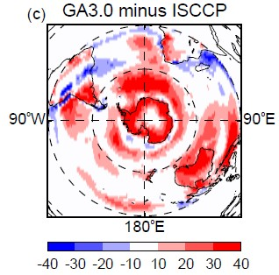
Research Background
More recently, the study by Bodas-Salcedo et al. (2012) using the UK Met Office Unified Model highlights that the underprediction of the low- and mid-level postfrontal clouds contributes to the largest bias of the surface downwelling shortwave radiation over the Southern Ocean (SO). These clouds are typically associated the SLW.
Bodas-Salcedo et al. (2012)
Research Objectives:
Construct a climatology of the cloud thermodynamic phase and cloud structure over the SO with A-Train observations----CloudSat, CALIPSO, and DARDAR-MASK (Delanoë and Hogan. 2010).
Evaluate the Weather Research and Forecasting Model (WRFV3.3.1) NWP model in simulating the post-frontal clouds over Tasmania and the SO with the A-Train observations.

Slide 4
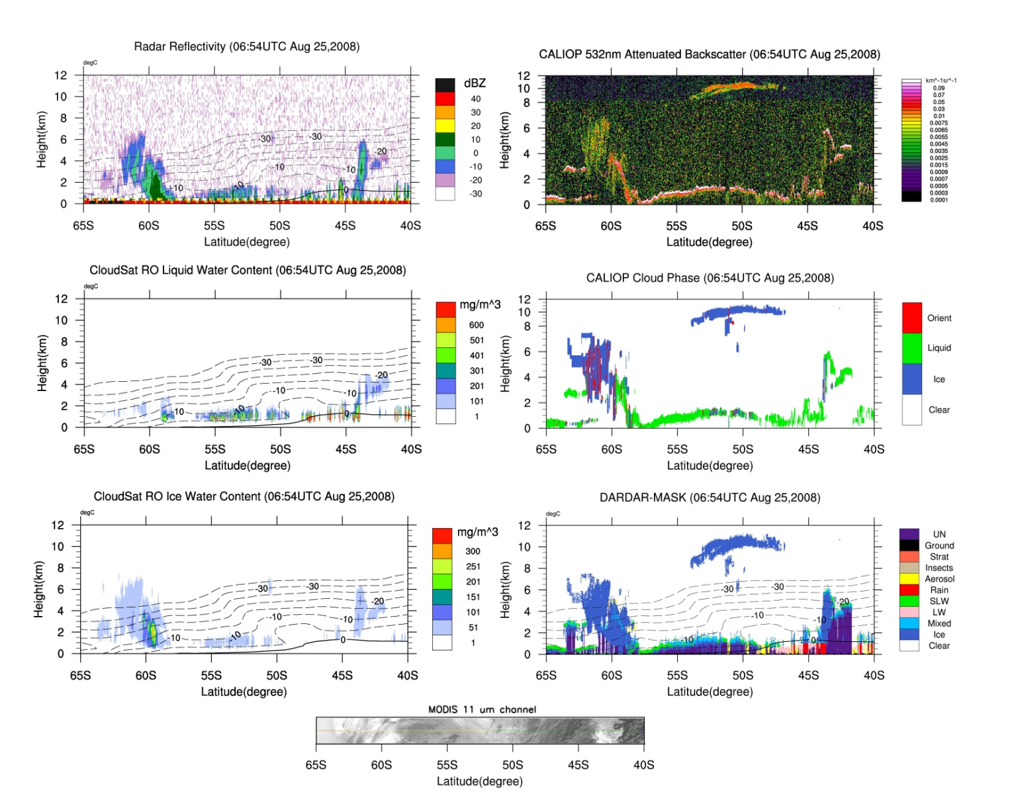
Example of A-Train observations

Slide 5
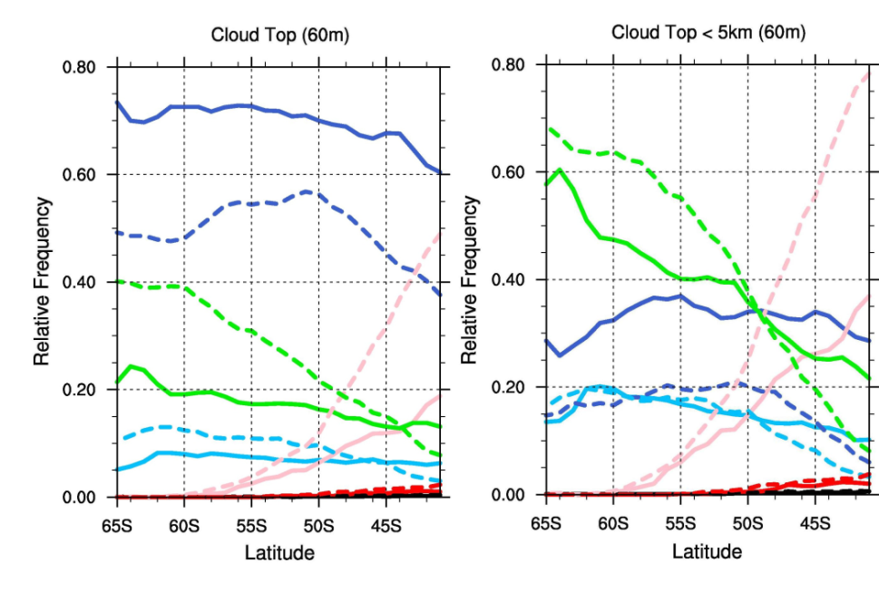
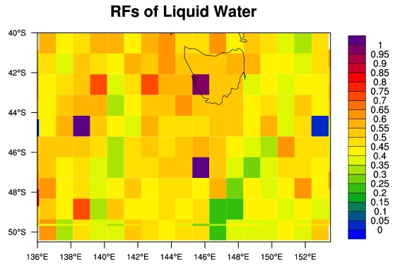
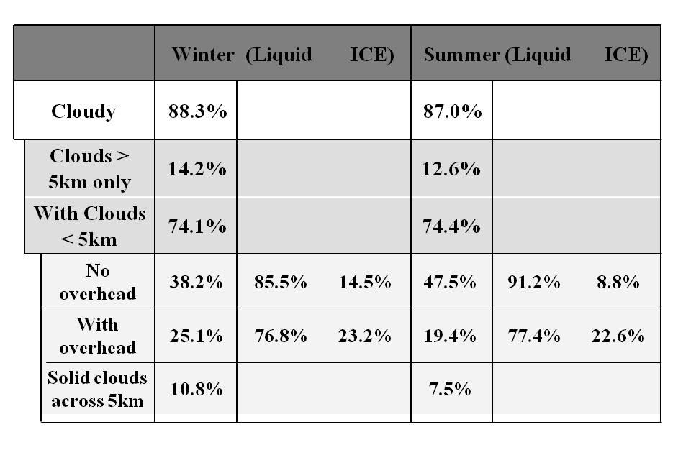
A-Train observations of cloud phase properties over the SO
Climatology of the CTP properties with DARDAR-MASK (2006-2009)
The DARDAR-MASK climatology highlights the extensive presence of SLW over the SO, particularly during summer.
The dominance of SLW becomes most significant over 50-65S. The RF of SLW is twice as that of ICE for clouds below 5 km.
CTP climatology as seen by CALIPSO
CALIPSO cannot produce mixed phase !

Slide 6
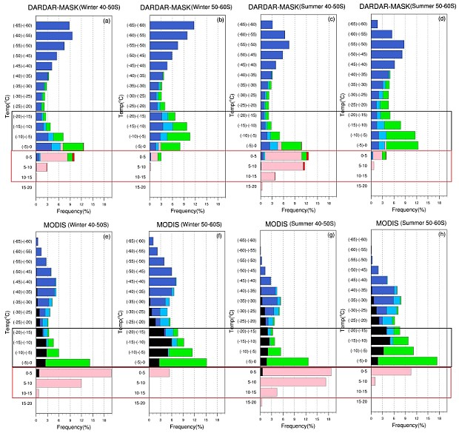
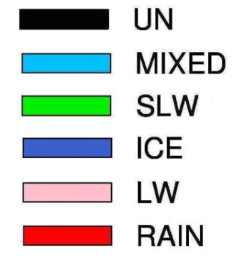
Comparison of CTP climatology between DARDAR-MASK and MODIS
DARDAR-MASK
MODIS

Slide 7
Conclusion of A-Train observations of cloud thermodynamic phase properties over the SO
(1) A-Train observations provide ample evidences of the extensive existence of SLW over the SO for the low-altitude clouds. The DARDAR-MASK finds more ICE and MIXED at cloud-top than either CALIPSO or MODIS. This may be, in part, a consequence of the limitations of the CPR filtering through the DARDAR-MASK algorithm at a temperature below freezing;
(2) More glaciated clouds are derived by DARDAR-MASK at temperatures below -50°C, given the sensitivity of CALIOP to high-level cirrus. Challenges remain when considering the geometrically thin clouds near the surface that are apparently present in MODIS but could possibly be missed by both CloudSat and CALIPSO (Chan and Comiso, 2011);
(3) Given the persistent uncertainties in the remote sensing of the SO clouds, enormous challenges remain in better defining the energy and water budget over the Southern Ocean.

Slide 8
Numerical modeling of the Southern Ocean Clouds
CASE A: 30 Jun – 2 Jul, 2008
CASE B: 7-8 Nov, 2008

Slide 9
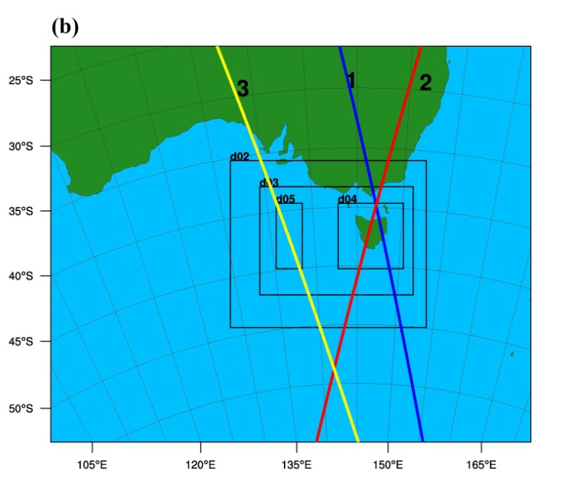
Numerical modeling of the Southern Ocean Clouds
CASE A: 30 Jun – 2 Jul, 2008
WRF configuration settings for the two cases
CASE A
Abbreviation | Vertical Resolution | Microphysics Scheme | Boundary Layer Scheme | CCN Concentration
TC | default 64η levels | Thompson 2008 | YSU | 100 cm⁻³
TH | modified 64η levels | Thompson 2008 | YSU | 100 cm⁻³
LH | modified 64η levels | Lin | YSU | 100 cm⁻³
MH | modified 64η levels | Morrison | YSU | 100 cm⁻³
CASE B
Abbreviation | Vertical Resolution | Microphysics Scheme | Boundary Layer Scheme | CCN Concentration
TC | default 64η levels | Thompson 2008 | YSU | 100 cm⁻³
TH | modified 64η levels | Thompson 2008 | YSU | 100 cm⁻³
LH | modified 64η levels | Lin | YSU | 100 cm⁻³
TH_MYJ | modified 64η levels | Thompson 2008 | MYJ | 100 cm⁻³
TH_MYNN (track 3) | modified 64η levels | Thompson 2008 | MYNN | 100 cm⁻³
TH_CCN50 | modified 64η levels | Thompson 2008 | YSU | 50 cm⁻³
TH_CCN25 | modified 64η levels | Thompson 2008 | YSU | 25 cm⁻³
CASE B: 7-8 Nov, 2008

Slide 10
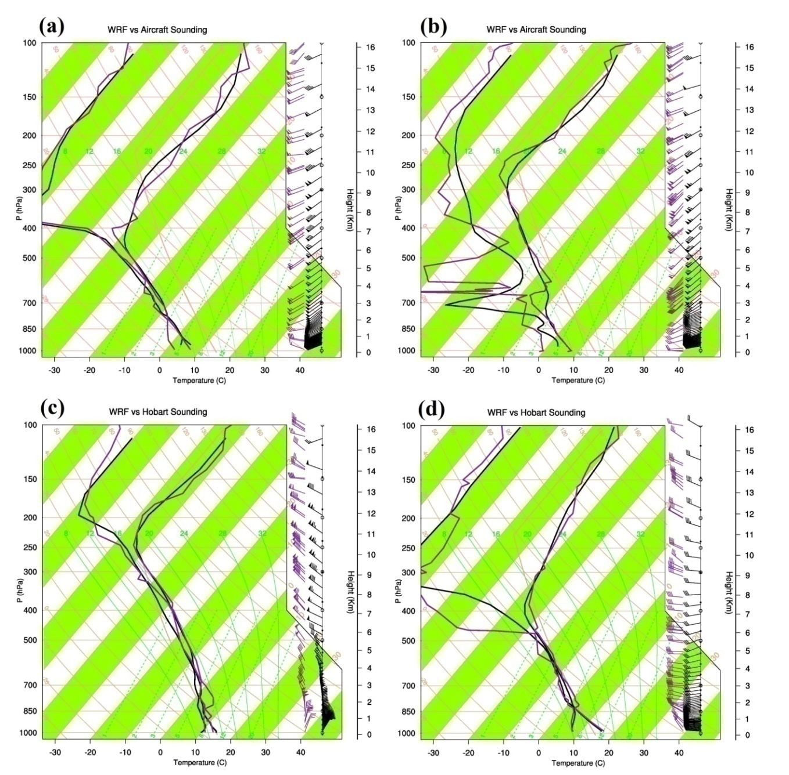
Numerical modeling of the SO Clouds
00:00UTC Jul 2
12:00UTC Jul 2
WRF: -30min
WRF: -30min
12:00UTC Nov 7
00:00UTC Nov 8
WRF: -30min
WRF: +30min

Slide 11
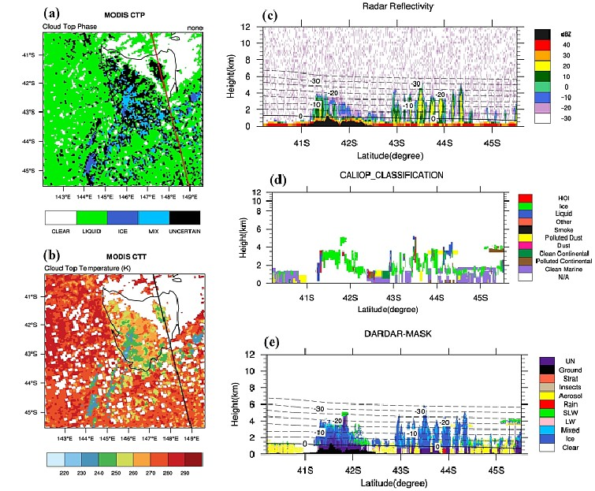
Numerical modeling of the SO Clouds ------ CASE A
Track 3
Observations

Slide 12
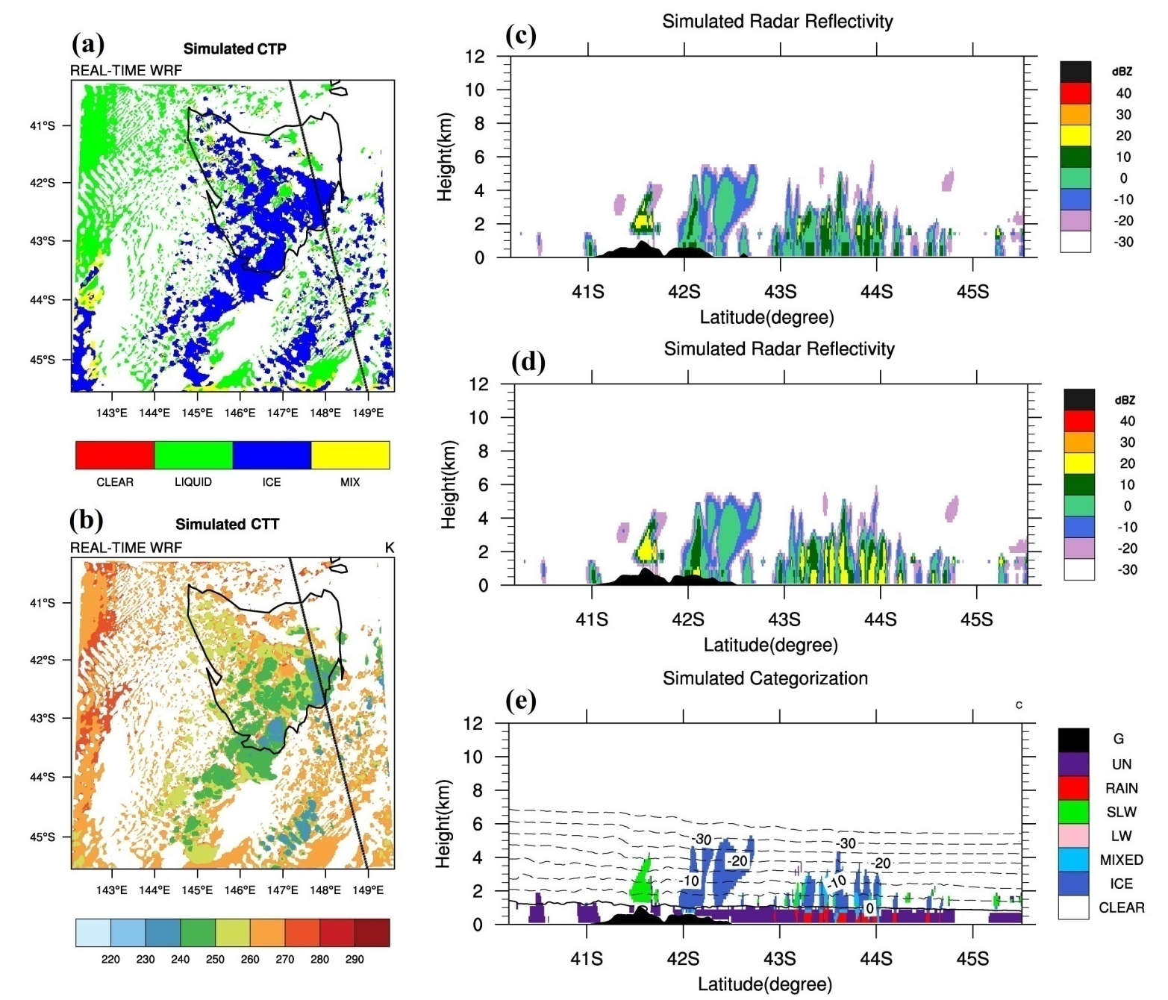
Numerical modeling of the SO Clouds ------ CASE A
Track 3
Simulations

Slide 13
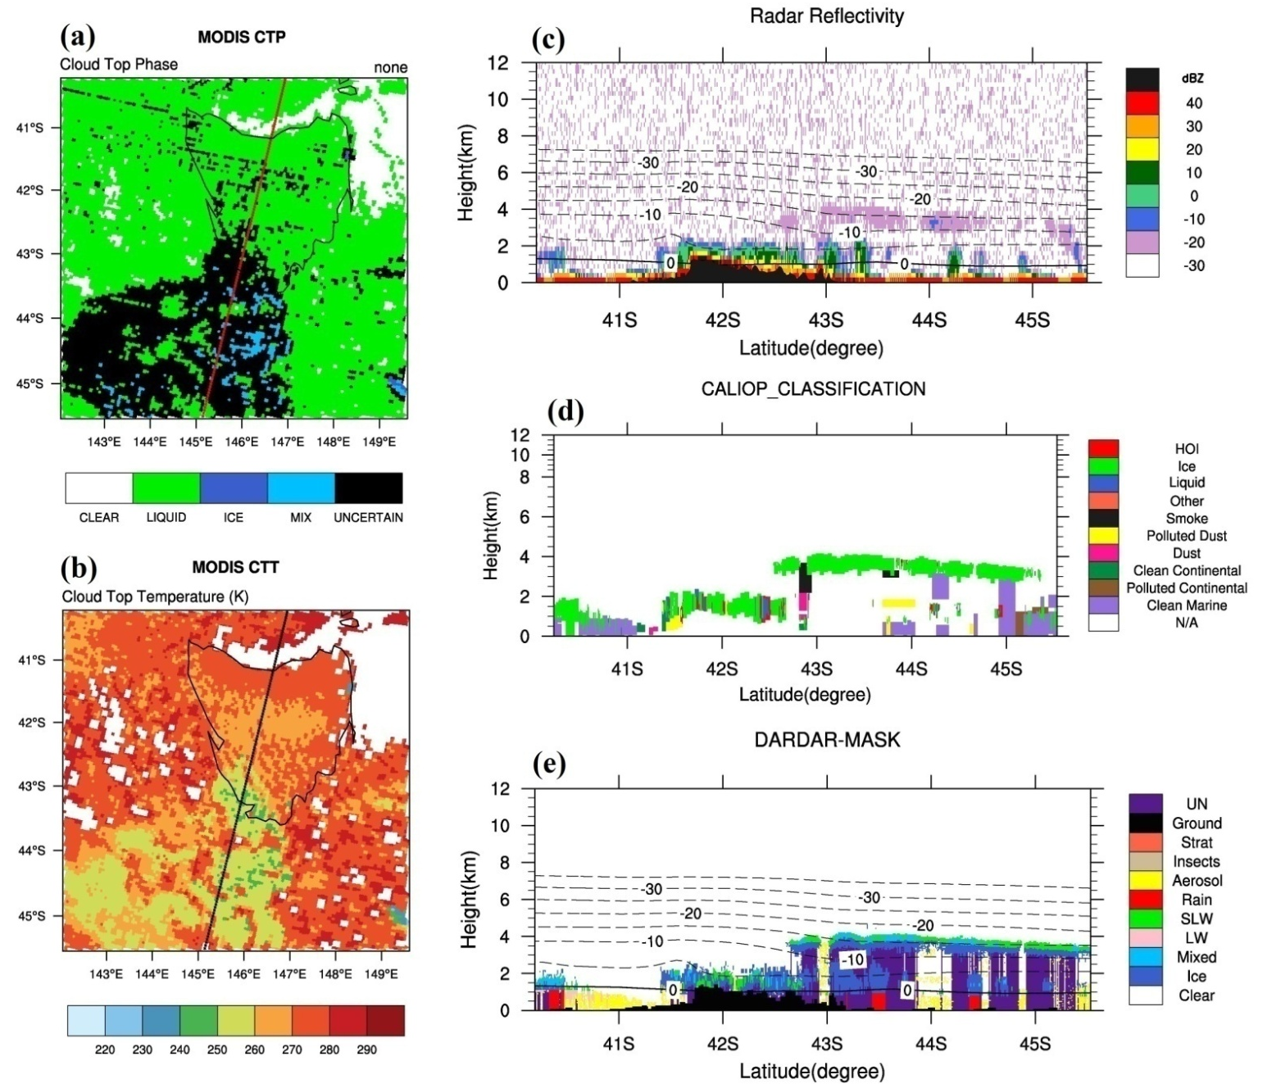
Numerical modeling of the SO Clouds ------ CASE A
Track 4
Observations

Slide 14
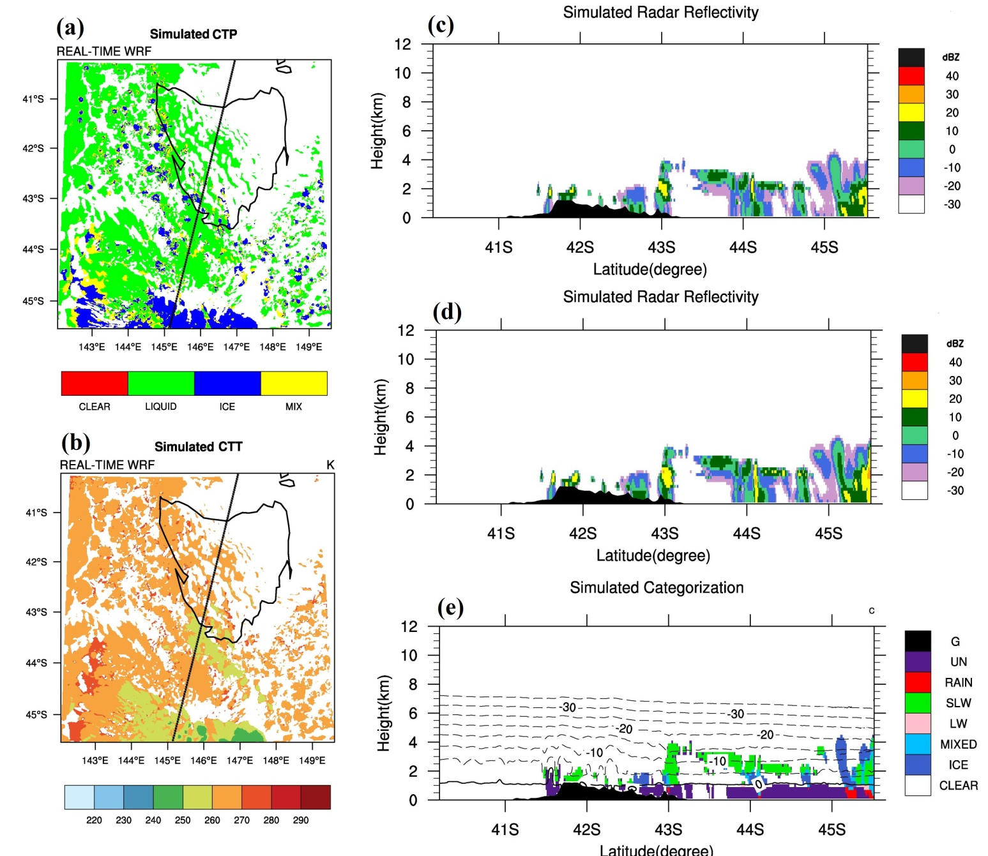
Numerical modeling of the SO Clouds ------ CASE A
Track 4
Simulations

Slide 15
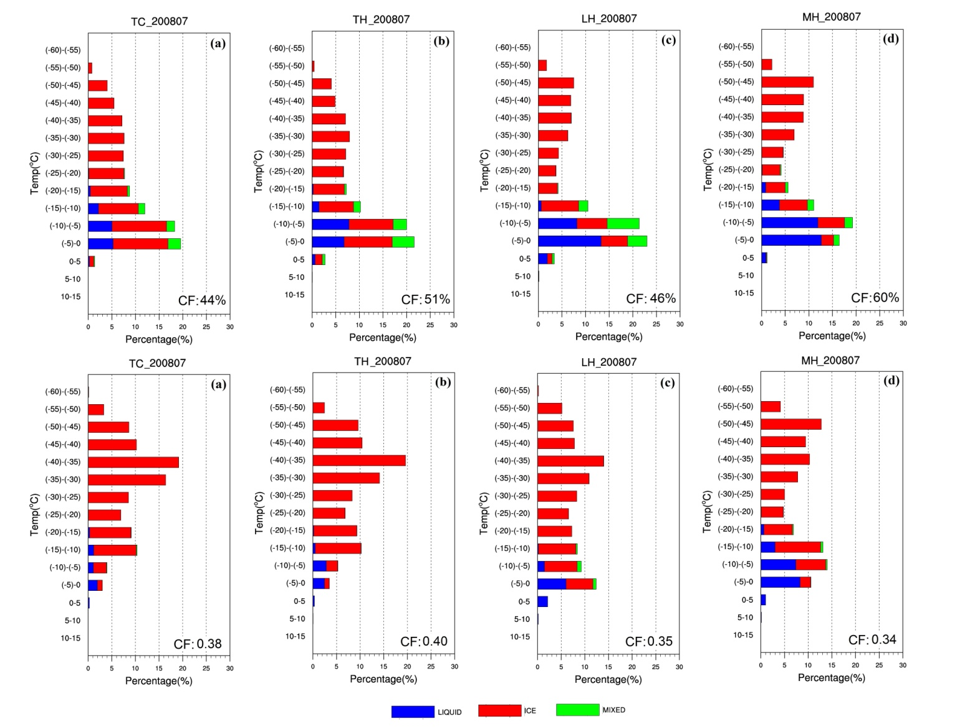
Numerical modeling of the SO Clouds ------ CASE A
RFs of the simulated CTT decomposed into their constituent phases
Cloud-top defined at
0.1 optical depth
Cloud-top defined at TWMR = 1.E-6 kg/kg

Slide 16
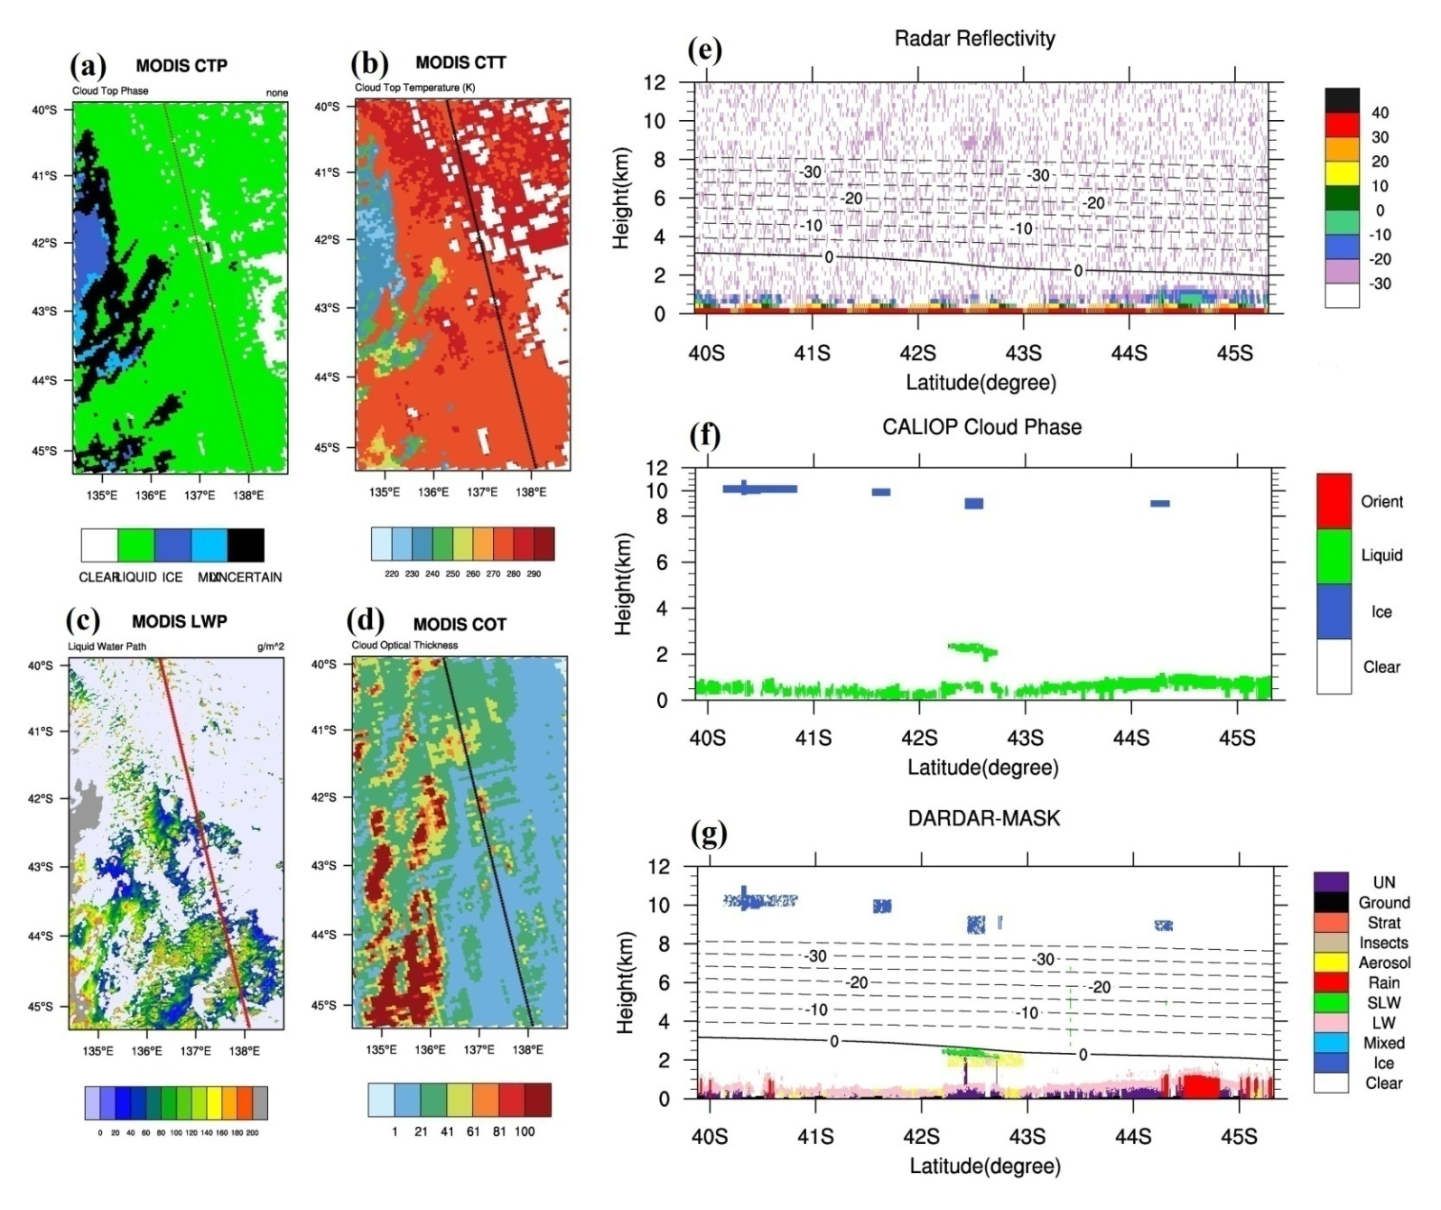
Numerical modeling of the SO Clouds ----- CASE B
Track 3
Observations

Slide 17
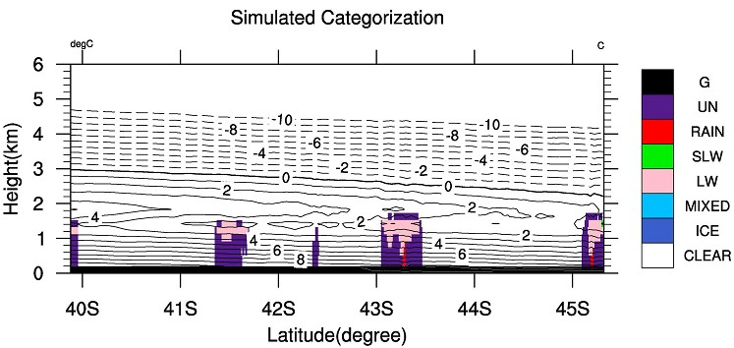
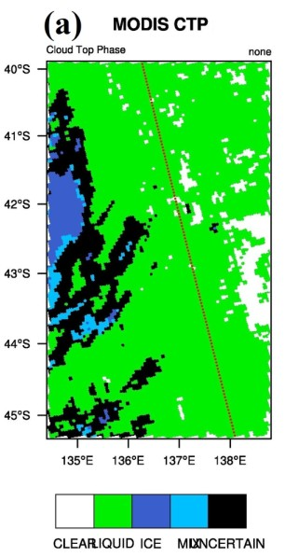
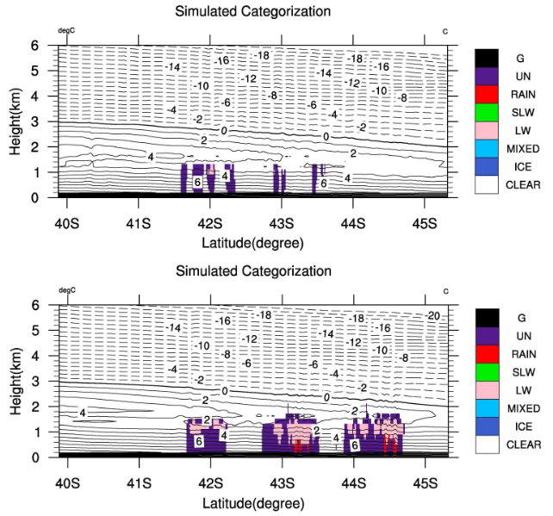
Numerical modeling of the SO Clouds ------ CASE B
Track 3
Simulations
YSU
MODIS
YSU
MYJ
MYJ
MYNN
MYNN

Slide 18
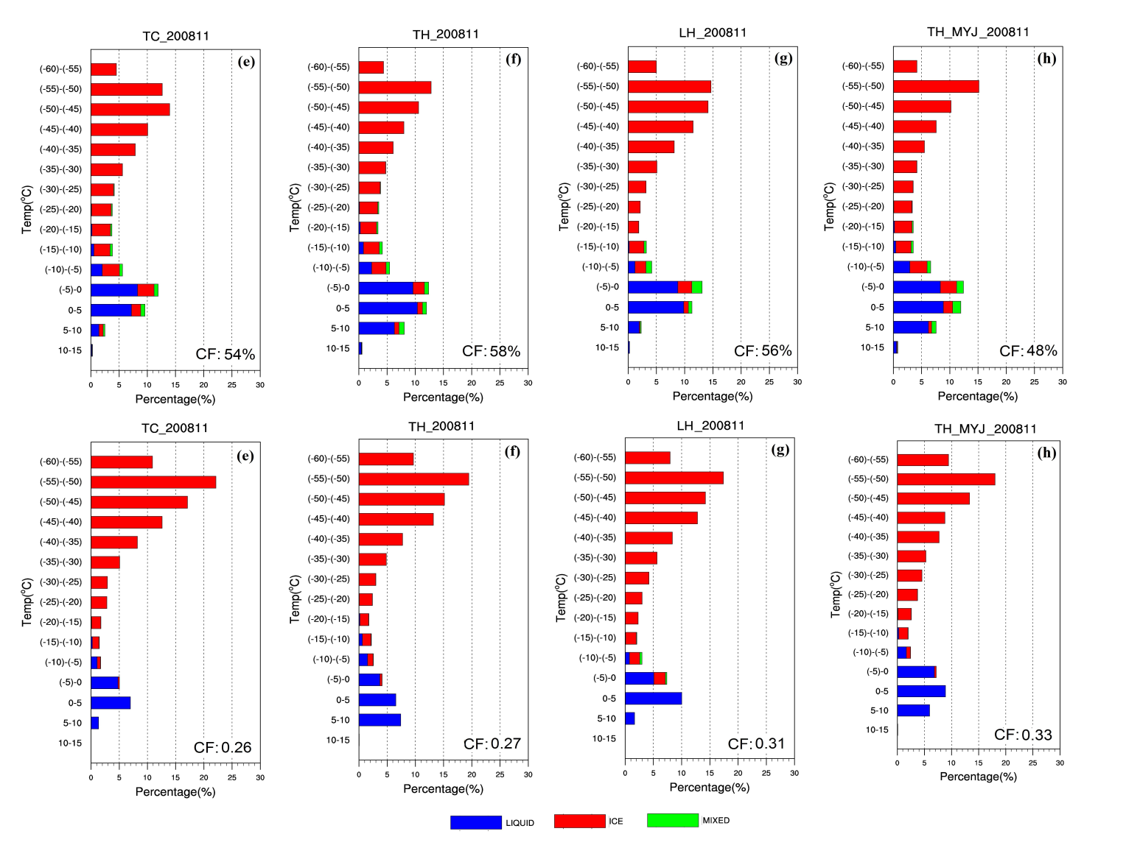
Numerical modeling of the SO Clouds ------ CASE B
RFs of the simulated CTT decomposed into their constituent phases
Cloud-top defined at
0.1 optical depth
Cloud-top defined at TWMR = 1.E-6 kg/kg

Slide 19
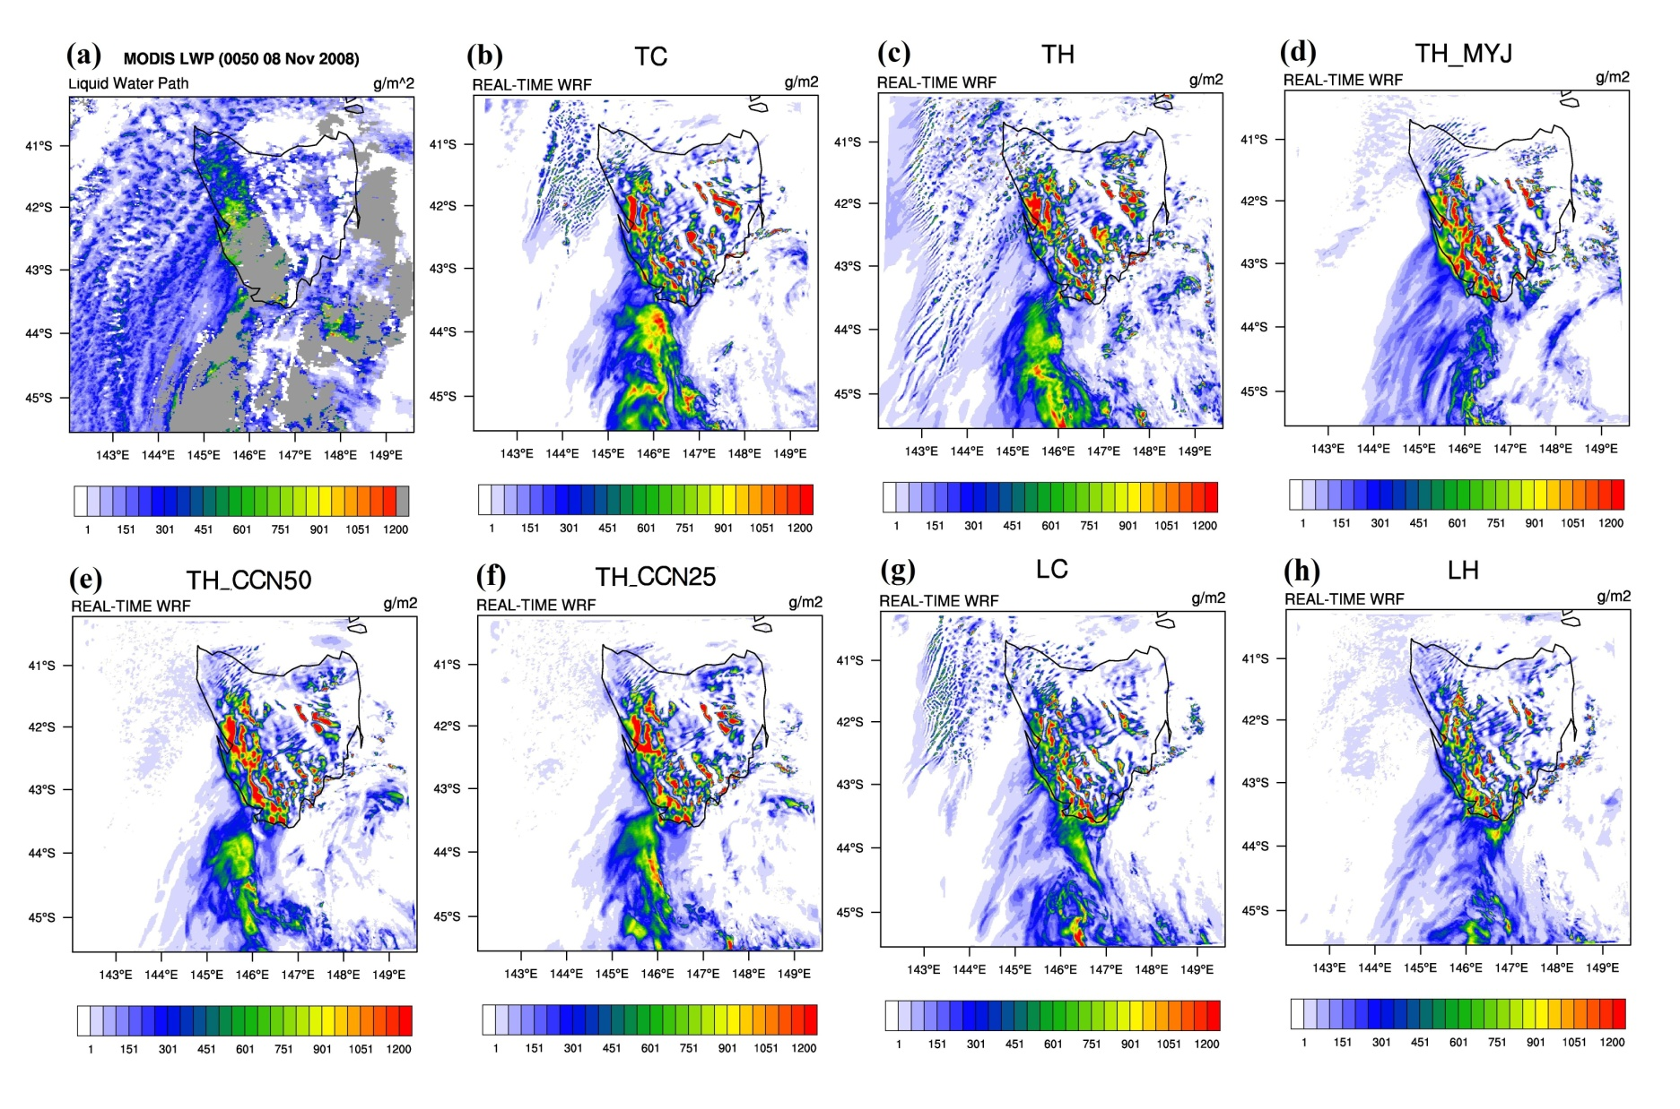
Numerical modeling of the SO Clouds
Comparison to the MODIS LWP and simulated LWP

Slide 20
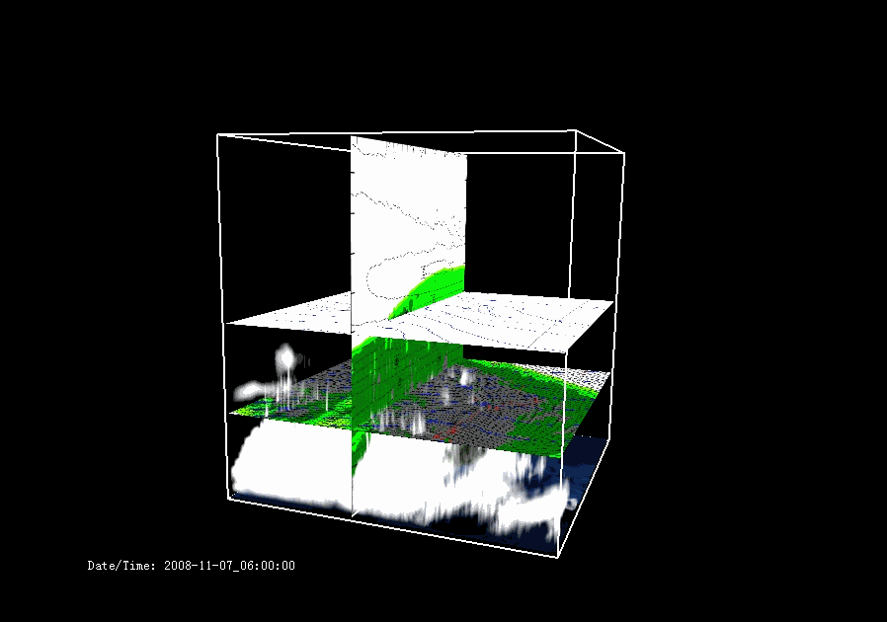
Numerical modeling of the SO Clouds

Slide 21
Summary of WRF simulations
(1) WRF is capable of capturing the overall structure and phase composition of the frontal convective clouds.
(2) The mid-top SLW clouds within the postfrontal air mass can be reproduced but are sensitive to microphysics scheme.
(3) The simulated CTP properties depend strongly upon both the microphysics schemes and vertical resolution.
(4) The simulations have great difficulties capturing the widespread low-altitude clouds that are not immediately associated with the fronts, even at high resolution.
(5) The simulations are only found to be marginally sensitive to the boundary layer schemes.

