Slide 1
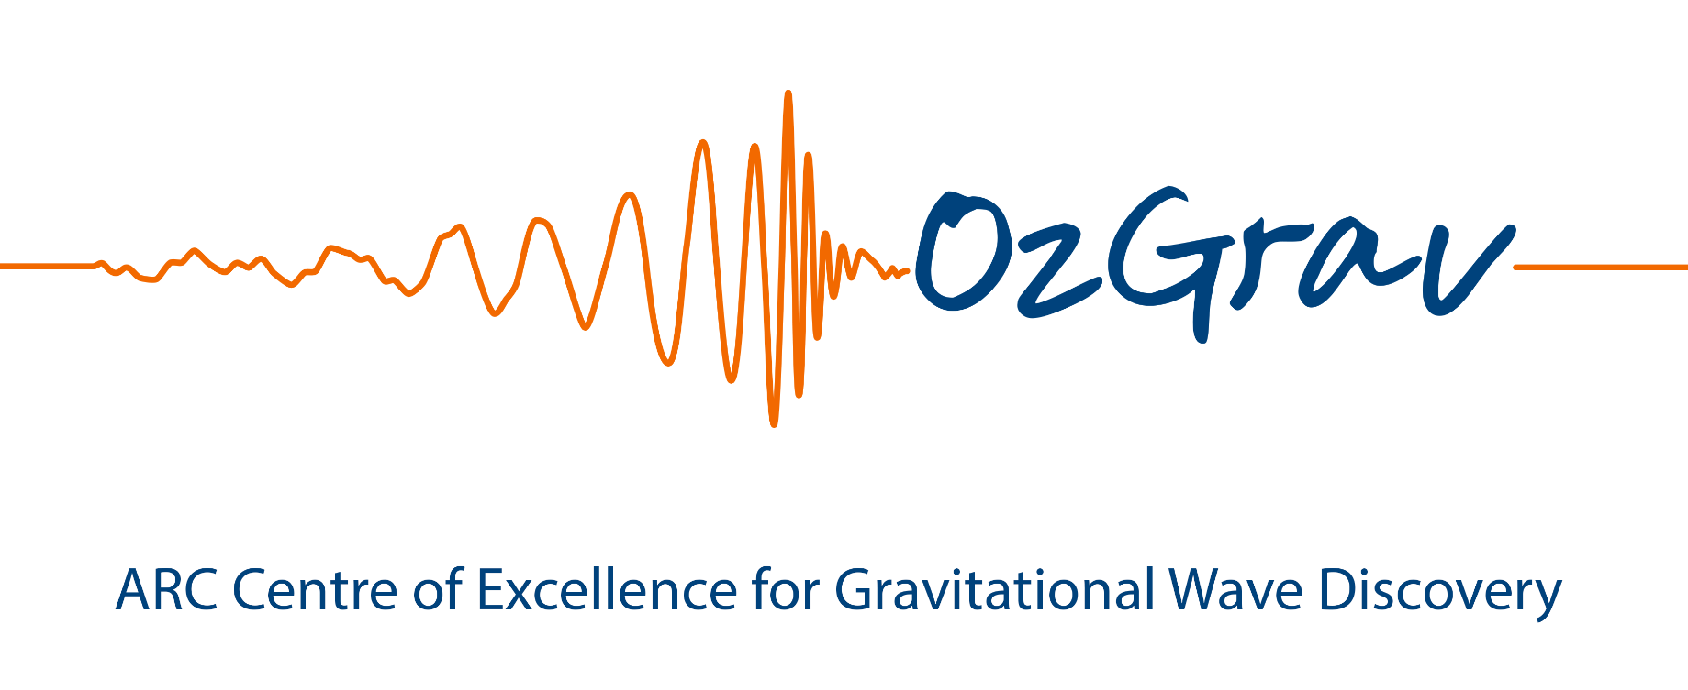








New discoveries by LIGO during its
first and second observing runs
Susan Scott
ANU
Paul Lasky
Monash

Slide 2
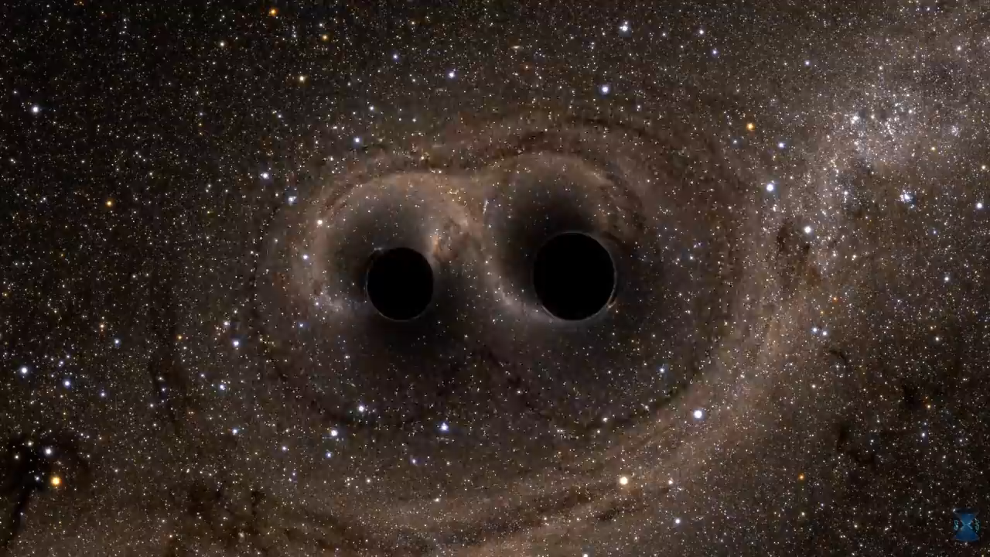
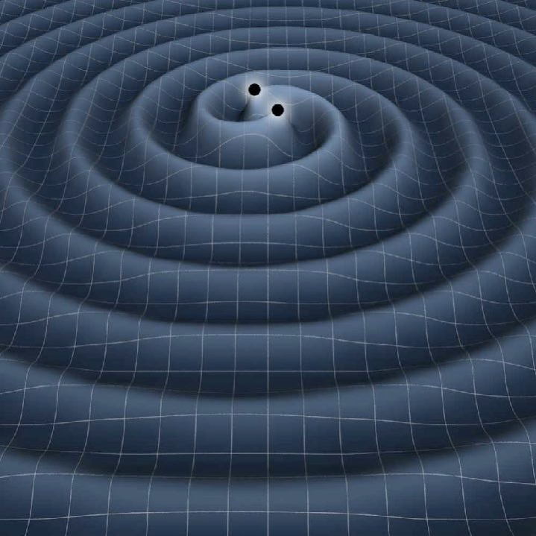
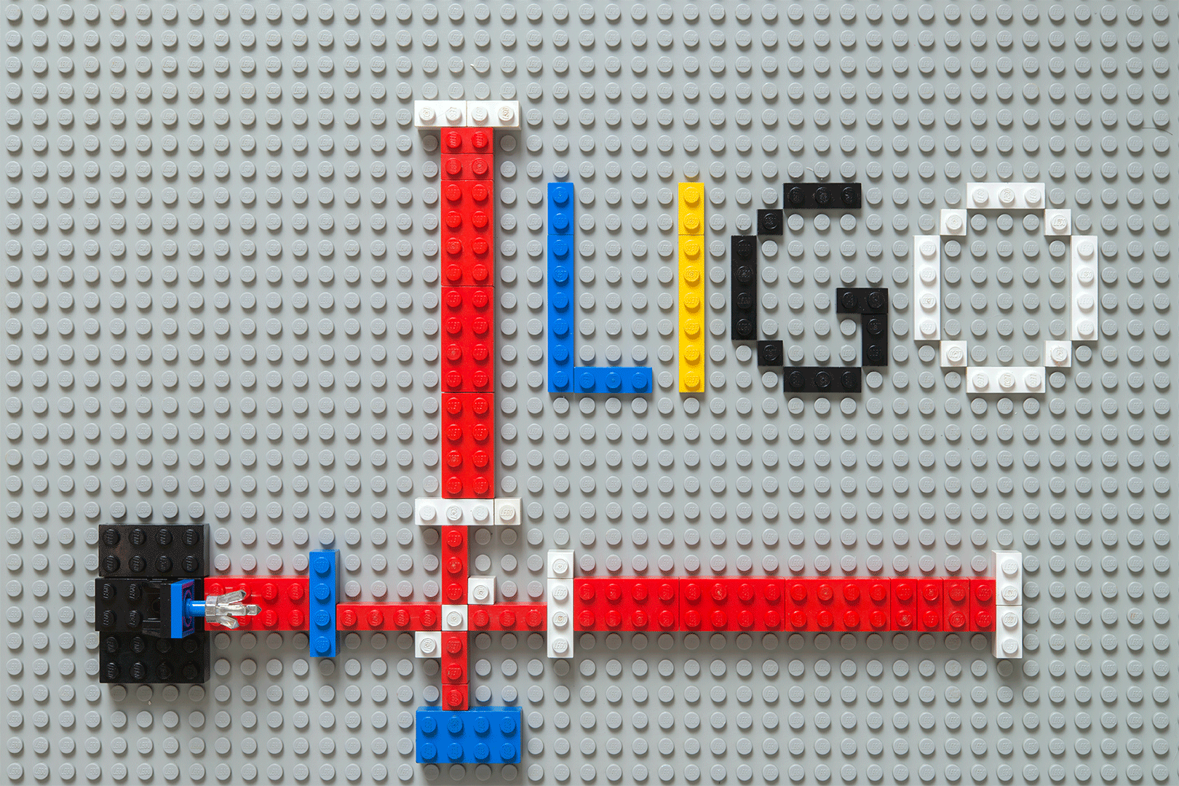

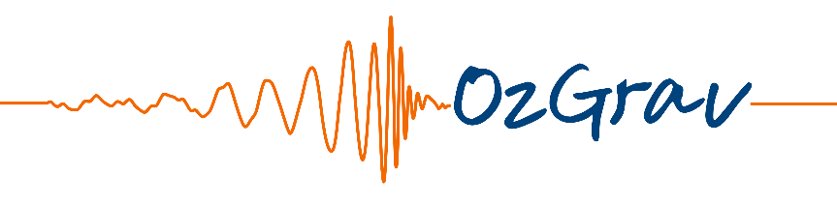
a one-page
gravitational-wave primer

Slide 3
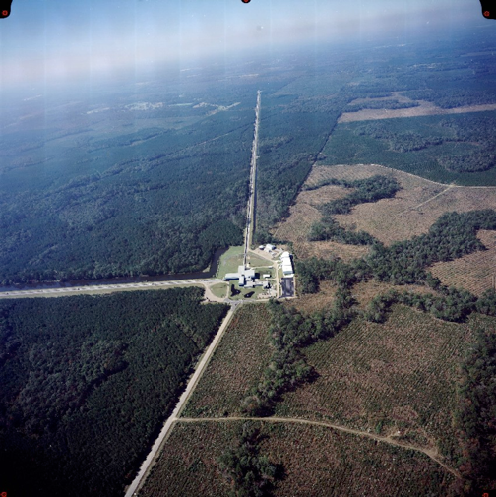
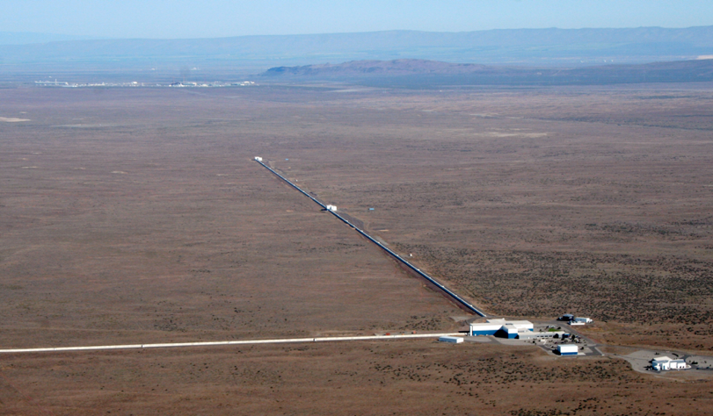
LIGO Hanford
LIGO Livingston

Slide 4
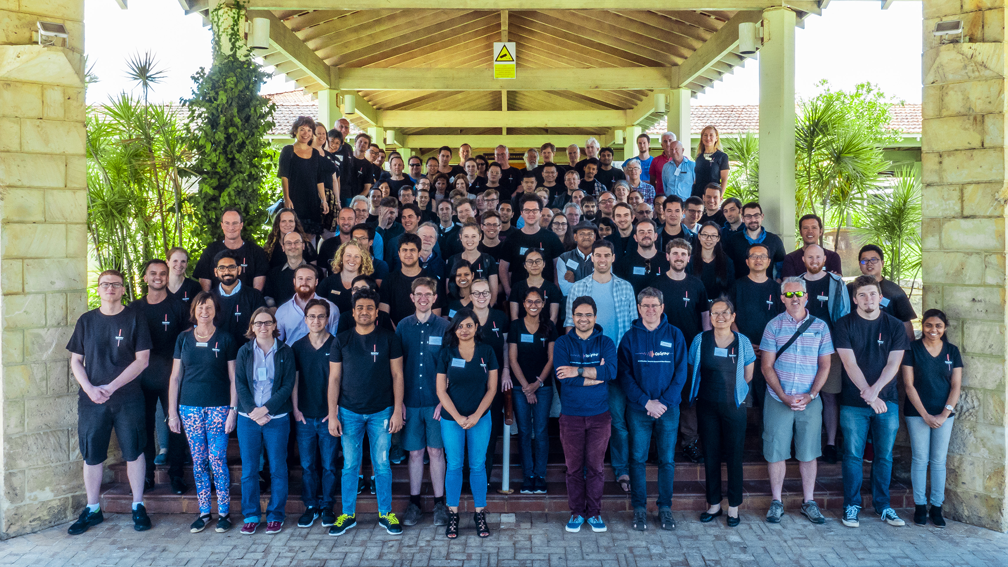
LIGO: ~1300 people across the globe
Australia:
~150 people across six universities
Instrumentation
Data analysis
Astrophysics/physics

Slide 5
14th September 2015 - GW150914
Abbott et al. (2016) - GW150914

Slide 6
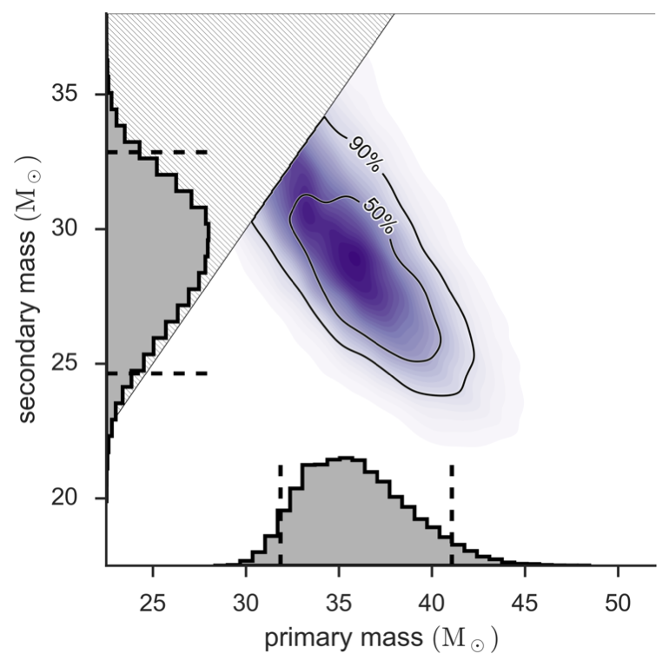
Binary Black
Hole Merger
Abbott et al. (2016) - GW150914

Slide 7
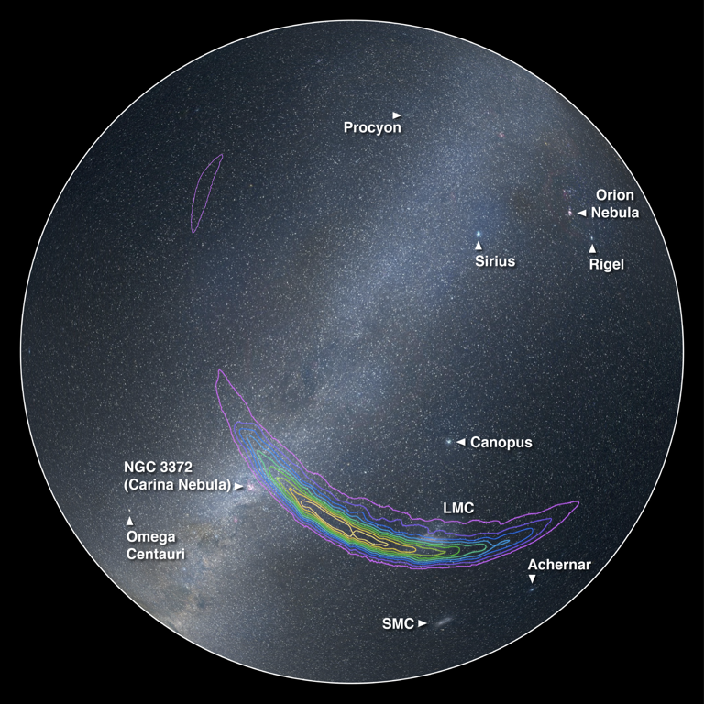
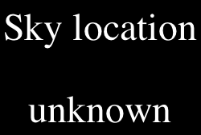
Abbott et al. (2016) - GW150914

Slide 8
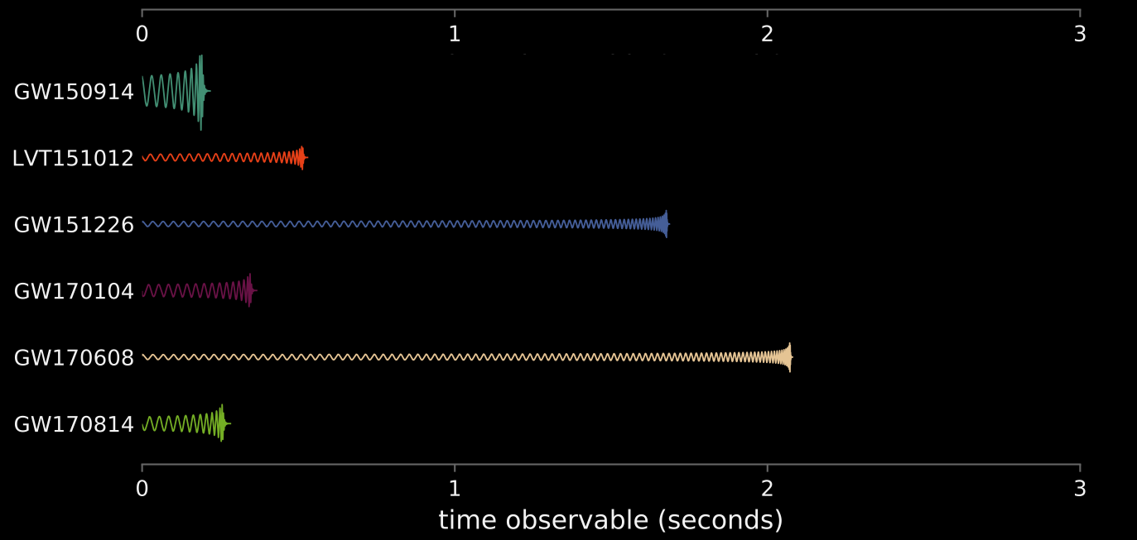

GW150914
GW151012
GW151226
GW170104
GW170608
GW170814

Slide 9
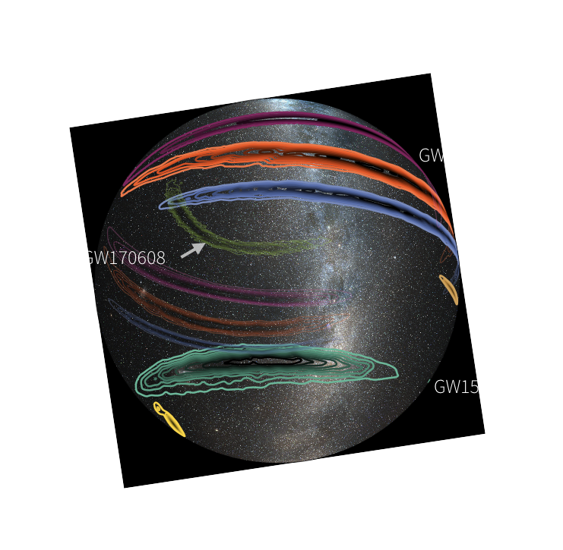

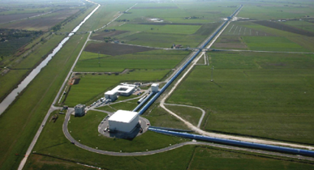
GW170104
GW151012
GW170814
GW170608
GW151226
GW150914
60 deg²

Slide 10
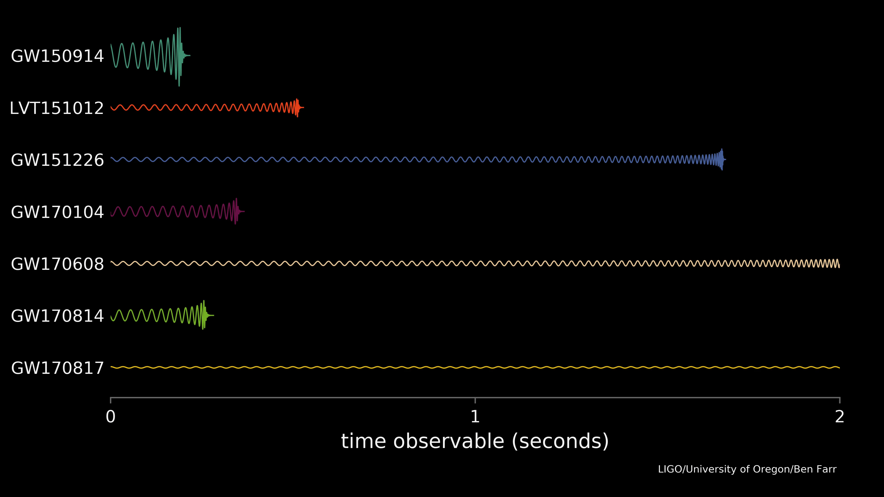
17 Aug. 2017
GW150914
GW151012
GW151226
GW170104
GW170608
GW170814
GW170817

Slide 11

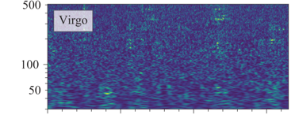
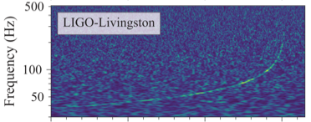
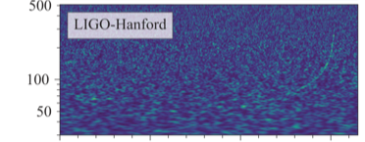
GW170104
17 Aug. 2017
GW151012
GW170608
GW151226
GW170817
GW150914
GW170814

Slide 12
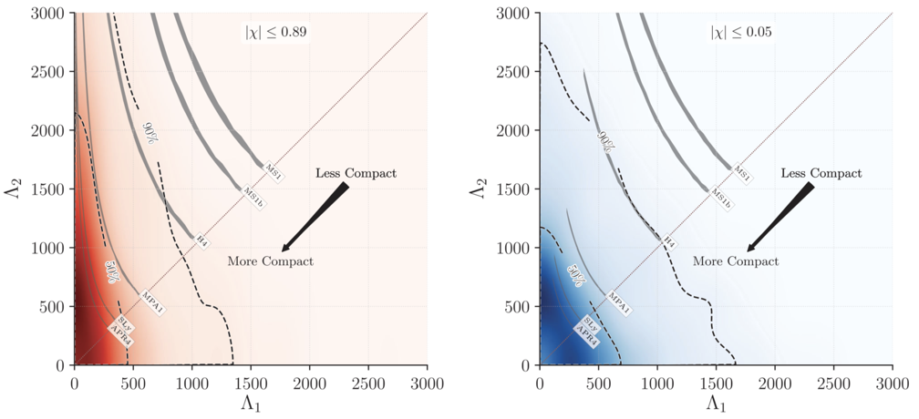
secondary mass (M☉)
secondary tidal deformability
primary mass (M☉)
primary tidal deformability

Slide 13
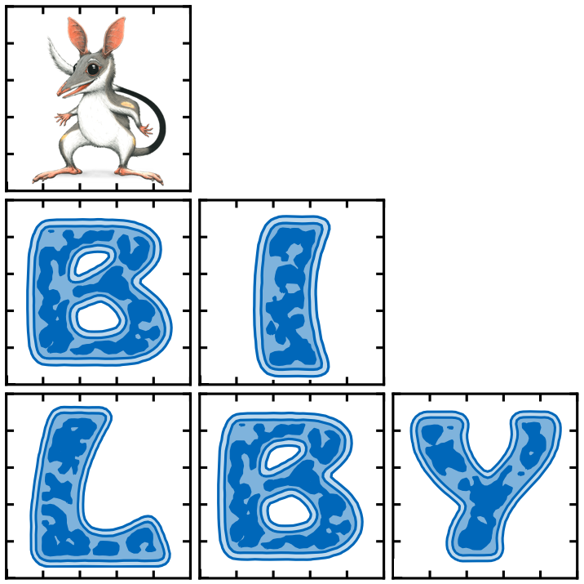


The user-friendly Bayesian inference library
for gravitational-wave astronomy
Ashton, Hübner, Lasky, Talbot et al (2018)
A parameter-estimation code being adopted for production science in next LIGO observing run.

Slide 14
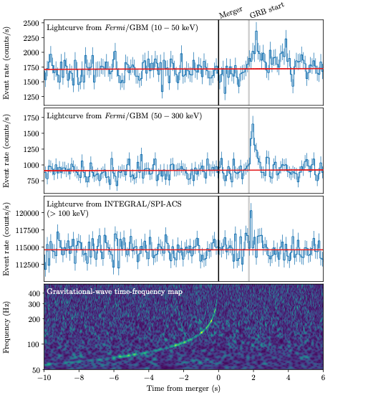

17 Aug. 2017

Slide 15
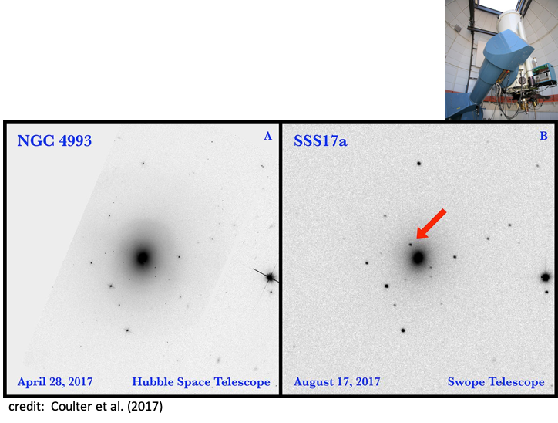
Swope – 11 hours later

Slide 16
Huge Australian Involvement
ASKAP
MWA
SkyMapper
Zadko
Parkes
DWF
ATCA
….

Slide 17
OzHF:
“A matter machine”
Modest financial investment
OzGrav future detector working group
aLIGO
binary neutron star
A+
OzHF

Slide 18
Compact Binary Mergers in the First and Second
Observing Runs of Advanced LIGO and Advanced Virgo
LIGO Hanford, Washington State
O1 12 September 2015 ⎯ 19 January 2016
O2 30 November 2016 ⎯ 25 August 2017
LIGO Livingston, Louisiana

Slide 19
Virgo detector
Cascina, Italy
Advanced Virgo detector joined O2 on 1 August 2017
This enabled the first three-detector observations of gravitational waves for 25 days

Slide 20
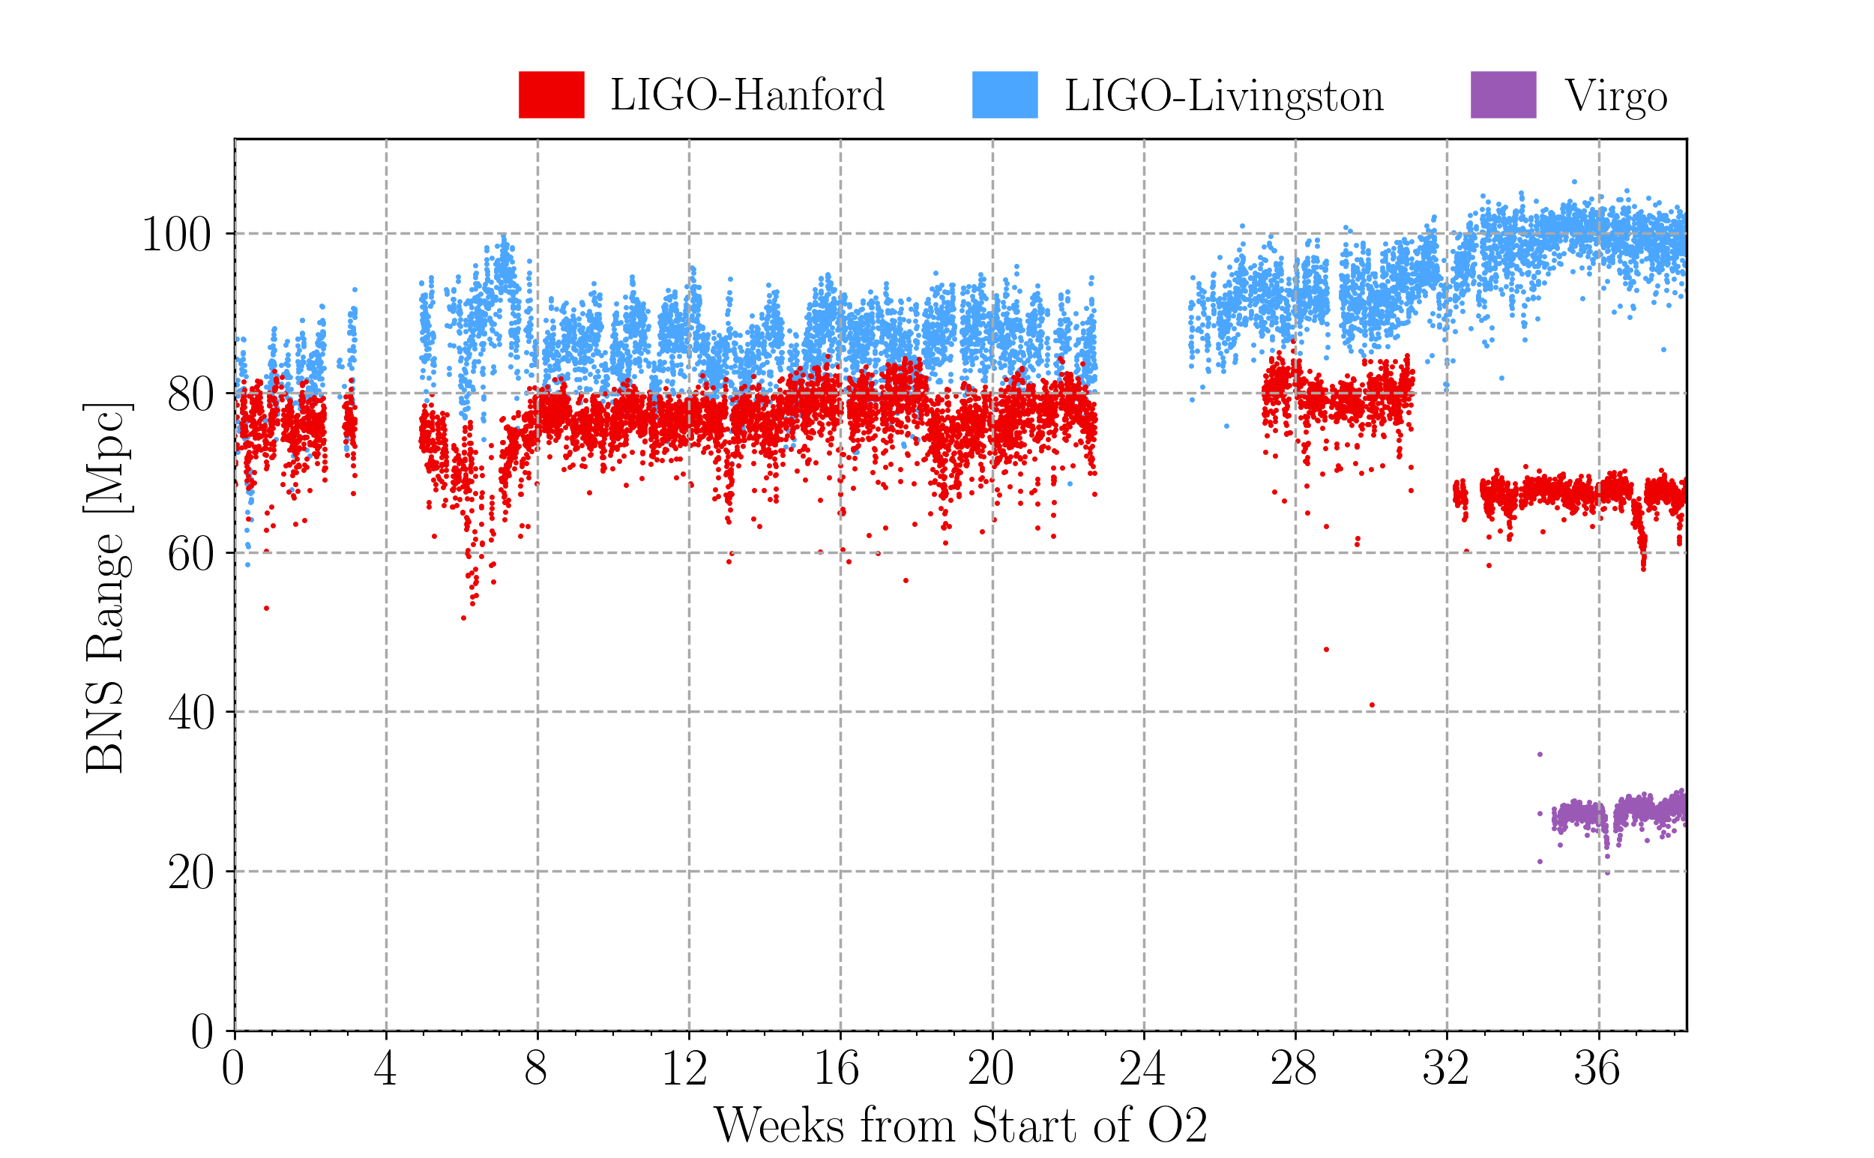
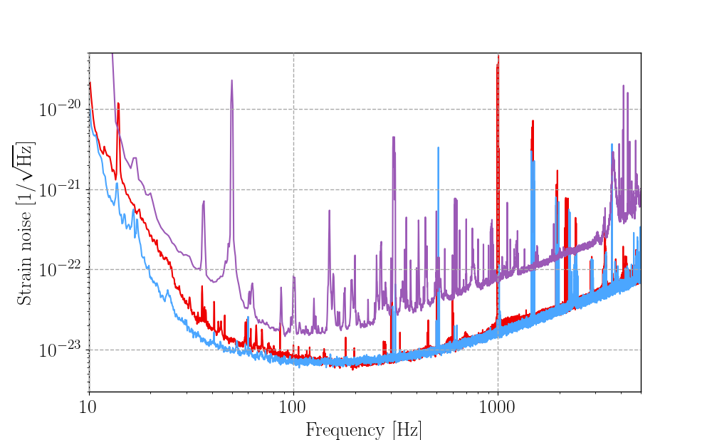
Sensitive distance to binary neutron star
mergers for each detector during O2
Total strain noise for each of the detectors
Planned break at week 3 to accommodate the 2016 end-of-year holidays
Planned break starting week 23 to make improvements to the sensitivity of the detectors
Impact of a 5.8 magnitude earthquake in Montana on LIGO Hanford sensitivity is evident at week 31

Slide 21
Compact Binary Coalescences (CBCs)
black hole – black hole black hole – neutron star neutron star – neutron star
binary black hole system
binary neutron star system

Slide 22
The network of three ground-based interferometric detectors is
sensitive to gravitational waves from the inspiral, merger and
ringdown of compact binary coalescences
Frequency range from about 20 Hz up to a few kHz
During O2 the individual LIGO detectors had duty
factors of ∼ 60% with a LIGO network duty factor of
∼ 45% resulting in 118 days of data suitable for
coincident analysis
Of this data 15 days were collected in coincident
operation with Virgo, which after joining O2
operated with a duty factor of ∼ 80%

Slide 23
NEW RESULTS
All searches have undergone further improvements since O1
We used two different matched filter searches, PyCBC and GstLAL, and the burst search cWB
The two matched filter searches assume sources that can be modelled by general relativity
− quasi-circular binaries with spin angular momenta (anti-)aligned with their orbital angular momenta
The cWB search relies on no specific physical models of the source waveform
− the only restriction imposed is that signals should be “chirping” in the time-frequency plane
For the PyCBC analysis the template bank covered binary systems with total mass from 2 to 500 solar masses
For the GstLAL analysis the template bank covered binary systems with total mass from 2 to 400 solar masses
Components of the binary with a mass less than 2 solar masses were assumed to be neutron stars with a
maximum spin magnitude of 0.05 − for black holes the maximum magnitude was 0.998 (0.999 for GstLAL)
We used a threshold on the estimated FAR of 1 per 30 days (∼12.2 per year)
Excluded any event that did not have a FAR less than this threshold in at least one of the two
matched-filter analyses

Slide 24
CATALOGUE OF EVENTS FOR O1 AND O2
Event | m₁/M☉ | m₂/M☉ | χ_{eff} | M_{f}/M☉ | E_{rad} /(M☉c²) | d_{L} /Mpc | ∆Ω/deg²
GW150914 | 35.6 | 30.6 | -0.01 | 63.1 | 3.1 | 430 | 179
GW151012 | 23.3 | 13.6 | 0.04 | 35.7 | 1.5 | 1060 | 1555
GW151226 | 13.7 | 7.7 | 0.18 | 20.5 | 1.0 | 440 | 1033
GW170104 | 31.0 | 20.1 | −0.04 | 49.1 | 2.2 | 960 | 924
GW170608 | 10.9 | 7.6 | 0.03 | 17.8 | 0.9 | 320 | 396
GW170729 | 50.6 | 34.3 | 0.36 | 80.3 | 4.8 | 2750 | 1033
GW170809 | 35.2 | 23.8 | 0.07 | 56.4 | 2.7 | 990 | 340
GW170814 | 30.7 | 25.3 | 0.07 | 53.4 | 2.7 | 580 | 87
GW170817 | 1.46 | 1.27 | 0.00 | ≤ 2.8 | ≥ 0.04 | 40 | 16
GW170818 | 35.5 | 26.8 | −0.09 | 59.8 | 2.7 | 1020 | 39
GW170823 | 39.6 | 29.4 | 0.08 | 65.6 | 3.3 | 1850 | 1651

Slide 25

Our four calling
birds of Christmas
LIGO – Virgo
Advent calendar 2018

Slide 26
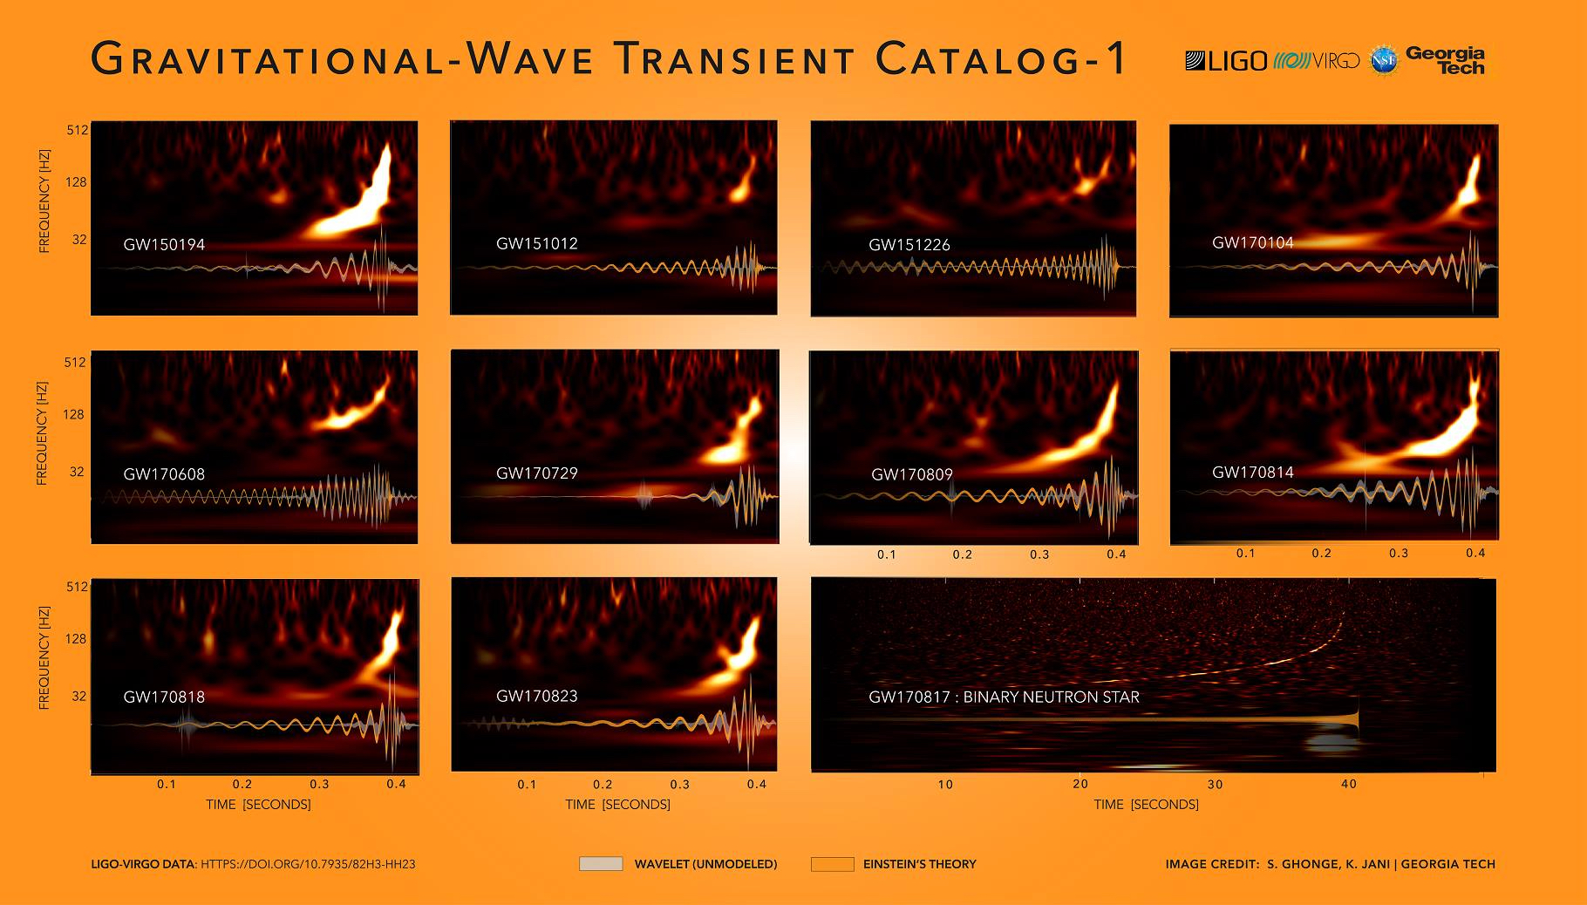

Slide 27
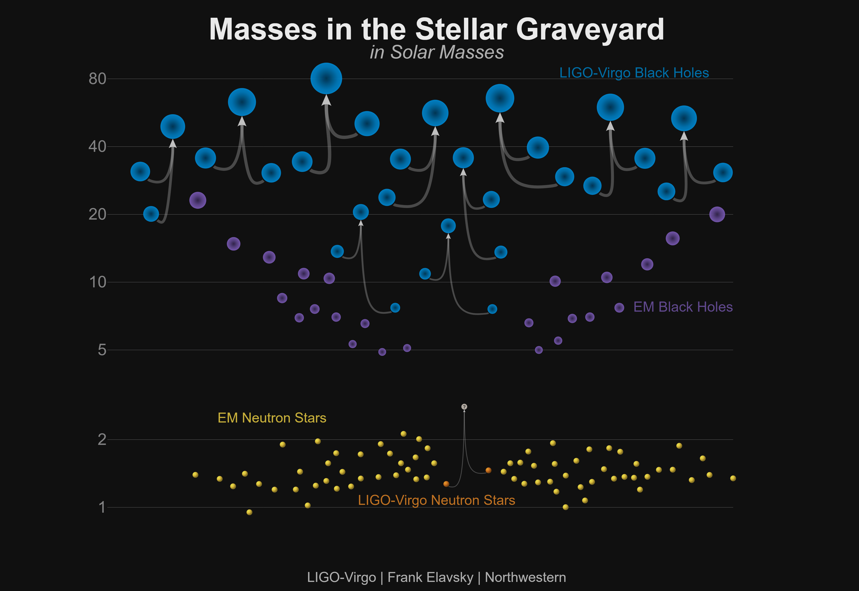

Slide 28
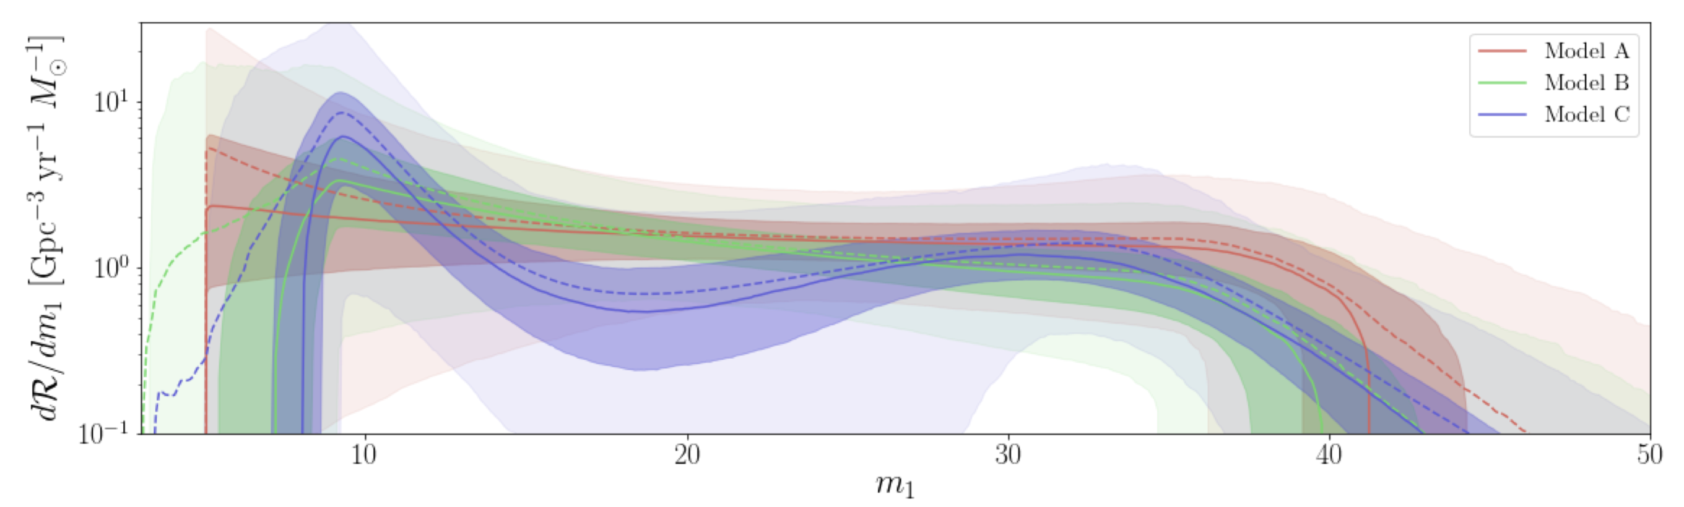
“Rates & Population” paper
Structure in the black-hole mass spectrum
Made in Australia!

Slide 29
dimensionless spin
magnitude a_{f} of the
final black hole
mass M_{f} of the
final black hole
the contours show 90% credible regions

Slide 30
What do these results tell us?
The component masses of the detected black hole binaries cover a wide range from ∼ 5 M☉ to
∼ 70 M☉ and lie within the range expected for stellar mass black holes
The final black hole in GW170729 grazes the lower boundary of the possible mass gap expected
from pulsational pair instability and pair instability supernovae at ∼ 60 − 120 M☉
The lowest mass binary black hole systems, GW151226 and GW170608, have 90% credible lower
bounds on m₂ of 5.6 M☉ and 5.9 M☉ and therefore lie above the proposed black hole mass gap
region of 2−5 M☉
We can measure best an averaged projection of the spins parallel to the Newtonian orbital angular
momentum of the binary black hole system
Positive (negative) values of χ_{eff} increase (decrease) the number of orbits from any given
separation to merger with respect to a non-spinning binary black hole system
None of the binary black hole detections exhibit clear precession

Slide 31
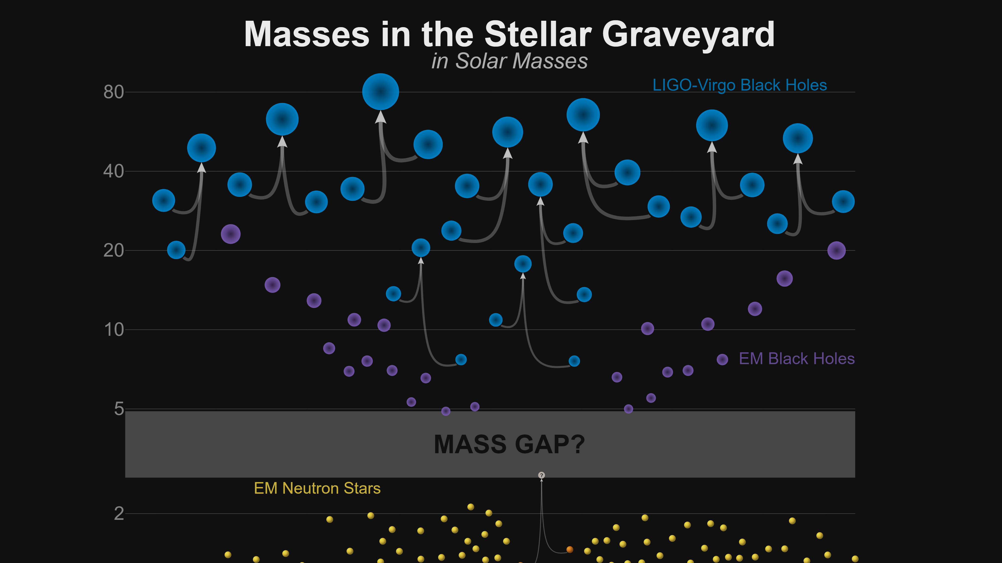

Slide 32
Inferred merger rates
The data for O1 and O2 include approximately one gravitational wave detection per 15 days of
data searched
Inferred merger rates at the 90% confidence intervals:
9.7−101 Gpc⁻³ y⁻¹ for binary black holes
110−3840 Gpc⁻³ y⁻¹ for binary neutron stars
a neutron star – black hole merger rate 90% upper limit of 610 Gpc⁻³ y⁻¹

Slide 33
Even with ten binary black hole detections and one binary neutron star detection, several
outstanding questions remain regarding the origin and evolution of the detected binaries
To date, no binary components have been observed in either of the two putative mass gaps – one
between neutron stars and black holes and the other one due to pair instability supernovae
More intriguingly, the component spins, when measurable, tend to favour small magnitudes –
this contrasts with the sample of Galactic X-ray binaries, which have a spread encompassing the
entire range of allowed values
Note, however, that spin magnitudes could be relatively large, but tilted into the orbital plane.
This would favour a formation scenario where no spin alignment process is present, e.g., assembly
in globular clusters
Studies indicate that with a few hundred detections, more detailed formation scenarios and
evolutionary details can be parsed from the population

Slide 34
Anticipated rates of detection in O3
Binary black holes: at least a few per month, maybe more
Binary neutron stars: 1-10, possibly up to ∼1 per month
Neutron star and black hole binary: could detect
one or more in O3, but uncertain. We’ll see!

Slide 35
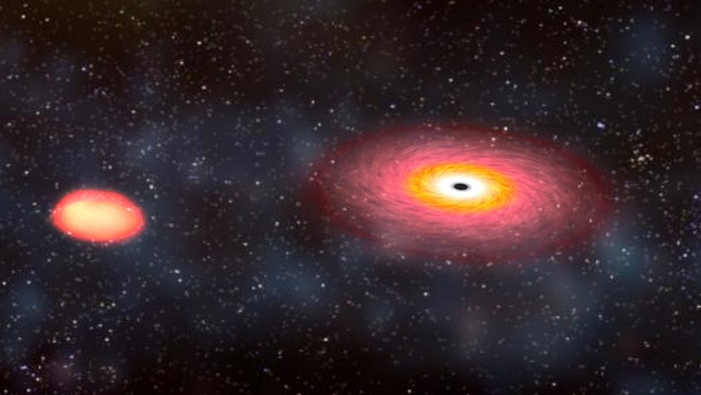

Slide 36
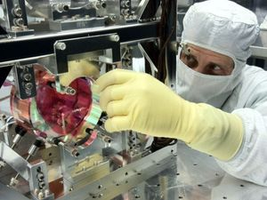
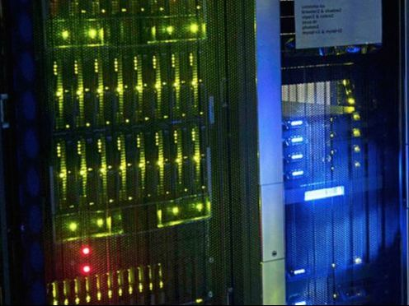
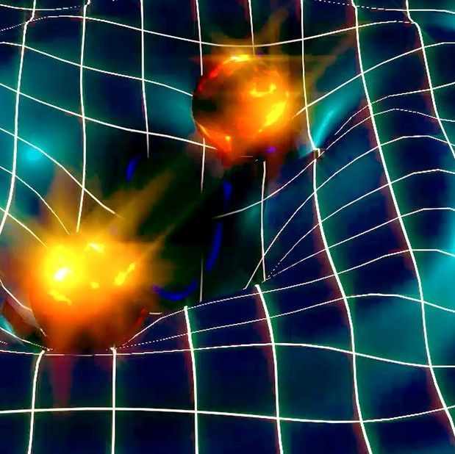
ARC Centre of Excellence for Gravitational Wave Discovery
INSTRUMENTATION DATA ASTROPHYSICS

