Slide 1


Dommenget et al.
Notes:
Abstract: ENSO variability has a seasonal phase locking, with SST anomalies decreasing during the beginning of the year and SST anomalies increasing during the second half of the year. In this study it is shown that the seasonal phase locking as observed exist in model simulations of the linear recharge oscillator and in the slab ocean model coupled to a fully complex AGCM. It suggests that atmospheric feedbacks can lead to the seasonal phase locking in different ways. In the slab ocean model simulation the seasonal phase locking is primarily caused by state dependent cloud feedbacks that are negative during warm SST seasons (beginning of the year) and positive during cold SST seasons (second half of the year).

Slide 2
Overview
The Slab Ocean El Nino
Teleconnections delayed feedback
Non-linearity
Seasonality (spring barrier)
CP vs. EP
How good are the CMIP models?
Climate Change
Notes:
Outline:
Outline
Motivation
Methods: EOF-modes example (Fig.2)
Methods: EOF-methods
Methods: EOF-methods
Methods: fig.3
Methods: null hypo
Methods high vs. low pass
Trop Indo-Pacific
Trop Indo-Pacific
Trop Atl.
Trop Atl.
N. Pac
N. Pac
N Atl.
N Atl.
S-ocean
S-ocean
Global summary
Super model
Super model
EOF-errors
Extra-tropics
Summary
Outlook climate change

Slide 3
Overview
The Slab Ocean El Nino
Teleconnections delayed feedback
Non-linearity
Seasonality (spring barrier)
CP vs. EP
How good are the CMIP models?
Climate Change
Notes:
Outline:
Outline
Motivation
Methods: EOF-modes example (Fig.2)
Methods: EOF-methods
Methods: EOF-methods
Methods: fig.3
Methods: null hypo
Methods high vs. low pass
Trop Indo-Pacific
Trop Indo-Pacific
Trop Atl.
Trop Atl.
N. Pac
N. Pac
N Atl.
N Atl.
S-ocean
S-ocean
Global summary
Super model
Super model
EOF-errors
Extra-tropics
Summary
Outlook climate change

Slide 4
Slab Ocean
The Odd ENSO
Atmospheric GCM / Slab ocean
No Ocean Dynamics (Rossby/Kelvin waves)
No Thermocline variability
Only heat capacity
All lateral dynamics are from Atmosphere
Dommenget [2010]

Slide 5
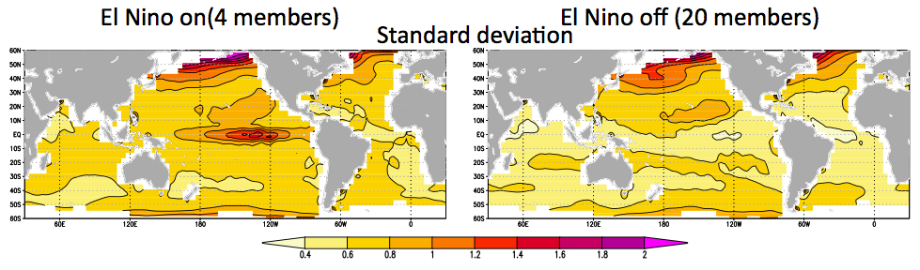
The Slab Ocean El Nino
SST standard deviation
20 slab ocean models
4 slab ocean models
Dommenget [2010]

Slide 6
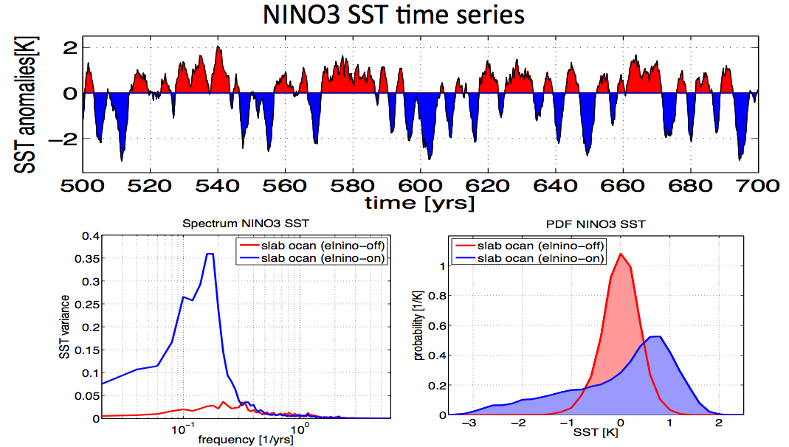
The Slab Ocean El Nino
Dommenget [2010]

Slide 7
The Slab Ocean El Nino Dynamics
Decay phase
Mature phase
Neutral mean state
Initial phase
Dommenget [2010]

Slide 8
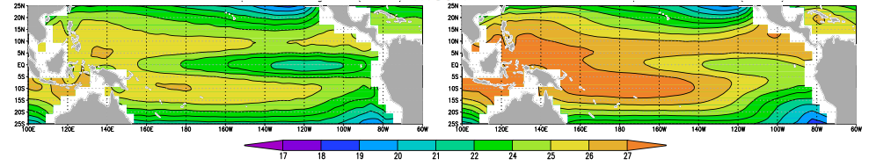
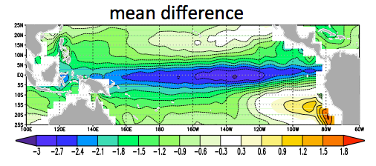
The Slab Ocean El Nino
SST mean state dependence
El Nino OFF: 20 models
El Nino ON: 4 models
El Nino ON: mean difference
Dommenget [2010]

Slide 9
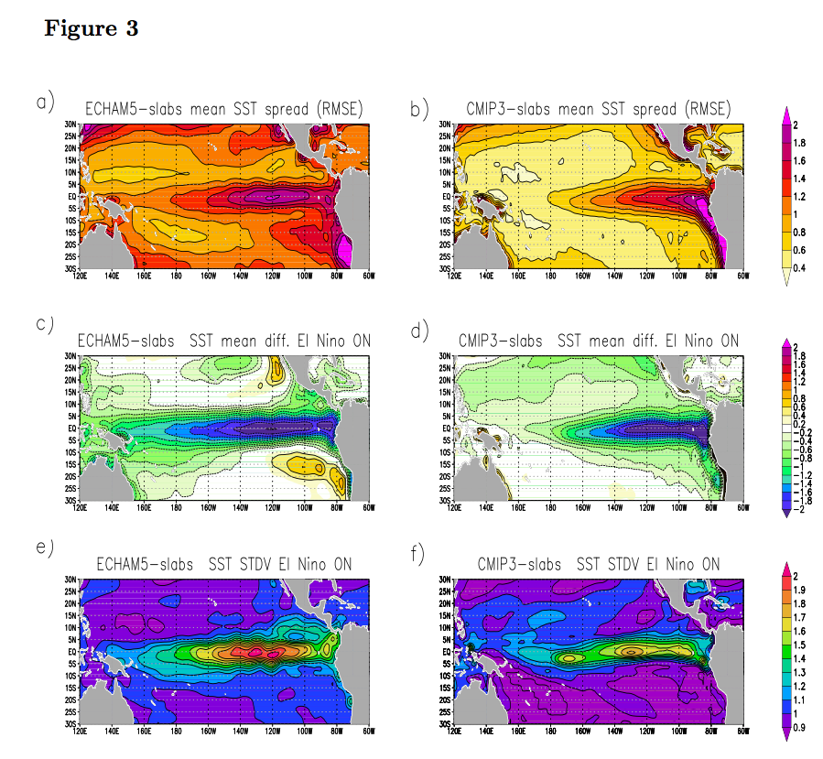
CMIP3 AGCM-slab-oceans
ECHAM5-slab
CMIP3 slabs (13 models)
Mean SST RMSE relative to ensemble mean
Mean SST of runs with stdv NINO3 >0.5K
Ratio SST stdv NINO3 [cold NINO3]/[all]

Slide 10
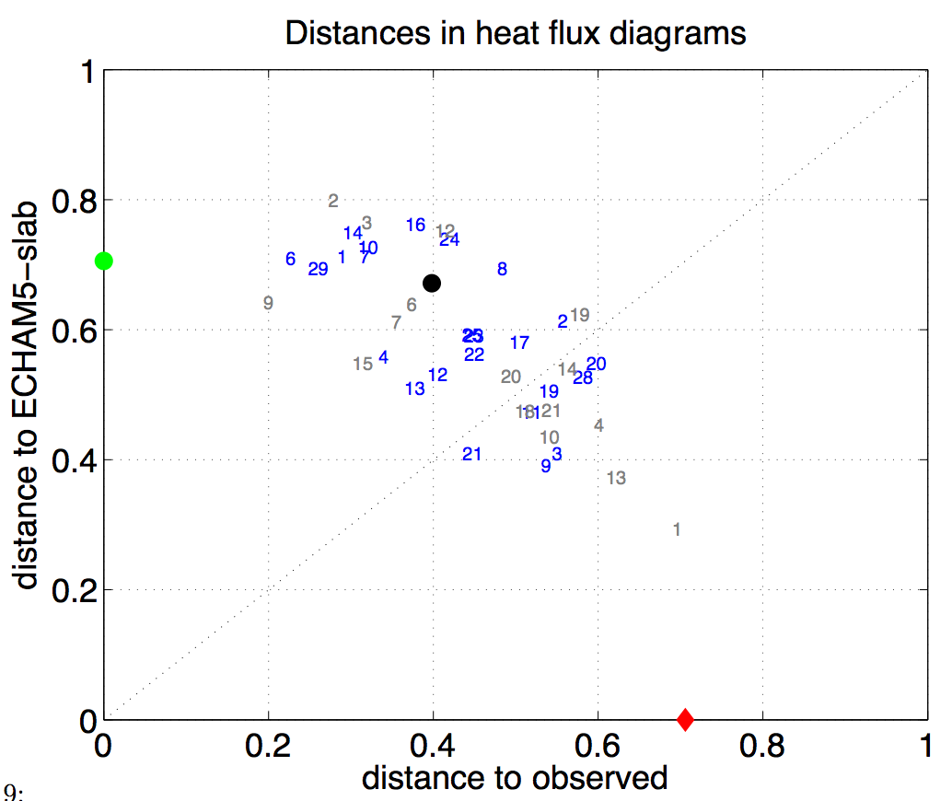
CMIP Models: Simulated heat flux feedbacks
CMIP3
CMIP5
Obs.
Slab Ocean
CGCM3.1(T63)
GISS−AOM
ACCESS1
CCSM4
GFDL−ESM2M
NorESM1−ME
BCCR−BCM2.0
CNRM−CM3
GISS−EH
INM−CM3.0
BCC−CSM1−1
CSIRO−Mk3.6
INMCM4
Negative cloud/sensible feedback
Weak/normal cold tongue
Positive cloud/sensible feedback
Strong cold tongue
East-2-West propagation
[Dommenget et al. 2014]

Slide 11
Summary: The Slab Ocean El Nino
El Nino SST variability can exist in models without ocean dynamics
Cloud and turbulent flux feedbacks can create an atmospheric El Nino
It exist if the eq. cold tongue is very cold
This exist in many, if not all AGCMs coupled to slab oceans
These feedbacks exist in observations
These feedbacks exist in many CGCMs
The El Nino in CGCMs follows different dynamics, some are atmospherically driven (at least partly)

Slide 12
Overview
The Slab Ocean El Nino
Teleconnections delayed feedback
Non-linearity
Seasonality (spring barrier)
CP vs. EP
How good are the CMIP models?
Climate Change
Notes:
Outline:
Outline
Motivation
Methods: EOF-modes example (Fig.2)
Methods: EOF-methods
Methods: EOF-methods
Methods: fig.3
Methods: null hypo
Methods high vs. low pass
Trop Indo-Pacific
Trop Indo-Pacific
Trop Atl.
Trop Atl.
N. Pac
N. Pac
N Atl.
N Atl.
S-ocean
S-ocean
Global summary
Super model
Super model
EOF-errors
Extra-tropics
Summary
Outlook climate change

Slide 13
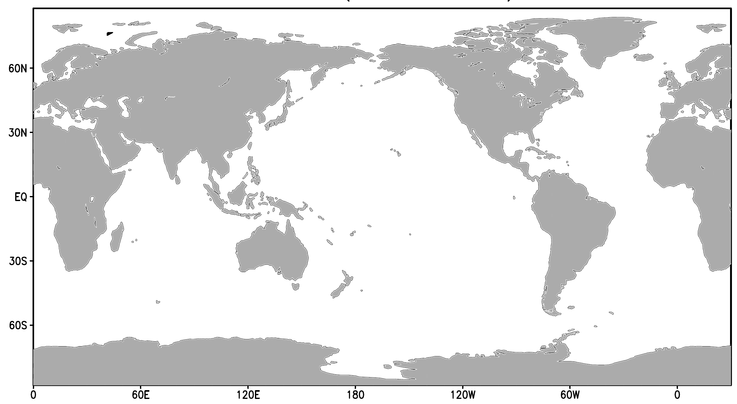
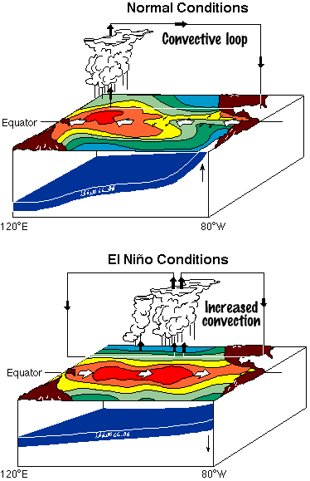
El Nino Delayed Negative Feedback
Textbook knowledge:
ENSO Delayed negative feedback is due to ocean dynamics (Rossby/Kelvin waves)
ENSO teleconnections influence remote regions
Remote regions do not influence ENSO dynamics
Recent findings:
-
-
+
+
[Kug and Kang 2006]
[Dommenget et al. 2006]
[Jansen et al. 2009]
[Ham et al. 2013]
… many others

Slide 14
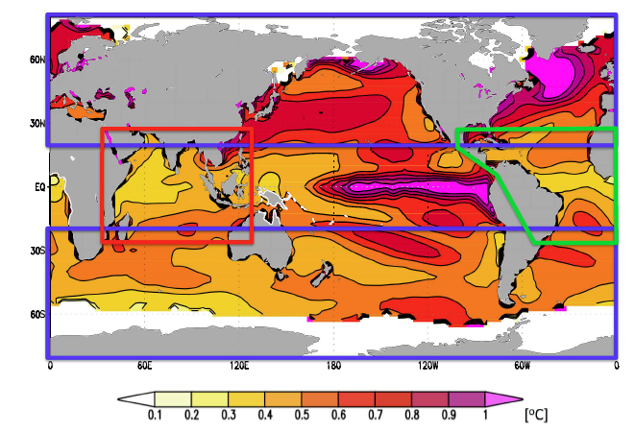
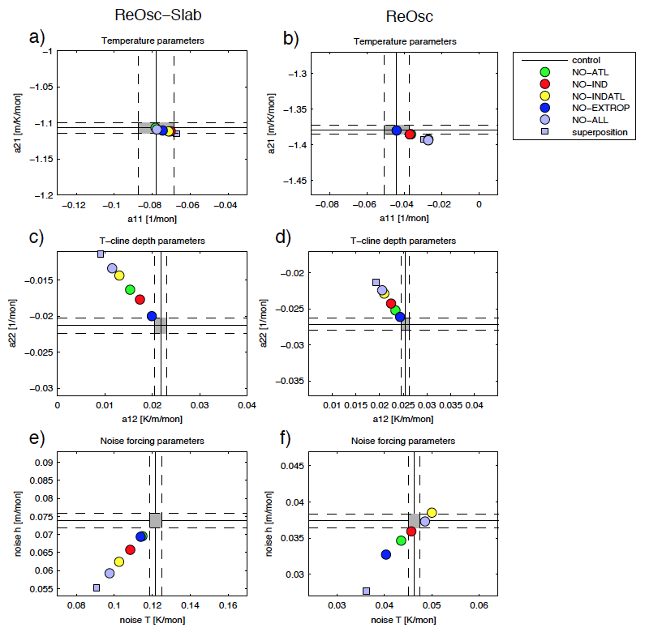
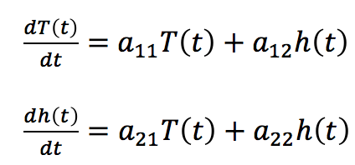
Simulation with decoupled regions
ACCESS-ReOsc-Slab with decoupled regions (500yrs)
Delayed Negative Feedback for T

Slide 15
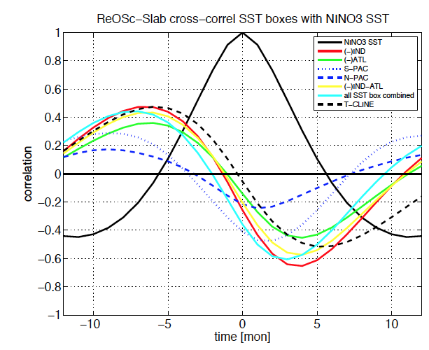
NINO3 SST lag-lead cross-corelation

Slide 16
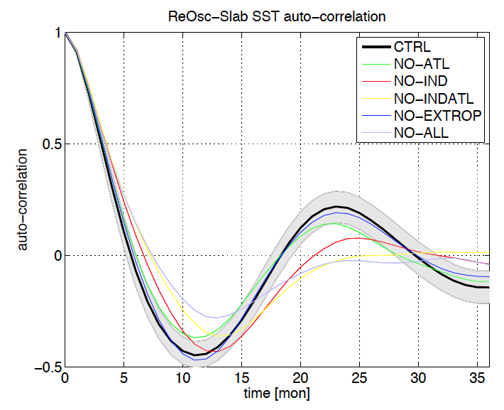
NINO3 SST auto-correlation

Slide 17
Summary: Teleconnections delayed feedback
Remote regions influence ENSO dynamics, variability and pattern.
The remote regions are a delayed negative feedback.
About 40% of ENSO delayed negative feedback is from the coupling to remote regions.

Slide 18
Overview
The Slab Ocean El Nino
Teleconnections delayed feedback
Non-linearity
Seasonality (spring barrier)
CP vs. EP
How good are the CMIP models?
Climate Change
Notes:
Outline:
Outline
Motivation
Methods: EOF-modes example (Fig.2)
Methods: EOF-methods
Methods: EOF-methods
Methods: fig.3
Methods: null hypo
Methods high vs. low pass
Trop Indo-Pacific
Trop Indo-Pacific
Trop Atl.
Trop Atl.
N. Pac
N. Pac
N Atl.
N Atl.
S-ocean
S-ocean
Global summary
Super model
Super model
EOF-errors
Extra-tropics
Summary
Outlook climate change

Slide 19
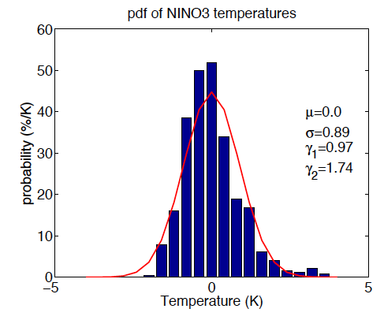
El Nino non-linearity
El Ninos are stronger than La Ninas
SST has positive skewness
La Nina
El Nino

Slide 20
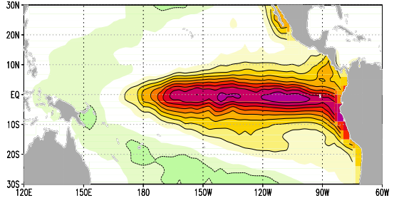
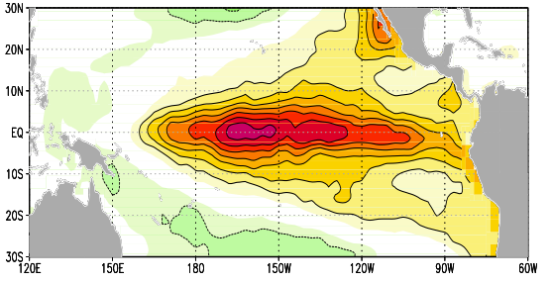
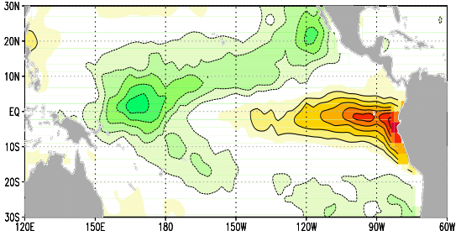
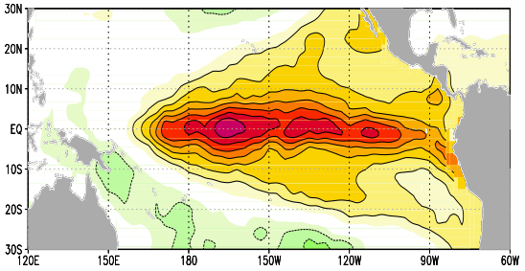
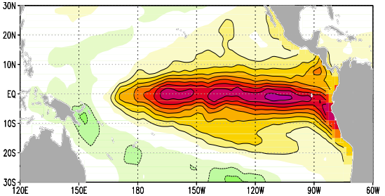
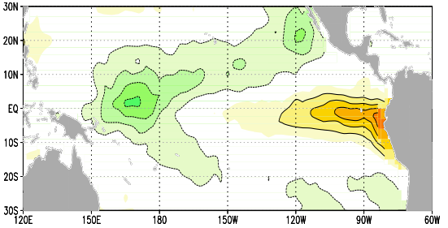
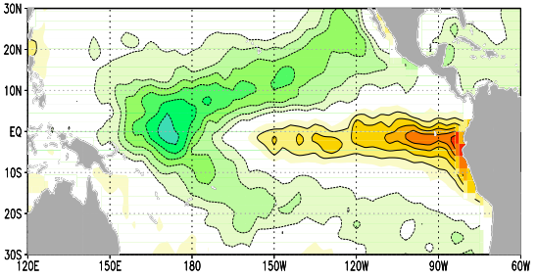
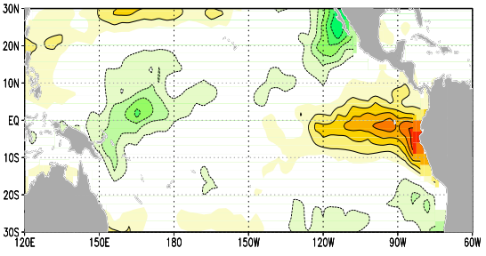
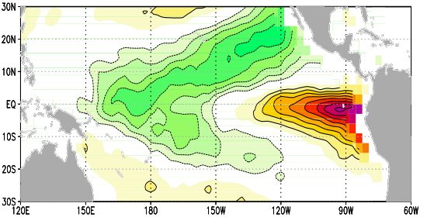
Pattern non-linearity
A Strong El Niño
B Strong La Niña
Diff. Strong A - B
C Weak El Niño
D Weak La Niña
Diff. Weak D - C
[K/K]
Diff. El Niño C - A
Diff. La Niña D - B
EOF-2
Composites are normalized by the mean NINO3.4 SST

Slide 21
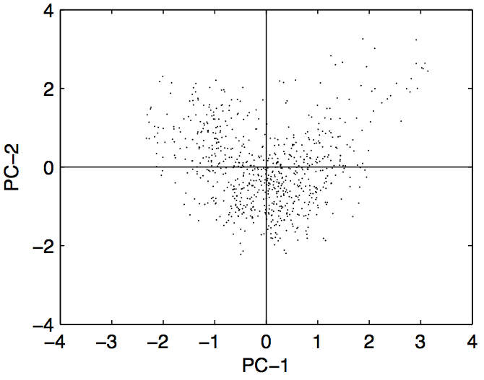
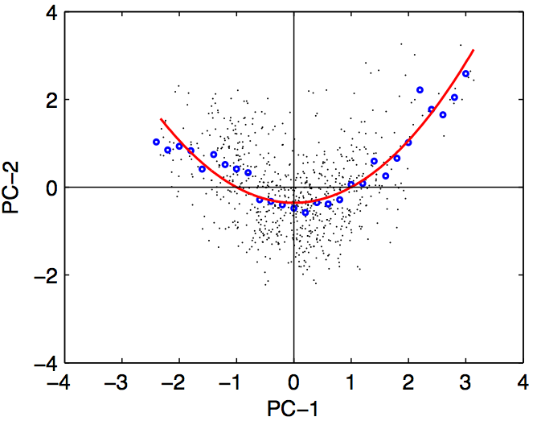
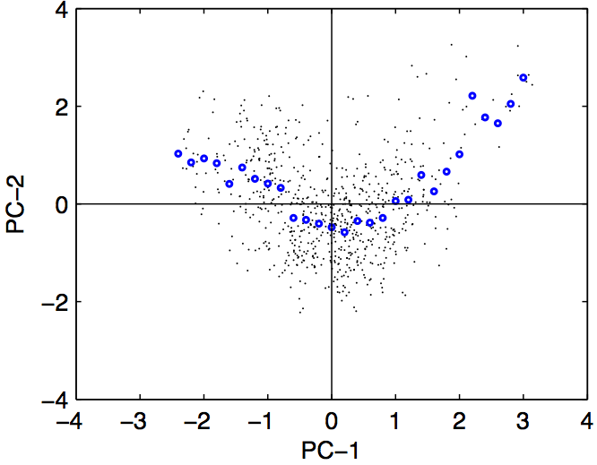
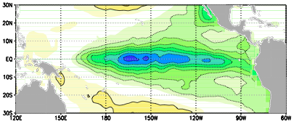
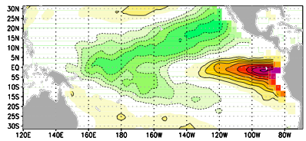
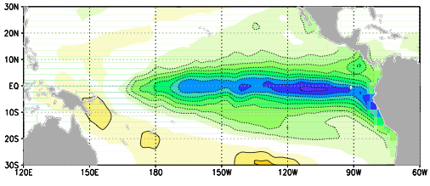
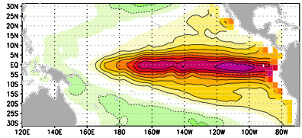
Pattern non-linearity
Strong La Niña
Strong El Niño
PC-2
Weak La Niña
Weak El Niño
[Takahashi et al. 2011]
[Dommenget et al. 2013]

Slide 22
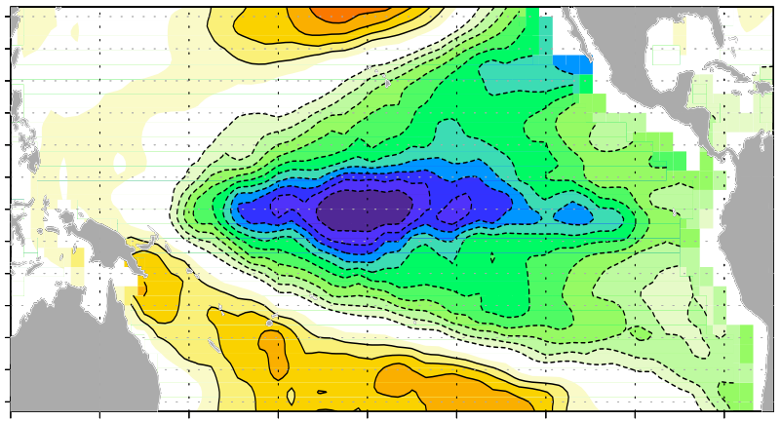
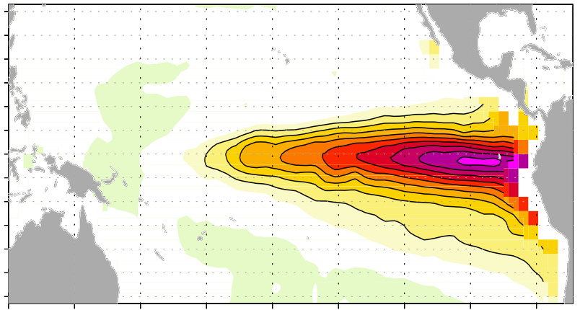
Idealized ENSO patterns
La Niña
El Niño

Slide 23
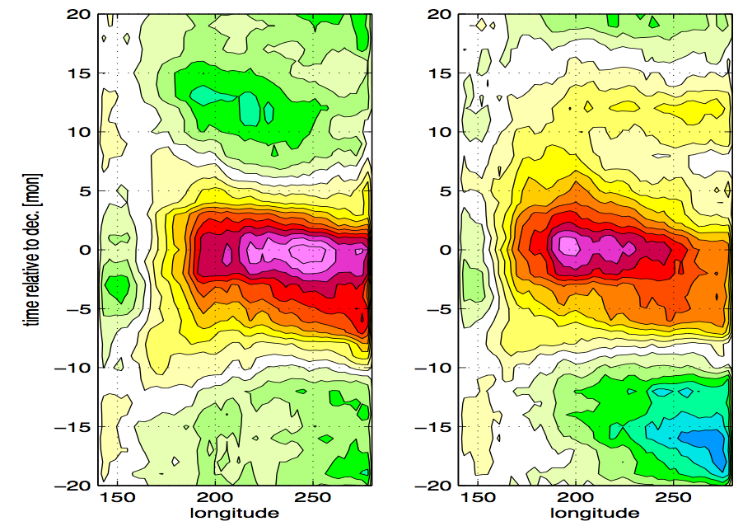
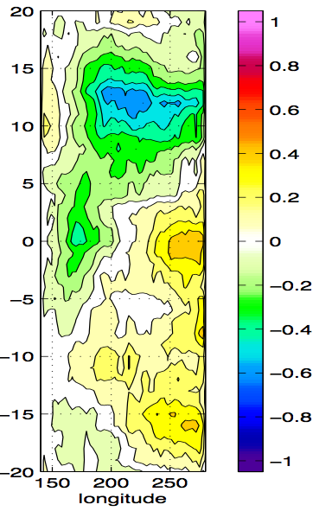
Time Evolution non-linearity
Strong El Niño
Strong La Niña
difference
[K/K]
Composites are normalized by the mean NINO3.4 SST at lag 0

Slide 24
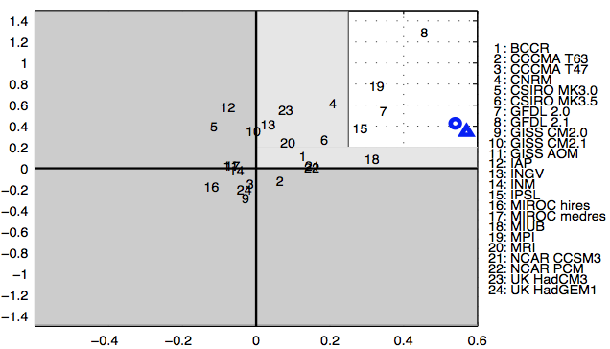
CMIP model non-linearity: pattern vs. time evolution
time evolution difference
Pattern difference

Slide 25
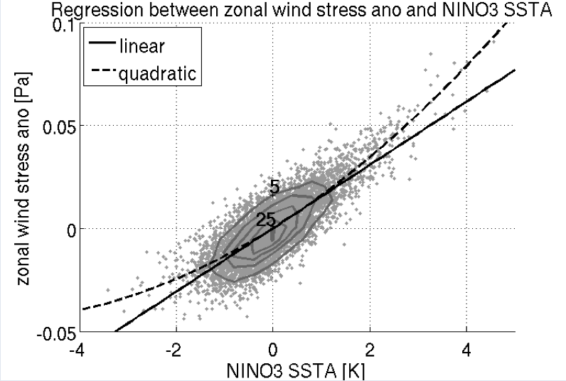
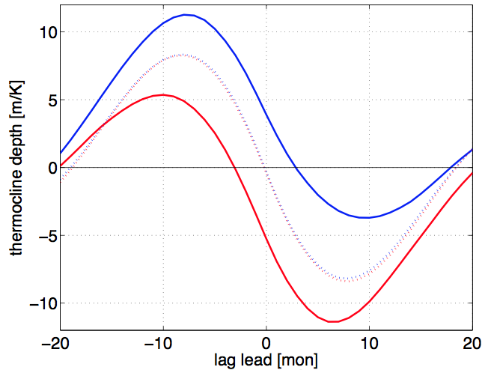

Wind-SST non-linearity
Wind response
Thermocline depth evolution
Model simulation with linear ocean
dashed: linear
solid: non-linear

Slide 26
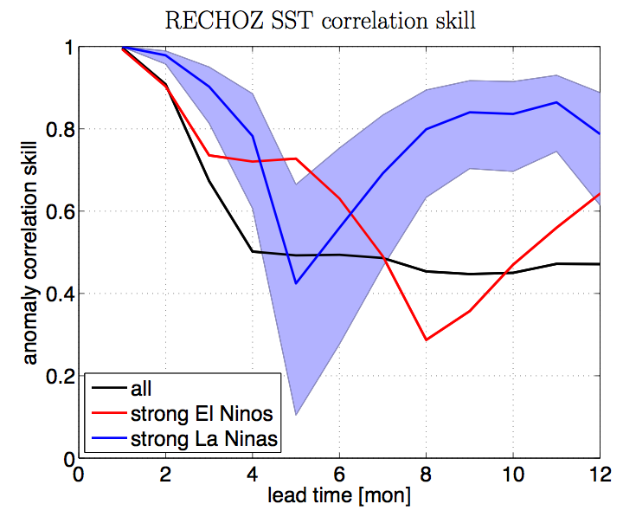
RECHOZ Model Forecasts
Wind-SST non-linearity
100 perfect model forecast
Anomaly correlation skill
Jan.
Dec.

Slide 27
Summary: non-linearity
Pattern non-linearity:
  strong El Ninos are to the east
  strong La Ninas are further west
  Vice versa for weak events
Time evolution non-linearity:
  strong El Ninos are followed by La Ninas
  strong La Ninas are preceded by El Ninos
  Vice versa for weak events
Wind Feedback non-linearity:
  strong El Ninos are forced by stronger zonal winds
  Strong La Ninas are forced by stronger thermocline depth anomalies
  The stronger thermocline depth is caused by the non-linear zonal wind
Predictability non-linearity:
  strong La Ninas are better predictable than strong El Ninos

Slide 28
Overview
The Slab Ocean El Nino
Teleconnections delayed feedback
Non-linearity
Seasonality (spring barrier)
CP vs. EP
How good are the CMIP models?
Climate Change
Notes:
Outline:
Outline
Motivation
Methods: EOF-modes example (Fig.2)
Methods: EOF-methods
Methods: EOF-methods
Methods: fig.3
Methods: null hypo
Methods high vs. low pass
Trop Indo-Pacific
Trop Indo-Pacific
Trop Atl.
Trop Atl.
N. Pac
N. Pac
N Atl.
N Atl.
S-ocean
S-ocean
Global summary
Super model
Super model
EOF-errors
Extra-tropics
Summary
Outlook climate change

Slide 29
Seasonality (spring barrier)
Observed STDV NINO3 SST
Standard deviation [C]
Calendar month

Slide 30
Observed seasonal cross-correl: NINO3 SST vs. tendencies
SST lags time [mon] SST leads

Slide 31
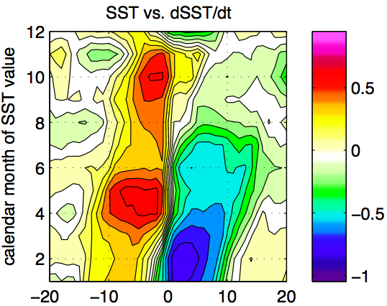
Observed seasonal cross-correl: NINO3 SST vs. tendencies
SST lags time [mon] SST leads

Slide 32
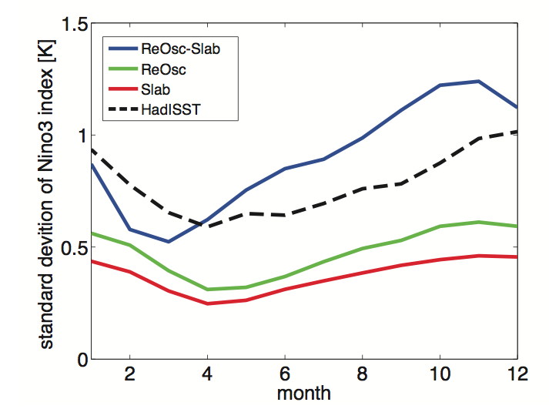
Model STDV NINO3 SST
standard deviation NINO3 SST [ºC]

Slide 33
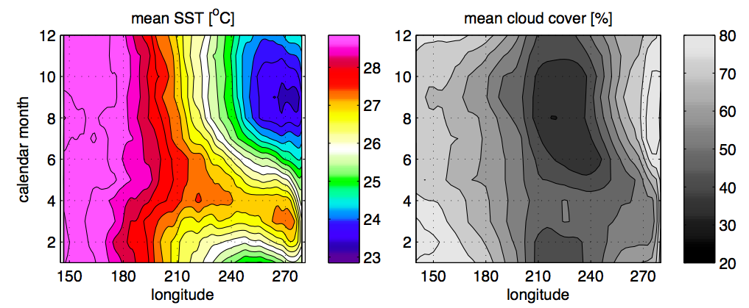
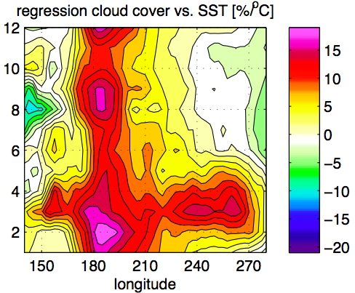
Eq. Pacific seasonal mean state & cloud feedback
Cloud cover (ISCCP) [%]
State dependent Cloud feedback

Slide 34


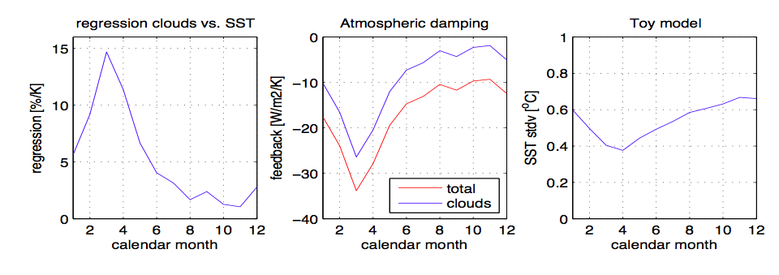
Simple cloud-short-wave feedback model
(NINO3)
SST standard deviations of toy models

Slide 35
Summary: Seasonality (spring barrier)
Seasonally changing cloud feedbacks are likely to contribute to the seasonal phase locking of ENSO.
The warmer mean SST supports stronger negative cloud feedbacks.
Slab ocean and ENSO-recharge oscillator both have similar seasonal phase locking.
Both are similar to observed.
Both contribute to the total eq. SST variability.

Slide 36
Overview
The Slab Ocean El Nino
Teleconnections delayed feedback
Non-linearity
Seasonality (spring barrier)
CP vs. EP
How good are the CMIP models?
Climate Change
Notes:
Outline:
Outline
Motivation
Methods: EOF-modes example (Fig.2)
Methods: EOF-methods
Methods: EOF-methods
Methods: fig.3
Methods: null hypo
Methods high vs. low pass
Trop Indo-Pacific
Trop Indo-Pacific
Trop Atl.
Trop Atl.
N. Pac
N. Pac
N Atl.
N Atl.
S-ocean
S-ocean
Global summary
Super model
Super model
EOF-errors
Extra-tropics
Summary
Outlook climate change

Slide 37
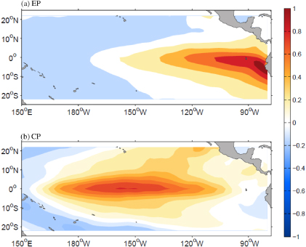
ENSO diversity: CP vs. EP
East Pacific (EP) El Nino
Central Pacific (EP) El Nino

Slide 38
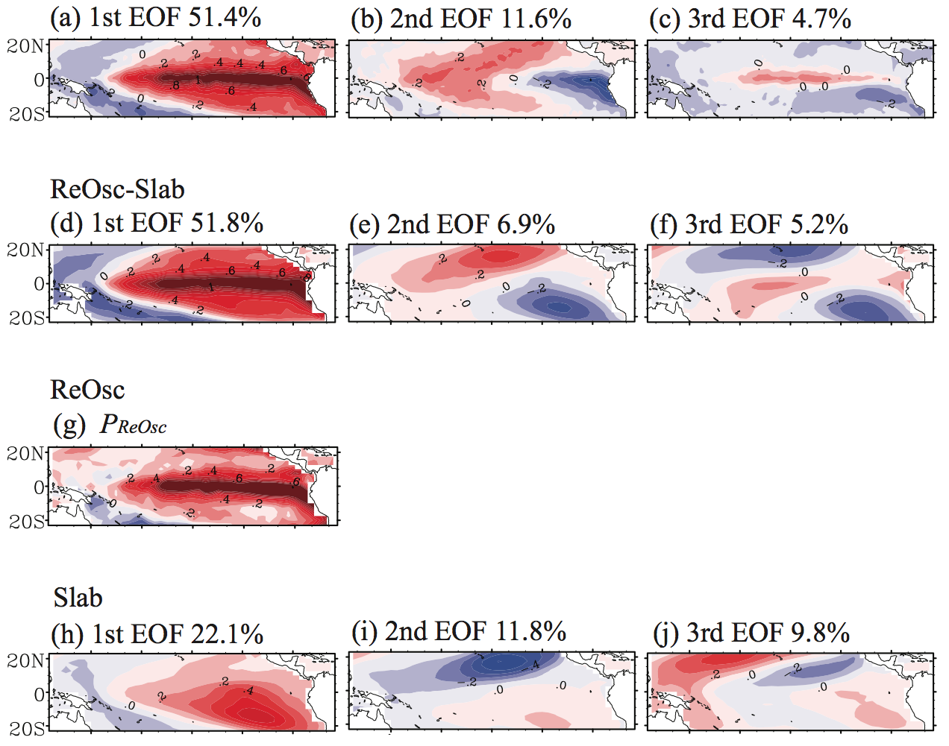
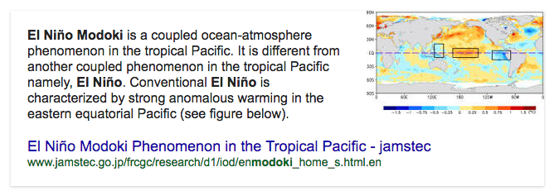
ENSO diversity
Observations
El Nino Modoki
[Ashok et al. 2007]

Slide 39
ENSO diversity
Observations
El Nino Modoki
[Ashok et al. 2007]
  A Cautionary Note
Don’t trust Google!
EOF-mode = statistical mode ≠ physical mode
An EOF-mode is a superposition of many physical modes
EOF-modes are not independent of each other
El Nino Modoki (EOF-2) is not a physical mode

Slide 40
ENSO diversity
Our Hypothesis:
CP El Nino / El Nino Modoki:

Slide 41
ENSO diversity: non-linearity
Strong La Niña
Strong El Niño
PC-2
Weak La Niña
Weak El Niño
[Takahashi et al. 2011]
[Dommenget et al. 2013]

Slide 42
ENSO diversity: Red Noise
Observations
1st EOF 100%
ReOsc
Slab
(red noise)
ReOsc-Slab
[Yu et al. 2016]

Slide 43
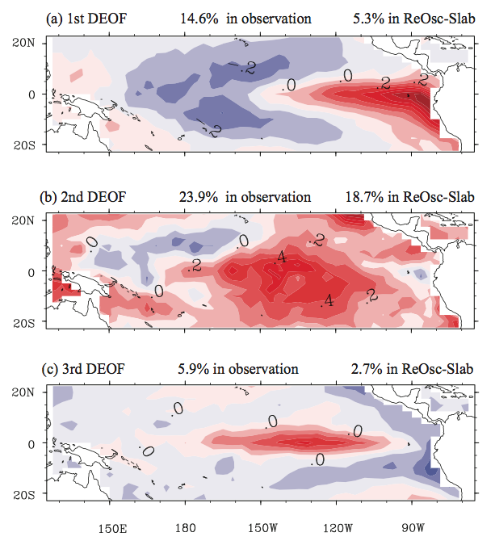
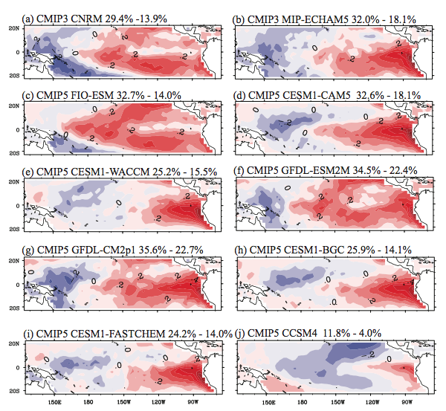
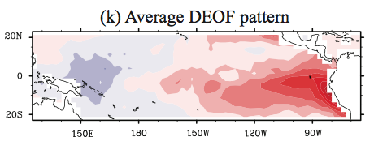
ENSO diversity simulations: missing pattern
ReOsc-Slab
1st DEOF 14.6% obs 5.3% model
CMIP models
[Yu et al. 2014, submitted]

Slide 44
Summary: ENSO diversity
CP El Nino / El Nino Modoki:
Red Noise: A single mode (ReOsc) interacting with Slab Ocean
Non-Linearity: El Ninos and La Ninas have different patterns due to wind-sst interaction.
Dynamics: Some eq. ocean dynamics of smaller scales; GCMs can not simulate well.

Slide 45
Overview
The Slab Ocean El Nino
Teleconnections delayed feedback
Non-linearity
Seasonality (spring barrier)
CP vs. EP
How good are the CMIP models?
Climate Change
Notes:
Outline:
Outline
Motivation
Methods: EOF-modes example (Fig.2)
Methods: EOF-methods
Methods: EOF-methods
Methods: fig.3
Methods: null hypo
Methods high vs. low pass
Trop Indo-Pacific
Trop Indo-Pacific
Trop Atl.
Trop Atl.
N. Pac
N. Pac
N Atl.
N Atl.
S-ocean
S-ocean
Global summary
Super model
Super model
EOF-errors
Extra-tropics
Summary
Outlook climate change

Slide 46
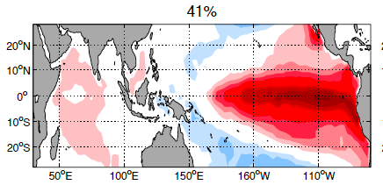




ENSO pattern

Slide 47
EOF-modes: Models vs. Obs. error
Model Errors In EOF-modes
RMSE_{EOF} (long time scales; >5yrs)
RMSE_{EOF} (short time scales; <5yrs) [% of eigenvalues]
Notes:
Outline:
Outline
Motivation
Methods: EOF-modes example (Fig.2)
Methods: EOF-methods
Methods: EOF-methods
Methods: fig.3
Methods: null hypo
Methods high vs. low pass
Trop Indo-Pacific
Trop Indo-Pacific
Trop Atl.
Trop Atl.
N. Pac
N. Pac
N Atl.
N Atl.
S-ocean
S-ocean
Global summary
Super model
Super model
EOF-errors
Extra-tropics
Summary
Outlook climate change

Slide 48
ENSO processes
T damping
coupling T to h
coupling h to T
wind response
h damping
net heat response
noise forcing T
noise forcing h
T damping (ocean)

Slide 49

CMIP model process errors
observed
SST stdv
models
wind response
most important
T damping (ocean)
heat response
h damping
noise forcing T
noise forcing h
coupling h to T
coupling T to h
least important

Slide 50
Summary: How good are the CMIP models?
ENSO pattern is still biased
ENSO processes are mostly too weak.
Models look tuned to fit observed.
Models are improving a little bit.

Slide 51
Overview
The Slab Ocean El Nino
Teleconnections delayed feedback
Non-linearity
Seasonality (spring barrier)
CP vs. EP
How good are the CMIP models?
Climate Change
Notes:
Outline:
Outline
Motivation
Methods: EOF-modes example (Fig.2)
Methods: EOF-methods
Methods: EOF-methods
Methods: fig.3
Methods: null hypo
Methods high vs. low pass
Trop Indo-Pacific
Trop Indo-Pacific
Trop Atl.
Trop Atl.
N. Pac
N. Pac
N Atl.
N Atl.
S-ocean
S-ocean
Global summary
Super model
Super model
EOF-errors
Extra-tropics
Summary
Outlook climate change

