Slide 1
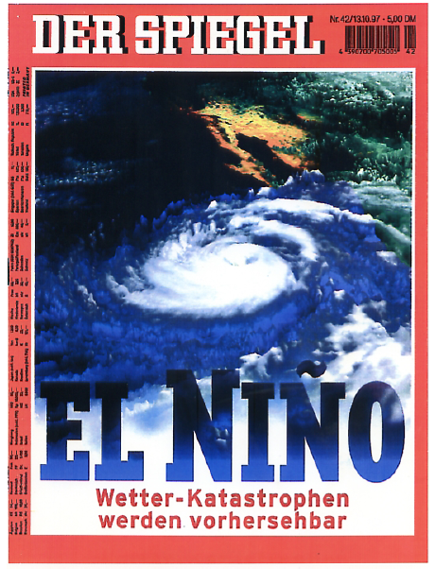
El Niño / Southern Oscillation
13.10.1997

Slide 2
Overview El Nino
History
Phenomenon
Dynamics
Research

Slide 3
History
El Niño: was always known to fishers in South America.
Coastal waters of the Pacific coast of South America had dramatic warming events every few years around Christmas time (that why it is call El Nino) causing large-scale fish dying or immigration to other regions.
Southern Oscillation: Sir Gilbert Thomas Walker ~1910.
Walker was analyzing the variability of Indian Monsoon variability and found it to be related to very large-scale atmospheric sea level pressure variability to the south of India, which he called the Southern Oscillation, as it is south of India. But it actually is more or less right on the equator.
ENSO coupling: Bjerknes 1969.
Bjerknes was one of the first researchers that understood that El Nino and the Southern Oscillation (ENSO) are not only related to each other, but that the interaction between the two may actually be the causes for the variability in both.
Notes:
Sir Gilbert Thomas Walker, CSI, FRS, (14 June 1868 – 4 November 1958)

Slide 4
History
ENSO numerical model: Cane and Zebiak, Science, 1985.
Cane and Zebiak were the first to demonstrate that a numerical model of the ocean and atmospheric dynamics in the tropical Pacific could reproduce the ENSO mode. Modern numerical climate models are used to predict the ENSO evolution for the next few month to one year. It is basically the only process that allows for seasonal weather forecast in the tropical regions.
ENSO research today:
The ENSO is still a subject of ongoing research. Many aspects of the ENSO mode and how the interaction/feedbacks work are still unclear. It is also currently researched how ENSO may change in the changing climate and how ENSO relates to interactions with the rest of the world.
Notes:
Sir Gilbert Thomas Walker, CSI, FRS, (14 June 1868 – 4 November 1958)

Slide 5
Overview El Nino
History
Phenomenon
Dynamics
Research

Slide 6
El Niño variability
The global SST standard deviation already shows quite clearly that the equatorial region of the Pacific has a unique and globally dominating amount of variability.
If we look at global SST anomalies during ENSO events we quite clearly see how dominating the ENSO pattern of variability is compared to SST variability in the rest of the world.
The ENSO event are marked by a very well defined SST pattern in the tropical Pacific.
The warming events are called El Nino and tend to peak around Nov. to Jan.. They last less than a year. Strong event can warm by 4ºC over most of the east equatorial Pacific.
The cold events are cold La Nina (the girl as in contrast to El Nino). They last long and are usually not as strong as the positive events. They are basically an intensification of the mean state.
Notes:
Sir Gilbert Thomas Walker, CSI, FRS, (14 June 1868 – 4 November 1958)

Slide 7
El Niño variability
The pattern of La Nina is slightly different from that of the El Nino events. The latter are narrower and have stronger amplitudes near the South American coast.
ENSO is a quasi periodic/chaotic oscillation with a period of about 4 years (between 2-7years). So warm and cold events follow each other.
Strong (>2ºC) El Nino events a rare and return every 10 to 20yrs.
Strong ENSO El Nino events have a significant global warming effect, that can be seen in the global mean surface temperatures.
In response to the ENSO event SST anomalies in the tropical Indian, North Pacific and the tropical Atlantic are forced. They tend to lag the time evolution of the ENSO event behind, as they need some time to respond to the ENSO forcing.
Notes:
Sir Gilbert Thomas Walker, CSI, FRS, (14 June 1868 – 4 November 1958)

Slide 8
SST standard deviation
[K]

Slide 9
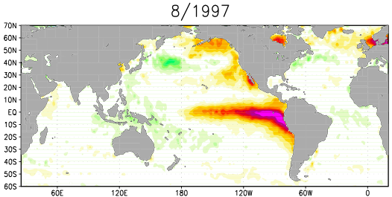
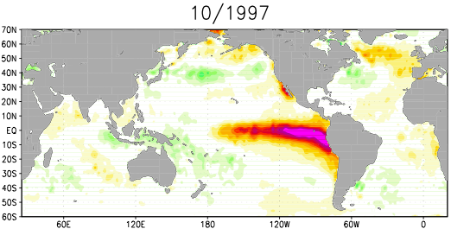
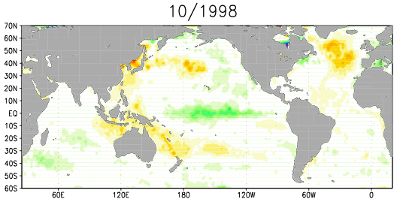
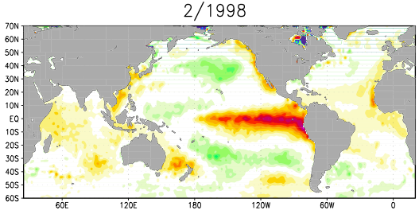
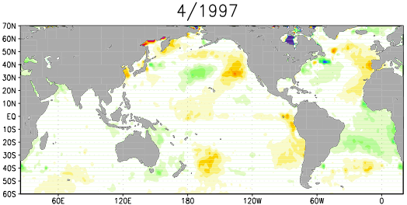
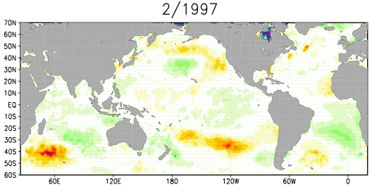
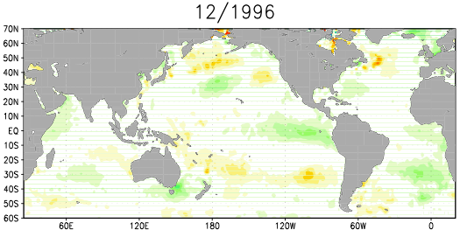
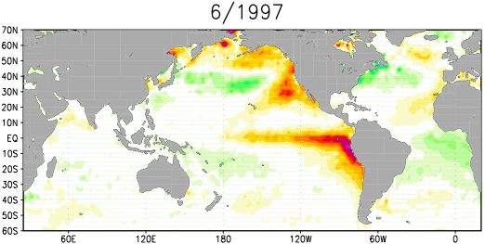
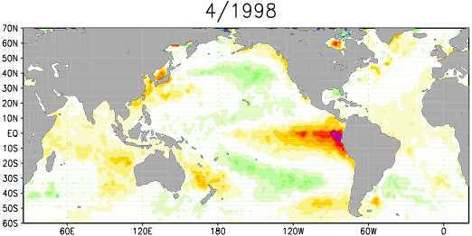
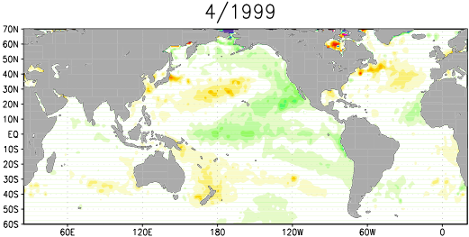
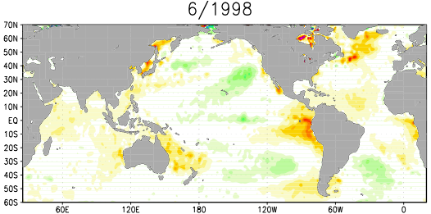
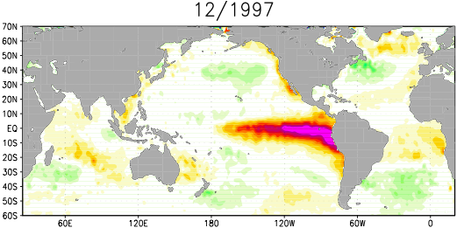
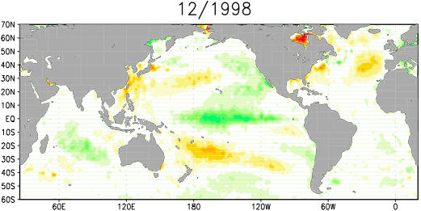
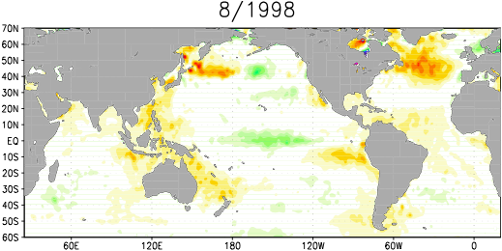
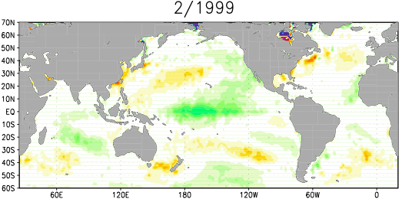
El Niño event 1997

Slide 10
El Niño event 1997

Slide 11
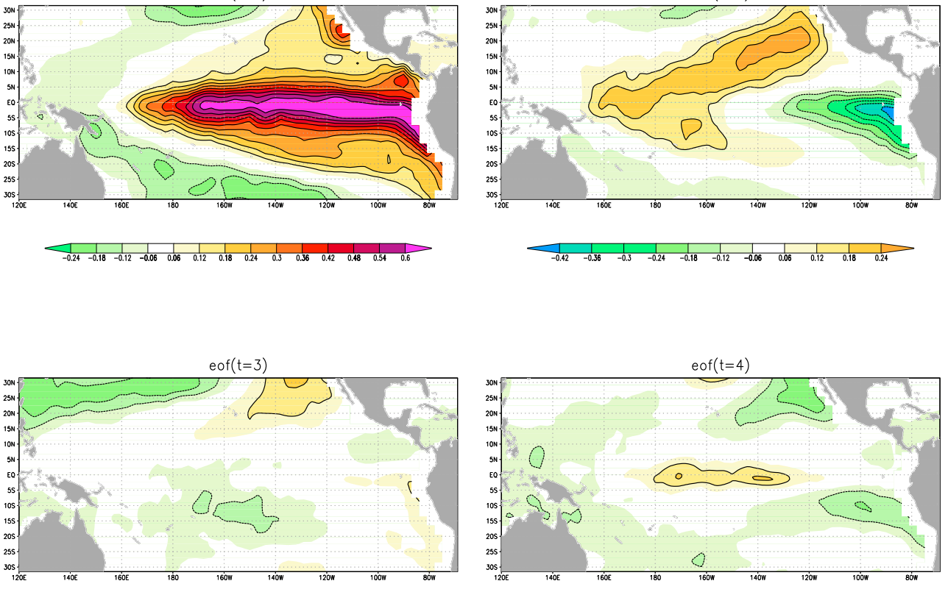
El Niño event 1997
EOF-1 (44%)
EOF-2 (10%)
EOF-3 (5%)
EOF-4 (5%)

Slide 12
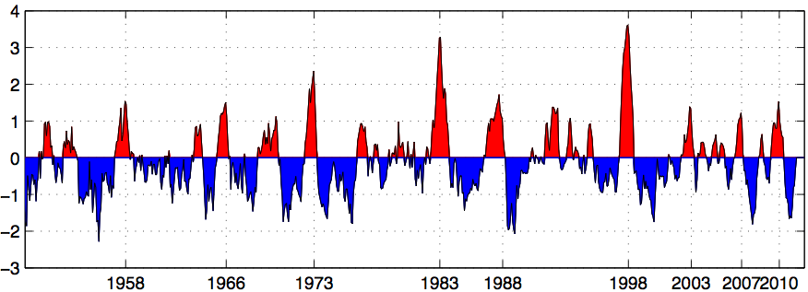
El Niño time series
Temperature [ºC]

Slide 13
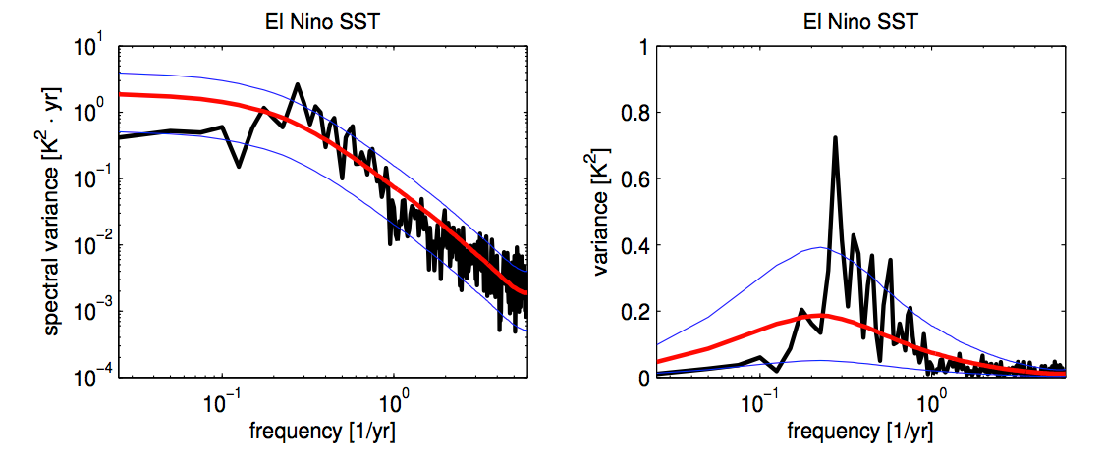
El Niño power spectrum
Log-log scaling
Log-linear scaling

Slide 14
El Niño variability
ENSO dynamics are strongly controlled by dynamics in the upper ocean of the tropical Pacific.
The strongest ENSO variability is not at the surface but in about a 100-200m depth in the thermocline of the ocean. The thermocline is the region of the upper ocean where the temperature decrease very fast. It marks the change from light/warm surface water from dense/cold subsurface waters.
New observation systems (local buoys or satellites) since the 1990s allow to follow an ENSO event in the subsurface ocean, which very nicely demonstrates the dynamical evolution of an ENSO event.
A deepening of the thermocline marks the increase heat content before an El Nino event in the western/central eq. Pac.. This propagates to the east, which is followed by large scale warming of the surface.
During the strong surface warming the western thermocline marks reduced heat content in the west, which starts to propagate to the east, introducing the end of the El Nino event and introducing the change to a La Nina event.
Notes:
Sir Gilbert Thomas Walker, CSI, FRS, (14 June 1868 – 4 November 1958)

Slide 15
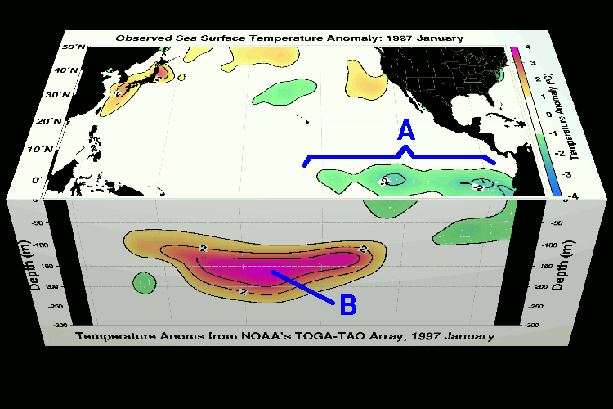
Subsurface dynamics
Evolution of temperature anomalies, January 1997

Slide 16
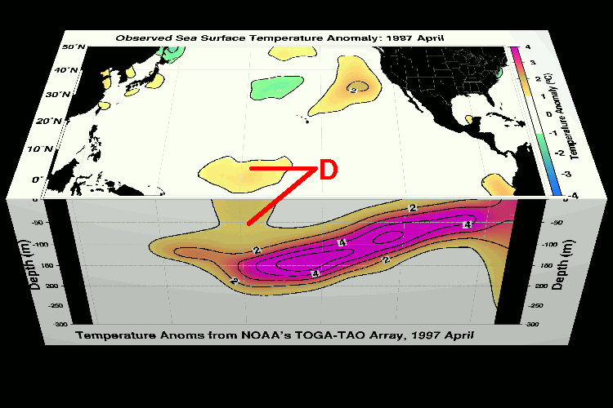
Subsurface dynamics
Evolution of temperature anomalies, April 1997

Slide 17
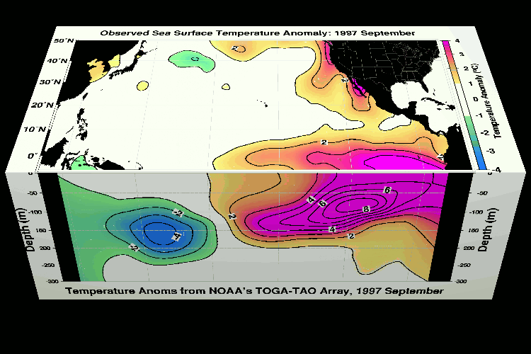
Subsurface dynamics
Evolution of temperature anomalies, September 1997

Slide 18
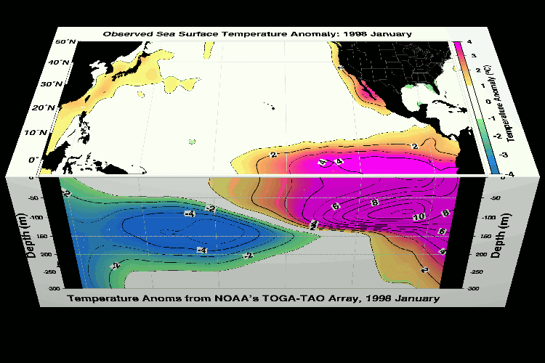
Subsurface dynamics
Evolution of temperature anomalies, Januar 1998

Slide 19
Southern Oscillation
Correlation SLP vs. NINO3 SST

Slide 20
Overview El Nino
History
Phenomenon
Dynamics
Research

Slide 21
SST standard deviation
[K]

Slide 22
ENSO Dynamics
Mean state
Bjerknes Feedbacks
Recharge Oscillator

Slide 23
ENSO Dynamics
Mean state
Bjerknes Feedbacks
Recharge Oscillator

Slide 24
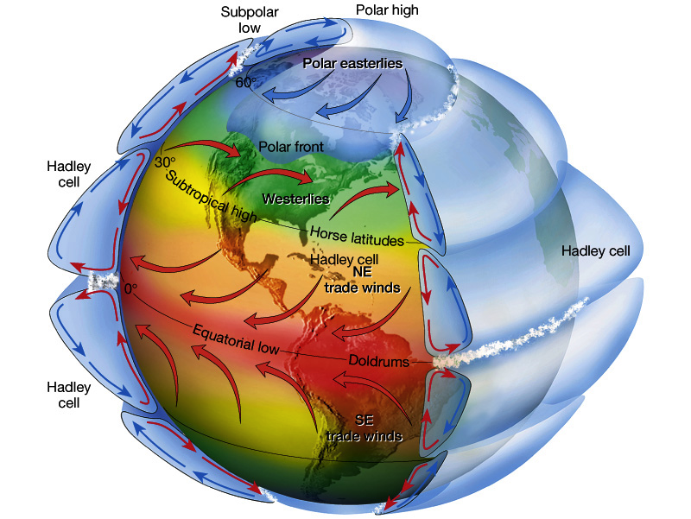
The General Circulation
Momentum :
Pressure gradient force
Coriolis forcing
gravity
friction

Slide 25
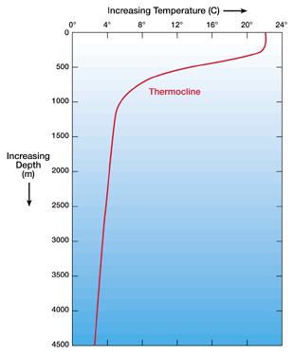
Dynamics at the Equator
Ocean at rest (not responding to winds):
winds
warm
height
cold

Slide 26
Dynamics at the Equator
Ocean Surface:
winds
Ocean surface currents
Eq.
winds

Slide 27
Dynamics at the Equator
Ocean in equilibrium:
winds
warm
height
cold

Slide 28
Dynamics at the Equator
Atmosphere at equator (no SST gradient):
Convection (air lifting)
height
warm
warm
warm

Slide 29
Dynamics at the Equator
Atmosphere in equilibrium (with SST gradient):
Walker Circulation
height
warm
cold

Slide 30
El Niño mean state dynamics
The dynamics that control the mean state are usually also the dynamics that dominate the variability.
The tropical Pacific mean state in the ocean and atmosphere are very strongly linked. It is a quite unique situation, where you can not understand the state of one of the two system without the state of the other.
The most remarkable feature of the tropical Pacific mean state is the equatorial cold tongue. The fact that the equatorial SST are colder than the higher latitudes SSTs.
Further the tropical Pacific is marked by strong temperature gradient from the east (cold) to the west (warm).
Trade winds blow from the east to the west and from the higher latitudes towards the equator.
Notes:
Sir Gilbert Thomas Walker, CSI, FRS, (14 June 1868 – 4 November 1958)

Slide 31
Ocean mean state dynamics
The most important feature of the equatorial cold tongue is a result of prevailing easterly trade winds and the Ekman ocean currents induced by the friction and Coriolis forcing.
Note that the equator has the unique feature of no horizontal coriolis forcing and opposing Coriolis forcing off the equator.
This leads to divergence of ocean surface water away from the equator, leading to upwelling of cold subsurface waters.
The prevailing easterly winds also transport warm surface waters to the west, leading to much warmer SST in the west and to a higher sea level in the west.
The upwelling the east causes the thermocline to have a east to west gradient.
We roughly have a counter clockwise vertical overturning circulation along the equator.
This whole circulation is entirely forced by the atmospheric winds.
Notes:
Sir Gilbert Thomas Walker, CSI, FRS, (14 June 1868 – 4 November 1958)

Slide 32
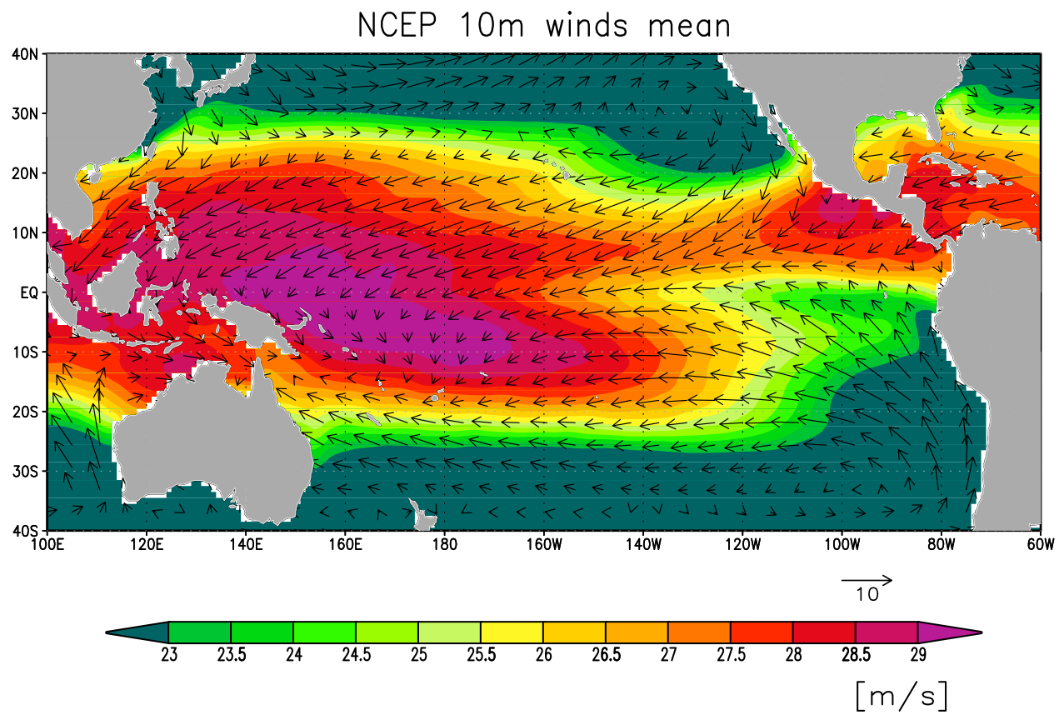
Mean Winds and SST

Slide 33
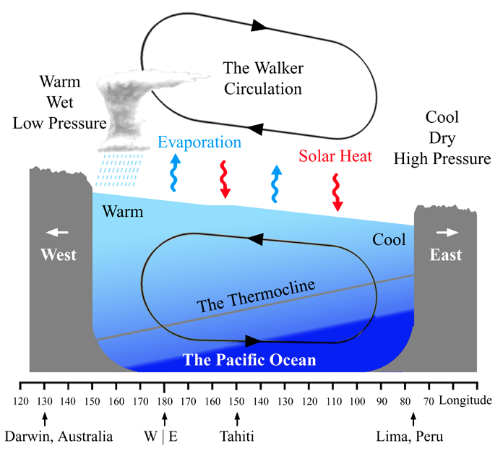
Mean State

Slide 34
Atmospheric mean state dynamics
The equatorial Pacific is marked by a strong surface temperature difference between the east (cold) to the west (warm), caused by ocean dynamics.
The atmospheric circulation is mostly forced by surface temperature difference. It induces, for instance, the most dominant Hadley cell circulation in the tropics. With rising air over warmer regions and descending air over colder regions, forced by the buoyancy of the air masses.
The Pacific temperature gradient induces a secondary tropical circulation, called Walker-circulation with rising over the warm pool in the west and sinking over the cold east eq. Pac.
Due to the absence of the Coriolis force along the equator, the circulation induced by the surface temperature differences can directly circulated from high surface pressure (cold SST) to low surface pressure (warm SST).
This induces the surface easterly over the eq. Pac..
Notes:
Sir Gilbert Thomas Walker, CSI, FRS, (14 June 1868 – 4 November 1958)

Slide 35
Atmospheric mean state dynamics
Rising air favors convection, which favors precipitation. The opposite holds for sinking air.
The walker circulation causes the different in the precipitation patterns, with very wet conditions in the western rising branch and very dry conditions in the eastern sinking branch (similar to the subtropics).
Variability of the walker circulation is called the Southern Oscillation (for historical reasons). A stronger walker circulation means a positive Southern Oscillation Index (SOI).
During El Nino the walker circulation is weakened or even totally collapsed (negative SOI).
The whole mean Walker circulation is strongly controlled by the SST gradient in the Pacific.
Notes:
Sir Gilbert Thomas Walker, CSI, FRS, (14 June 1868 – 4 November 1958)

Slide 36
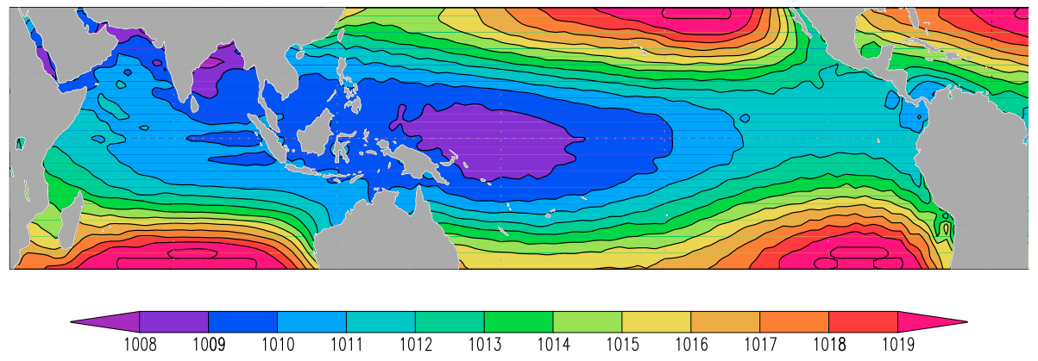
Mean State: Sea Level Pressure (SLP)
Surface pressure
[hPa]

Slide 37
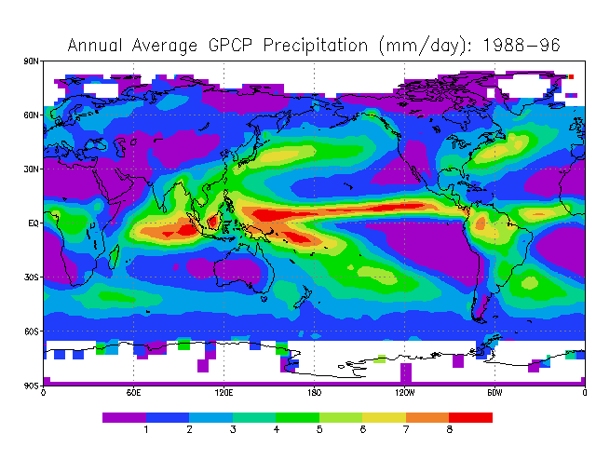
Mean State: Precipitation

Slide 38
Mean State

Slide 39
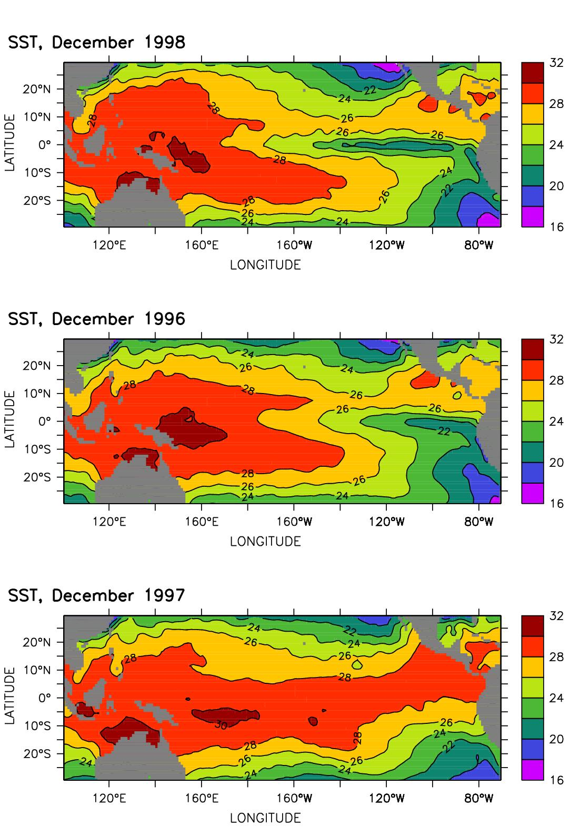
Variability: SST for different states
La Nina
Normal
El Nino

Slide 40
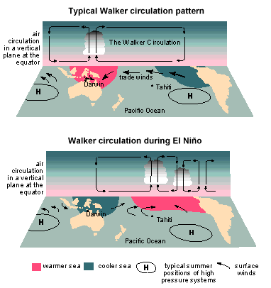
Variability: Southern Oscillation

Slide 41
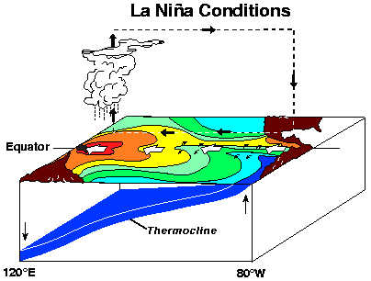
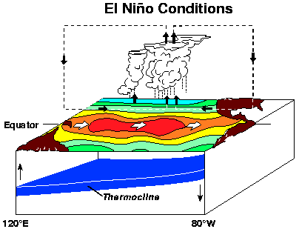
Variability: El Nino / Southern Oscillation

Slide 42
ENSO Dynamics
Mean state
Bjerknes Feedbacks
Recharge Oscillator

Slide 43
Bjerknes Feedbacks
The fact that both the atmospheric and the ocean mean state strongly depend on the other systems state, makes the ocean-atmosphere system in the tropical Pacific very sensitive and potentially unstable to small change in one of the two systems.
The three main elements which are involved here are the SST, zonal winds and the thermocline depth.
The interactions between these three elements are often describe by the so called Bjerknes feedbacks. They are:
      SST forces zonal wind
      Zonal winds forces thermocline
      thermocline forces SST
As you can see these feedbacks define a feedback cycle.
Notes:
Sir Gilbert Thomas Walker, CSI, FRS, (14 June 1868 – 4 November 1958)

Slide 44
Bjerknes Feedbacks
SST forces zonal wind: A warm SST anomaly causes heating of the atmosphere, which leads to low surface pressure. The winds will blow towards the low pressure (no deflection by Coriolis force at equator). This means reduced zonal winds to the west (central Pacific).
Zonal winds forces thermocline: The thermocline depth in the central and western Pacific is kept deeper than in the eastern Pacific by prevailing easterly zonal winds. Weaker than normal winds lead to a shallowing of the thermocline. Gravity waves will propagate the thermocline adjustment to the east leading to a deepening of the thermocline in the east (The Bathtub effect).
Thermocline forces SST: A deeper thermocline in the east reduces the upwelling of cold subsurface waters along the equator and the South American coasts. This leads to warming of the SST.
Notes:
Sir Gilbert Thomas Walker, CSI, FRS, (14 June 1868 – 4 November 1958)

Slide 45
SST Feedbacks
Note that the strength of the SST response to changes in thermocline and zonal winds depend on many factors in the atmosphere and ocean.
The atmospheric feedbacks depend on changes in cloud cover, which change the incoming solar radiation. Is depends on the latent cooling by evaporation at the surface, which depends on the wind speed, humidity and SST.
The oceanic feedbacks depend on the strength of the upwelling and the temperature difference between the surface and the subsurface ocean. This strongly depends on the sensitivity of the thermocline to zonal winds, which can be different at different regions.
Overall these interactions are quite complex. State of the art IPCC climate models largely disagree in the characteristics of ENSO mode with each other and with observation. Indicating that it is far from trivial to produce the ENSO dynamics correctly.
Notes:
Sir Gilbert Thomas Walker, CSI, FRS, (14 June 1868 – 4 November 1958)

Slide 46
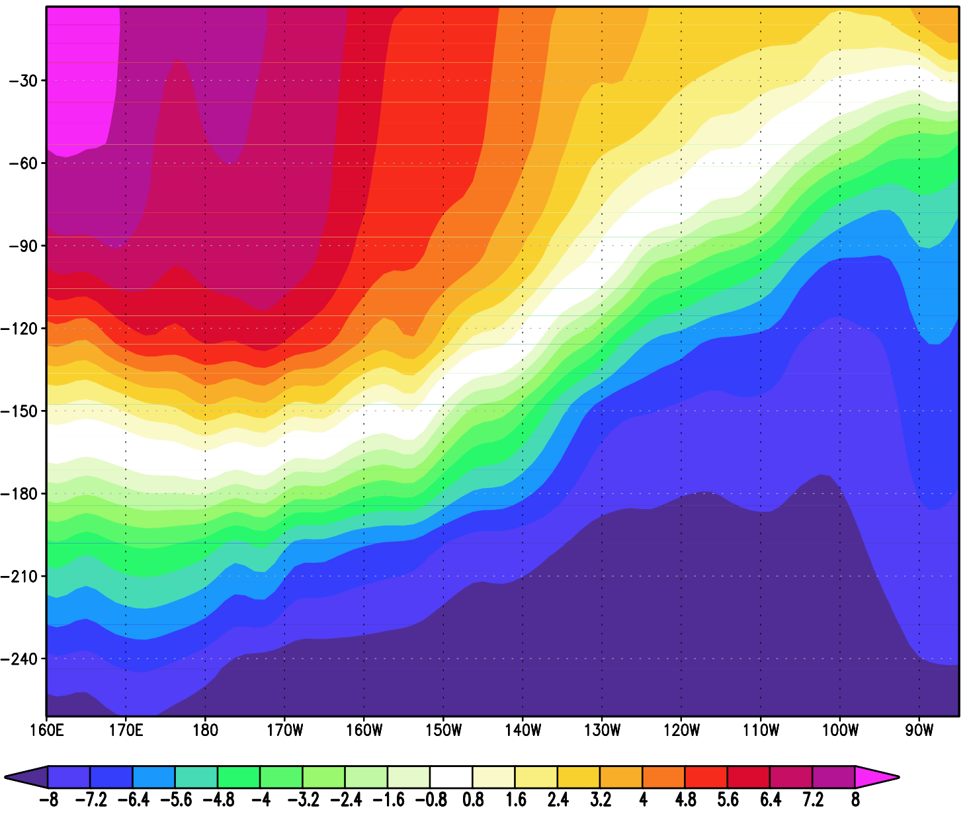
Bjerknes Coupled Feedbacks
1. SST forced Wind Anomaly
  Sea Level
SST Anomaly
  Layer Thickness
3. Heat Content forces SST
Heat Content Anomaly
2. Wind forced Heat Content change
[Cº]
Clouds +
(-)
SST +
Subsurface (+)
Winds (-)

Slide 47
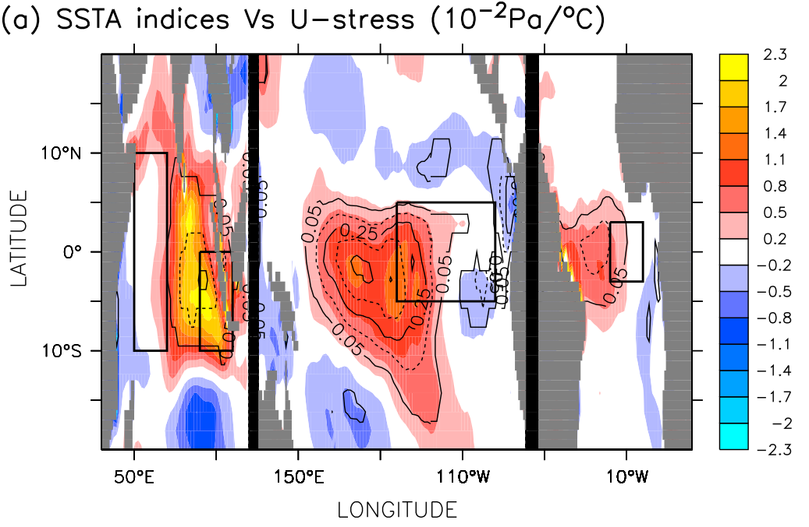
SST vs. zonal winds
Relation between the zonal wind field and the SST in the box. For the three tropical oceans separately

Slide 48
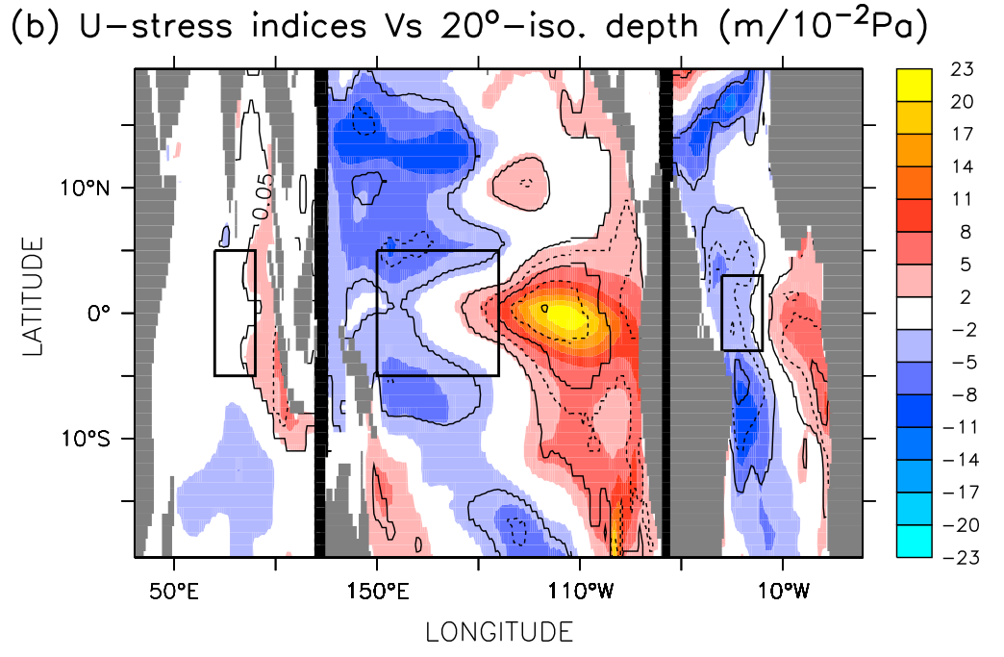
zonal winds vs. heat content
Relation between the 20ºC isotherm depth field and the zonal wind in the box. For the three tropical oceans separately

Slide 49
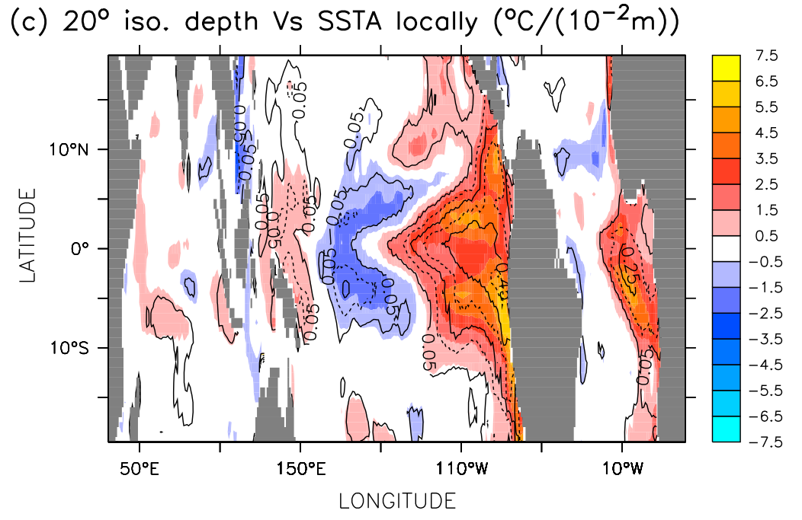
Heat content vs. SST
The local relation between the 20ºC isotherm depth field and the SST field.

Slide 50
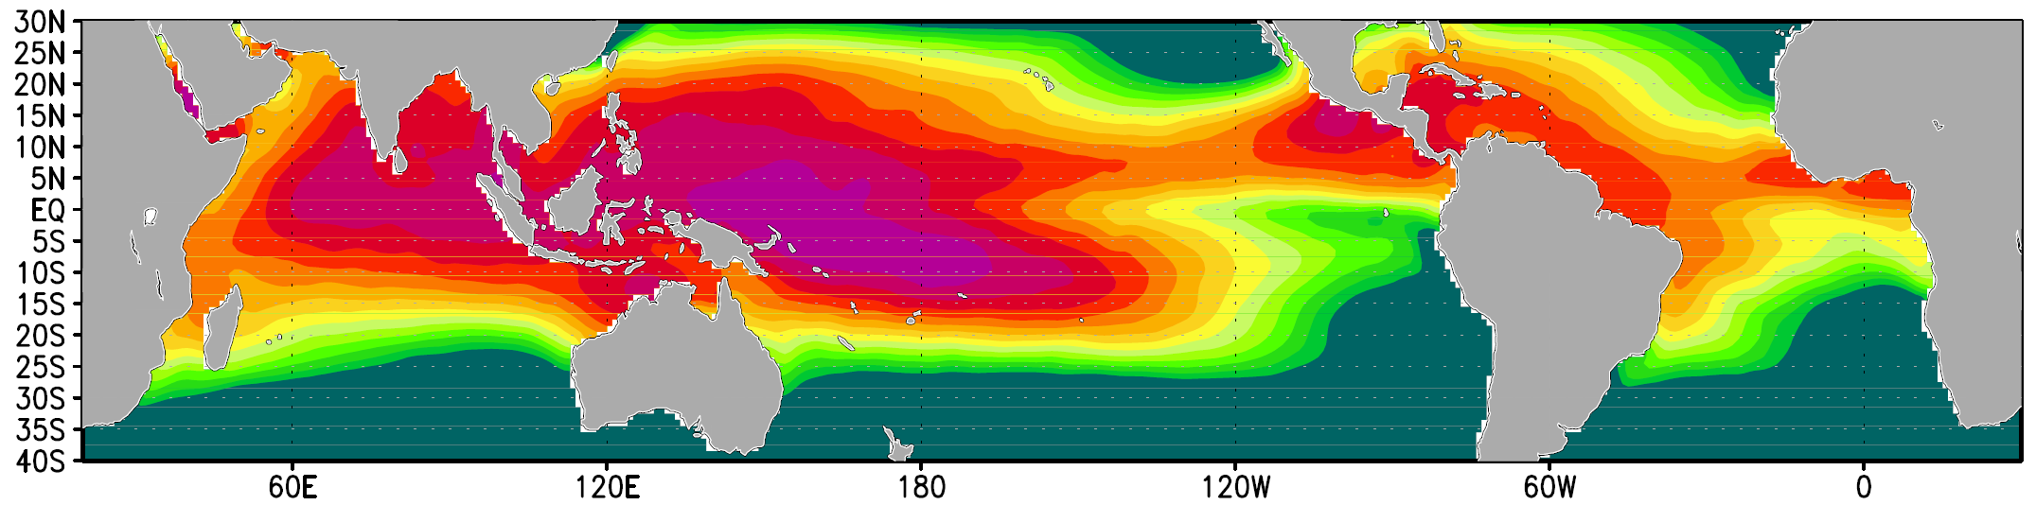
Mean Sea Surface Temperature
Mean SST
[ºC]

Slide 51
ENSO Dynamics
Mean state
Bjerknes Feedbacks
Recharge Oscillator

Slide 52
Recharge Oscillator model of ENSO
[Jin 1997]
The recharge oscillator model of ENSO describes the dynamics of ENSO much better.
It basically includes all the Bjerknes feedbacks in a consistent framework
ENSO can be understood as a coupling between thermocline depth over the whole Pacific, h, and the SST in the NINO3 region.
Thermocline depth is basically a measure of heat content in the upper ocean. Large depth = large heat content.
A large h forces positive SST tendencies.
A large SST reduces the thermocline depth.
Notes:
Sir Gilbert Thomas Walker, CSI, FRS, (14 June 1868 – 4 November 1958)

Slide 53
Recharge Oscillator model of ENSO
[Jin 1997]
The damping of the SST, a₁₁, is caused by atmospheric and oceanic feedbacks. The atmosphere has positive feedbacks dominating (aA₁₁>0) and the ocean has negative feedbacks dominating (aO₁₁<0).
The model is a damped oscillation between heat content and SST with a period of about 4 years.
The variability in thermocline depth and SST are 90º out of phase with the thermocline depth evolution leading the time evolution of the SST by a few month.
Chaotic weather fluctuations in zonal winds and atmospheric heat fluxes force variability and oscillation in SST and h.
Assuming the atmospheric forcing is white noise the predictability of this model is good until about 6 to 9 month lead time. State of the art seasonal forecast models of the big global weather forecasting centers are better, but not much.
Notes:
Sir Gilbert Thomas Walker, CSI, FRS, (14 June 1868 – 4 November 1958)

Slide 54
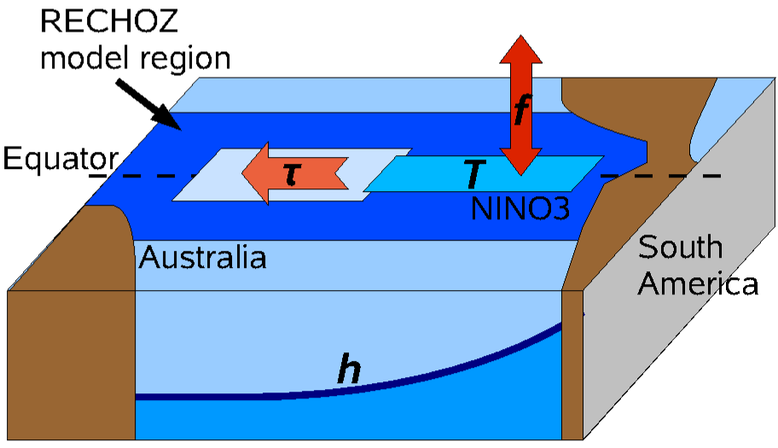
Recharge Oscillator model of ENSO

Slide 55
Recharge Oscillator model of ENSO

Slide 56
Recharge Oscillator model
T growth rate (damping)
coupling T to h
coupling h to T
h growth rate (damping)
wind response
noise forcing T
net heat response
noise forcing h
T damping (ocean)

Slide 57
Recharge Oscillator model

Slide 58
Recharge Oscillator model

Slide 59
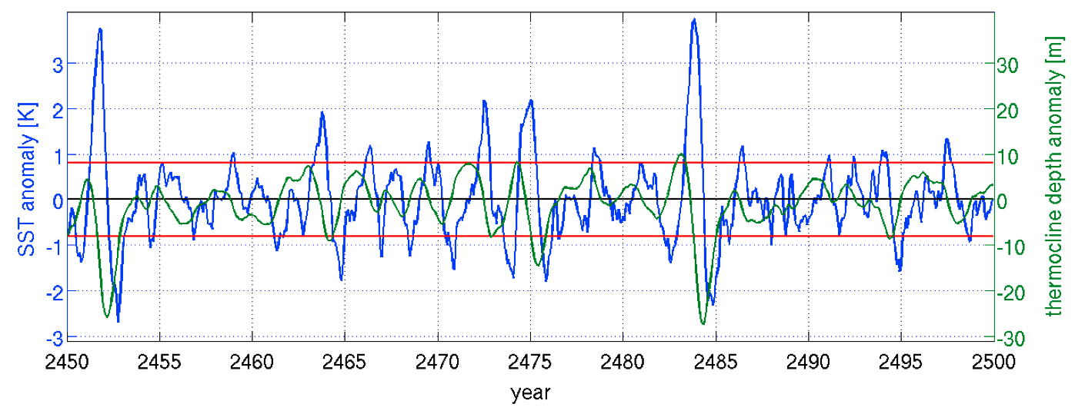
Recharge Oscillator model of ENSO

Slide 60
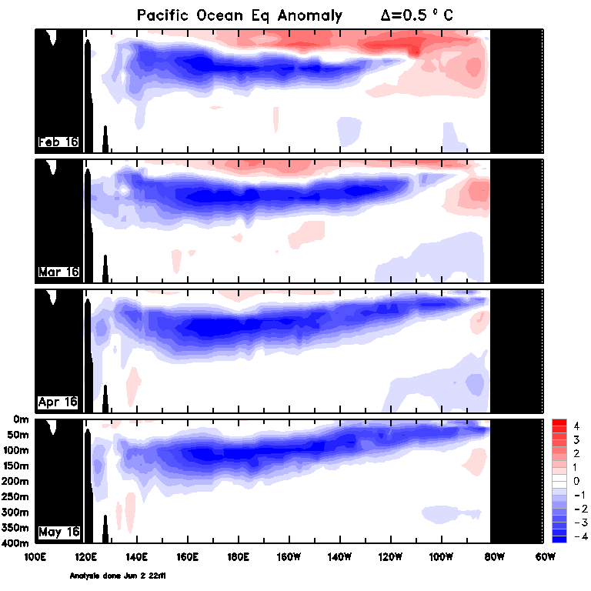
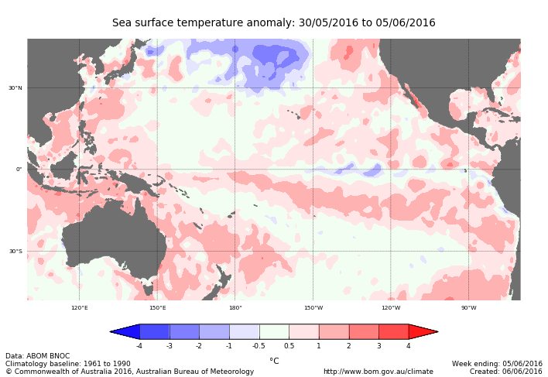
El Nino Forecast
Current conditions
Notes:
Source: http://www.bom.gov.au/climate/enso/

Slide 61
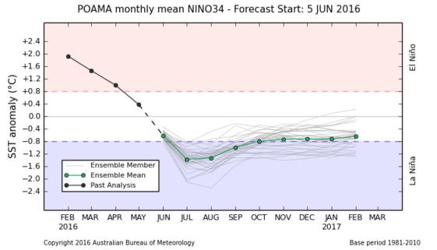
El Nino Forecast
Notes:
Source: http://www.ecmwf.int/products/forecasts/d/overview/seasonal/
BoM: I need a login !!!!

Slide 62
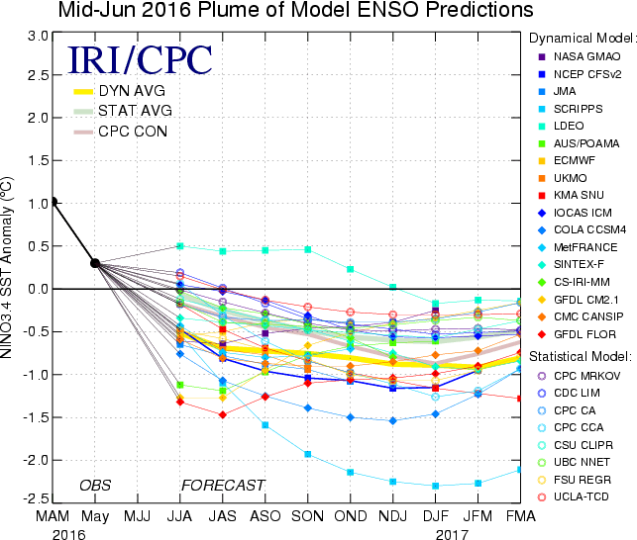
El Nino Forecast
Notes:
Source:
2014: http://iri.columbia.edu/our-expertise/climate/forecasts/enso/current/
2013: http://iri.columbia.edu/climate/ENSO/currentinfo/SST_table.html

