Slide 1
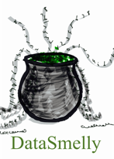
Learning from Extremely Large Quantities of Data:
A Detailed Study
Presented by: Nayyar Zaidi
nayyar@datasmelly.com
IBM Research Lab, Melbourne — May 2017

Slide 2
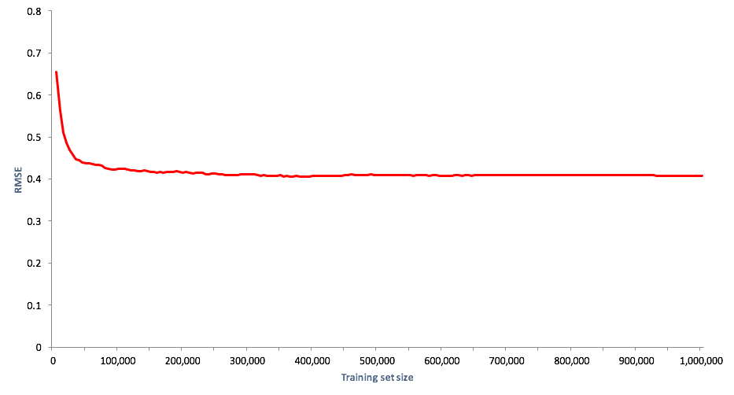
IBM Research Lab, Melbourne — May 2017

Slide 3
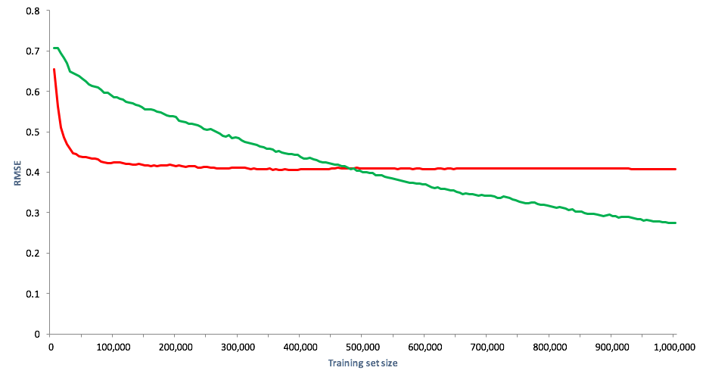
IBM Research Lab, Melbourne — May 2017

Slide 4
Objectives of the Talk
Propose the Properties of Large-scale Machine Learning (LSML)
Motivate the need for LSML
Appreciate a data-centric approach to machine learning problems
Outline of the Talk
Scalability of current machine learning models for Big Data
Properties of LSML
Present an overview of the current work
Discuss future work directions
Target Audience
Research Scientists
Machine Learning Practitioners
Ph.D Students
Final year under-graduate students
IBM Research Lab, Melbourne — May 2017

Slide 5
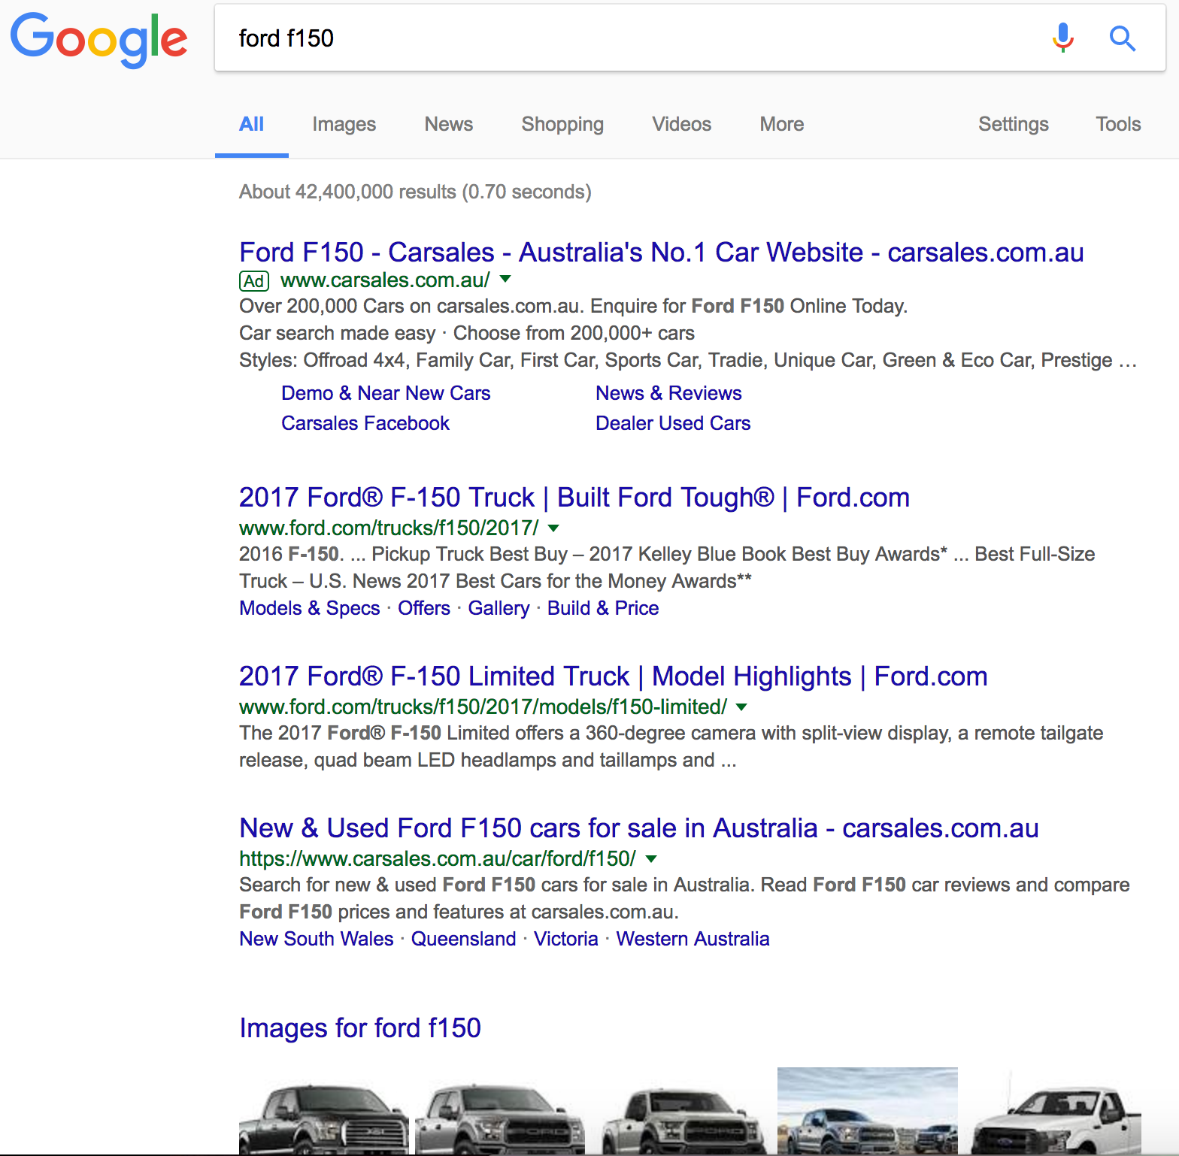
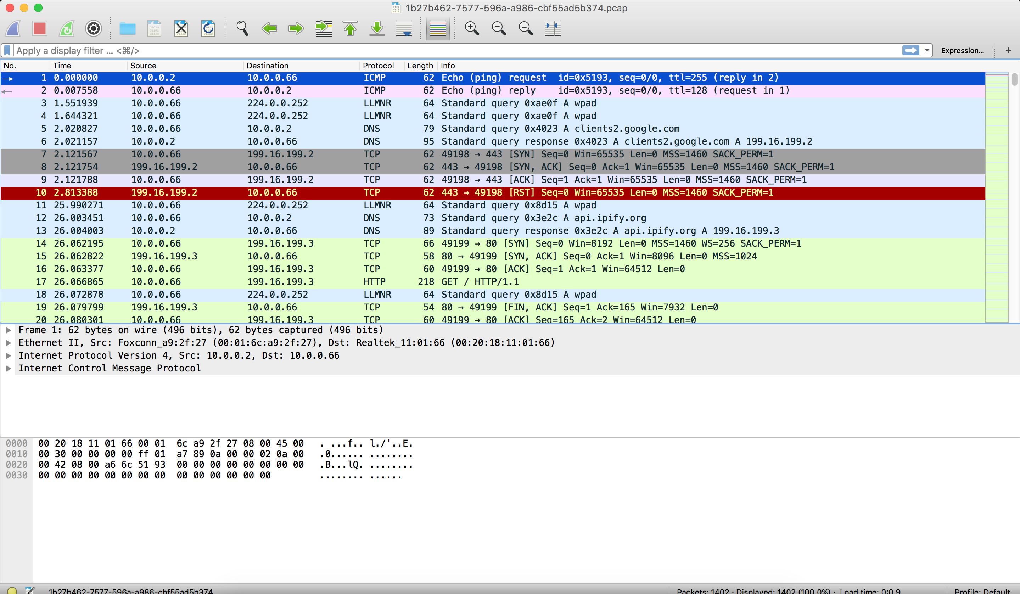
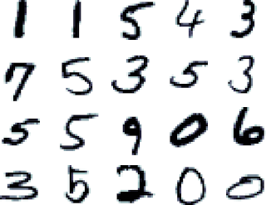
Big Data Learning Examples
Ranking
Advertising based on Query
News Placement
Ad Placement
Intrusion
Detection
Digit
Recognition
IBM Research Lab, Melbourne — May 2017

Slide 6
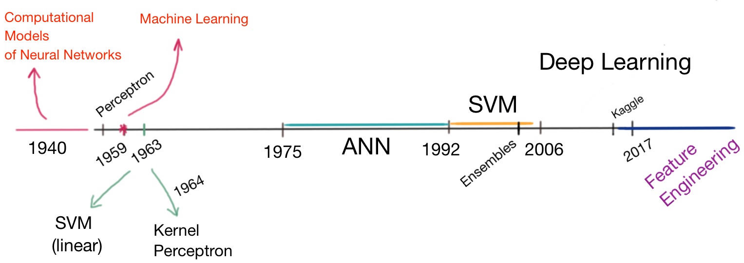
Machine Learning
IBM Research Lab, Melbourne — May 2017

Slide 7
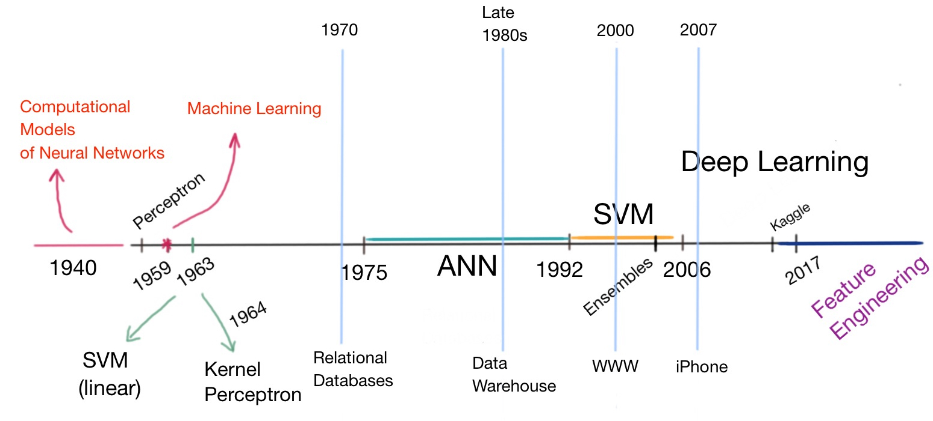
Machine Learning
IBM Research Lab, Melbourne — May 2017

Slide 8
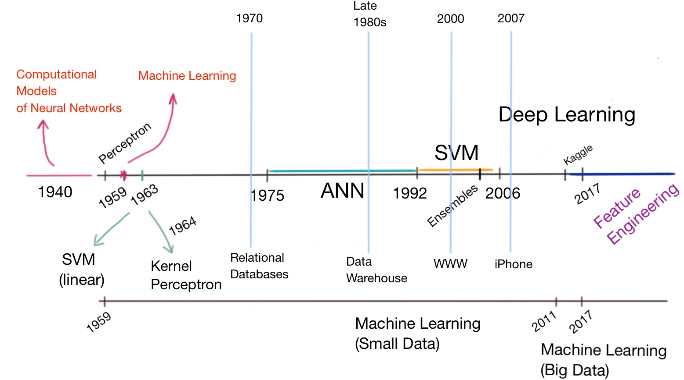
Machine Learning
IBM Research Lab, Melbourne — May 2017

Slide 9
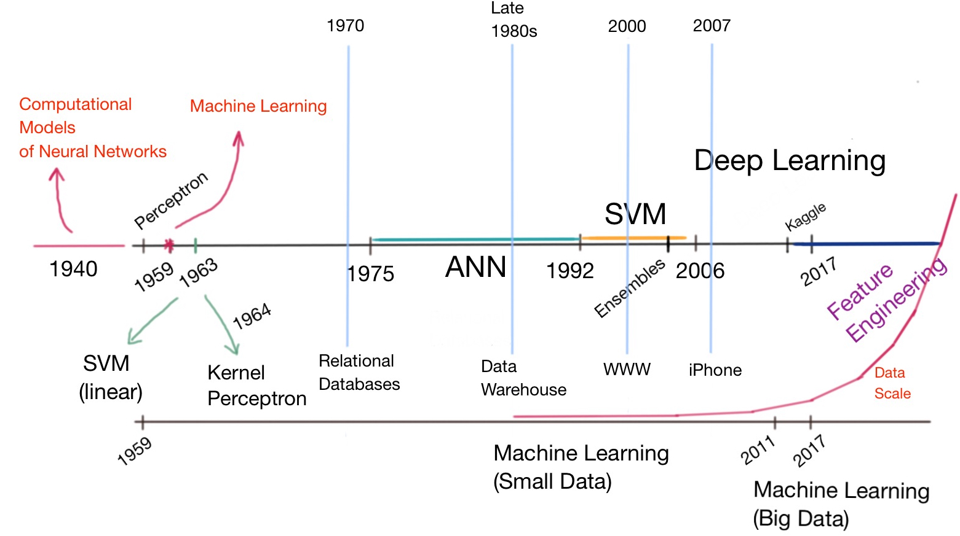
Machine Learning
IBM Research Lab, Melbourne — May 2017

Slide 10
Good Old-Fashioned Machine Learning
Regularization
Non-parameteric Methods
Nearest Neighbour
Tree-based Methods
Power of Ensemble
Random Forest
Boosting
Kernel Theory
Batch Optimization Methods
Bayesian vs. Frequentist
Feature Selection
Large Scale Machine Learning
Feature Engineering
Deep Learning
SGD
Minimal Pass Learning
Automatic Regularization
Minimal Tuning
Future Machine Learning
Single Pass Learning
Automatic Feature Engineering
No Tuning Parameter
IBM Research Lab, Melbourne — May 2017

Slide 11
Good Old-Fashioned Machine Learning (GOFML)
Regularization
Non-parameteric Methods
Nearest Neighbour
Tree-based Methods
Power of Ensemble
Random Forest
Boosting
Kernel Theory
Batch Optimization Methods
Bayesian vs. Frequentist
Feature Selection
Large Scale Machine Learning (LSML)
Feature Engineering
Deep Learning
SGD
Minimal Pass Learning
Automatic Regularization
Minimal Tuning
Future Machine Learning (FML)
Single Pass Learning
Automatic Feature Engineering
No Tuning Parameter
IBM Research Lab, Melbourne — May 2017

Slide 12
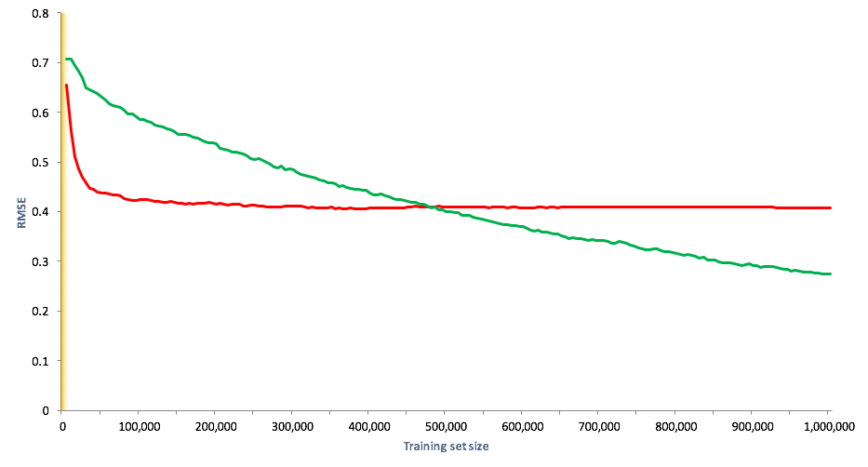
GOFML vs. LSML
IBM Research Lab, Melbourne — May 2017

Slide 13
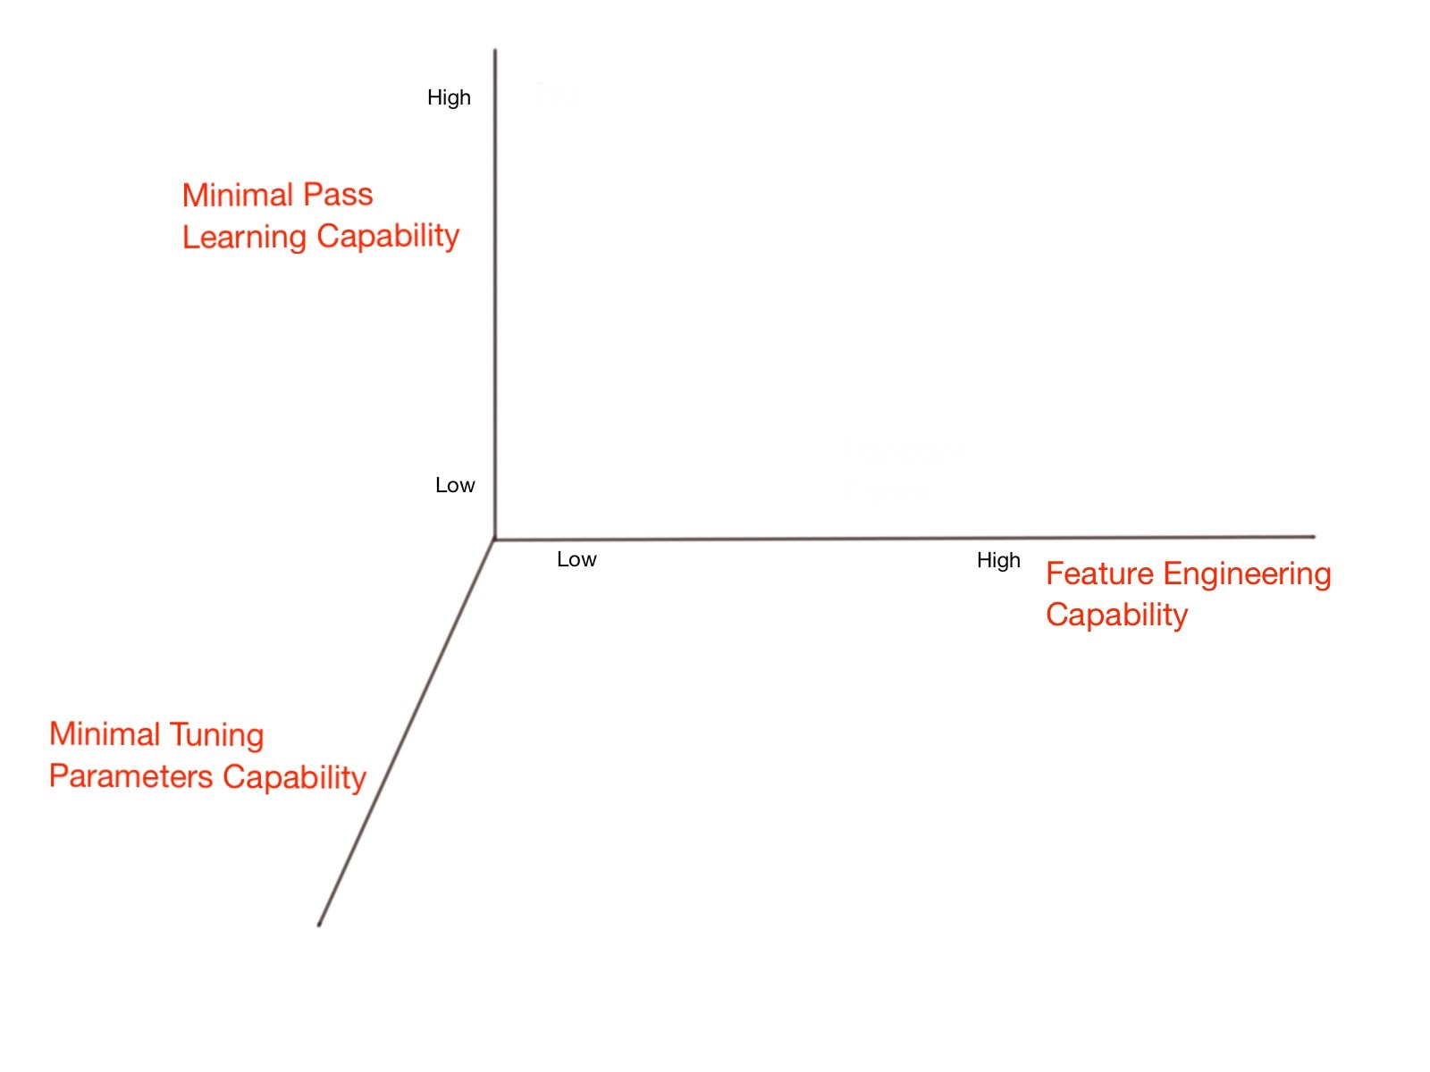
Three Properties of LSML
IBM Research Lab, Melbourne — May 2017

Slide 14
Three Properties of LSML
Efficient Out-of-core Learning
Low-bias Learning
Faster learning
IBM Research Lab, Melbourne — May 2017

Slide 15
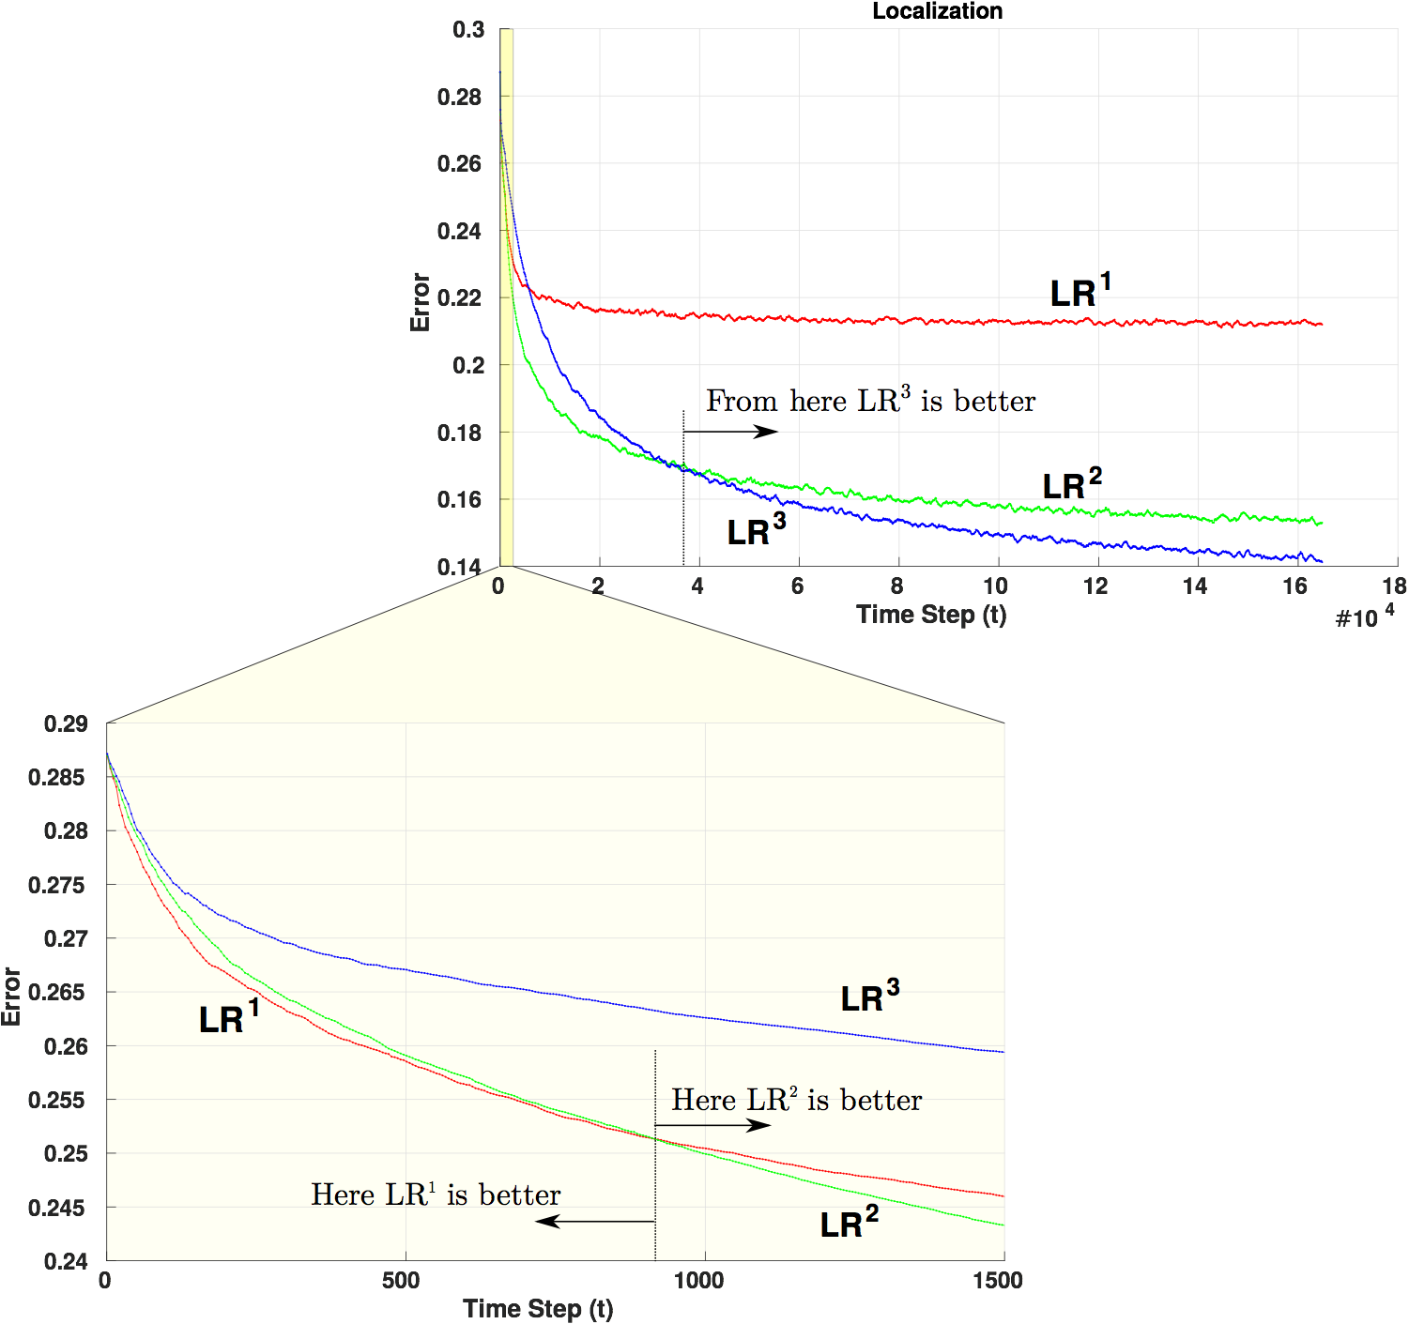
IBM Research Lab, Melbourne — May 2017

Slide 16
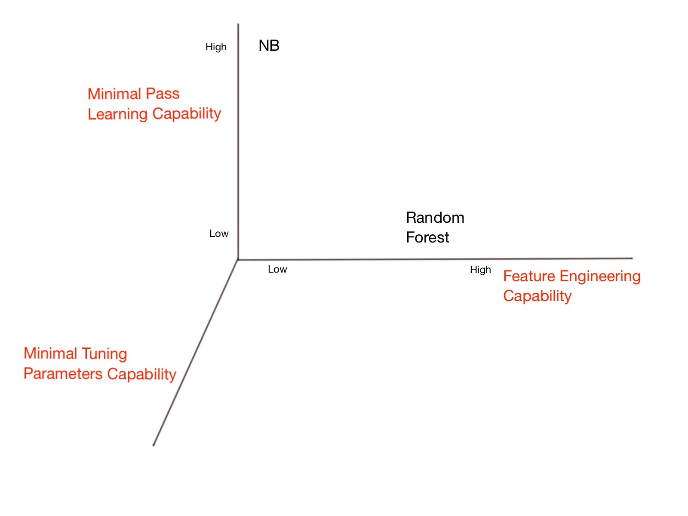
Two Extremes
NB
High-bias, low-variance
Extremely easy to train
Single Pass
Minimal Tuning Parameters
RF
Low-bias, high-variance
Multiple Pass
Some Tuning Parameters
IBM Research Lab, Melbourne — May 2017

Slide 17
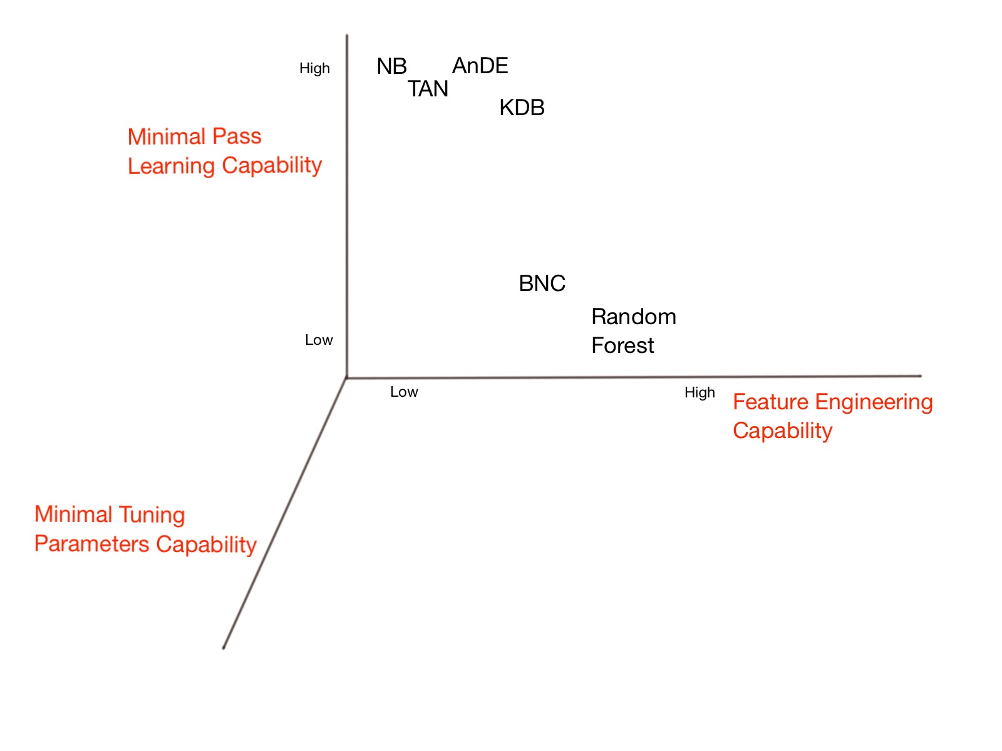
Minimal Pass Learning
Generative Classifiers
Semi-naive Bayes Classifiers
Easy to Train
Big Model Size
TAN, KDB, BNC
AnDE
Zaidi, N. and Webb G. — Fast and Efficient Single Pass Bayesian Learning, Advances in Knowledge Discovery and Data Mining, pp. 149-160, 2012
Martinez, A. and Webb, G. and Li, S. and Zaidi, N. — Scalable Learning of Bayesian Network Classifiers, JMLR, pp 1-35, 2016
IBM Research Lab, Melbourne — May 2017

Slide 18
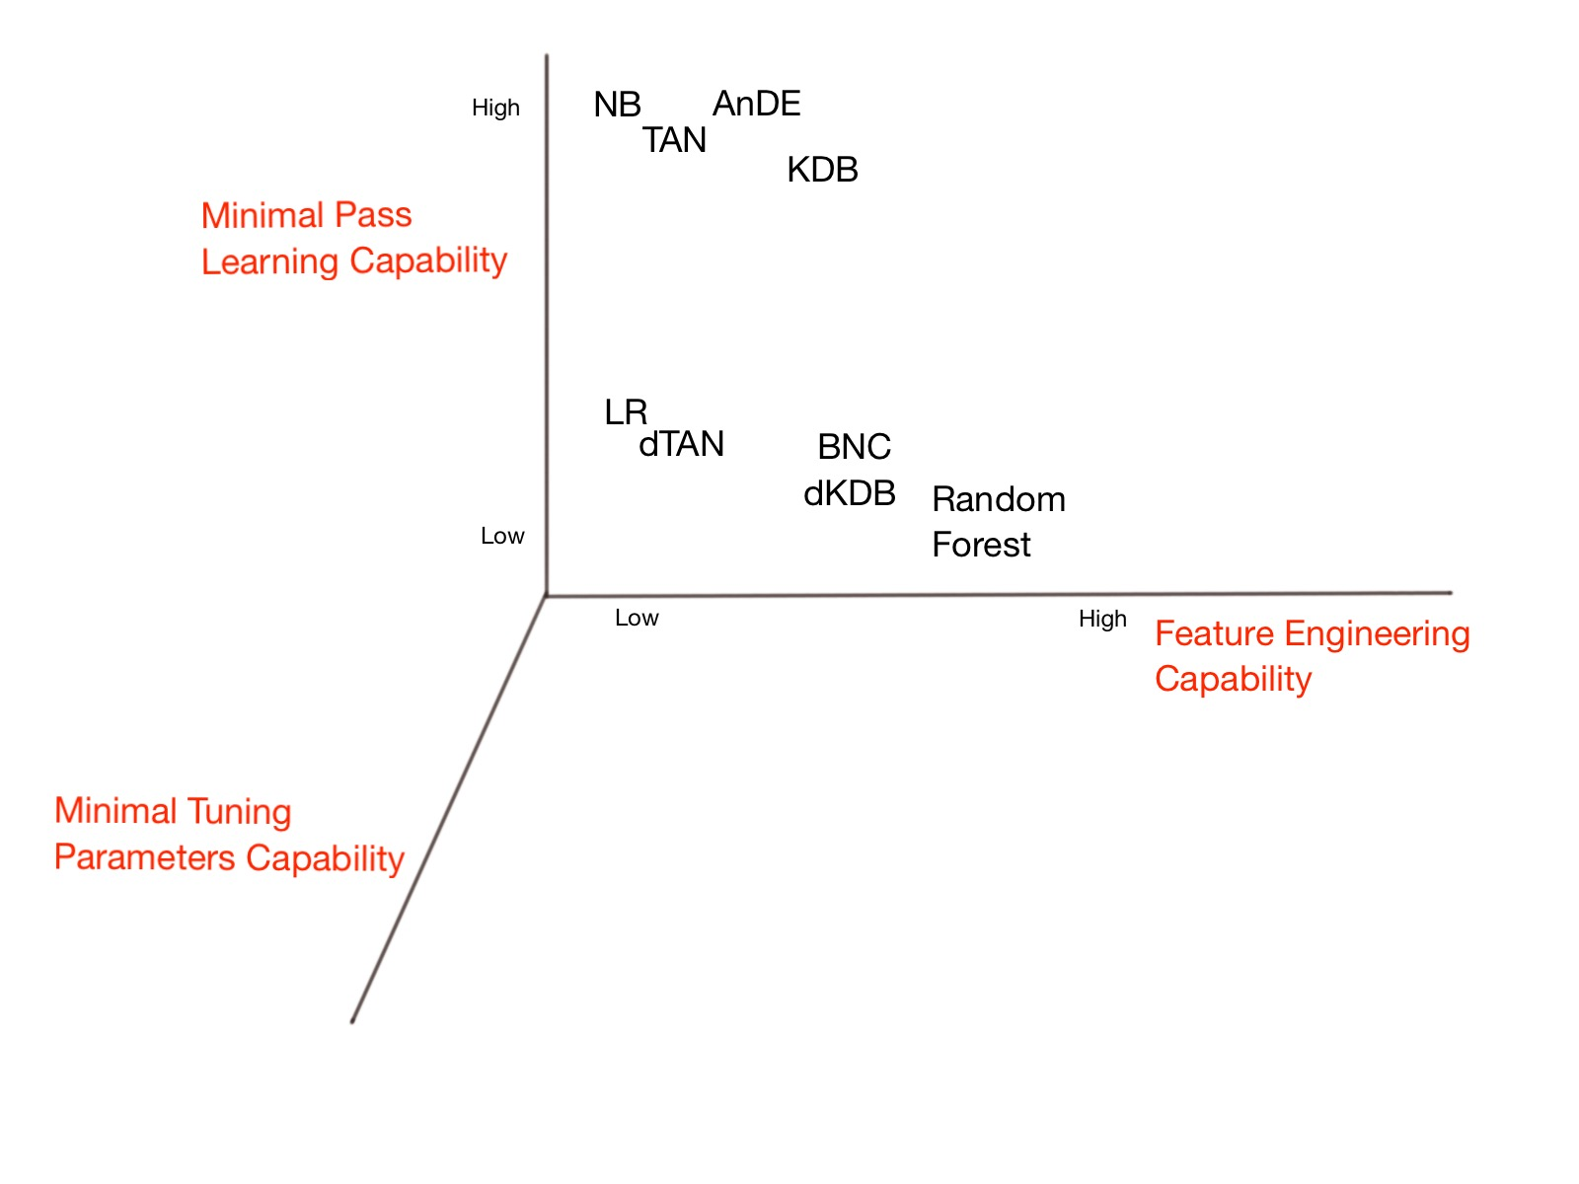
Discriminative Semi-naive Bayes Methods
NB -> dNB = LR (Logistic Regression)
TAN -> dTAN
KDB -> dKDB
Zaidi, N. and Webb G. and Carman, M. and Petitjean, F. and Buntine, W. and Hynes, M. and De Sterck H. — Efficient Parameter Learning of Bayesian Network Classifiers, Machine Learning, Volume 106, pp 1-44, 2016
IBM Research Lab, Melbourne — May 2017

Slide 19
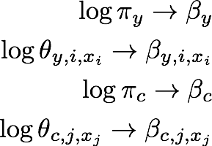
The Equivalence
Zaidi, N. and Carman, M. and Cerquides, J. and Webb G. — Naive-Bayes Inspired Effective Pre-Conditioners for Speeding-up Logistic Regression, ICDM, pp. 1097-1102, 2014
Zaidi, N. and Webb, G. — Preconditioning an Artificial Neural Network Using Naive Bayes, Advances in Knowledge Discovery and Data Mining, pp. 341-353, 2016
IBM Research Lab, Melbourne — May 2017

Slide 20
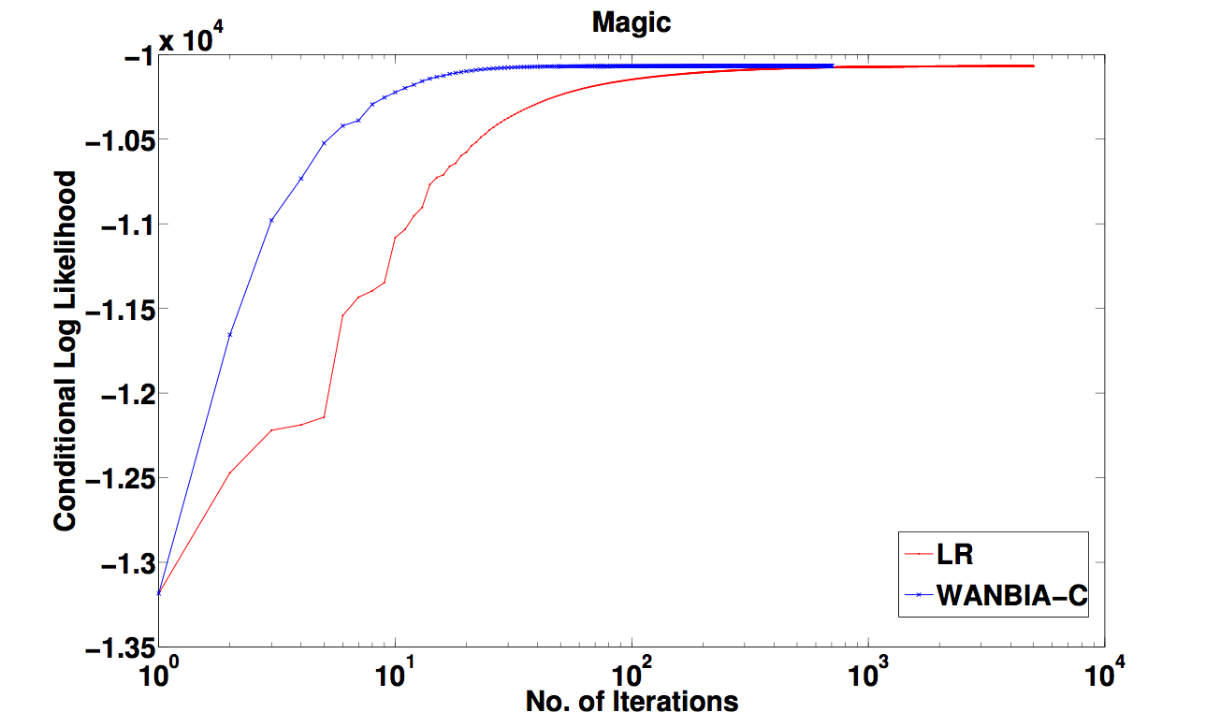
The Equivalence: WANBIA-C
Faster Convergence of LR
Contains both generative and discriminative parameters
Alleviated NB independence assumptions
IBM Research Lab, Melbourne — May 2017

Slide 21
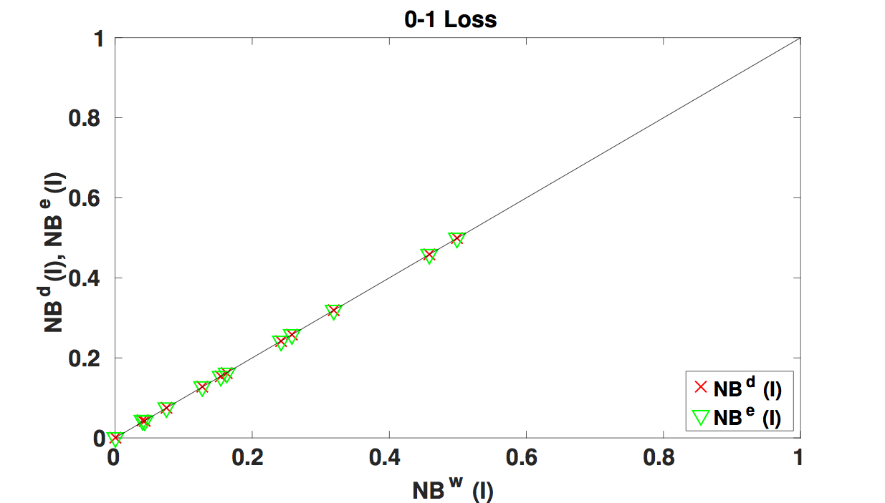
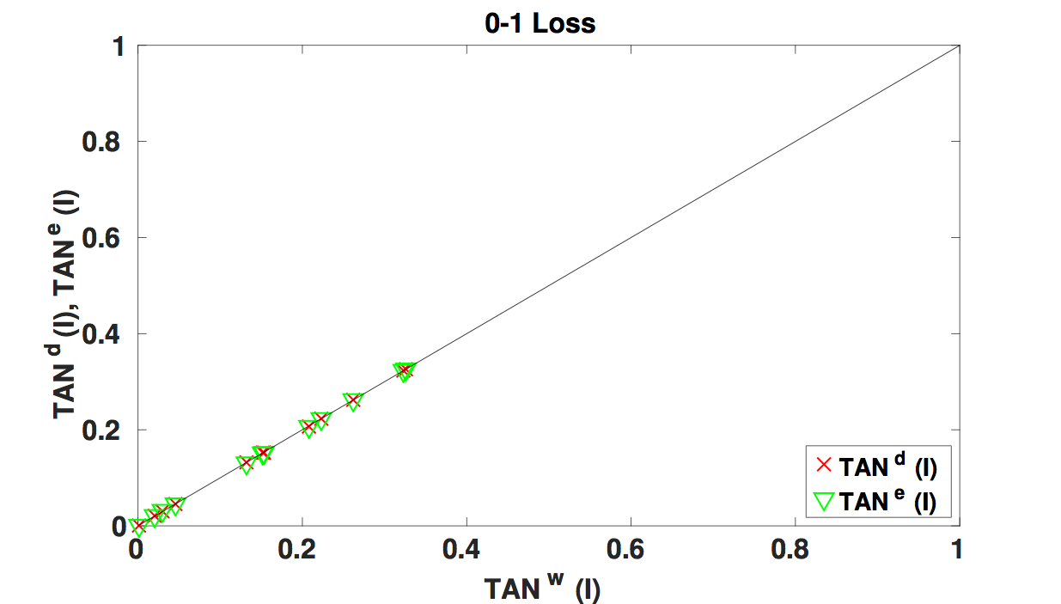
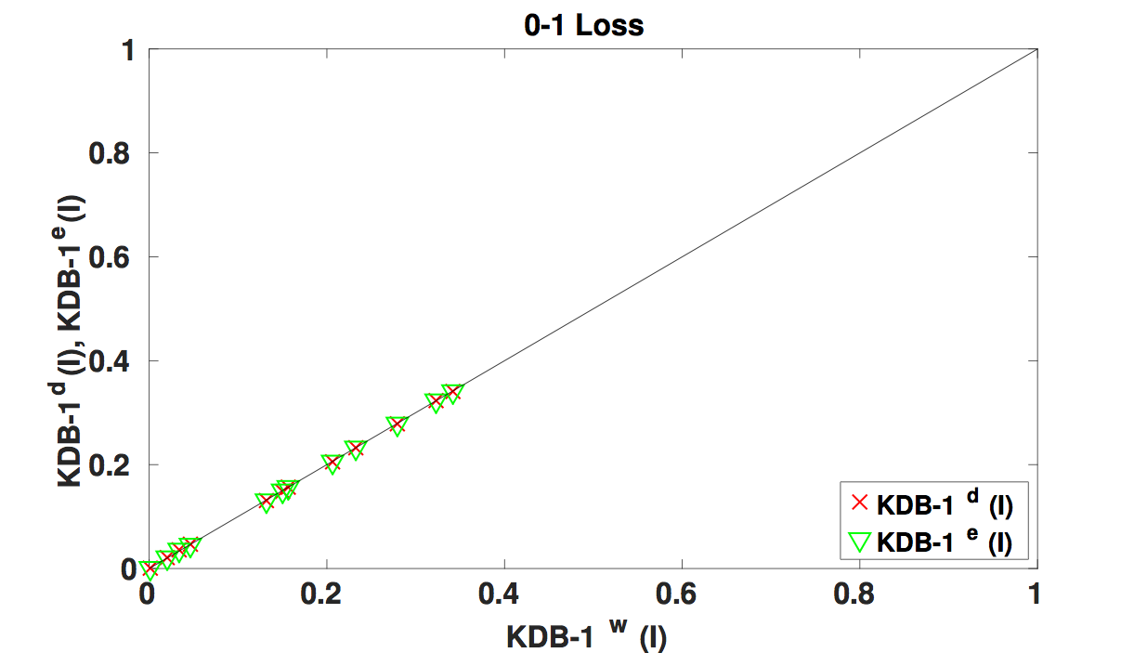
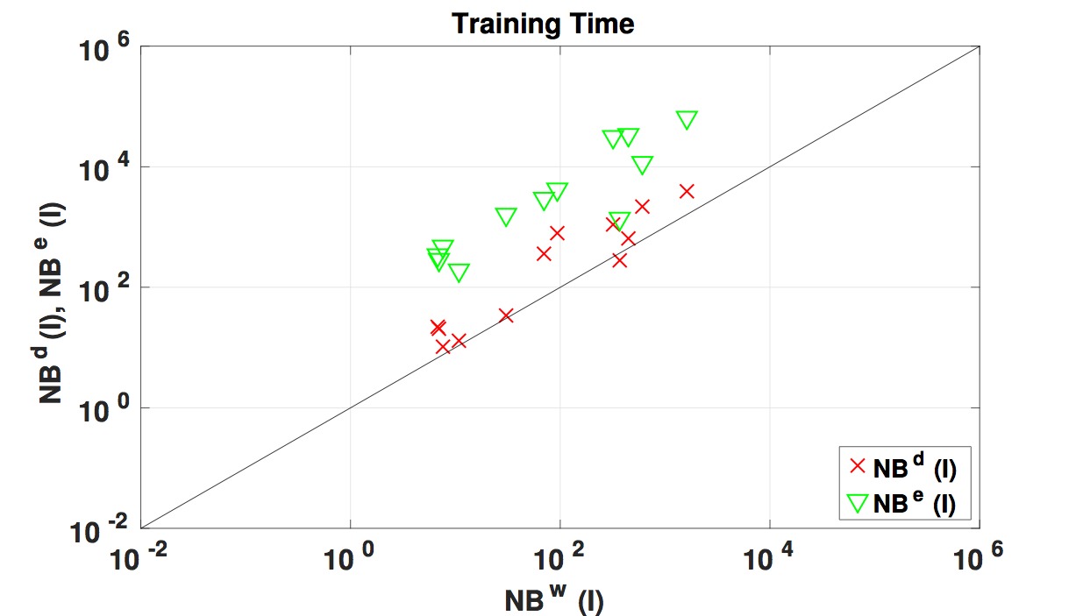
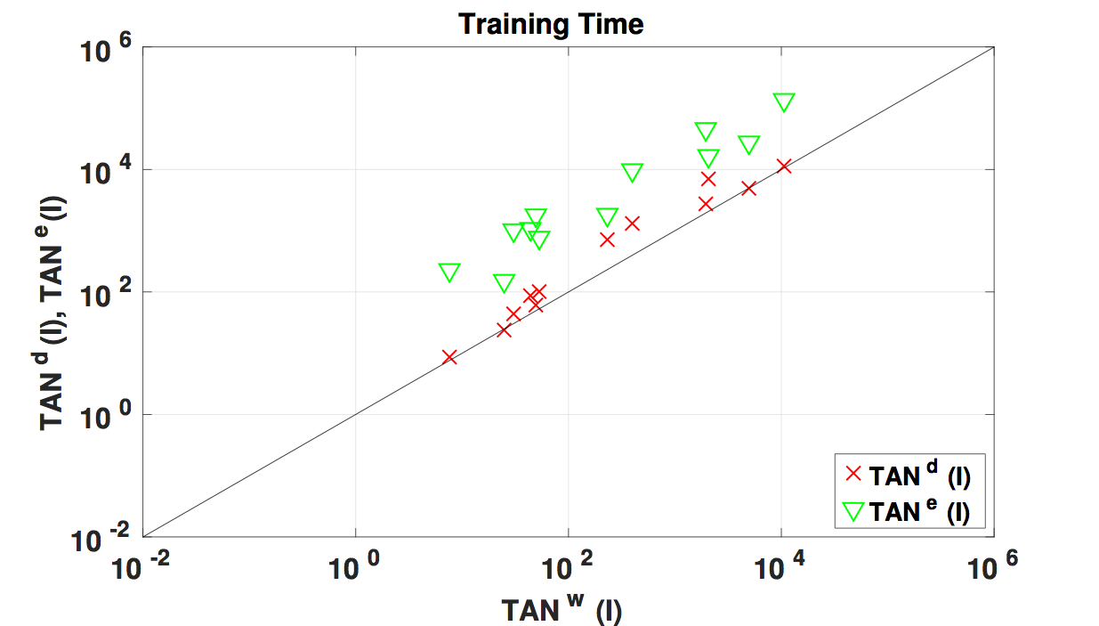
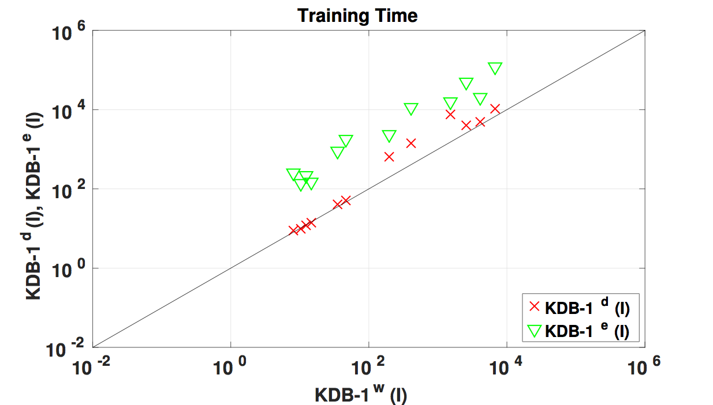
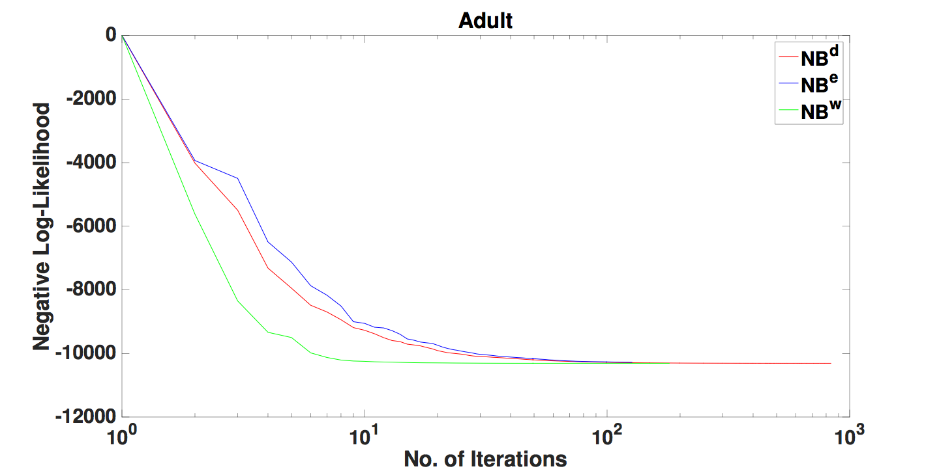
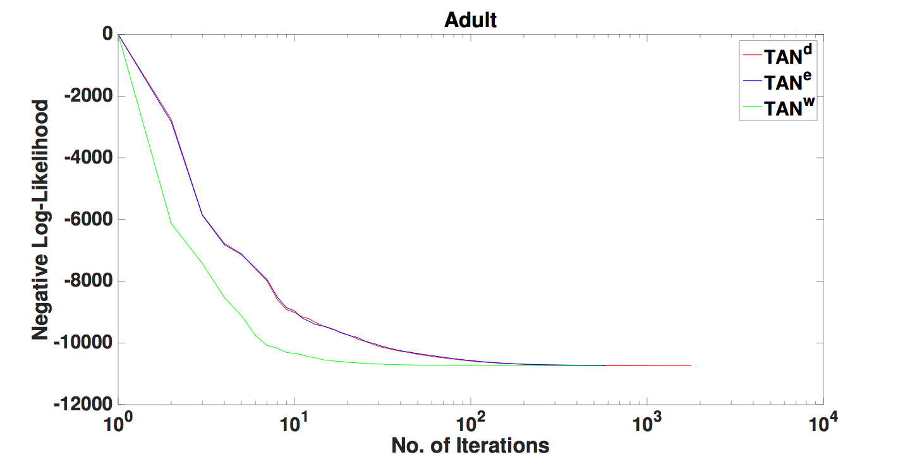
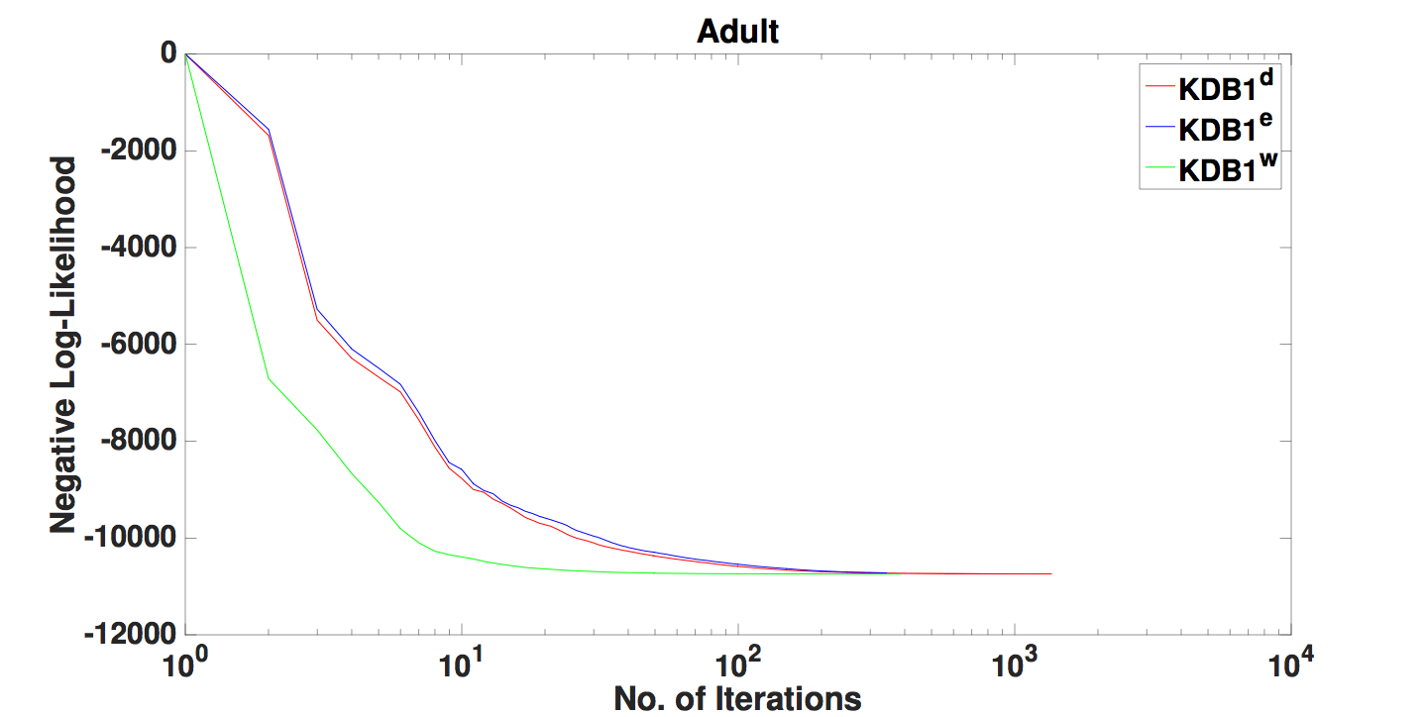
WANBIA-C: The Equivalence Beyond NB
IBM Research Lab, Melbourne — May 2017

Slide 22
Discriminative Classifier
Computationally Expensive
Discriminative Semi-naive Bayes Methods
Tuneable Parameter
Big Model Size
NB -> dNB = LR (Logistic Regression)
TAN -> dTAN
KDB -> dKDB
Zaidi, N. and Webb G. and Carman, M. and Petitjean, F. and Buntine, W. and Hynes, M. and De Sterck H. — Efficient Parameter Learning of Bayesian Network Classifiers, Machine Learning, Volume 106, pp 1-44, 2016
IBM Research Lab, Melbourne — May 2017

Slide 23
Discriminative Semi-naive Bayes Methods
Lessons learnt so far:
Discriminative Semi-naive-Bayes leads to better performance on large datasets
WANBIA-C trick can result in faster convergence
Expensive training:
Conjugate Gradients
Quasi-Newton
How to speed-up?
Use TRON
Optimize softmax
Zaidi, N. and Webb G. — A Fast Trust-Region Newton Method for Softmax Logistic Regression, SIAM SDM, 2017
Zaidi, N. and Du, Y. and Webb, G — On the Effectiveness of Discretizing Quantitative Attributes in Linear Classifiers, in submission to MLj (2017)
IBM Research Lab, Melbourne — May 2017

Slide 24
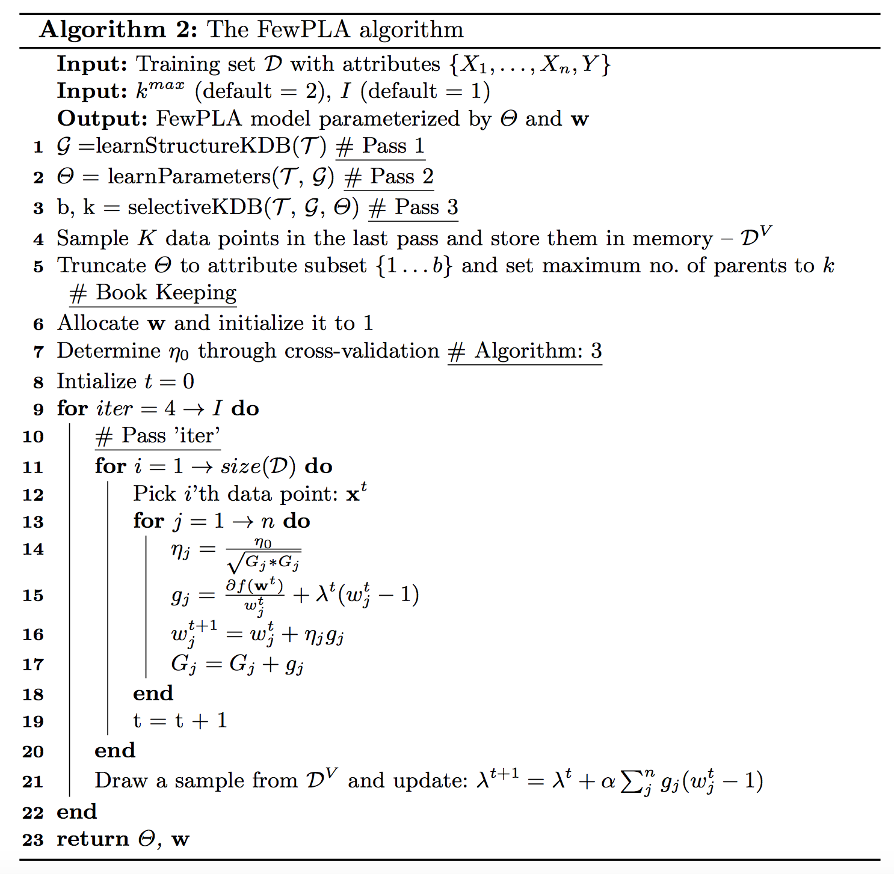
Towards Minimal Pass Discriminative Semi-naive Bayes Methods
Salient Features:
Four Pass Learning
Low-Bias
Minimal Tuning Parameters
2-Pass KDB
1-Pass SKDB
1-Pass for SGD optimising
Step-size tuning
NoPeskyLearning Rates
Adaptive Gradients
Regularization
Adaptive
IBM Research Lab, Melbourne — May 2017

Slide 25
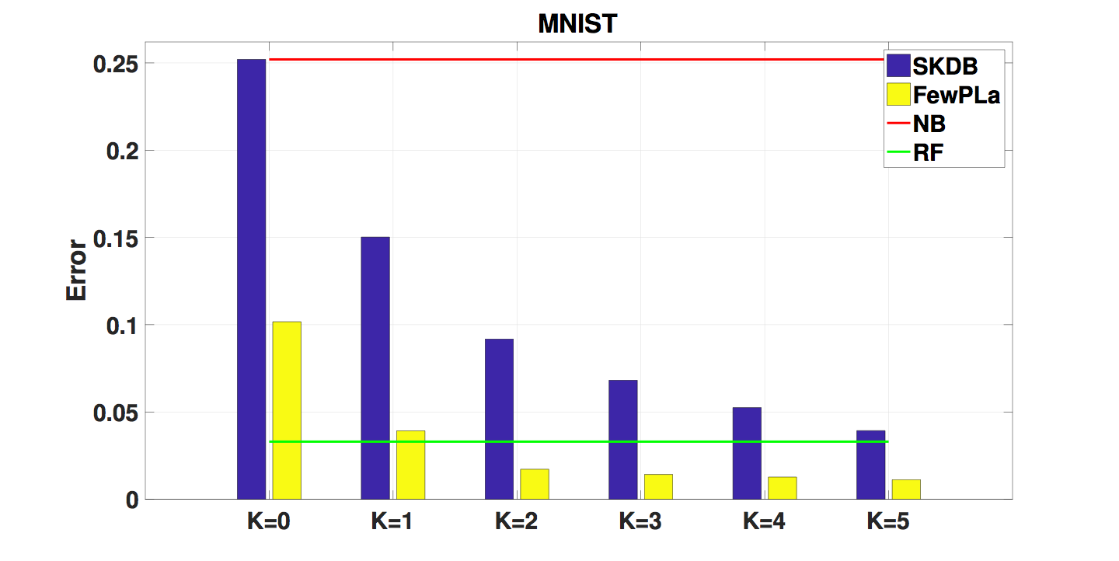
Towards Minimal Pass Discriminative Semi-naive Bayes Methods
IBM Research Lab, Melbourne — May 2017

Slide 26
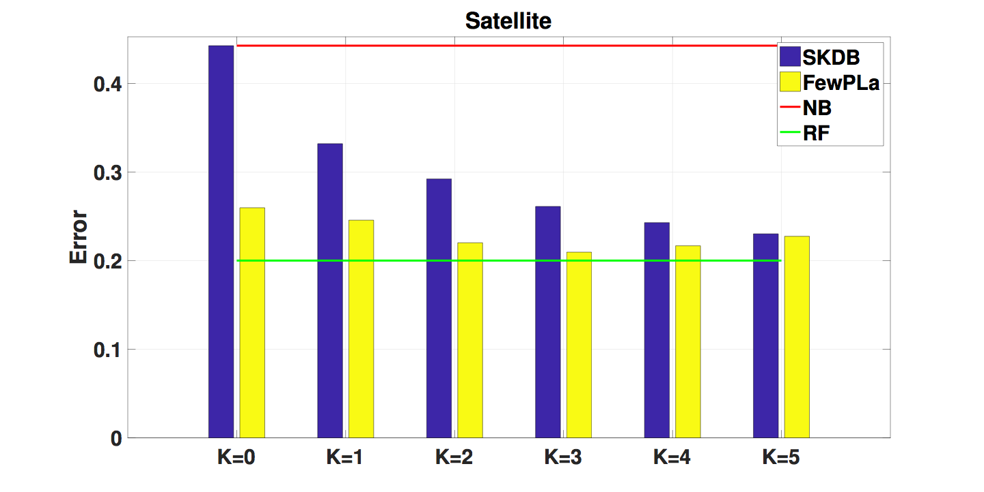
Towards Minimal Pass Discriminative Semi-naive Bayes Methods
IBM Research Lab, Melbourne — May 2017

Slide 27
Artificial Neural Networks
Salient Features:
Low-Bias
Minimal Pass Learning?
Minimal Tuning Parameters?
Deep vs. Shallow?
Shallow Model:
One-hidden layer ANN are universal function-approximators
Deep Model:
Constant-depth circuits are less powerful than deep circuits and Less no. of parameters
Broad Model:
Discriminative Bayesian Networks
Others?
Hal Daume III, A course in Machine Learning, Chapter 8
Liang and Srikant, Why Deep Neural Networks, ArXiv, Oct 2016
Eldan and Shamir, The Power of Depth for Feedforward Neural Networks, ArXiv, 2016
Telgarksy, Benefits of Depth in Neural Networks, ArXiv, May 2016
IBM Research Lab, Melbourne — May 2017

Slide 28
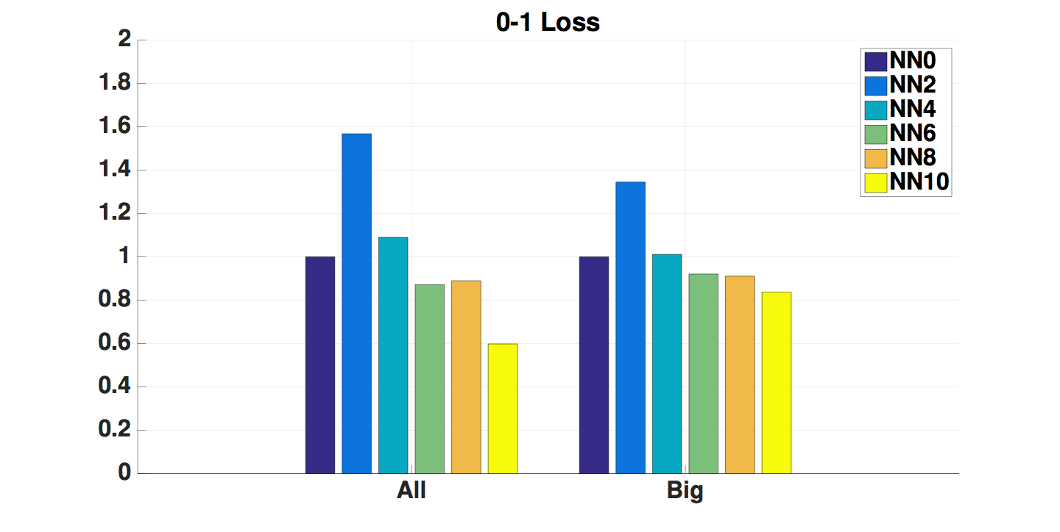
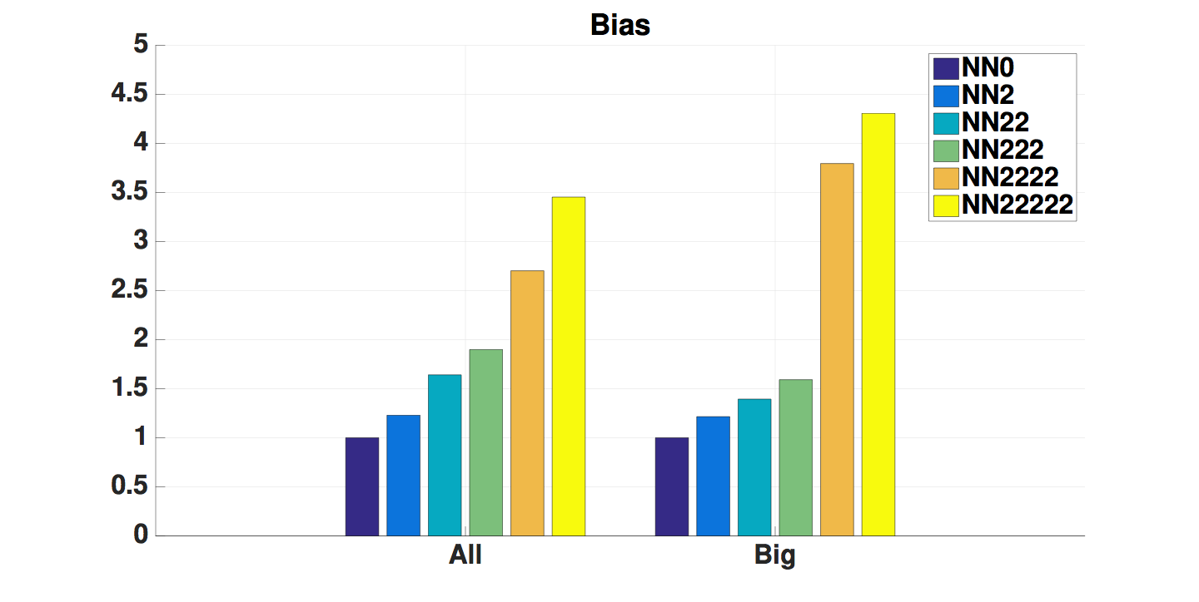
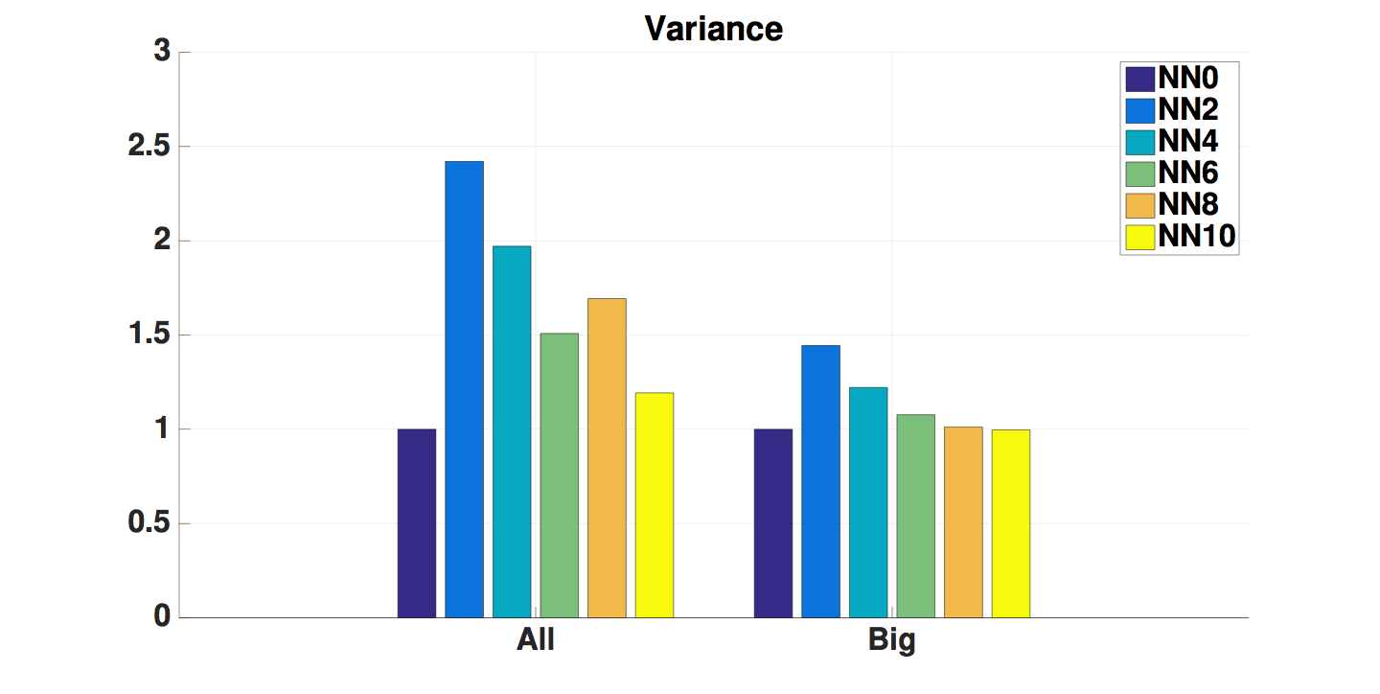
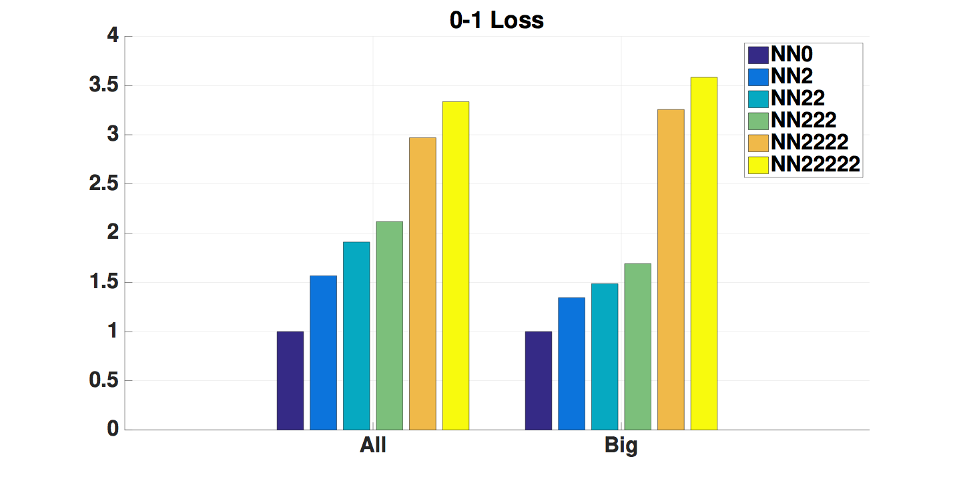
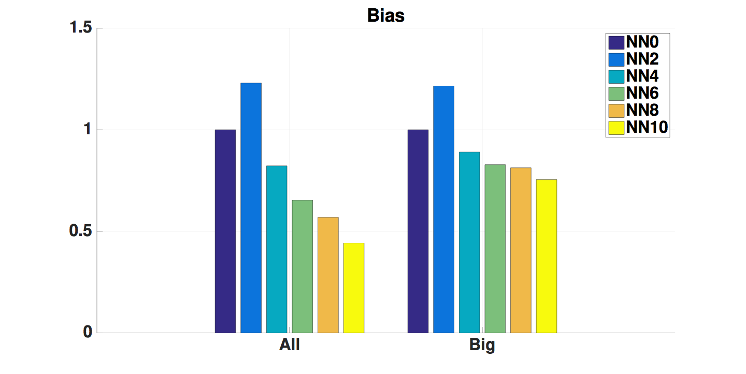
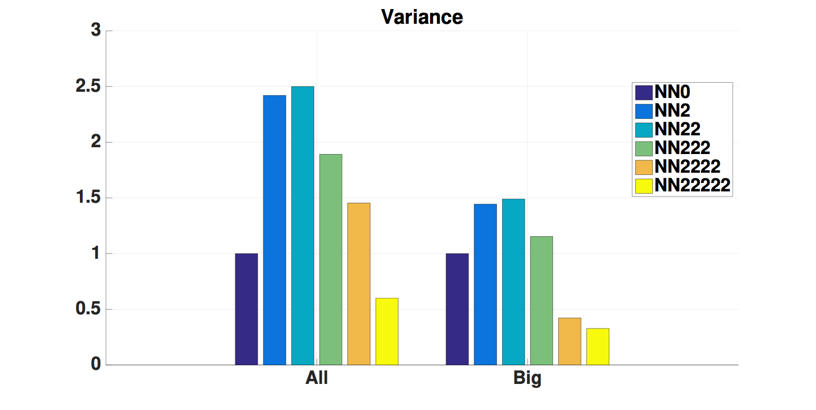
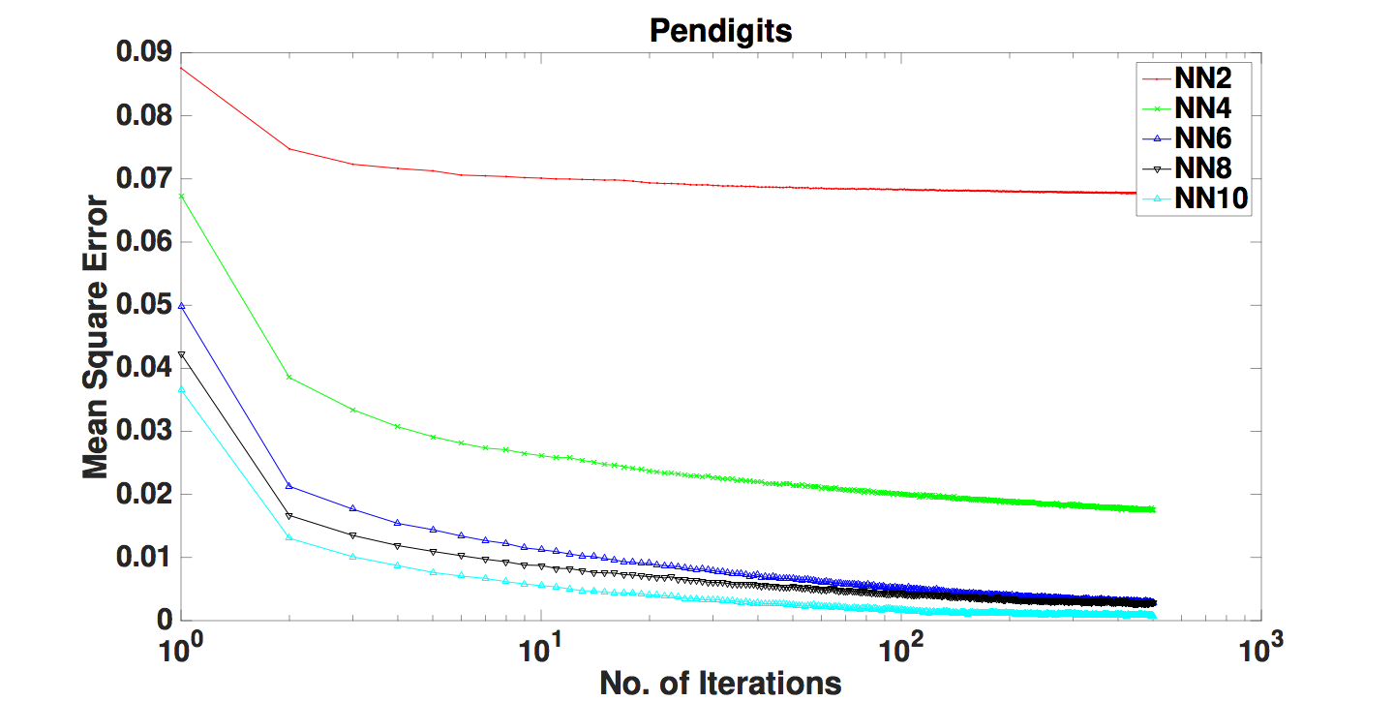
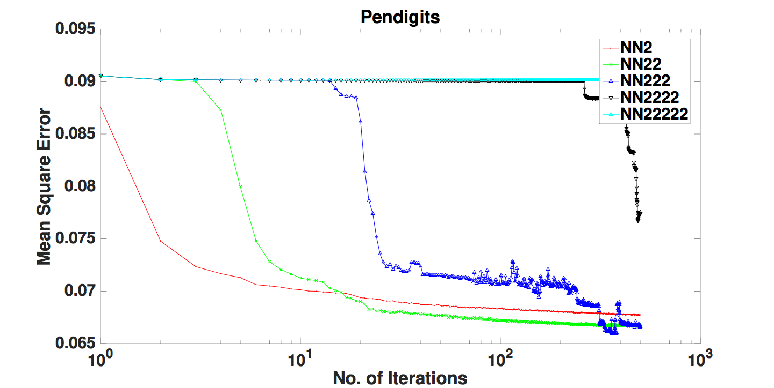
Artificial Neural Networks (Shallow vs. Deep)
Liu, N. and Zaidi, N. — Artificial Neural Network: Deep or Broad? An Empirical Study, AI2016: Advances in Artificial Intelligence, 2016
IBM Research Lab, Melbourne — May 2017

Slide 29
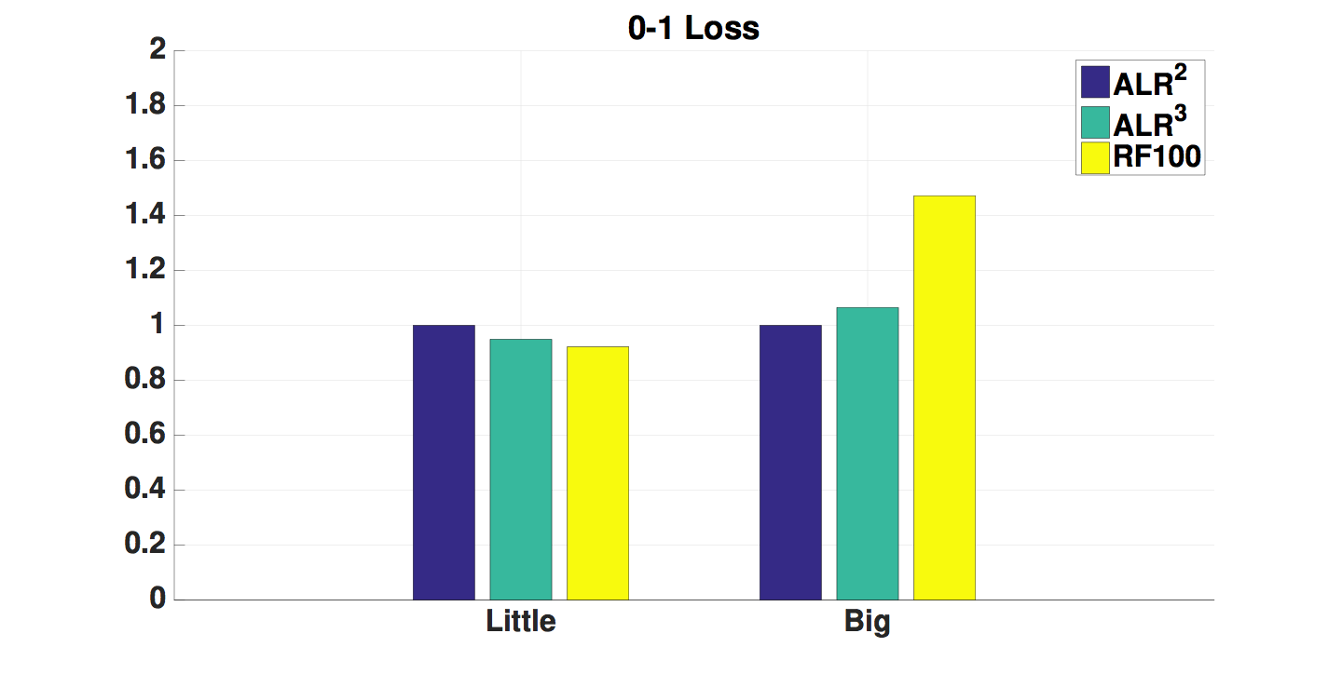
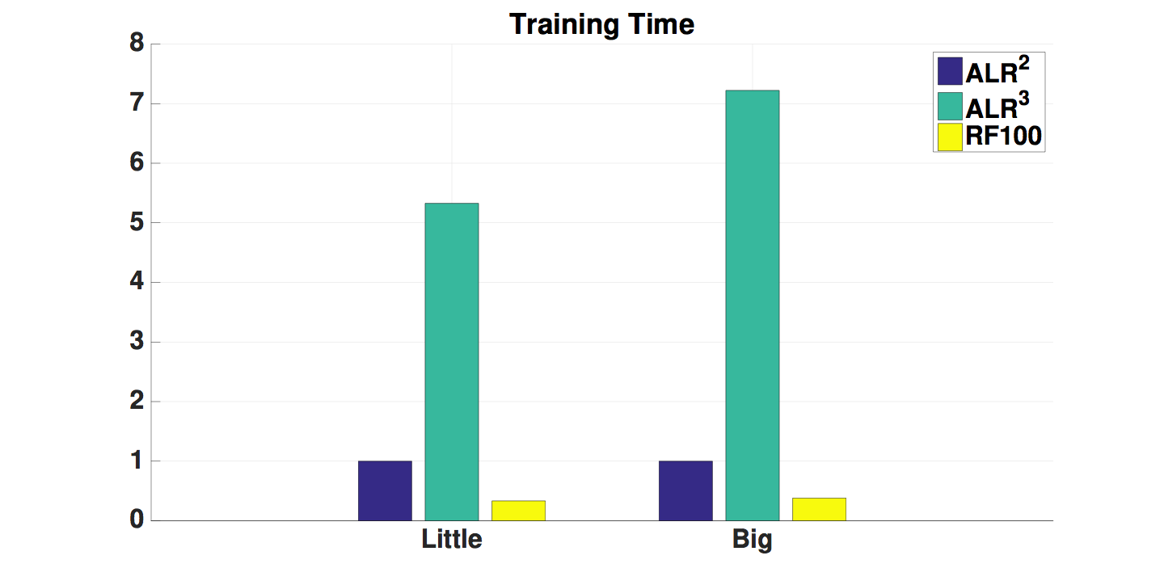
Accelerated Logistic Regression (ALR^{n})
Salient Features:
Many Pass Learning
Low-Bias
Minimal Tuning Parameters
Higher-order LR — LR¹, LR², LR³
Involves deriving a generative counter-part of higher-order LR — AnJE
Extremely low-biased classifier
Faster convergence than standard LR
Zaidi, N. and Webb, G. and Carman, M. and Petitjean, F. and Cerquides, J. — ALR^{n}: Accelerated Higher-Order Logistic Regression, Machine Learning, Volume 104, pp. 151-194, 2016
IBM Research Lab, Melbourne — May 2017

Slide 30
Accelerated Logistic Regression (ALR^{n})
Big Models
Counts/Probabilities
Gradients
Parameters
Batch Optimization
Use multi-threading (MapReduce)
Example: Covtype Dataset
LR¹: 2,338
LR²: 348,285
LR³: 30,871,645
LR⁴: 1,807,261,078
LR⁵: 73,539,151,882
Size of Double (8 bytes) in java:
2,147,483,639
Important to regularize
Reduce the size of the model
Mutual Information
Hashing
IBM Research Lab, Melbourne — May 2017

Slide 31
Out-of-Core Accelerated Logistic Regression (oocALR^{n})
Salient Features:
Two Pass Learning
Low-Bias
Minimal Tuning Parameters
Higher-order LR — LR¹, LR², LR³
SGD
Adaptive Regularization
Adaptive Step-size
Regularization towards generative parameters
Discretization study
Zaidi, N. and Webb, G. and Petitjean, F. — Engineering a Big Data Classifier, submitted to ICDM, 2017
IBM Research Lab, Melbourne — May 2017

Slide 32
Factorization Machines
Salient Features:
One Pass Learning
Low-Bias
Minimal Tuning Parameters
Defined for continuous attributes
Implementation goes to only quadratic features (n = 2)
Going to higher n (n > 2) is not straight-forward
Nonetheless, nifty idea, but tried mostly in recommender system community
Need for a systematic evaluation with ALR^{n} and FewPLA algorithms
IBM Research Lab, Melbourne — May 2017

Slide 33
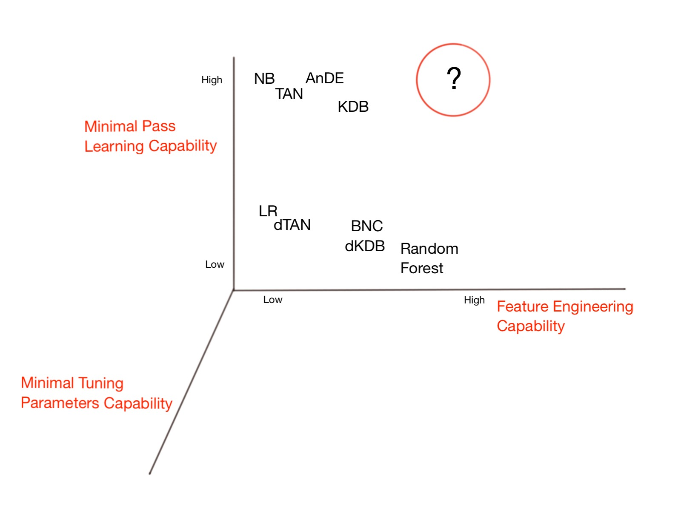
Back to the Properties
Goal:
Single-pass,
Low-bias learning
Minimal Tuning
Path 1:
FewPLA: use dKDB with higher values of K
Path 2:
oocALR: Automatically create features with LR
Path 3:
FM: Factorization Machines
Path 4:
ANN: Deep or Shallow Artificial Neural Networks
IBM Research Lab, Melbourne — May 2017

Slide 34
Summary
Big data is ripped for picking, we need good ‘Big Models’
Feature Engineering is the key
Minimal pass learning
Minimum tuning parameters
Feature Hashing, Feature selection will play a big role big model implementation
ALR, FewPLA, FM, oocALR
Deep learning is a potential contender
Adaptive Regularization
SGD
Adaptive Step size
Exciting road ahead
IBM Research Lab, Melbourne — May 2017

Slide 35
Collaborators
Offline Discussions
Email: nayyar.zaidi@gmail.com
Twitter: @nayyar_zaidi
Github: nayyarzaidi
LinkedIn: nayyar_zaidi
URL: http://users.monash.edu.au/~nzaidi/index.html
Questions?
IBM Research Lab, Melbourne — May 2017

