Slide 1


A Fast Trust Region Newton Method for Logistic Regression
Nayyar A. Zaidi, Geoffrey I. Webb

Slide 2
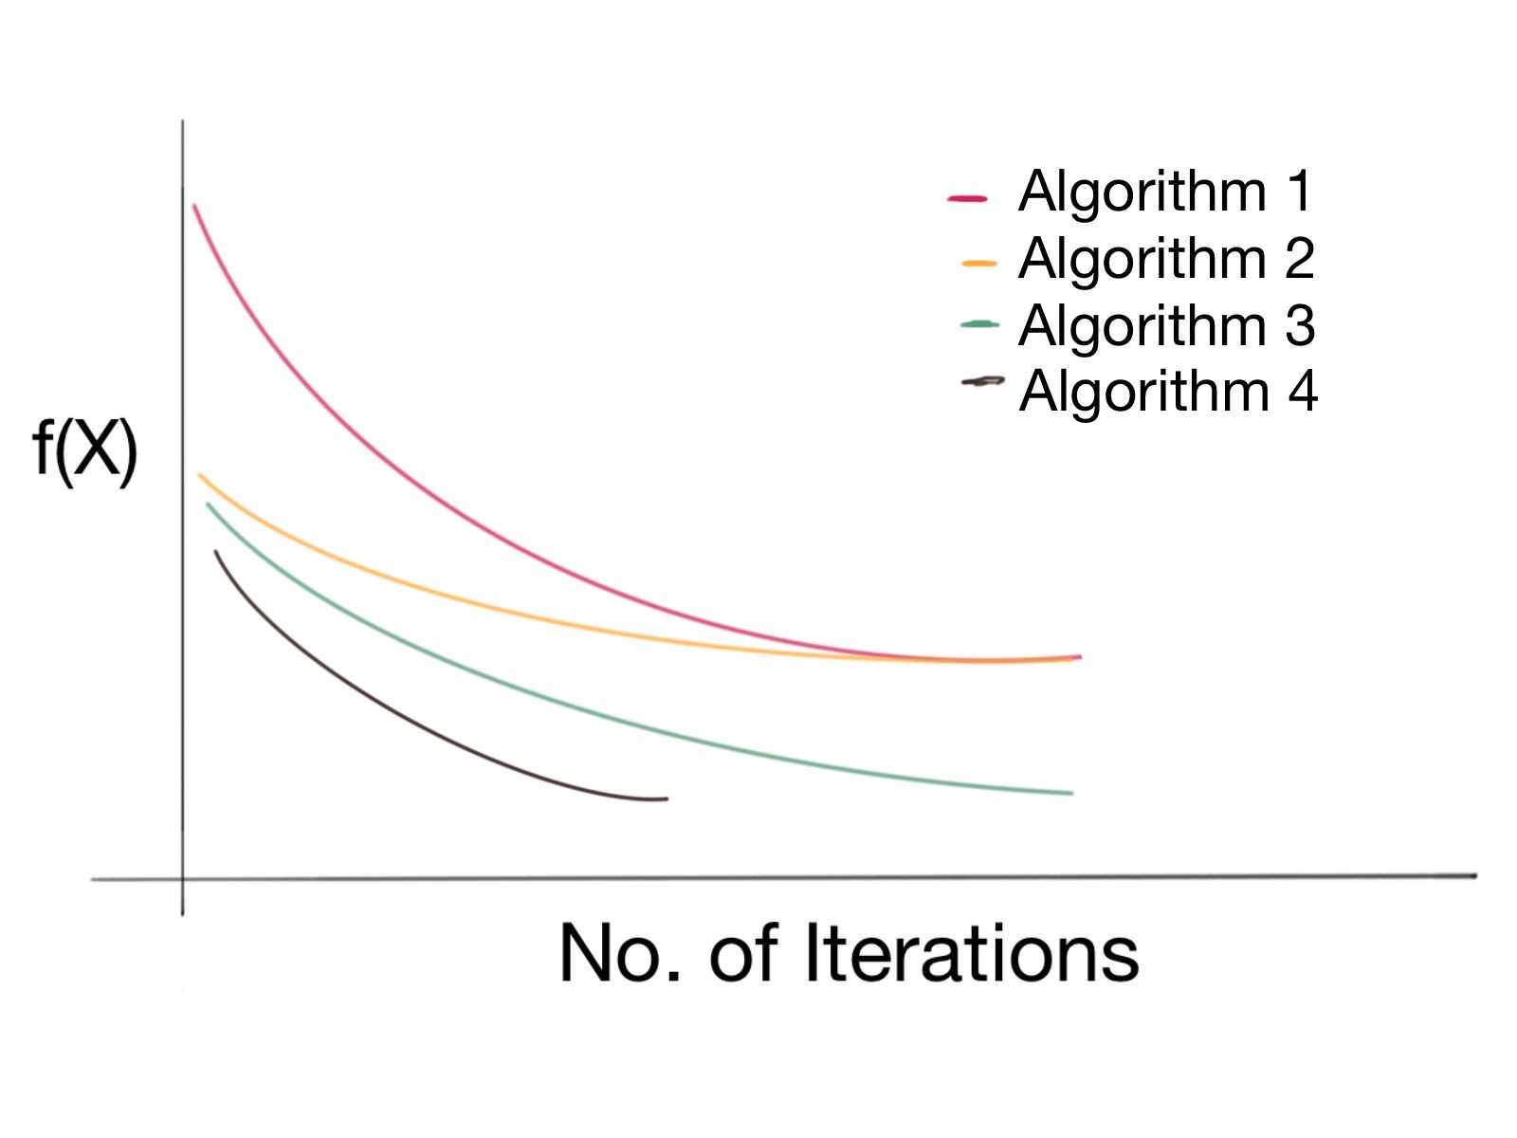
Introduction
The emergence of larger quantities of data has led to a renewed interest in classification techniques that converges faster
Faster Convergence leads to faster training time
Three elements of interest:
  Optimization function, e.g., CLL, MSE, HL
  Optimization space
  Optimization technique, e.g., gradient descent, quasi-Newton

Slide 3
Introduction (2)
Logistic Regression (LR) is a widely used classifier
How to speed-up LR has been the main motivation of this work
Interest A
  Softmax objective function
  Binary objective function
  Convergence analysis is not well-known
Interest B
  WANBIA-C trick that combines Naïve Bayes and LR has been shown to significantly improves LR convergence
Interest C:
  Trust-region based Newton Method has been shown to converge the fastest

Slide 4
Contributions of the Paper
We show that WANBIA-C pre-conditioning can be equally effective for second-order methods such as TRON
We present a TRON algorithm optimizing a LR Softmax objective function
We show that optimizing a softmax objective function leads to better RMSE, log-loss and classification time than standard one-vs-all classification
We present a comprehensive software library for fast and effective binary and sofmax classification -- fastLR

Slide 5
Talk Outline
5 Minutes
Introduction
Building Blocks
  Optimization
  TRON
  LR
  WANBIA-C
WANBIA-C with TRON
Experimental Results
Conclusion and Future works
Q & A
4 Minutes
1 Minutes
3 Minutes
5 Minutes

Slide 6
Iterative Optimization
Every iteration requires an update of form:
Two Problems:
Storing and computing the Hessian can be an issue
  Gradient Descent
  Quasi-Newton
Solution obtained does not guarantee any convergence
  Line Search
  Trust Region
(1)
(2)
(3)
(4)
(5)
(6)

Slide 7
Logistic Regression
Dimensions:
  Hessian: p x p matrix
  X: N x p matrix
  W: N x N diagonal matrix
Dimensions:
  Hessian: p(C - 1) x p(C - 1) matrix
  : N(C - 1) x p(C - 1) matrix
  : N(C - 1) x N(C - 1) diagonal matrix

Slide 8
WANBIA-C
LR:
Naïve Bayes:
WANBIA-C
Faster Convergence of LR
Contain both generative and discriminative learned parameters
Alleviates NB independence assumption

Slide 9
WANBIA-C
LR:
Naïve Bayes:
WANBIA-C
Faster Convergence of LR
Contain both generative and discriminative learned parameters
Alleviates NB independence assumption

Slide 10
WANBIA-C for TRON
Modified Gradients:
Modified Hessians:
Intercept
Non-Intercept
Intercept vs. Intercept
Intercept vs. Non-Intercept
Non-Intercept vs. Non-Intercept

Slide 11
Efficient Implementation
An important operation in TRON
Binary Objective Function
Softmax Objective Function

Slide 12
Experimental Results

Slide 13
Convergence Analysis

Slide 14
LR Tron vs. LR QN

Slide 15
Experimental Results

Slide 16

fastLR -- Library
Implements: Softmax, One-vs-All objective functions
Optimization Methods: Tron, QN, Conjugate Gradient, SGD
Salient Feature:
- Handles both numeric and categorical data
- Does not transform data to do one-hot-encoding, but transforms model instead
-
https://github.com/nayyarzaidi/fastLR.git

Slide 17



Summary
Combines the idea of WANBIA-C with TRON
  An extremely fast learning algorithm for Logistic Regression
Softmax objective function leads to better results than one-vs-all
Offline Discussions:
  LinkedIn: nayyar.zaidi
  Twitter: @nayyar_zaidi
  Email: nayyar.zaidi@gmail.com
Questions

